Slide 1
Tutorial on Quanty
Second quantization and Green’s functions
Maurits W. Haverkort
Institute for theoretical physics – Heidelberg University
M.W.Haverkort@thphys.uni-heidelberg.de

Slide 2
Quantum mechanics for solids / molecules
Why do we use mean-field approximations like Hartree-Fock and Density Functional Theory (in the local density approximation) and why do we not just solve Schrödinger's equation
with

Slide 3
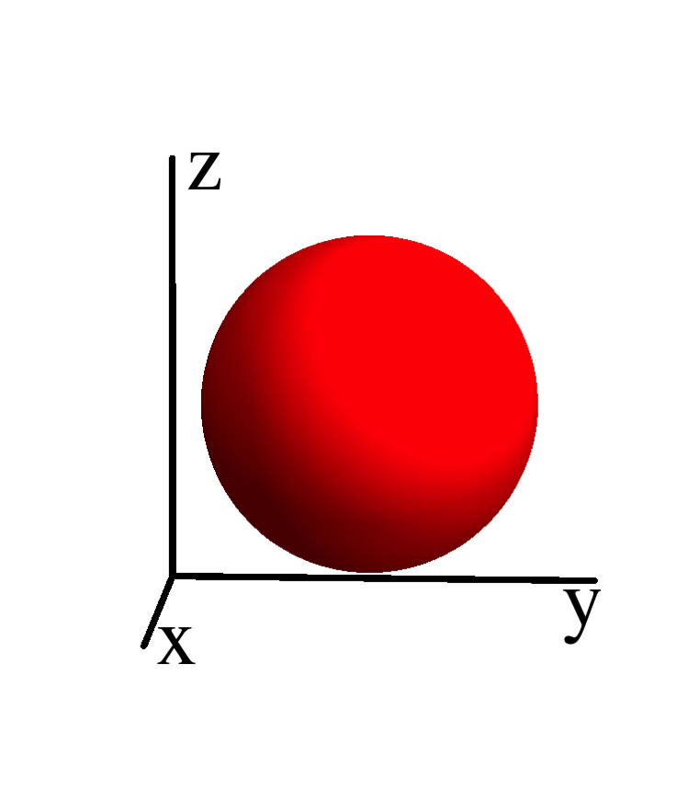
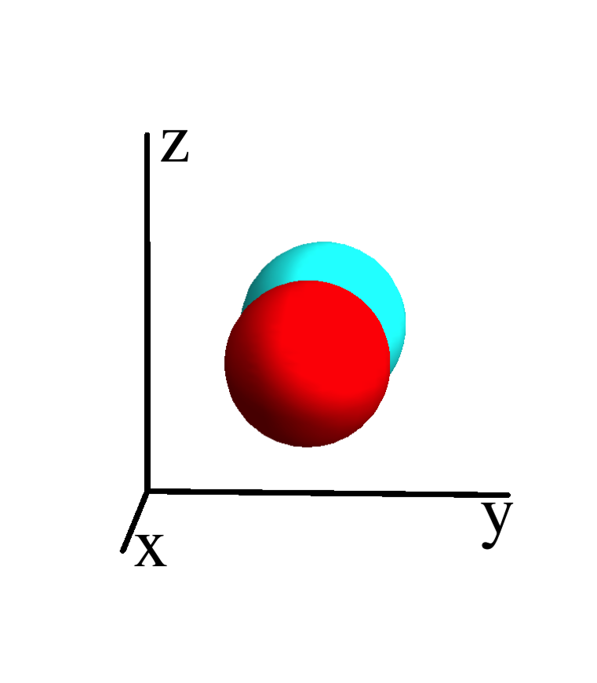
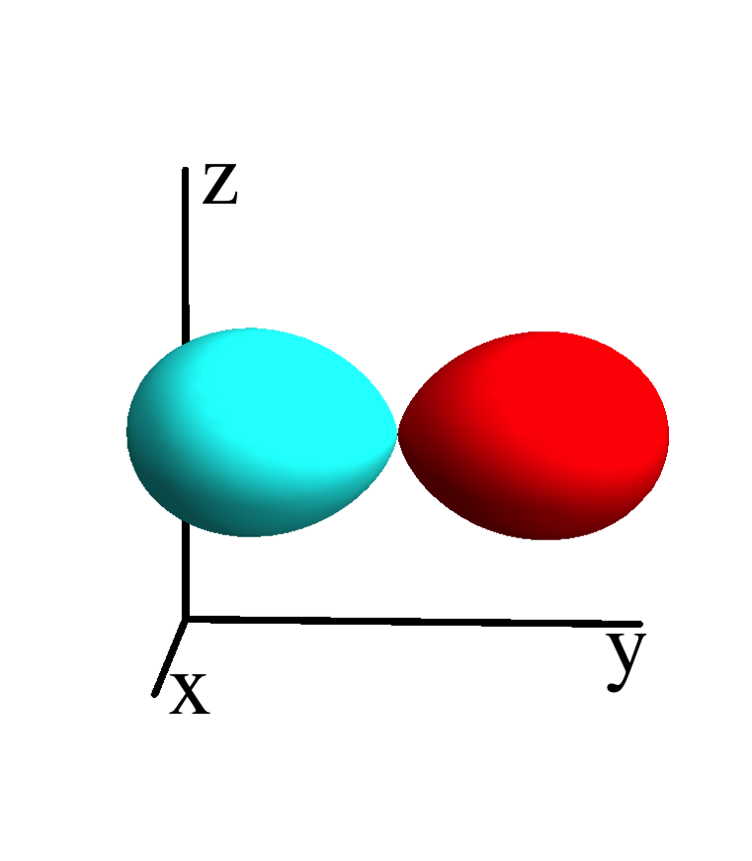
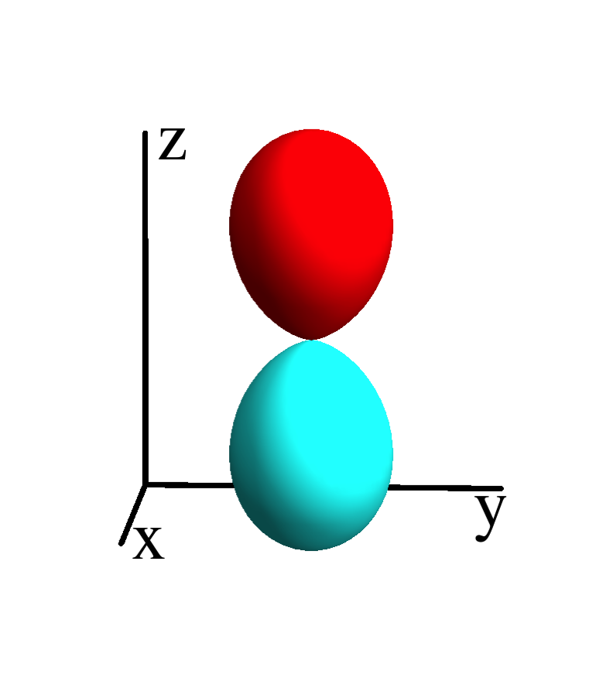
Quantum mechanics in matrix formalism – 1 electron
Define a basis of spin-orbitals
ε_{s}
Hamiltonian is a matrix on this basis
ε_{p}
ε_{p}
ε_{p}

Slide 4
Quantum mechanics in matrix formalism – multi electron
_
Define a basis of many electron wave-functions (states)
0
ε_{s}
ε_{p}
ε_{p}
ε_{p}
Hamiltonian is a matrix on this basis
ε_{s}+ε_{p}+U_{sp}
ε_{s}+ε_{p}+U_{sp}
ε_{s}+ε_{p}+U_{sp}
2ε_{p}+U_{pp}
2ε_{p}+U_{pp}
2ε_{p}+U_{pp}
ε_{s}+2ε_{p}
+2U_{sp}+U_{pp}
ε_{s}+2ε_{p}
+2U_{sp}+U_{pp}
ε_{s}+2ε_{p}
+2U_{sp}+U_{pp}
…
3ε_{p}
+3U_{pp}

Slide 5

Exponential scaling of quantum mechanics
Example cluster of H atoms
# spin-
orbitals
# electrons
# atoms
# states
1 | 2 | 1 |  | ( ) | 2
2
1
Cluster of H atom
only include the 1s orbital

Slide 6
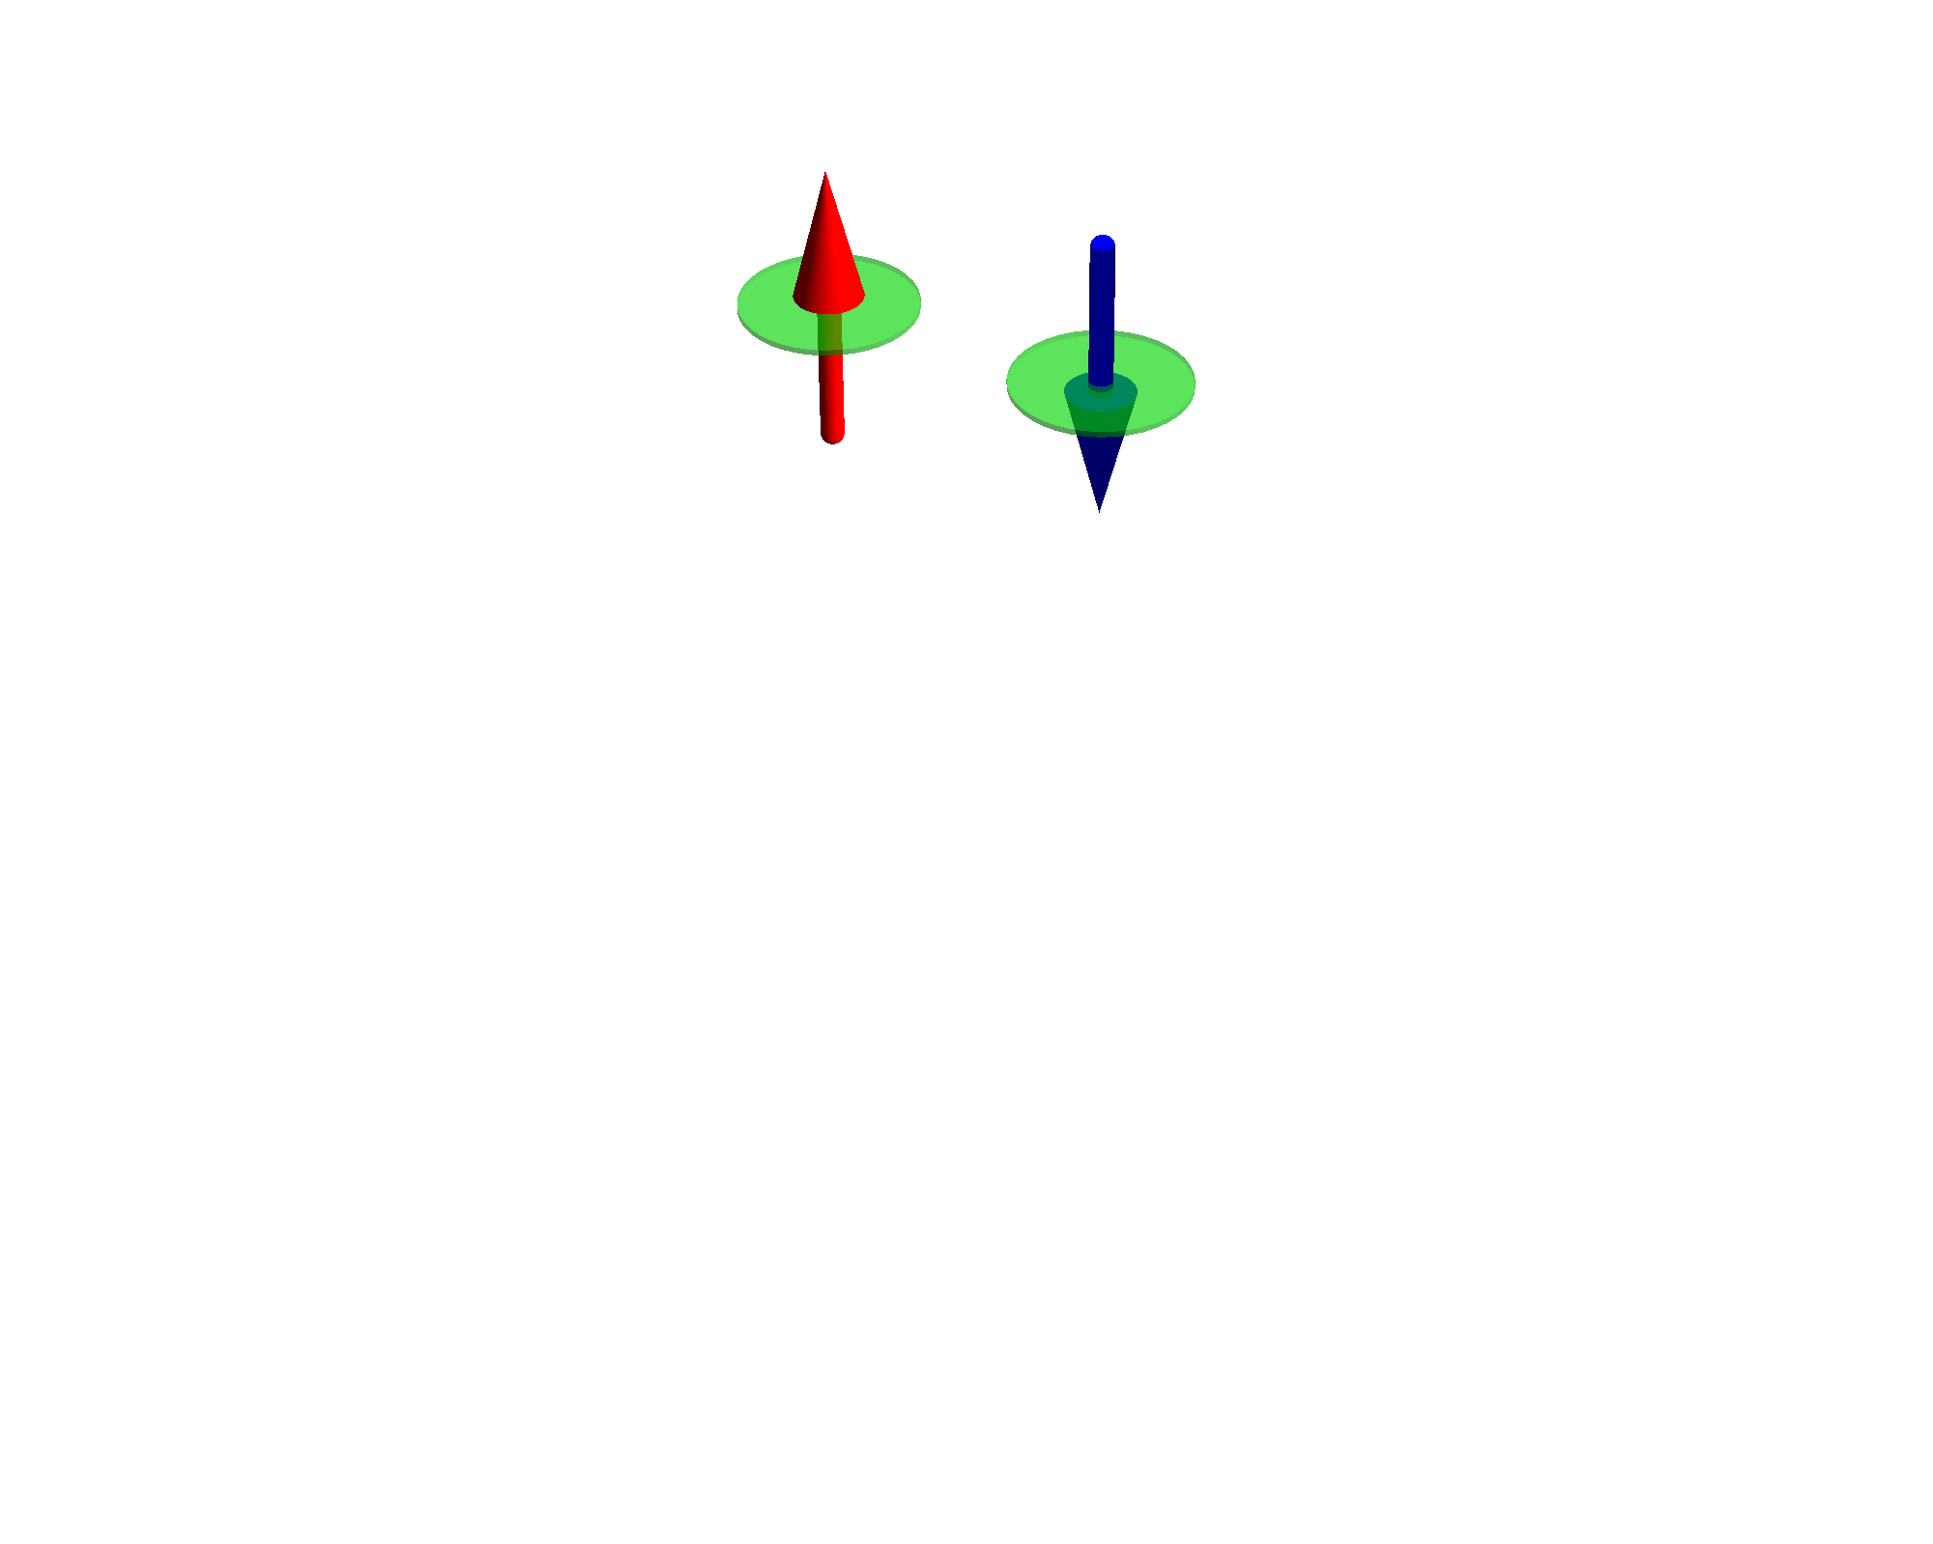
Exponential scaling of quantum mechanics
Example cluster of H atoms
# spin-
orbitals
# electrons
# atoms
# states
1 | 2 | 1 |  | ( ) | 2
2 | 4 | 2 |  | ( ) | 6
2
1
4
2
Cluster of H atom
only include the 1s orbital

Slide 7
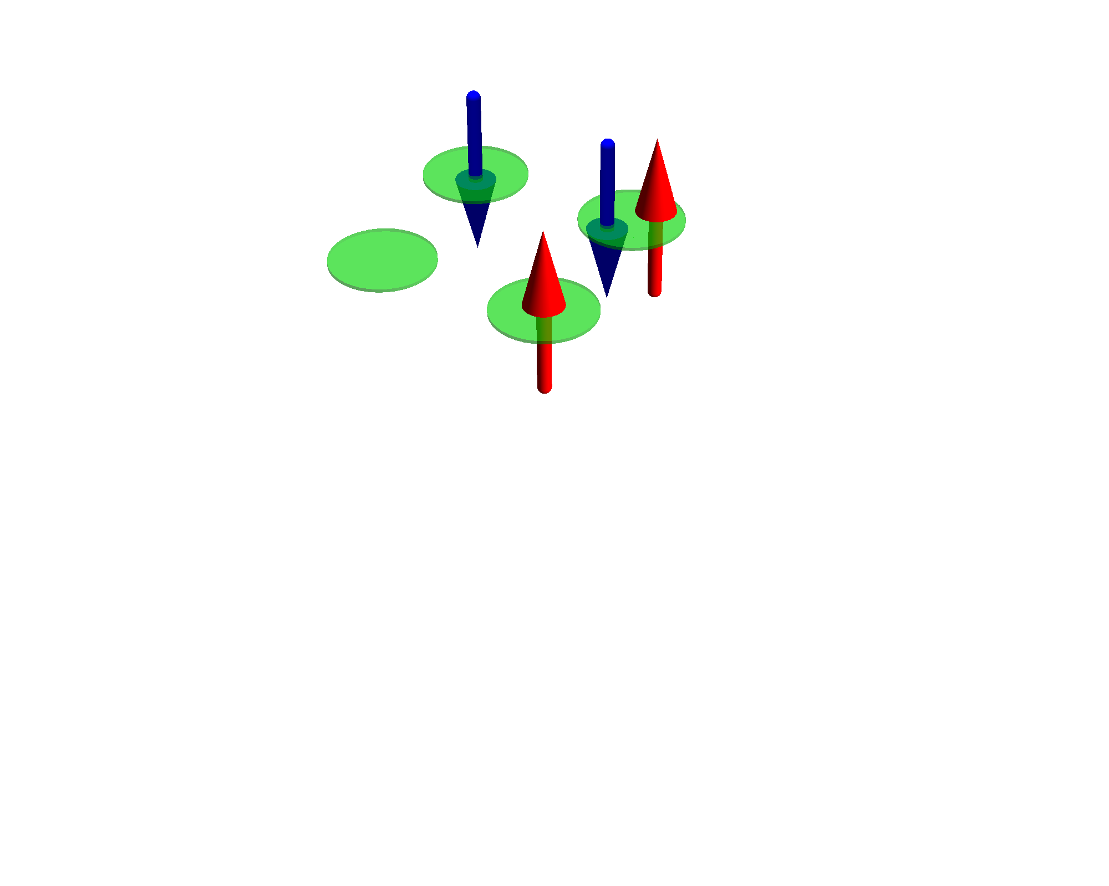
Exponential scaling of quantum mechanics
Example cluster of H atoms
# spin-
orbitals
# electrons
# atoms
# states
1 | 2 | 1 |  | ( ) | 2
2 | 4 | 2 |  | ( ) | 6
4 | 8 | 4 |  | ( ) | 70
2
1
4
2
8
4
Cluster of H atom
only include the 1s orbital

Slide 8
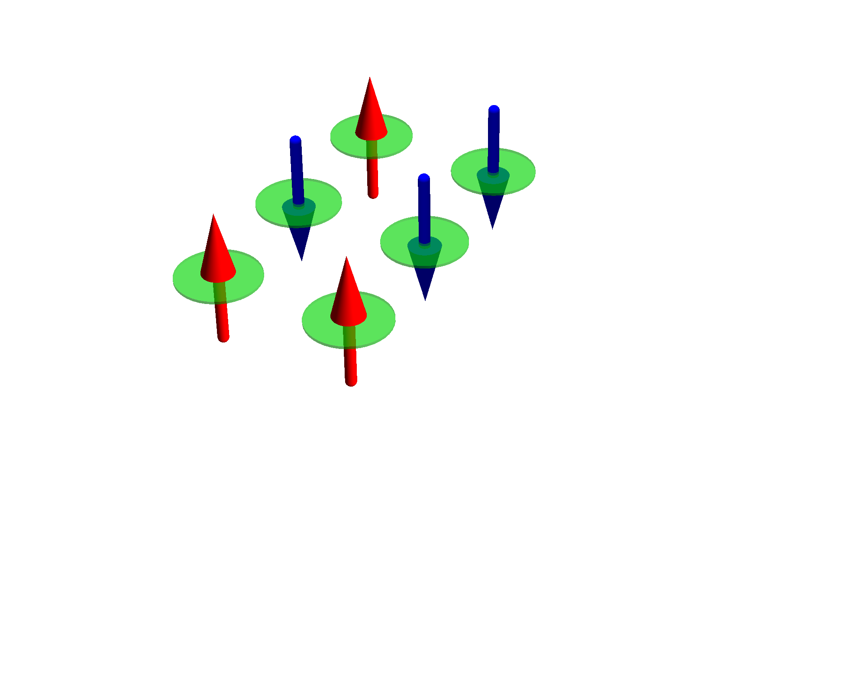
Exponential scaling of quantum mechanics
Example cluster of H atoms
# spin-
orbitals
# electrons
# atoms
# states
1 | 2 | 1 |  | ( ) | 2
2 | 4 | 2 |  | ( ) | 6
4 | 8 | 4 |  | ( ) | 70
6 | 12 | 6 |  | ( ) | 924
2
1
4
2
8
4
12
6
Cluster of H atom
only include the 1s orbital

Slide 9
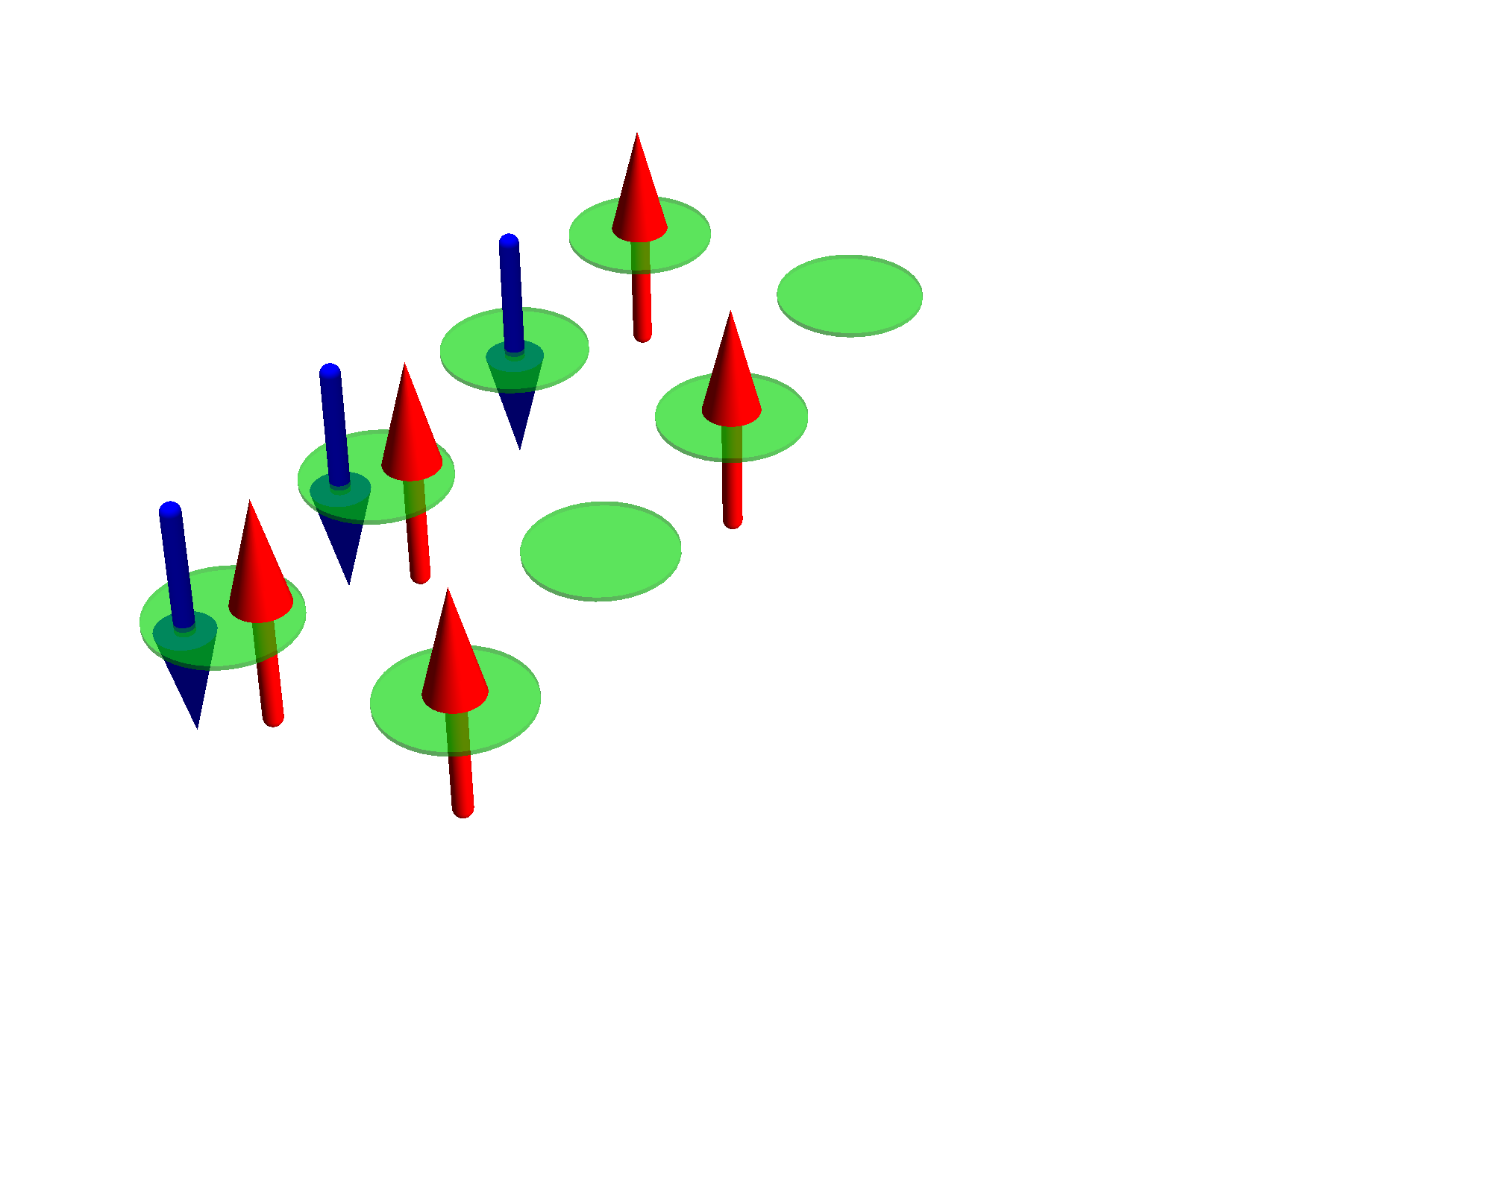
Exponential scaling of quantum mechanics
Example cluster of H atoms
# spin-
orbitals
# electrons
# atoms
# states
1 | 2 | 1 |  | ( ) | 2
2 | 4 | 2 |  | ( ) | 6
4 | 8 | 4 |  | ( ) | 70
6 | 12 | 6 |  | ( ) | 924
8 | 16 | 8 |  | ( ) | 12 870
2
1
4
2
8
4
12
6
16
8
Cluster of H atom
only include the 1s orbital

Slide 10
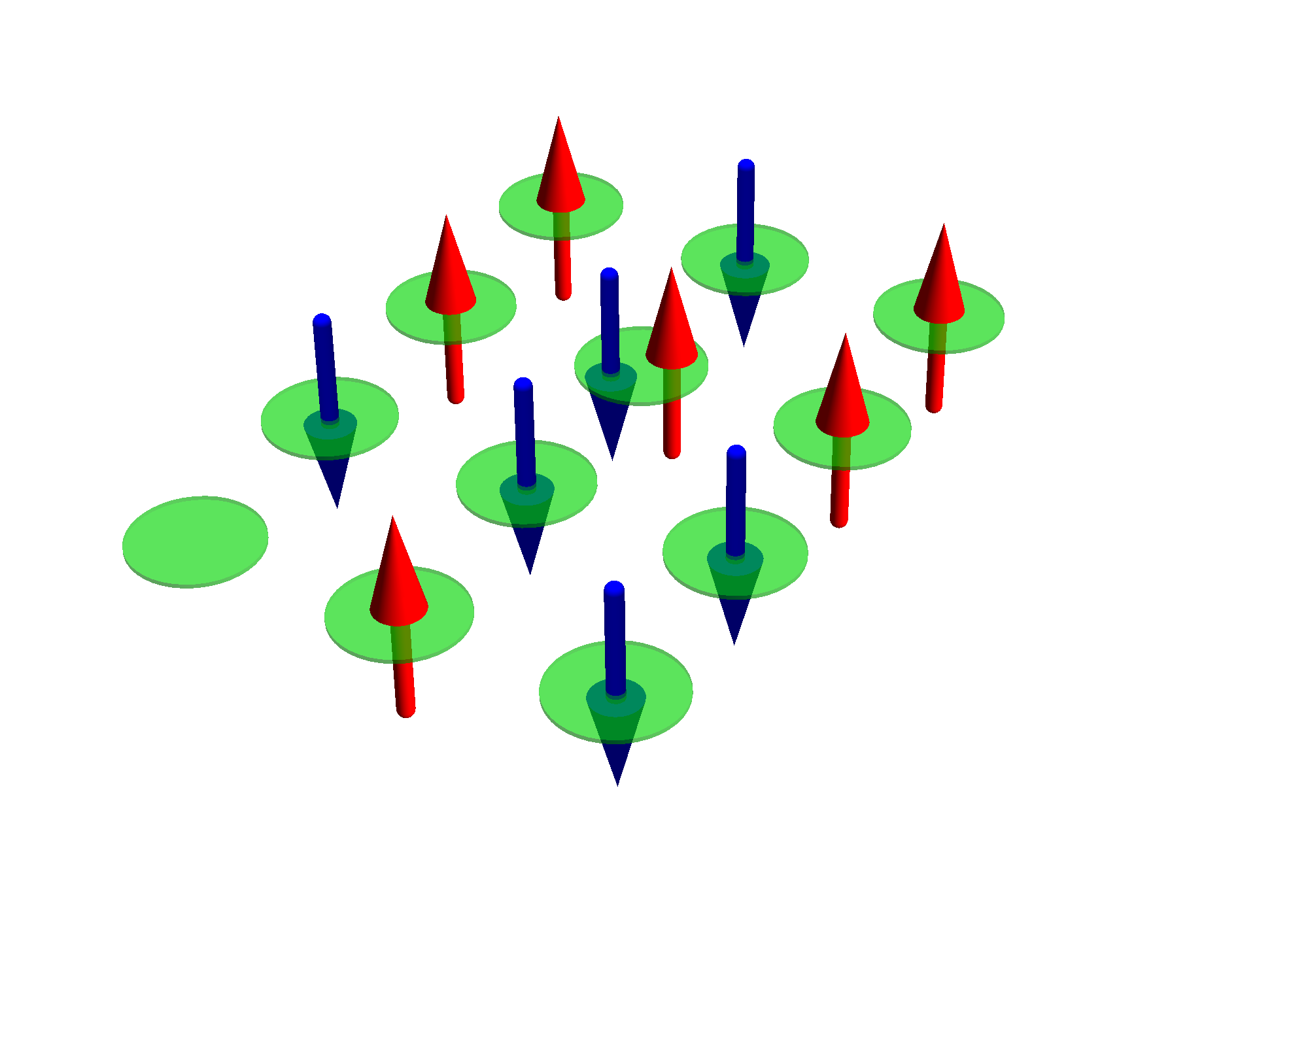
Exponential scaling of quantum mechanics
Example cluster of H atoms
# spin-
orbitals
# electrons
# atoms
# states
1 | 2 | 1 |  | ( ) | 2
2 | 4 | 2 |  | ( ) | 6
4 | 8 | 4 |  | ( ) | 70
6 | 12 | 6 |  | ( ) | 924
8 | 16 | 8 |  | ( ) | 12 870
10 | 20 | 10 |  | ( ) | 184 756
2
1
4
2
8
4
12
6
16
8
20
10
Cluster of H atom
only include the 1s orbital

Slide 11
Exponential scaling of quantum mechanics
Example cluster of H atoms
# spin-
orbitals
# electrons
# atoms
# states
1 | 2 | 1 |  | ( ) | 2
2 | 4 | 2 |  | ( ) | 6
4 | 8 | 4 |  | ( ) | 70
6 | 12 | 6 |  | ( ) | 924
8 | 16 | 8 |  | ( ) | 12 870
10 | 20 | 10 |  | ( ) | 184 756
12 | 24 | 12 |  | ( ) | 2 704 156
2
1
4
2
8
4
12
6
16
8
20
10
Cluster of H atom
only include the 1s orbital
24
12

Slide 12
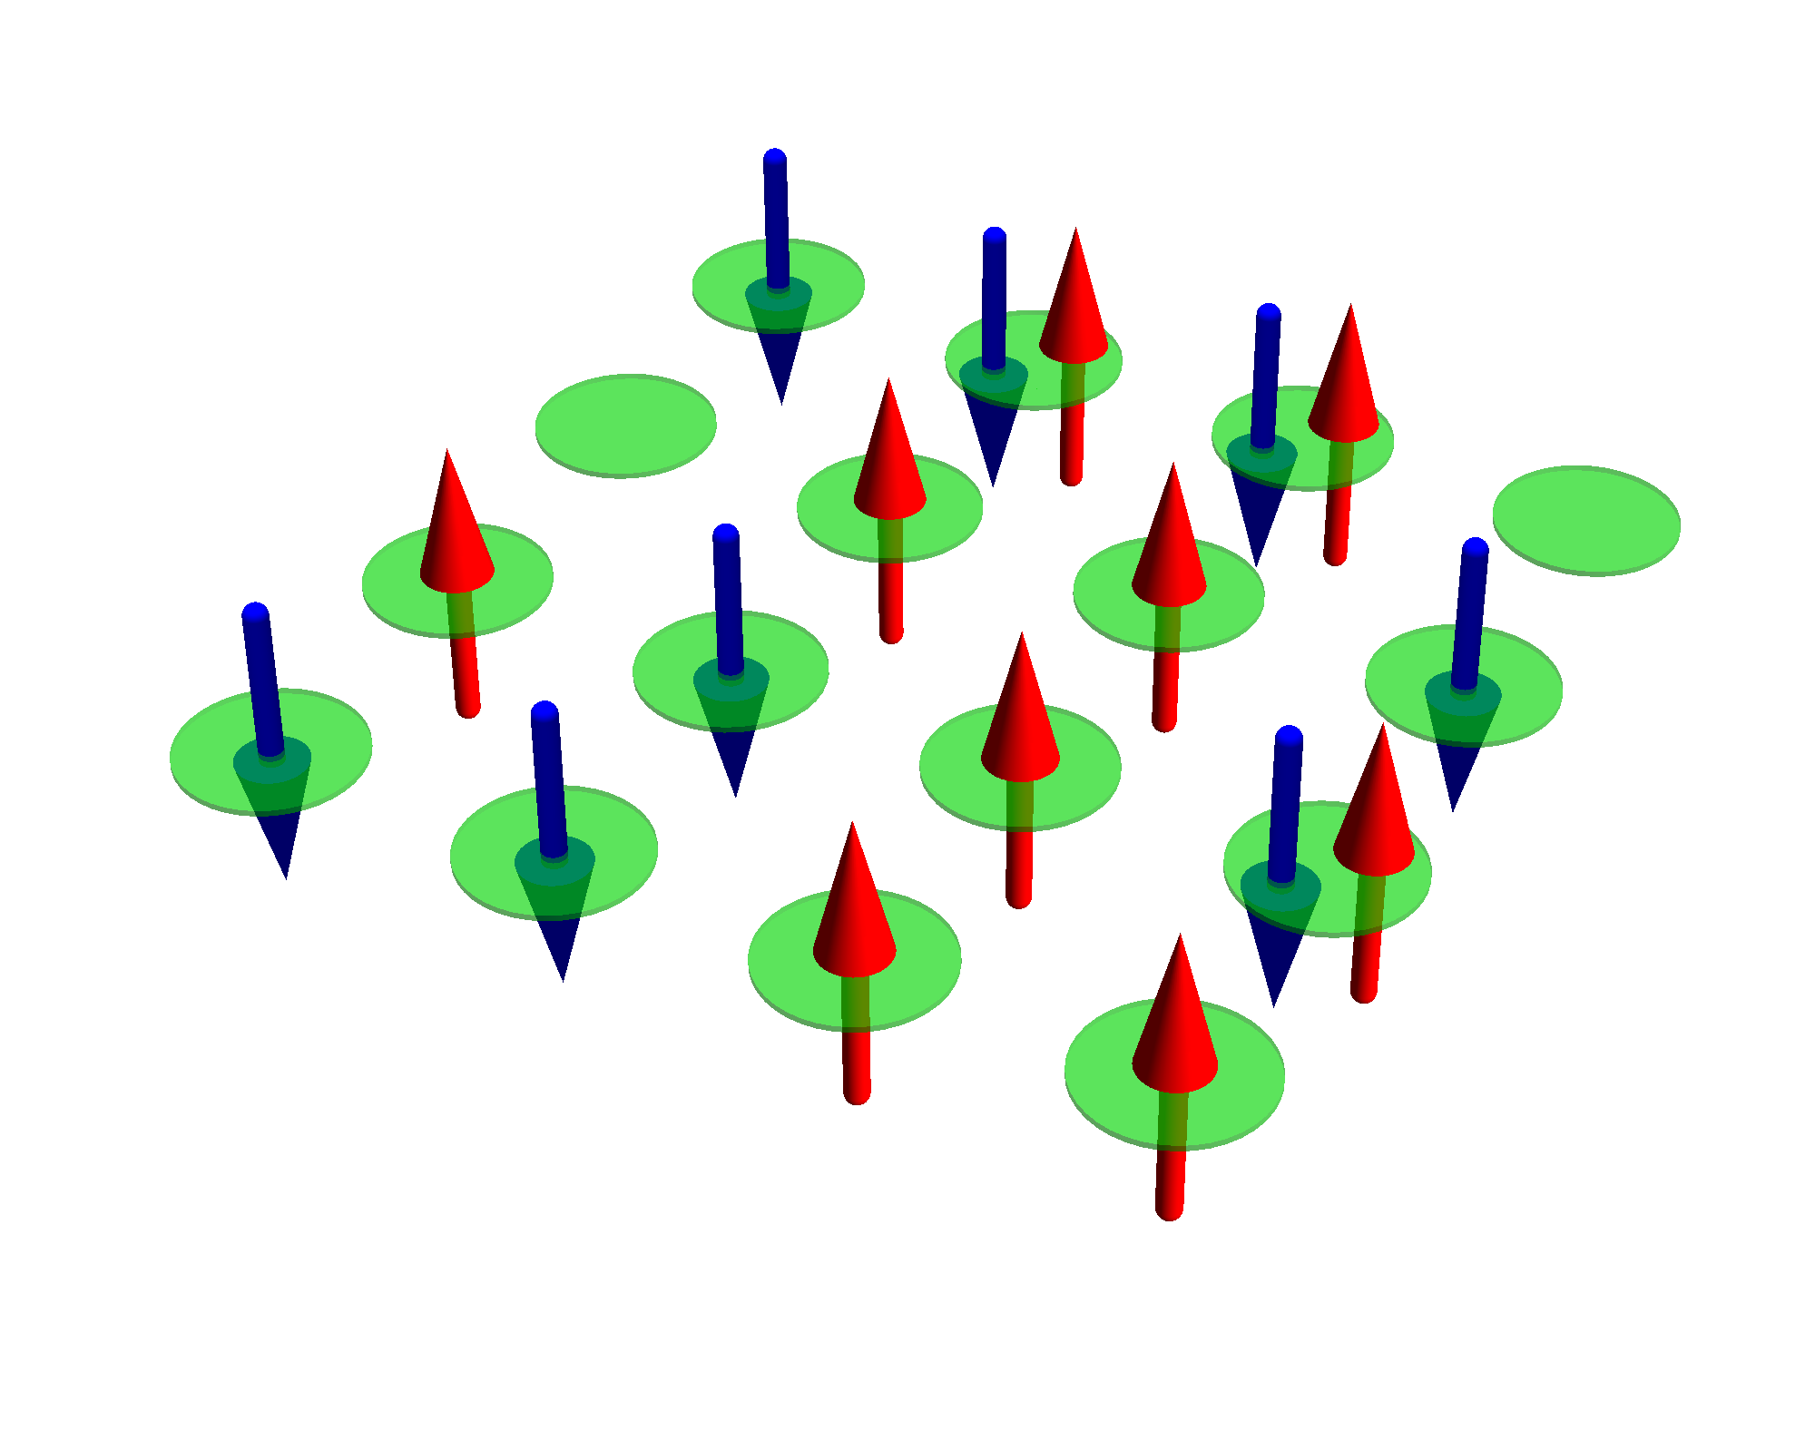
Exponential scaling of quantum mechanics
Example cluster of H atoms
# spin-
orbitals
# electrons
# atoms
# states
1 | 2 | 1 |  | ( ) | 2
2 | 4 | 2 |  | ( ) | 6
4 | 8 | 4 |  | ( ) | 70
6 | 12 | 6 |  | ( ) | 924
8 | 16 | 8 |  | ( ) | 12 870
10 | 20 | 10 |  | ( ) | 184 756
12 | 24 | 12 |  | ( ) | 2 704 156
14 | 28 | 14 |  | ( ) | 40 116 600
2
1
4
2
8
4
12
6
16
8
20
10
Cluster of H atom
only include the 1s orbital
24
12
28
14

Slide 13
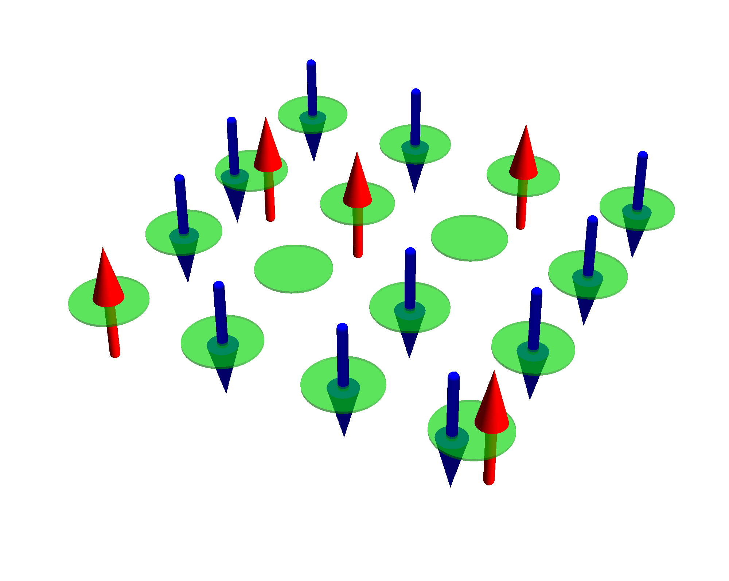
Exponential scaling of quantum mechanics
Example cluster of H atoms
# spin-
orbitals
# electrons
# atoms
# states
1 | 2 | 1 |  | ( ) | 2
2 | 4 | 2 |  | ( ) | 6
4 | 8 | 4 |  | ( ) | 70
6 | 12 | 6 |  | ( ) | 924
8 | 16 | 8 |  | ( ) | 12 870
10 | 20 | 10 |  | ( ) | 184 756
12 | 24 | 12 |  | ( ) | 2 704 156
14 | 28 | 14 |  | ( ) | 40 116 600
16 | 32 | 16 |  | ( ) | 601 080 390
2
1
4
2
8
4
12
6
16
8
20
10
Cluster of H atom
only include the 1s orbital
24
12
28
14
32
16

Slide 14
Exponential scaling of quantum mechanics
Example cluster of H atoms
# spin-
orbitals
# electrons
# atoms
# states
1 | 2 | 1 |  | ( ) | 2
2 | 4 | 2 |  | ( ) | 6
4 | 8 | 4 |  | ( ) | 70
6 | 12 | 6 |  | ( ) | 924
8 | 16 | 8 |  | ( ) | 12 870
10 | 20 | 10 |  | ( ) | 184 756
12 | 24 | 12 |  | ( ) | 2 704 156
14 | 28 | 14 |  | ( ) | 40 116 600
16 | 32 | 16 |  | ( ) | 601 080 390
18 | 36 | 18 |  | ( ) | 9 075 135 300
2
1
4
2
8
4
12
6
16
8
20
10
Cluster of H atom
only include the 1s orbital
24
12
28
14
32
16
36
18

Slide 15
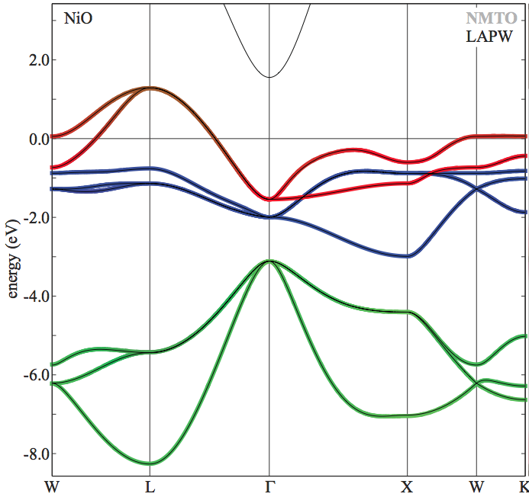
Exponential scaling of quantum mechanics
Example NiO
# spin-
orbitals
# electrons
# unit cells
# states
1 | 16 | 14 |  | ( ) | 120
16
14
NiO
Ni 3d and O 2p per unit cell
On LDA level NiO is metallic (in reality a good insulator)

Slide 16
Exponential scaling of quantum mechanics
Example NiO
# spin-
orbitals
# electrons
# unit cells
# states
1 | 16 | 14 |  | ( ) | 120
2 | 32 | 28 |  | ( ) | 35 960
16
14
32
28
NiO
Ni 3d and O 2p per unit cell
On LDA level NiO is metallic (in reality a good insulator)

Slide 17
Exponential scaling of quantum mechanics
Example NiO
# spin-
orbitals
# electrons
# unit cells
# states
1 | 16 | 14 |  | ( ) | 120
2 | 32 | 28 |  | ( ) | 35 960
3 | 48 | 42 |  | ( ) | 12 271 512
16
14
32
28
48
42
NiO
Ni 3d and O 2p per unit cell
On LDA level NiO is metallic (in reality a good insulator)

Slide 18
Exponential scaling of quantum mechanics
Example NiO
# spin-
orbitals
# electrons
# unit cells
# states
1 | 16 | 14 |  | ( ) | 120
2 | 32 | 28 |  | ( ) | 35 960
3 | 48 | 42 |  | ( ) | 12 271 512
4 | 64 | 56 |  | ( ) | 4 426 165 368
16
14
32
28
48
42
64
56
NiO
Ni 3d and O 2p per unit cell
On LDA level NiO is metallic (in reality a good insulator)

Slide 19
Exponential scaling of quantum mechanics
Example NiO
# spin-
orbitals
# electrons
# unit cells
# states
1 | 16 | 14 |  | ( ) | 120
2 | 32 | 28 |  | ( ) | 35 960
3 | 48 | 42 |  | ( ) | 12 271 512
4 | 64 | 56 |  | ( ) | 4 426 165 368
5 | 80 | 70 |  | ( ) | 1 646 492 110 120
16
14
32
28
48
42
64
56
80
70
NiO
Ni 3d and O 2p per unit cell
On LDA level NiO is metallic (in reality a good insulator)

Slide 20
Exponential scaling of quantum mechanics
Example NiO
# spin-
orbitals
# electrons
# unit cells
# states
1 | 16 | 14 |  | ( ) | 120
2 | 32 | 28 |  | ( ) | 35 960
3 | 48 | 42 |  | ( ) | 12 271 512
4 | 64 | 56 |  | ( ) | 4 426 165 368
5 | 80 | 70 |  | ( ) | 1 646 492 110 120
6 | 96 | 84 |  | ( ) | 624 668 654 531 480
16
14
32
28
48
42
64
56
80
70
96
84
NiO
Ni 3d and O 2p per unit cell
On LDA level NiO is metallic (in reality a good insulator)

Slide 21
Exponential scaling of quantum mechanics
Example NiO
# spin-
orbitals
# electrons
# unit cells
# states
1 | 16 | 14 |  | ( ) | 120
2 | 32 | 28 |  | ( ) | 35 960
3 | 48 | 42 |  | ( ) | 12 271 512
4 | 64 | 56 |  | ( ) | 4 426 165 368
5 | 80 | 70 |  | ( ) | 1 646 492 110 120
6 | 96 | 84 |  | ( ) | 624 668 654 531 480
7 | 112 | 98 |  | ( ) | 240 260 199 935 164 200
16
14
32
28
48
42
64
56
80
70
96
84
NiO
Ni 3d and O 2p per unit cell
On LDA level NiO is metallic (in reality a good insulator)
112
98

Slide 22
Exponential scaling of quantum mechanics
Example NiO
# spin-
orbitals
# electrons
# unit cells
# states
1 | 16 | 14 |  | ( ) | 120
2 | 32 | 28 |  | ( ) | 35 960
3 | 48 | 42 |  | ( ) | 12 271 512
4 | 64 | 56 |  | ( ) | 4 426 165 368
5 | 80 | 70 |  | ( ) | 1 646 492 110 120
6 | 96 | 84 |  | ( ) | 624 668 654 531 480
7 | 112 | 98 |  | ( ) | 240 260 199 935 164 200
…
16
14
32
28
48
42
64
56
80
70
96
84
NiO
Ni 3d and O 2p per unit cell
On LDA level NiO is metallic (in reality a good insulator)
112
98

Slide 23
What to do….
If you want / need to keep all correlations and have a solid, …. You’re basically still screwed. ☺
Here, start the approximations from the other side.
Include all correlations, but approximate the periodicity of the crystal.
Good for local properties in insulators.
Magnetic susceptibility, Orbital occupation, Valence, Excitonic spectra.
Start simple and introduce a language needed for discussing correlated materials: orbital – Slater determinant, valence fluctuations, multiplet
Beyond, … large research field with many achievements I do not talk about today.
Green’s functions, self energy + approximations

Slide 24
Quanty
Many possible models,
Many possible types of spectroscopy, response functions, properties to calculate, some work in a specific model, some don’t
Implement a script language that solves quantum many body problems using the best of quantum physics and quantum chemistry that allows you to define different models and calculate spectra

Slide 26
Introducing language – Second quantization
Many particle wave function
with

Slide 27
Introducing language – Second quantization
For H atom
Many particle wave function
  One particle orbital
  With quantum number

Slide 28
Introducing language – Second quantization
For He atom
Many particle wave function
Assume orbitals have similar structure as H orbitals and take as an ansatz the state:
  One particle orbital
  With quantum number
with
And optimize to find lowest energy

Slide 29
Introducing language – Second quantization
One problem: 4 solutions
Many particle wave function
  One particle orbital
  With quantum number
  Pauli: postulate: no math reason, but new physics:
Two electrons can not be in the same spin-orbital
They are all orthogonal to each other

Slide 30
Introducing language – Second quantization
One problem: 4 solutions
Many particle wave function
  One particle orbital
  With quantum number
  Pauli: postulate: no math reason, but new physics:
Two electrons can not be in the same spin-orbital
  Oh Oh still two states left …. Eh ….
  Must hold for any basis, see what happens when rotating the spin quantization axis
They are all orthogonal to each other

Slide 31
Introducing language – Second quantization

Slide 32
Introducing language – Second quantization

Slide 33
Introducing language – Second quantization
He ansatz wavefunction
Many particle wave function
  One particle orbital
  With quantum number
  Pauli: postulate: no math reason, but new physics:
Two electrons can not be in the same spin-orbital for any basis (anti-symmetrize)

Slide 34
Introducing language – Second quantization
He ansatz wavefunction
Many particle wave function
  One particle orbital
  With quantum number
  Pauli: postulate: no math reason, but new physics:
Two electrons can not be in the same spin-orbital for any basis (anti-symmetrize)

Slide 35
Introducing language – Second quantization
He ansatz wavefunction
Many particle wave function
  One particle orbital
  With quantum number
  Single Slater determinant

Slide 36
Introducing language – Second quantization
Li ansatz wavefunction

Slide 37
Introducing language – Second quantization
Ne ansatz wave function
  Not practical, need a different notation

Slide 38
Introducing language – Second quantization

Slide 39
Introducing language – Second quantization

Slide 40
Introducing language – Second quantization

Slide 41
Introducing language – Second quantization
Paul: postulate: no math reason, but new physics:
Two electrons can not be in the same spin-orbital for any basis (anti-symmetrize)

Slide 42
Introducing language – Second quantization
  One particle orbital
  With quantum number
  Single Slater determinant
Many particle wave function

Slide 44
Operators in second quantization
How to calculate:
or:
Distinguish two cases

Slide 45
Operators in second quantization
One particle operators
Two particle operators

Slide 46
Operators in second quantization
One particle operators
Proof: homework
with,
Two particle operators
with,

