Slide 1
X-ray Absorption Spectroscopy
Introduction to XAS
XAS detection techniques
XAS spectral shape
multiplet calculations

Slide 2
X-ray Absorption Spectroscopy
Element specific
Sensitive to low concentrations
Applicable under extreme conditions
SPACE: Combination with x-ray microscopy
TIME: femtosecond XAS
RESONANCE: RIXS, RPES, R diffraction
Notes:
XAS is element specific because each element has specific binding energies for its core levels.
The XAS edge energy is essentially given by the core level binding energy.

Slide 3
Interaction of x-rays with matter
X-ray Absorption Spectroscopy
XAS, XPS
Elastic scattering (SAXS, XRD)
Inelastic scattering
Mn

Slide 4
Interaction of x-rays with matter
X-ray Absorption Spectroscopy
[Rogantini, Astro & Astrophys.609, A22 (1018)]

Slide 5
X-ray absorption edges
X-ray Absorption Spectroscopy
Label
Orbital
eV
K
1s
6539
L _{I}
2s
769.1
L _{II}
2p_{1/2}
649.9 [3]
L _{III}
2p_{3/2}
638.7 [3]
M _{I}
3s
82.3 [3]
M _{II}
3p_{1/2}
47.2 [3]
M _{III}
3p_{3/2}
47.2 [3]

Slide 6
X-ray absorption edges
X-ray Absorption Spectroscopy
Label
Orbital
eV [literature reference]
K
1s
6539 [1]
L _{I}
2s
769.1 [3]
L _{II}
2p_{1/2}
649.9 [3]
L _{III}
2p_{3/2}
638.7 [3]
M _{I}
3s
82.3 [3]
M _{II}
3p_{1/2}
47.2 [3]
M _{III}
3p_{3/2}
47.2 [3]
BarKLa
The Nobel Prize in Physics 1917 was awarded to Charles Glover Barkla "for his discovery of the characteristic Röntgen radiation of the elements."

Slide 7
X-ray absorption edges
X-ray Absorption Spectroscopy
Label
Orbital
eV [literature reference]
K
1s
6539 [1]
L _{I}
2s
769.1 [3]
sharp
principal
diffuse
fundamental
L _{II}
2p_{1/2}
649.9 [3]
L _{III}
2p_{3/2}
638.7 [3]
M _{I}
3s
82.3 [3]
M _{II}
3p_{1/2}
47.2 [3]
J. Chem. Educ. 84, 757 (2007)
M _{III}
3p_{3/2}
47.2 [3]
BarKLa
The Nobel Prize in Physics 1917 was awarded to Charles Glover Barkla "for his discovery of the characteristic Röntgen radiation of the elements."

Slide 8
X-ray absorption
X-ray Absorption Spectroscopy
4sp
3d
O2p
O2s
3p
Excitation of 3p to 3d state
Lifetime of excitation is short
Lifetime broadening ~200 meV
Notes:
8

Slide 9
X-ray absorption & x-ray emission
X-ray Absorption Spectroscopy
Decay of 3d electron to 3p core state
X-ray emission
Notes:
9

Slide 10
X-ray absorption & Auger
X-ray Absorption Spectroscopy
Decay of 3d/valence electron to 3p core state
Energy used to excite a 3d/valence electron
Auger electron spectroscopy
Notes:
10

Slide 11
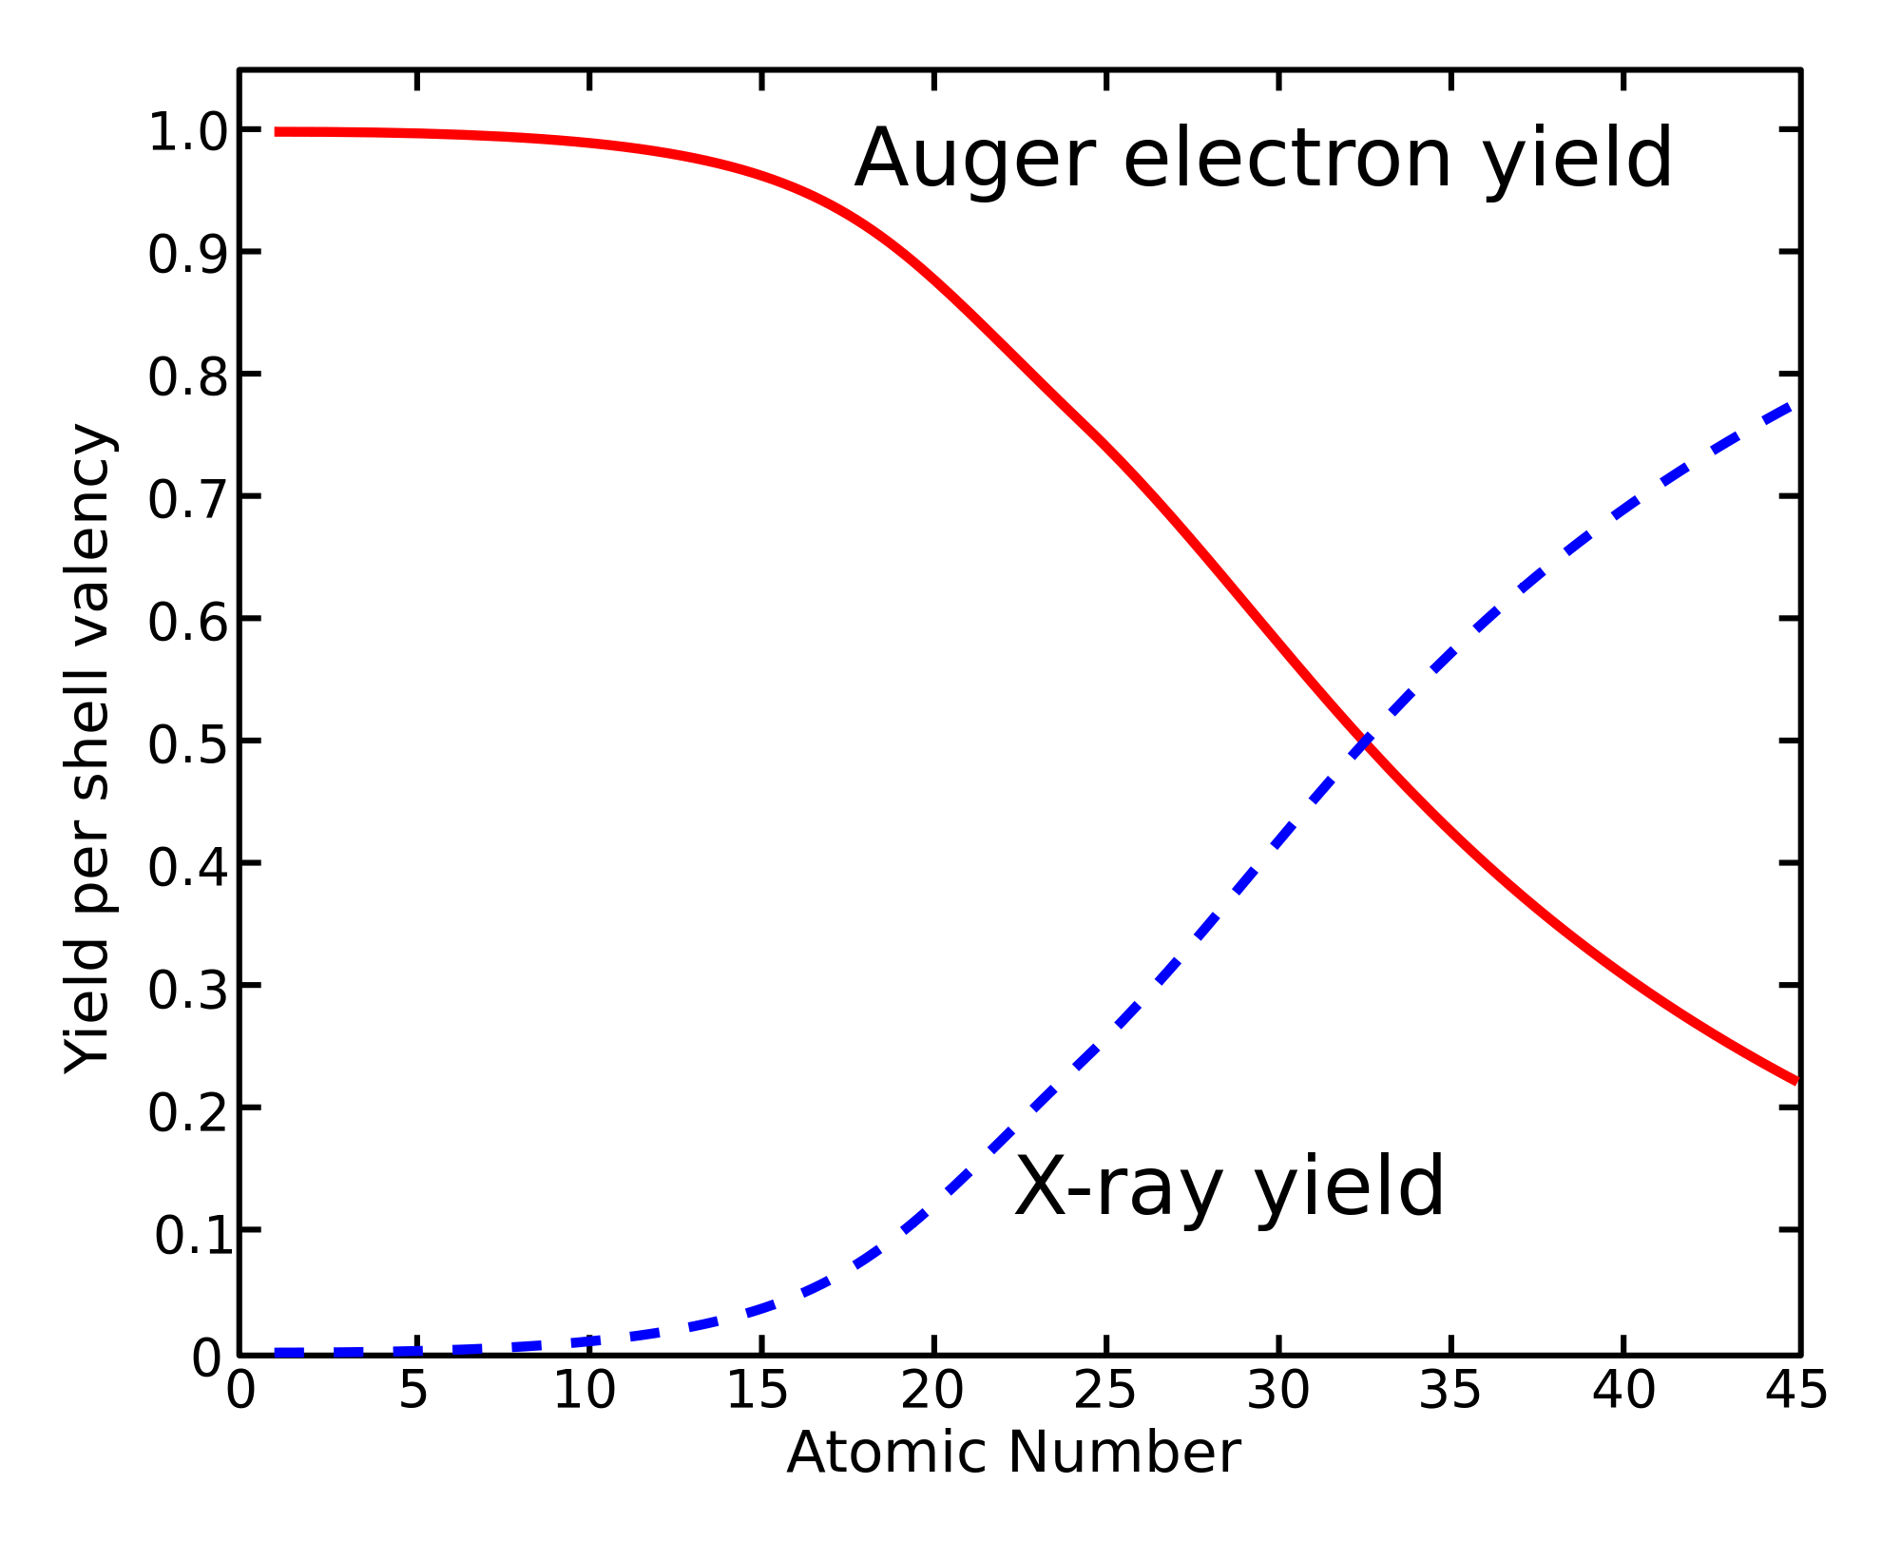
X-ray Absorption Spectroscopy
1s core state
Notes:
11

Slide 12
XAS: detection techniques

Slide 13
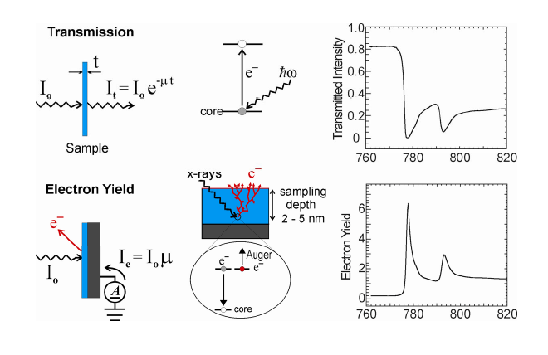
XAS: detection techniques
Use decay channels as detector
Uniform thickness
Uniform concentration of absorbing element
Thin enough for photons

Slide 14
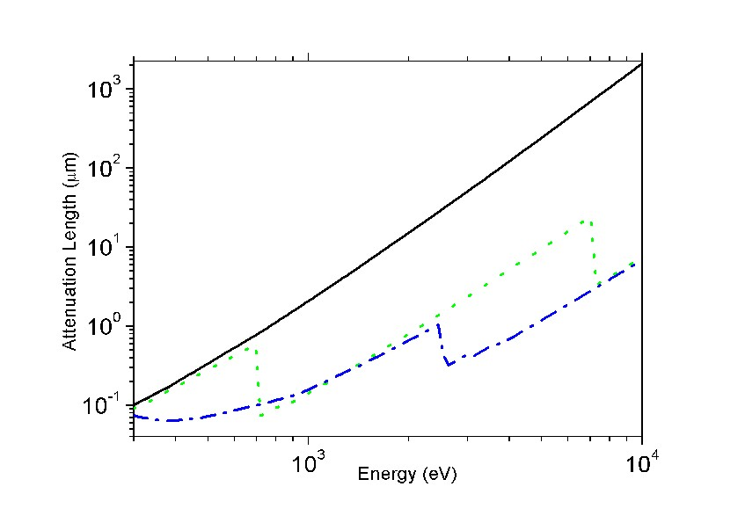
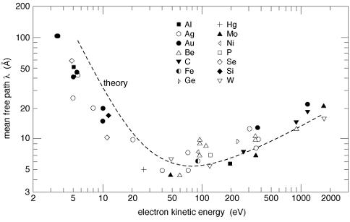
XAS: detection techniques
X-ray penetration lengths &
electron escape depths
100-1000 nm
(CXRO, but 20 nm for L edges)
1-5 nm

Slide 15
XAS: detection techniques
Use decay channels as detector
X-ray penetrate 1000 nm (λ_{X})
Electrons escape from 5 nm (λ_{E})
Number of core holes created in first 5 nm is proportional to μ and angle of incidence (α)
I_{TEY} ~ 1 / λ_{X} = μ_{X}

Slide 16
XAS: detection techniques
Transmission
(pinhole, saturation > thin samples)
Electron Yield
(surface sensitive)
Fluorescence Yield
(saturation & self-absorption:
> dilute samples)
[L edges are intrinsically distorted]

Slide 17
XAS: spectral shape
Interpretation of spectral shapes
Notes:
17

Slide 18
XAS: spectral shape
Excitations of core electrons to empty states
The XAS spectra are given by the
Fermi Golden Rule
exciton
edge jump

Slide 19
XAS: spectral shape (O 1s)
Fermi Golden Rule
↓
Excitations to
empty states as calculated by DFT
X
O 1s
Notes:
19

Slide 20
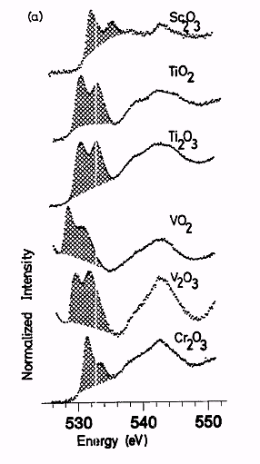
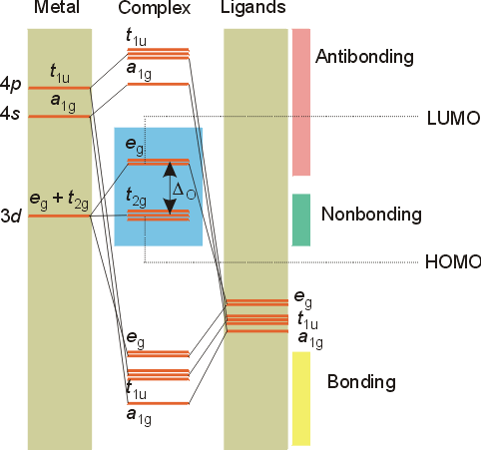
XAS: spectral shape (O 1s)
2p
2s
Phys. Rev. B.40, 5715 (1989)

Slide 21
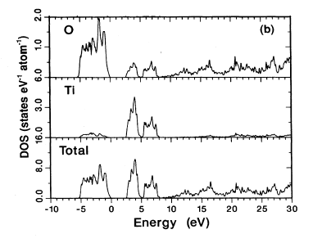
XAS: spectral shape (O 1s)
oxygen 1s > p DOS
Phys. Rev. B.40, 5715 (1989); 48, 2074 (1993)

Slide 22
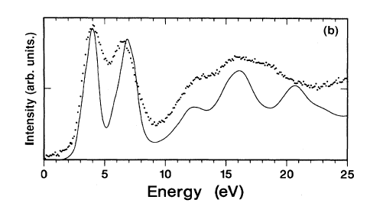
XAS: spectral shape (O 1s)
Phys. Rev. B. 40, 5715 (1989); 48, 2074 (1993)

Slide 23
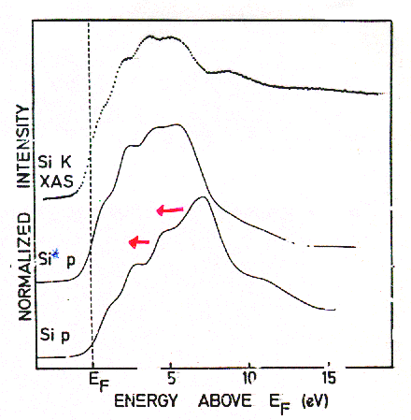
XAS: spectral shape
TiSi₂
Final State Rule: Spectral shape of XAS looks like final state DOS
Phys. Rev. B. 41, 11899 (1991)

Slide 24
XAS: spectral shape
TiSi₂
XAS codes:
Multiple scattering: FEFF, FDMNES, etc.
Band structure:
WIEN2K, Quantumespresso, etc.
Real-space DFT:
ADF, etc.
Phys. Rev. B. 41, 11899 (1991)

Slide 25
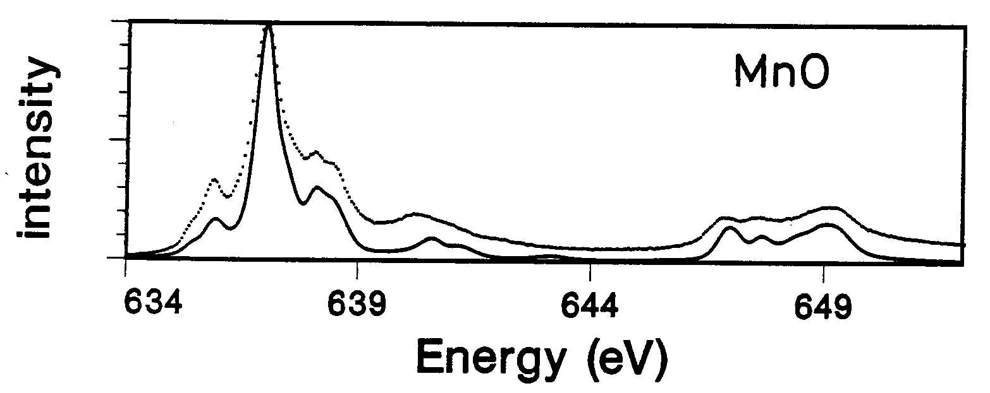
2p XAS of transition metal ions
Iron 1s XAS
exciton
2p > 3d
(3d⁵ > 2p⁵3d⁶, self screened)
X
edge jump
2p > s,d DOS
[Phys. Rev. B. 42, 5459 (1990)]
Notes:
25

Slide 26
XAS: spectral shape
XAS: multiplet effects
Overlap of core and valence wave functions
→ Spectral shape NOT improved in last 30 years!
3d
<2p3d|1/r|2p3d>
2p_{3/2}
2p_{1/2}
[Phys. Rev. B. 42, 5459 (1990)]

Slide 27
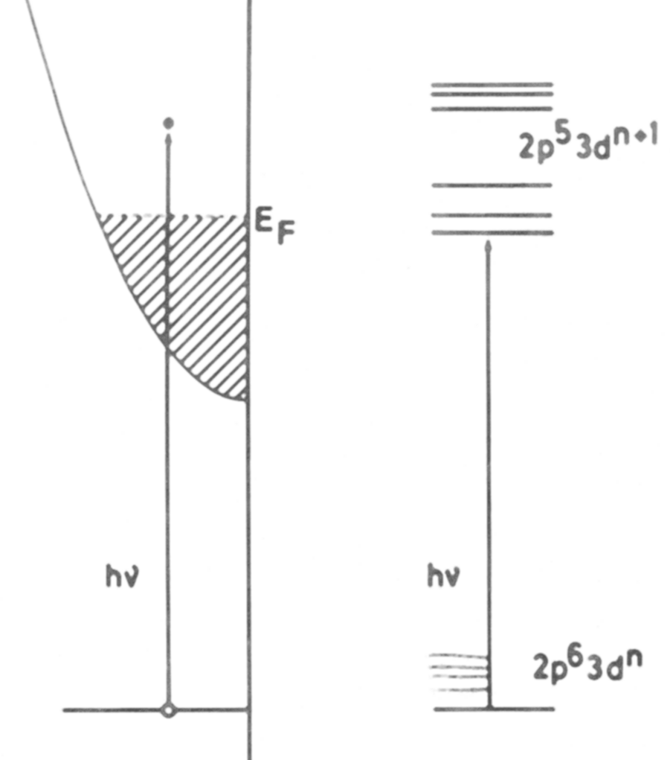
XAS: spectral shape
Interpretation of XAS
1-particle:
1s edges
(DFT + core hole +U)
many-particle:
open shell systems
(CTM4XAS)
Notes:
27

Slide 28
XAS: spectral shape
XAS
1s
DFT
pre-edge
of 3d system
??
2p, 3p,
3d, 4d
multiplets

Slide 29
X-ray absorption of a solid
Pre-edges structures in 1s XAS
Fe 4p -
Fe 3d 0
O 2p 5
O 2s 20
Fe 3p 50
Fe 3s 85
O 1s 530
Fe 2p 700
Fe 2s 800
Fe 1s 7115

Slide 30
Pre-edges structures in 1s XAS
1s
1
3d
N
4p
1
edge
exciton
edge jump
3d
4p
1s
1
3d
N+1
4p
0
pre-edge
N
0

Slide 31
Pre-edges structures in 1s XAS
1s
1
3d
N
4p
1
edge
3d
4p
1s
1
3d
N+1
4p
0
pre-edge
N
0
[Cabaret et al. j. Synchrot. Rad. 6, 258 (1999)]

Slide 32
Pre-edges structures in 1s XAS
1s
1
3d
N
4p
1
edge
3d
4p
1s
1
3d
N+1
4p
0
pre-edge
N
0
[J. Phys. Cond. Matt. 21, 104207 (2009)]

Slide 33
XAS: spectral shape
XAS
1s
DFT
pre-edge
of 3d system
2p, 3p,
3d, 4d
multiplets

Slide 34
3d XAS of rare earths
4f electrons are localized
No effect of surroundings (no crystal field)
3d XAS is self screened > no charge transfer effect
Initial state
electron-electron interaction.
Valence spin-orbit coupling
Final state
The core hole – valence hole ‘multiplet’ interaction.
The core hole spin-orbit coupling

Slide 35
3d XAS of rare earths
Nd³⁺ 4f³ system: ground state is ⁴I_{9/2}
^{2S+1}L_{J} term symbols and Hunds rule are explained
in the atomic multiplet pdf file

Slide 36
2p XAS of NiO with atomic multiplets
Atomic multiplets

Slide 37
2p XAS of 3d transition metal oxides
3d electrons are less localized
Effect of surroundings (crystal field effect)
3d XAS is self screened > weak charge transfer effect
Initial state
electron-electron interaction.
valence spin-orbit coupling
crystal field effect
Final state
core hole – valence hole ‘multiplet’ interaction.
core hole spin-orbit coupling
crystal field effect

Slide 38
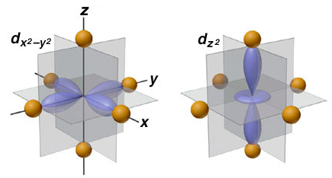
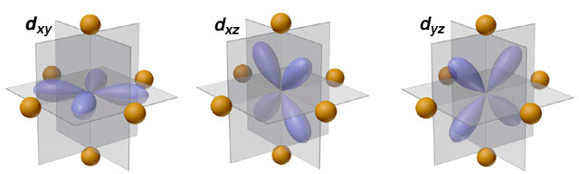
crystal field effect
Crystal Field Effects
e_{g} states
t_{2g} states

Slide 39
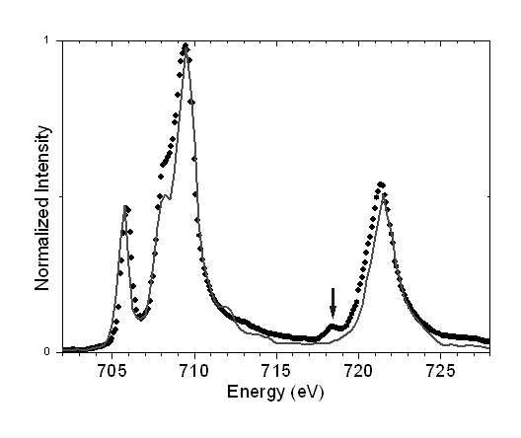
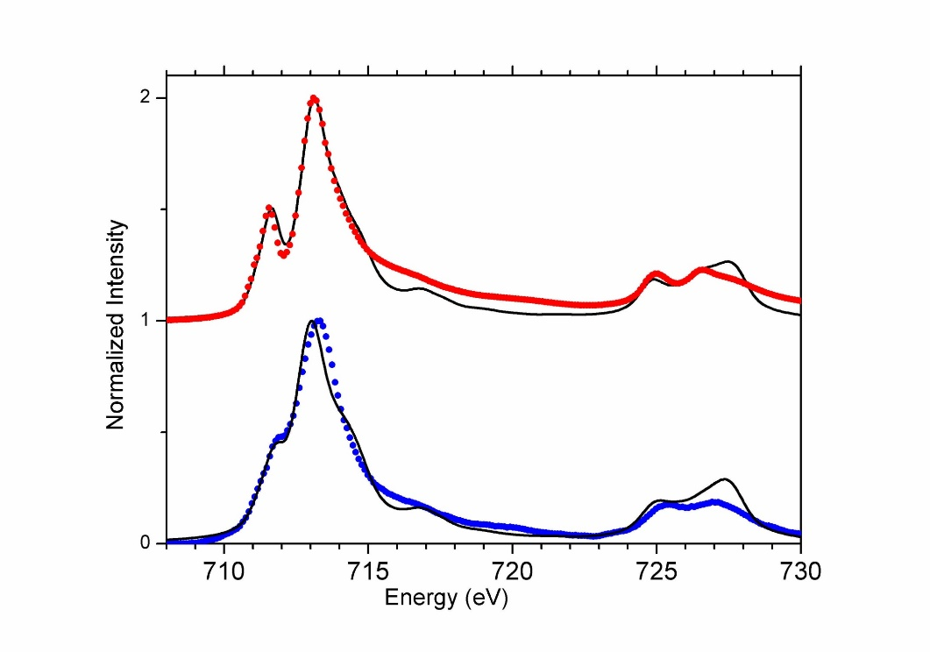
crystal field effect: spin state
High-spin or Low-spin
More in the lecture of Marie-Anne Arrio
E
T₂
E
T₂
High-spin 3d⁵
Low-spin 3d⁵

Slide 40
Multiplet calculations
valence e-e interactions F_{dd}
core-valence e-e F_{pd} G_{pd}
core & valence spin-orbit ζ
crystal field 10Dq, Ds, Dt
molecular field, M or H
e-e screening κ
charge transfer Δ, U, Q
hopping T_{Γ}
ionic 3d
(4d, 5d)
4f, 5f
covalent 3d
mixed valence f
ATOMIC
SYMMETRY
BONDING

Slide 41
Multiplet calculations
valence e-e interactions F_{dd}
core-valence e-e F_{pd} G_{pd}
core & valence spin-orbit ζ
crystal field 10Dq, Ds, Dt
molecular field, M or H
e-e screening κ
charge transfer Δ, U, Q
hopping T_{Γ}
ionic 3d
(4d, 5d)
4f, 5f
3d ions
covalent 3d
mixed valence f
ATOMIC
SYMMETRY
BONDING

Slide 42
Charge transfer effects
Charge Transfer Effects
Hubbard U for a 3d⁸ ground state:
U= E(3d⁷) + E(3d⁹) – E(3d⁸) – E(3d⁸)
Ligand-to-Metal Charge Transfer (LMCT):
Δ= E(3d⁹L) – E(3d⁸)

Slide 43
Charge transfer effects
Charge Transfer Effects
Main screening mechanism in XAS of oxides:
Ligand-to-metal charge transfer
Charge transfer energy Δ is important for XAS
Hubbard U is NOT important for XAS spectral shape

Slide 44
Charge transfer effects in XAS and XPS
transition metal oxides
Ground state: 3d⁸ + 3d⁹L
Energy of 3d⁹L: Charge transfer energy Δ
3d⁹L
Δ
3d⁸
Ground State

Slide 45
Charge Transfer Effects
3d⁹L
Δ
3d⁸

Slide 46
Charge Transfer Effects
9
3d⁹L
Δ
8
3d⁸

Slide 47
Charge Transfer Effects
β 3d⁸ - α 3d⁹L
α 3d⁸ + β 3d⁹L
3d⁹L
Δ
3d⁸

Slide 48
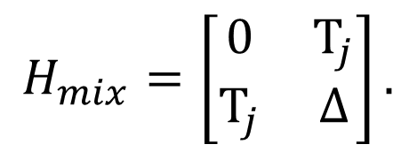
Charge Transfer Effects
$$H_{mix}=\left[\begin{matrix}0 & T_{j} \\ T_{j} & ∆\end{matrix}\right].$$
3d⁹L
E_{1,2} = ½ [Δ±√(Δ²+4T²)]
Δ=2 and T=0
E_{1,2} = ½ [2±√(2²+0)] = 0 and 2
Δ
3d⁸

Slide 49
Charge Transfer Effects
$$H_{mix}=\left[\begin{matrix}0 & T_{j} \\ T_{j} & ∆\end{matrix}\right].$$
3d⁹L
E_{1,2} = ½ [Δ±√(Δ²+4T²)]
Δ=2 and T=1
E_{1,2} = ½ [2±√(2²+4)] = 1 ± √2
Δ
3d⁸

Slide 50
Charge Transfer Effects in NiO
E(3d⁹L) – E(3d⁸) = Δ
E(3d¹⁰LL‘) – E(3d⁸) = 2Δ
X

Slide 51
Charge Transfer Effects in NiO
E(3d⁹L) – E(3d⁸) = Δ
E(3d¹⁰LL‘) – E(3d⁸) = 2Δ +U

Slide 52
Charge Transfer Effects

Slide 53
Charge Transfer Effects in NiO
2p XAS: 3d⁸ → 2p⁵ 3d⁹
E (2p⁵3d⁹) = E_{2p}+ Δ + E_{L} - 9Q

Slide 54
Charge Transfer Effects in NiO
2p XAS: 3d⁸ → 2p⁵ 3d⁹
E (2p⁵3d⁹) = E_{2p}+ Δ + E_{L} - 9Q
2p XAS: 3d⁹L→ 2p⁵ 3d¹⁰L
E (2p⁵3d¹⁰L) = E_{2p}+2Δ+U + E_{L} -10Q

Slide 55
Charge Transfer Effects in NiO
2p XAS: 3d⁸ → 2p⁵ 3d⁹
E (2p⁵3d⁹) = E_{2p}+ Δ + E_{L} - 9Q
2p XAS: 3d⁹L→ 2p⁵ 3d¹⁰L
E (2p⁵3d¹⁰L) = E_{2p}+2Δ+U + E_{L} -10Q
Energy difference: Δ_{FINAL} = Δ+U-Q ≅ Δ -1 eV

Slide 56
Charge Transfer Effects in XAS
Δ+U-Q
Δ

Slide 57
Charge transfer effects
Charge Transfer Effects
NiO: Ground state: 3d⁸ + 3d⁹L
Energy of 3d⁹L: Charge transfer energy Δ
3d⁹L
3d⁸
2p⁵3d¹⁰L
2p⁵3d⁹
Δ
Δ+U-Q ≈ Δ

Slide 58
β 3d⁸ - α 3d⁹L
α 3d⁸ + β 3d⁹L
β’ c3d⁹ – α’ c3d¹⁰L
α' c3d⁹ + β’ c3d¹⁰L
Charge transfer effects
~0
~1
Δ
Δ+U-Q ≈ Δ
Intensity bonding combination: [α α’+ β β’]²
α ≈ α’ ≈ α²+ β² =1

Slide 59
β 3d⁵ - α 3d⁶L
α 3d⁵ + β 3d⁶L
β’ c3d⁶ – α’ c3d⁷L
α' c3d⁶ + β’ c3d⁷L
Charge transfer effects
~0
~1
Δ
Δ+U-Q ≈ Δ
Intensity anti-bonding combination:α β’- β α’
α ≈ α’ ≈ αβ - βα =0

Slide 60
Charge transfer effects
Charge Transfer Effects
Neutral experiments are self-screened
XAS, optical, EPR, EELS, RIXS
>> small satellites
>> crystal field theory can be used
Ionising experiments are not self-screened
XPS, Auger,
>> large screening > large satellites
>> crystal field theory can not be used

Slide 61
Charge transfer effects in XAS and XPS
Charge transfer effects in XAS and XPS
Transition metal oxide: Ground state: 3d⁵ + 3d⁶L
Energy of 3d⁶L: Charge transfer energy Δ
3d⁶L
XPS
2p⁵3d⁵
XAS
2p⁵3d⁷L
Δ
3d⁵
Δ-Q
Ground State
Δ+U-Q ≈ Δ
2p⁵3d⁶L
2p⁵3d⁶

Slide 62
Charge transfer effects
Charge Transfer Effects
NiO: Ground state: 3d⁸ + 3d⁹L
Energy of 3d⁹L: Charge transfer energy Δ
3d⁹L
3d⁸
2p⁵3d¹⁰L
2p⁵3d⁹
Δ
Δ+U-Q ≈ Δ

Slide 63
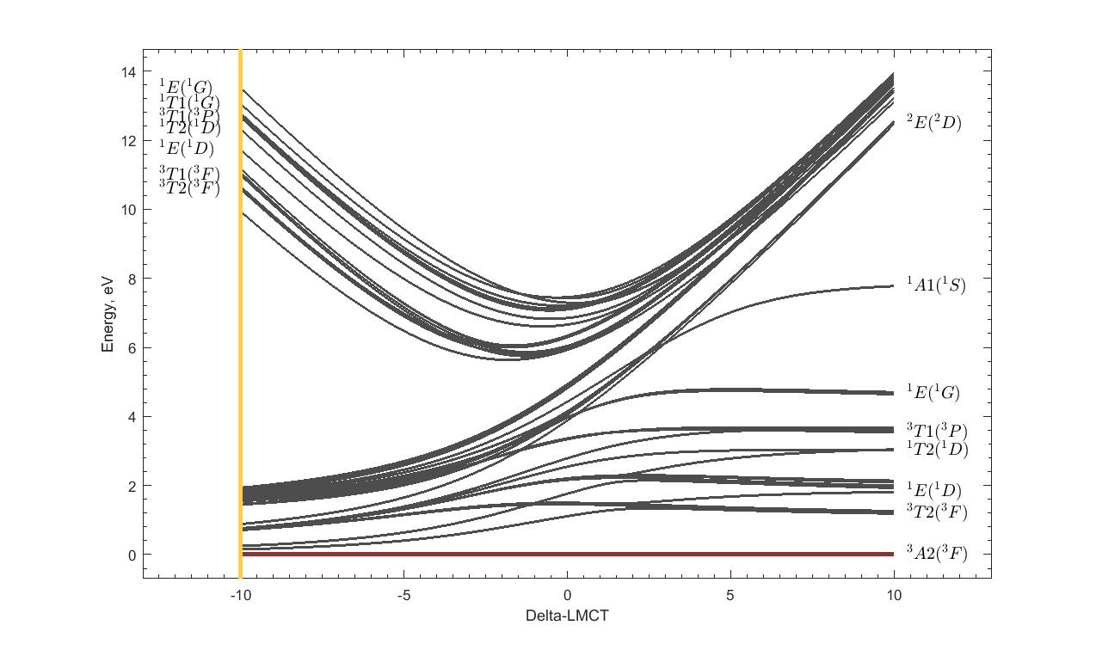
Tanabe-Sugano diagrams with charge transfer
Tanabe-Sugano with Charge transfer
α 3d⁸ + β 3d⁹L
NiO
Cu³⁺

Slide 64
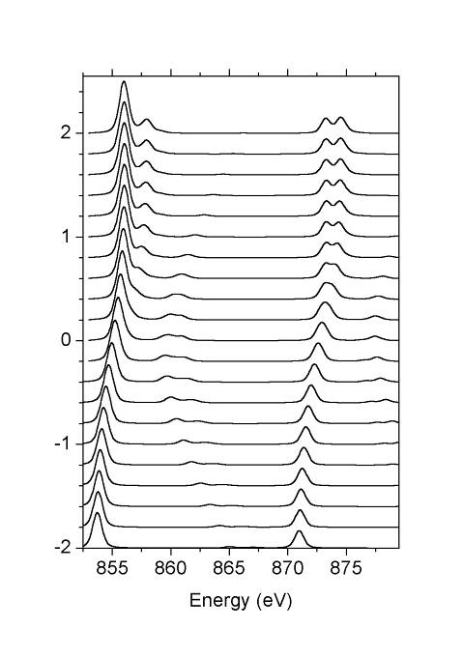
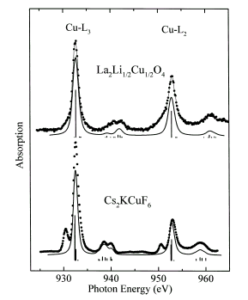
Charge transfer effects in XAS
Charge Transfer effects
3d⁸ + 3d⁹L
Δ=10
30% 3d⁸
¹A₁
Δ=5
NiO
Δ=0
La₂Li_{½}Cu_{½}O₄
30% 3d⁸
³A₂
Δ=-5
Δ=-10
Chem. Phys. Lett. 297, 321 (1998)

Slide 65
LMCT and MLCT: π - bonding
Fe^{III}: Ground state: 3d⁵ + 3d⁶L
3d⁶L
3d⁵
2p⁵3d⁷L
2p⁵3d⁶
Δ
Δ+U-Q ≈ Δ
with Ed Solomon (Stanford) JACS 125, 12894 (2003),
JACS 128, 10442 (2006), JACS 129, 113 (2007)

Slide 66
LMCT and MLCT: π - bonding
Fe^{III}: Ground state: 3d⁵ + 3d⁶L + 3d⁴L
2p⁵3d⁵L
2p⁵3d⁷L
2p⁵3d⁶
3d⁴L
3d⁶L
3d⁵
Δ_{π}-U+Q ≈ Δ_{π} + 2
Δ_{π}
Δ
Δ+U-Q ≈ Δ - 2
with Ed Solomon (Stanford) JACS 125, 12894 (2003),
JACS 128, 10442 (2006), JACS 129, 113 (2007)

Slide 67
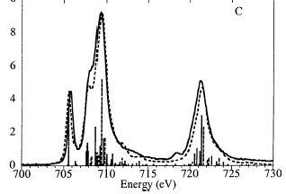
LMCT and MLCT: π - bonding
Fe^{III}(tacn)₂
Fe^{III}(CN)₆
with Ed Solomon (Stanford) JACS 125, 12894 (2003),
JACS 128, 10442 (2006), JACS 129, 113 (2007)

Slide 68
Multiplet calculations
Calculated for an atom/ion
Valence and core spin-orbit coupling
Core and valence electron-electron interaction.
Comparison with experiment
Core hole potential and lifetime
Local symmetry (crystal field)
Spin-spin interactions (molecular field)
Core hole screening effects (charge transfer)
Notes:
68

Slide 69
First Principle Multiplet calculations
Calculated for an atom/ion
Valence and core spin-orbit coupling
Core and valence electron-electron interaction.
Comparison with experiment
Core hole potential and lifetime
Local symmetry (crystal field)
Spin-spin interactions (molecular field)
Core hole screening effects (charge transfer)
Notes:
69

Slide 70
2p XAS first-principle codes
SOLIDS
Band structure multiplet (Haverkort, Green, Hariki)
Cluster DFT multiplet (Ikeno, Ramanantoanina, Delley)
MOLECULES
Restricted Active Space CI (Odelius, Kuhn)
Restricted Open-shell CI (Neese)
TDDFT/BSE
Time-Dependent DFT (Joly)
Bethe-Salpeter (Rehr, Shirley)
Multi-channel Multiple-scattering (Kruger)
Notes:
70

Slide 71
Iron 1s XAS
Overview
XAS
MCD
XPS
RIXS
Notes:
71

Slide 72
Iron 1s XAS
2p XAS
X
I(w)
Γ_{2p}= 0.2 eV
Notes:
72

Slide 73
Iron 1s XAS
2p XMCD
X
I⁺(w)- I⁻(w)
Γ_{2p}= 0.2 eV
Left and right polarized x-rays
Notes:
73

Slide 74
Iron 1s XAS
2p XPS
Large screening
I(E_{k})
Γ_{2p}= 0.2 eV
_{(additional broadening)}
Notes:
74

Slide 75
Iron 1s XAS
2p3d RIXS
X
I(w,w’)
Fixed energy loss
Γ_{3d}= 10 meV?
Electronic, magnetic, vibrational
Notes:
75

