Slide 1
Polarization, geometry dependence, sum rules and tensor formulation in XAS and RIXS
Michelangelo Tagliavini
European Xfel,
michelangelo.tagliavini@xfel.eu

Slide 2
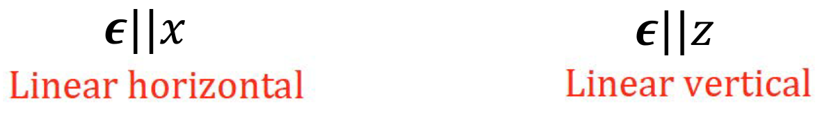
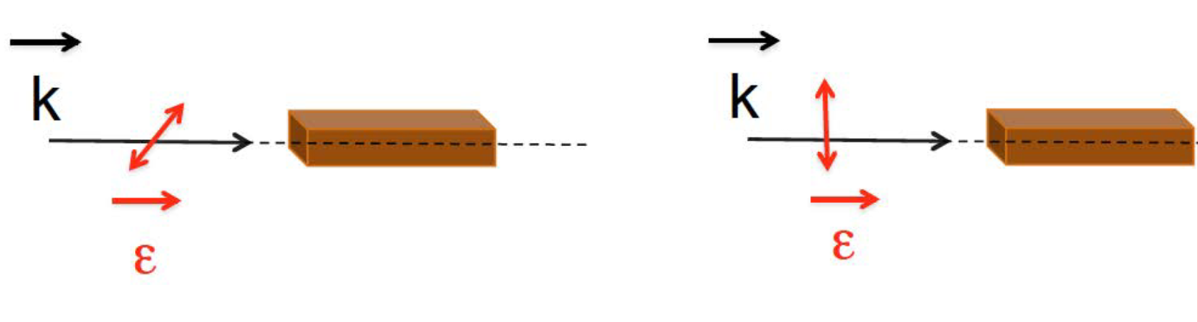
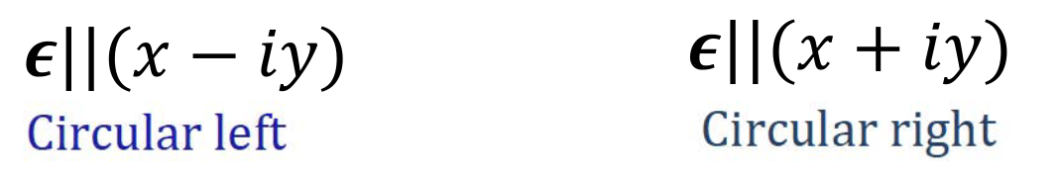
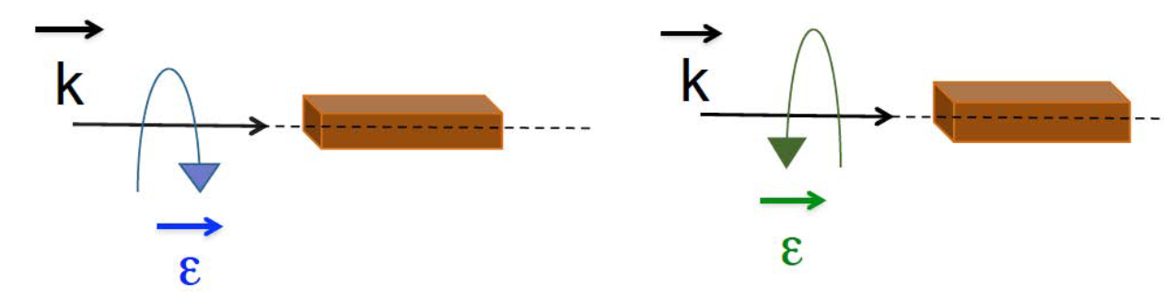
Dichroism
y
Linear
Circular
Images: H. Elnaggar
Notes:
I think most of us are familiar with dichroism in the optical regime from our daily lives. For example from polarized glasses and how it avoids glare.
Glare tends to happen when lightwaves strike a flat surface, causing the light to reflect, or bounce off the surface, in a horizontal manner (brewster law). This causes the light to be intense, which can hurt the eyes and make it more difficult to see.
The filters on polarized lenses absorbs LH light and hence stops the glare.

Slide 3

Dichroism
Avoid glare (LH light)
Dichroism:
Difference of the propagation of light measured with
two orthogonal polarization
states of the incoming light
Slide: H. Elnaggar
Notes:
I think most of us are familiar with dichroism in the optical regime from our daily lives. For example from polarized glasses and how it avoids glare.
Glare tends to happen when lightwaves strike a flat surface, causing the light to reflect, or bounce off the surface, in a horizontal manner (brewster law). This causes the light to be intense, which can hurt the eyes and make it more difficult to see.
The filters on polarized lenses absorbs LH light and hence stops the glare.

Slide 4
Introduction to X-ray dichroism
Measurement:
Linear Dichroism (LD):
Difference measured with LH / LV
Circular Dichroism (CD):
Difference measured with CR / CL
Origin:
Magnetic Dichroism (MD):
Difference in magnetic system
Natural Dichroism (ND):
Difference in structurally distorted system
Magneto-chiral Dichroism (MχD):
Difference in a magnetic + chiral system
And more …
Slide: H. Elnaggar
Notes:
So similar to the optical regime, dichrosim effect is also present in the x-ray regime.
And there are many different types of dichroism and classifications.
For example, it can be classified according to the measurement. So in this case we can say that it is linear dichroism when it is measured with linear light.

Slide 5
Why do we need X-ray dichroism?
The measurement of dichroism is often challenging…
Control polarization, orientation of sample, single crystals required, several measurements …
but provides access to properties that can be lost in the average measurements!
What we will discuss:
How can we understand X-ray polarization dependence and dichroism?
X-ray Linear (XLD) and Magnetic circular Dichroism (XMCD)
Can we predict all X-ray dichroism effects?
Extensions to RIXS.

Slide 6
Core to Valence transition Operator
https://en.wikipedia.org/wiki/Rubber_duck

Slide 7
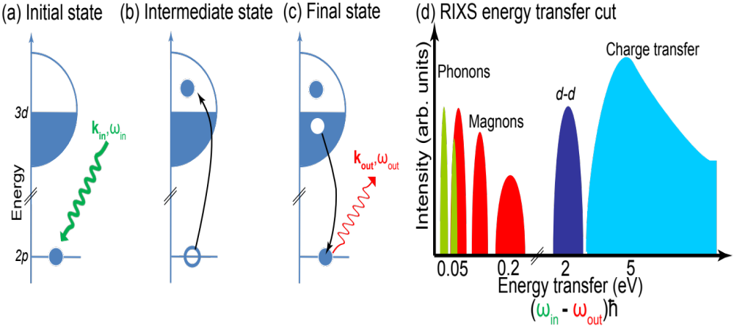
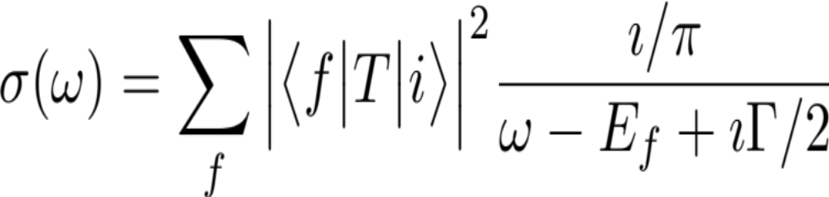
Excitations in XAS
Fermi golden rule!
Transition operator
Initial state
Final state
Slide: H. Elnaggar

Slide 8
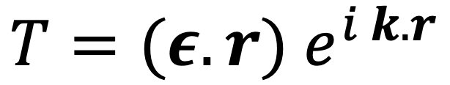

Electric light-matter excitations
Wave vector
Polarization vector
Position vector
Taylor expansion:
Slide: H. Elnaggar
Dipole
Quadrupole

Slide 9



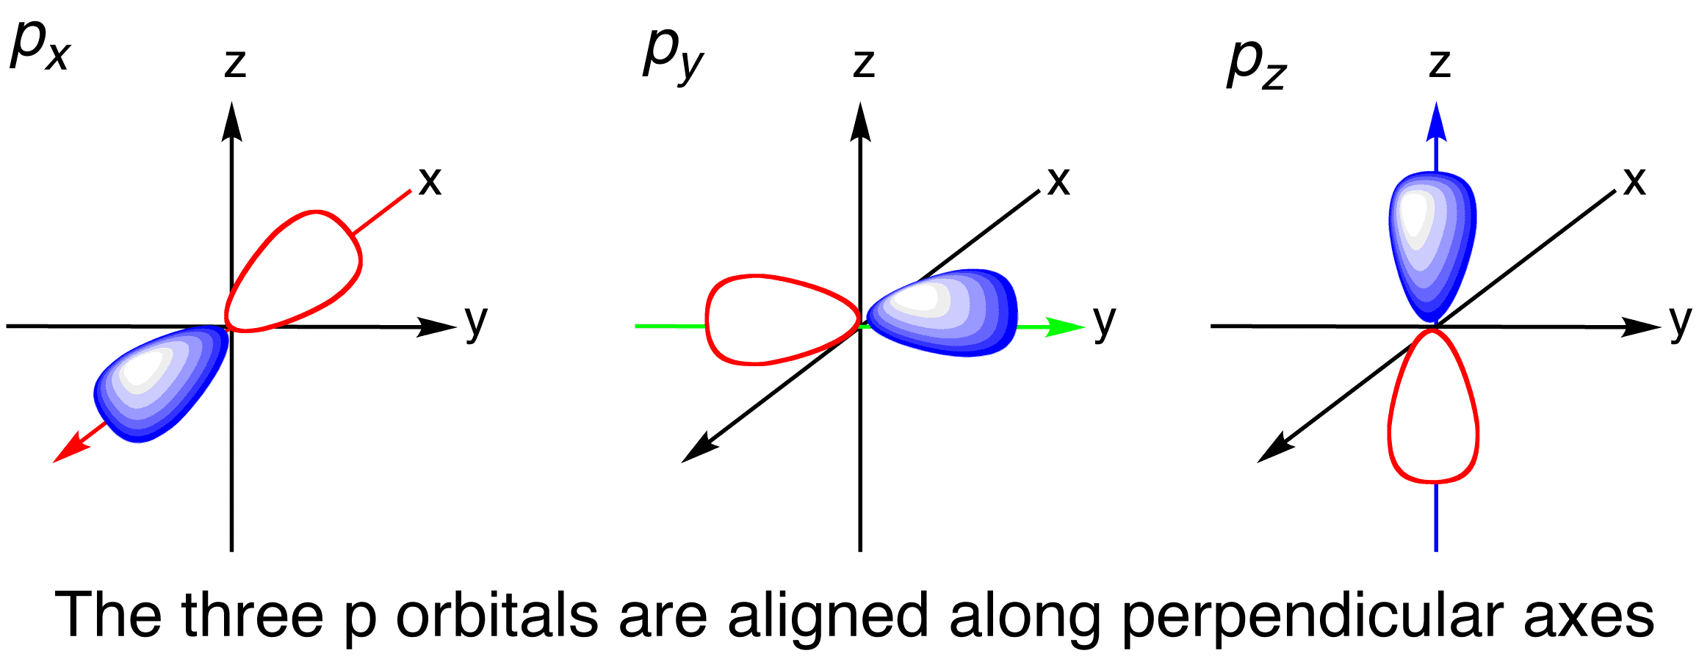



Dipole transition operator
Dipole:
Expression in terms of l=1 spherical harmonics (p orbitals):
Defined wrt to the crystal axes
Slide: H. Elnaggar
Examples: TM L2,3 , Ln, An M4,5 edges

Slide 10
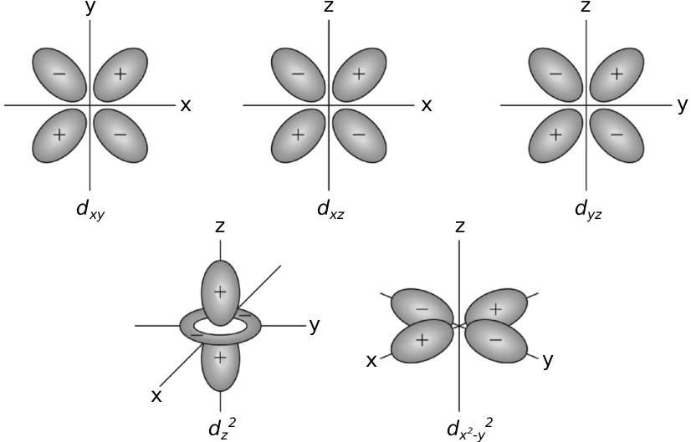


Quadrupole transition operator
Quadrupole:
Expression in l=2 spherical harmonics (d orbitals):
Examples: transition operator used for TM K pre-edges .
Slide: H. Elnaggar

Slide 11
Xray Linear Dichroism (XLD)
https://en.wikipedia.org/wiki/Rubber_duck

Slide 12
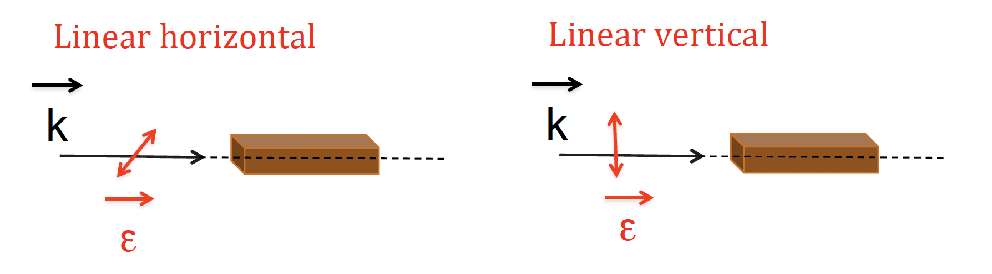


X-ray Linear Dichroism in Oh Cu²⁺
e_{g}:(d_{x}²_{- y}², d_{z}²)
d⁹
t_{2g}:(d_{xy}, d_{zy}, d_{zx})
Slide: H. Elnaggar

Slide 13

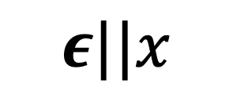
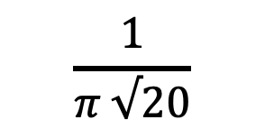
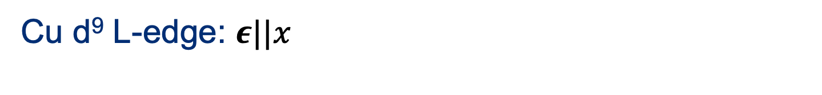
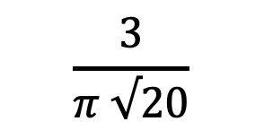
X-ray Linear Dichroism in Oh Cu²⁺
Dipole
(think p orbitals)
3d electron
(think d orbitals)
2p electron
(think p orbitals)
<f| | T | |i>
z
z
y
y
x
x
z
z
y
y
x
x
Slide: H. Elnaggar

Slide 14

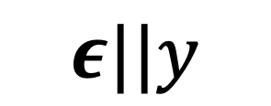
X-ray Linear Dichroism in Oh Cu²⁺
Dipole
(think p orbitals)
3d electron
(think d orbitals)
2p electron
(think p orbitals)
<f| | T | |i>
z
z
y
y
x
x
z
z
y
y
x
x
Slide: H. Elnaggar

Slide 15

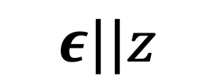
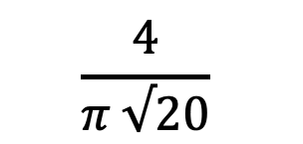
X-ray Linear Dichroism in Oh Cu²⁺
Dipole
(think p orbitals)
3d electron
(think d orbitals)
2p electron
(think p orbitals)
<f| | T | |i>
z
z
y
y
x
x
z
y
x
Slide: H. Elnaggar

Slide 16
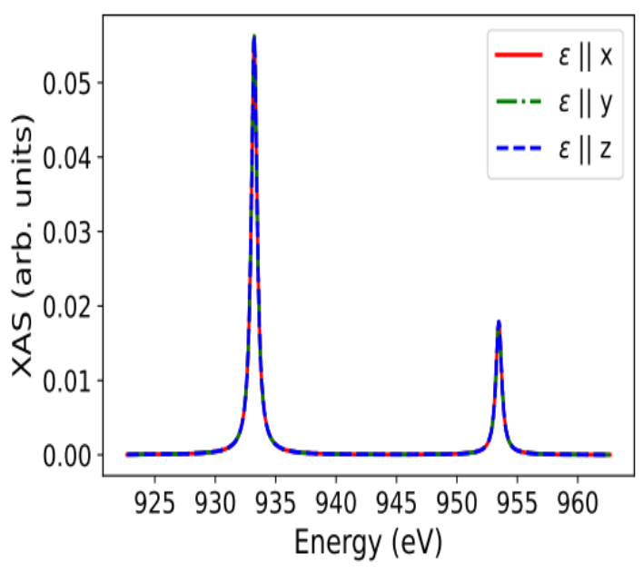
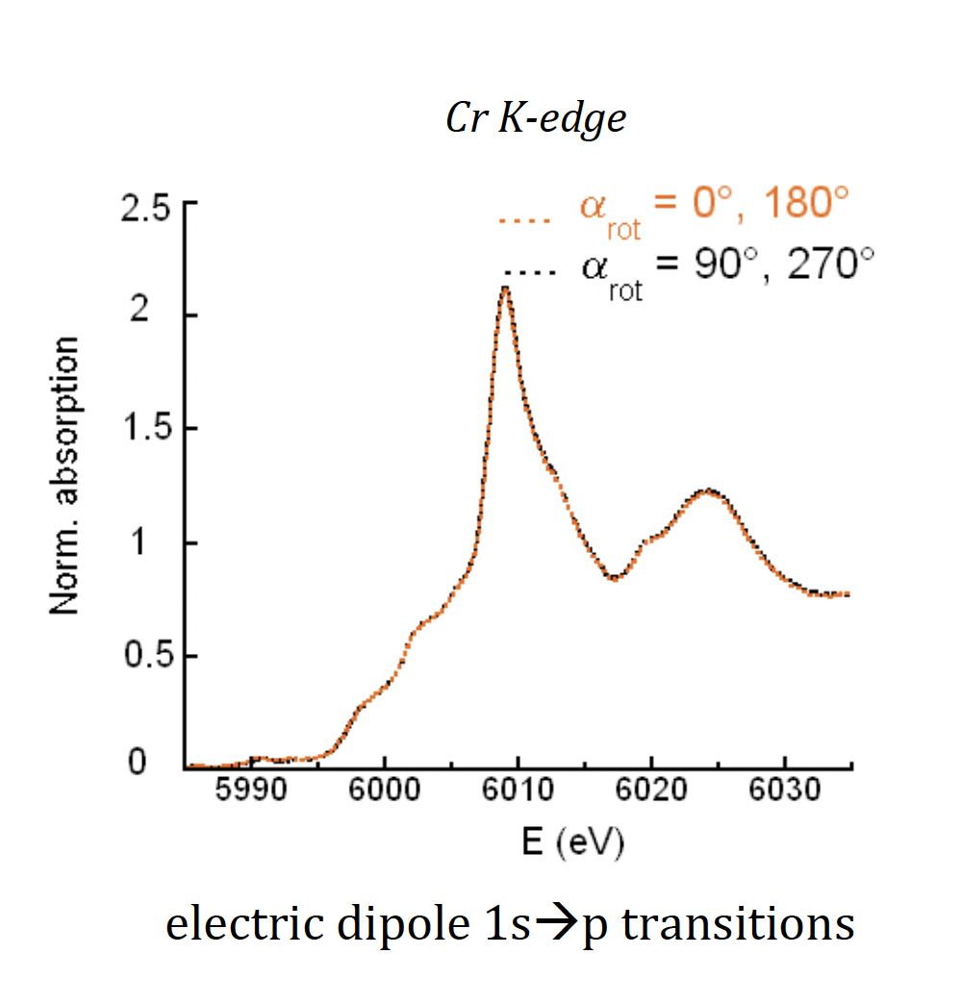
X-ray Linear Dichroism in Oh symmetry
Quanty Calculation of L2,3 XAS of Oh Cu²⁺
Experimental results of K-edge XAS of Oh Cr³⁺ in MgAl2O4
Dipole: p -> d
Dipole: s -> p
Juhin et. al., Phys. Rev. B 78, 195103, 2008
Dipole transition in Oh symmetry are isotropic !
Slide: H. Elnaggar

Slide 17

Dipole XLD in reduced symmetry
b_{1g}:(d_{x}²_{- y}² )
a_{1g}:(d_{z}²)
Elongated Oh
d⁹
b_{2g}:(d_{xy})
e_{g}:( d_{zy}, d_{zx})
Slide: H. Elnaggar

Slide 18
X-ray Linear Dichroism in D_{4h} Cu²⁺
Dipole
(think p orbitals)
3d electron
(think d orbitals)
2p electron
(think p orbitals)
<f| | T | |i>
z
z
y
y
x
x
Slide: H. Elnaggar

Slide 19
X-ray Linear Dichroism in D_{4h} Cu²⁺
Dipole
(think p orbitals)
3d electron
(think d orbitals)
2p electron
(think p orbitals)
<f| | T | |i>
z
z
y
y
x
x
Slide: H. Elnaggar

Slide 20
X-ray Linear Dichroism in D_{4h} Cu²⁺
Dipole
(think p orbitals)
3d electron
(think d orbitals)
2p electron
(think p orbitals)
<f| | T | |i>
z
y
x
Slide: H. Elnaggar

Slide 21
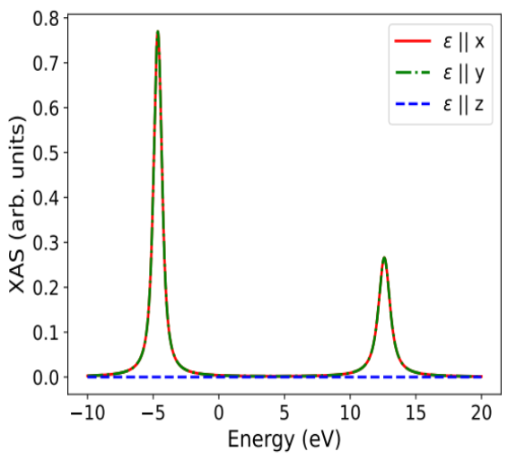
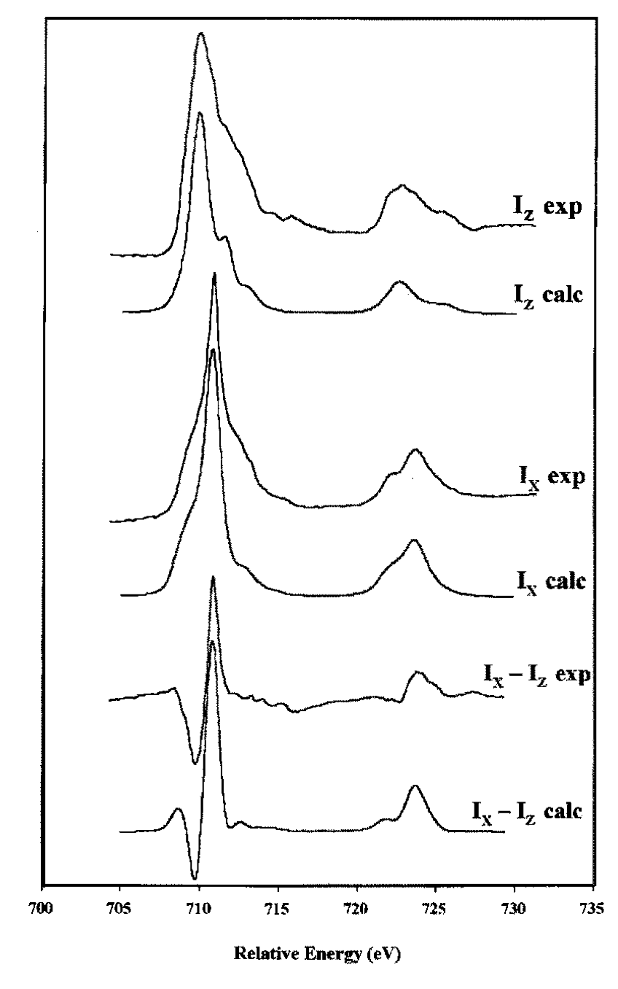
X-ray Linear Dichroism in D_{4h} symmetry
Quanty Calculation of L2,3 XAS of D_{4h} Cu²⁺
Experimental results of L2,3 XAS of D_{4h} Fe²⁺
Dipole transition in lower symmetries give rise to X-ray Linear Dichroism
XLD tells us which holes are these
Schofield et. al., Miner. B 62, 65, 1998
Slide: H. Elnaggar

Slide 22
Xray Magnetic Circular Dichroism (XMCD)
https://en.wikipedia.org/wiki/Rubber_duck

Slide 23
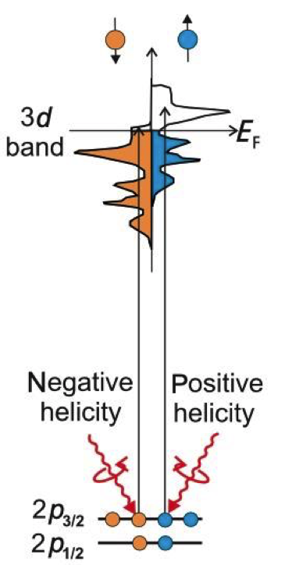
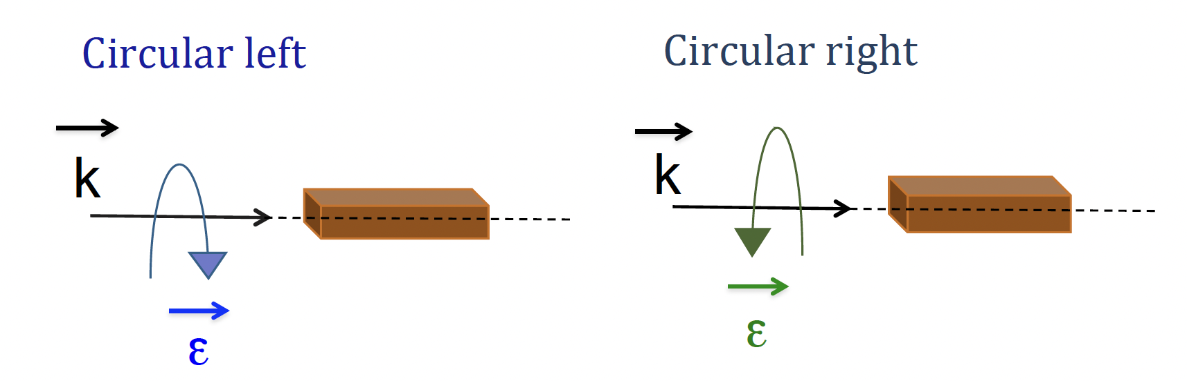
X-ray Magnetic Circular Dichroism (XMCD)
For ferro/ferri-magnetic materials
B
B
At L3,2 edges:
Valence band has a spin-imbalance due to the magnetic ordering
Right- and left-circularly polarized photons carry opposite momentum (+1, -1)
Angular momentum of the photon interacts with the spin of the electron by means of the SOC
Thole et. al., Phys. Rev. lett. (1992). 68
Slide: H. Elnaggar
Notes:
Angular momentum of the photon interacts with the spin of the electron by means of the SOC (Fano effect).
◮ Right- and left-circularly polarized photons carry opposite momentum ⇒ there is a spin imbalance in the photocurrent produced by the right- and left-circularly polarized x-rays.
2. Valence band acts as a spin detector for the (spin-imbalanced) photocurrent.

Slide 24
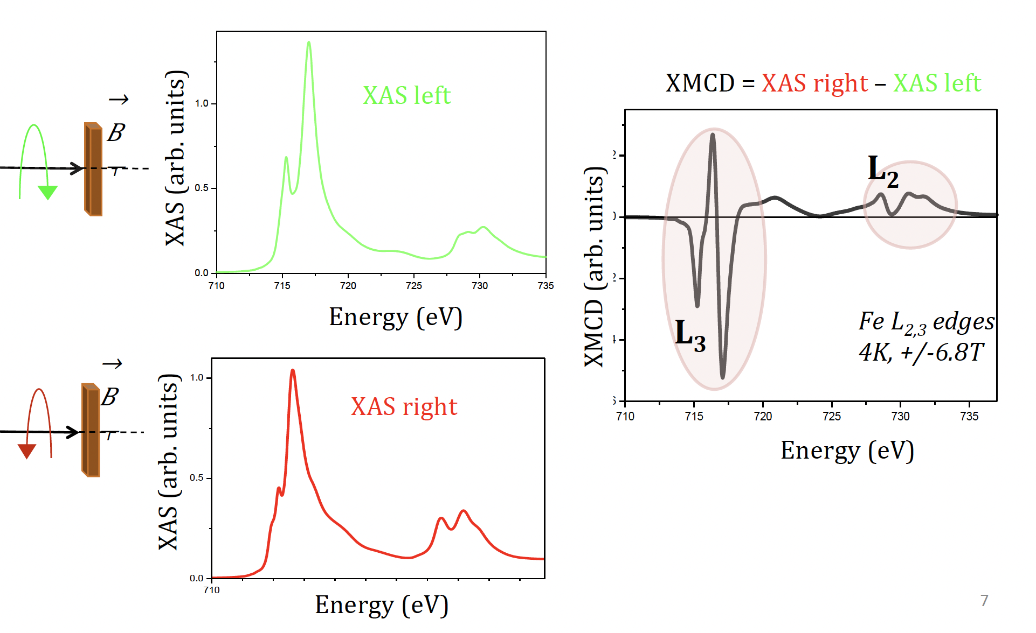
XMCD in CoFe₂O₄
Experimental results of Fe L2,3 XMCD
Sum rules:
Relate dichroism to the average ground state magnetic moment
Slide: H. Elnaggar

Slide 25
The XAS conductivity tensor
https://en.wikipedia.org/wiki/Rubber_duck

Slide 26



General expression of the XAS

Slide 27

General expression of the XAS
Rank 2, dim. 3 tensor:
r_{X}Gr_{X} | r_{X}Gr_{y} | r_{X}Gr_{z}
r_{Y}Gr_{X} | r_{y}Gr_{y} | r_{y}Gr_{z}
r_{z}Gr_{X} | r_{z}Gr_{y} | r_{z}Gr_{z}
Off-diagonal: ->
y polarized light is changed by the system to an x polarized
Low symmetry system or magnetic system
Slide: H. Elnaggar

Slide 28
Application of group theory
The tensor reflects the local symmetry of the probed atomic position. Group theory gives compact rules to predict its form.
For dipole interactions, each photon couples an angular momentum l=1 to the sample.
Rank 2, dim. 3 tensor:
r_{X}Gr_{X} | r_{X}Gr_{y} | r_{X}Gr_{z}
r_{Y}Gr_{X} | r_{y}Gr_{y} | r_{y}Gr_{z}
r_{z}Gr_{X} | r_{z}Gr_{y} | r_{z}Gr_{z}
If the system is time reversal symmetric, the XAS tensor is symmetric!

Slide 29
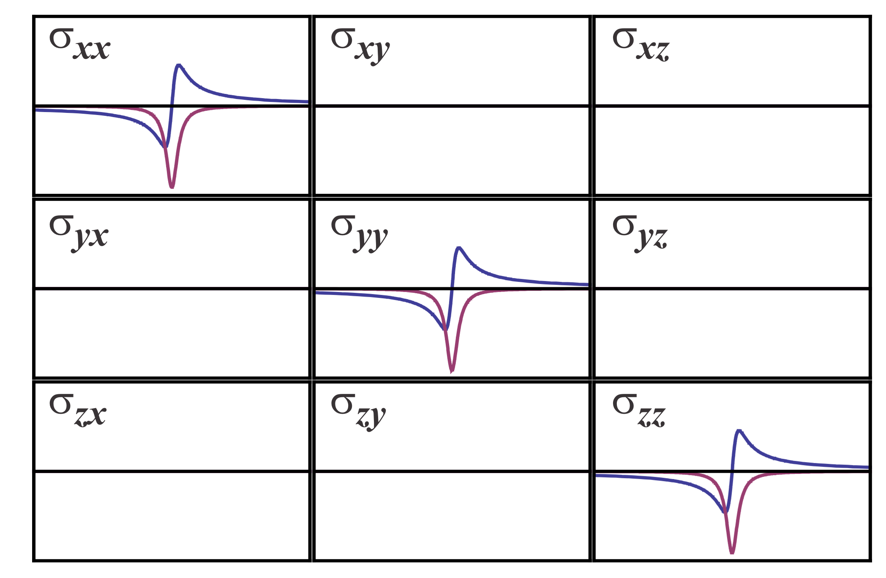
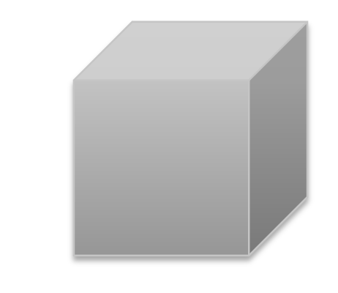
X-ray Linear Dichroism
Symmetry | x | y | z
Oh | t1g | t1g | t1g
εx
Oh
Images: M. W. Haverkort

Slide 30
X-ray Linear Dichroism
Symmetry | x | y | z
Oh | t1g
εz
Oh
Images: M. W. Haverkort

Slide 31
X-ray Linear Dichroism
Symmetry | x | y | z
Oh | t1g
ε= x+y
Oh
Images: M. W. Haverkort

Slide 32
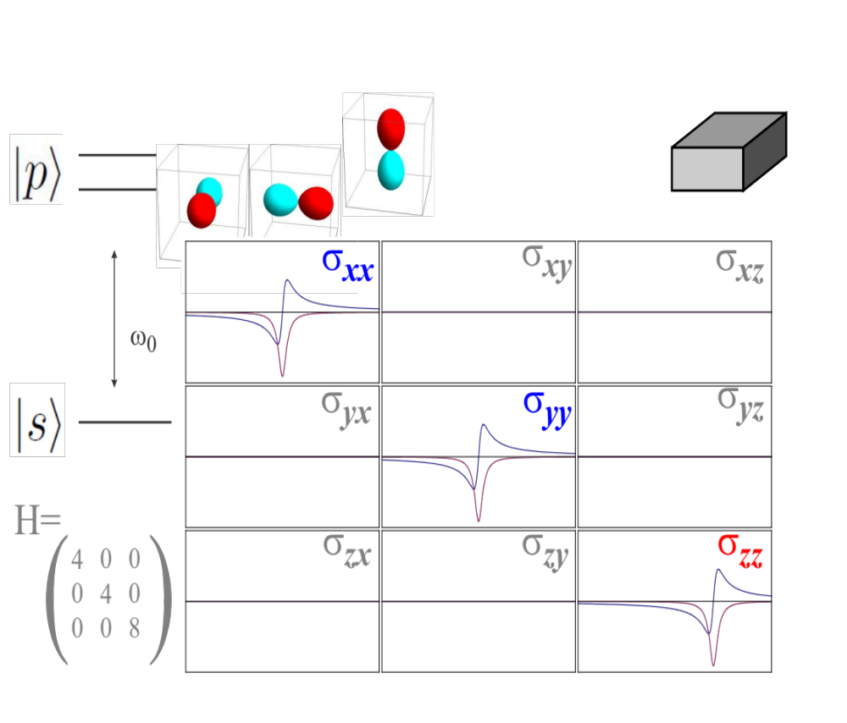
X-ray Linear Dichroism
Symmetry | x | y | z
D4h | eg |  | a2g
D4h
Images: M. W. Haverkort

Slide 33
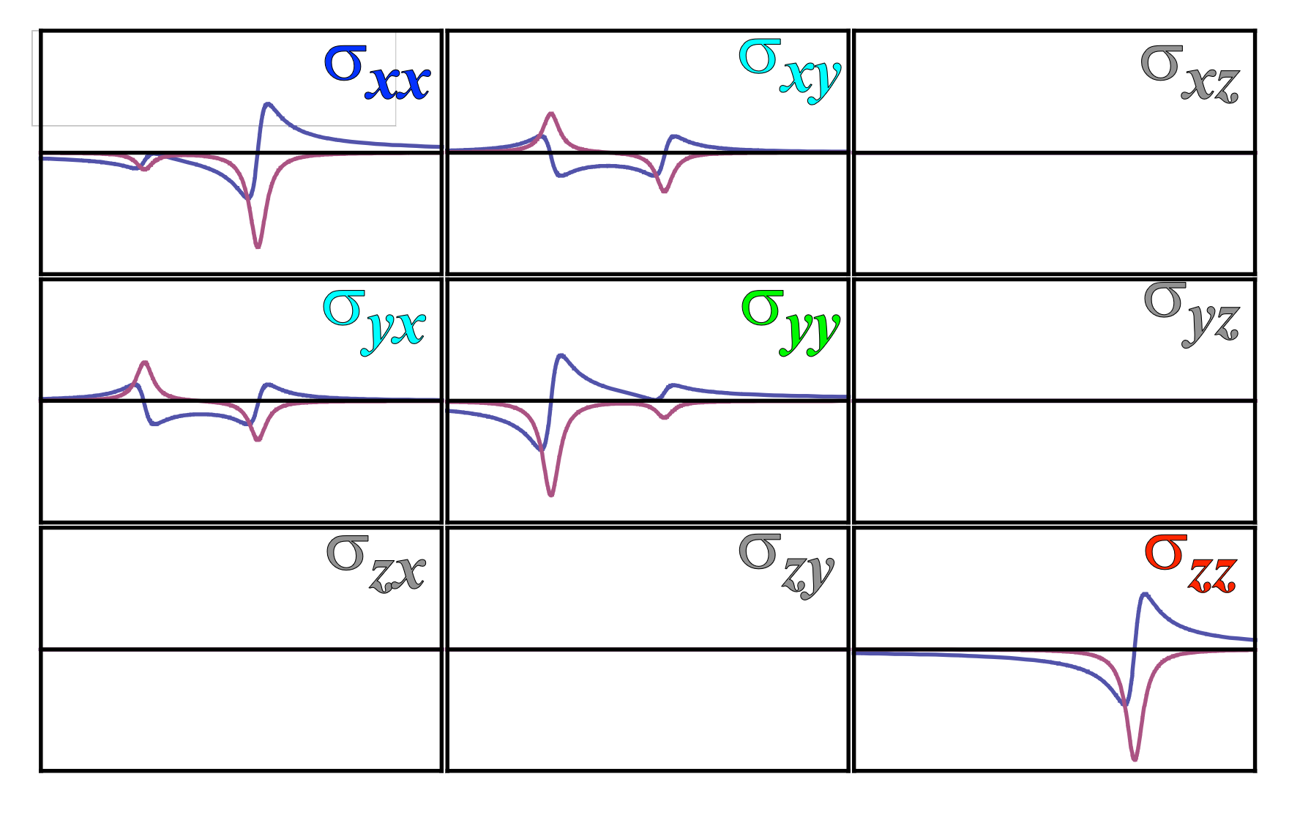
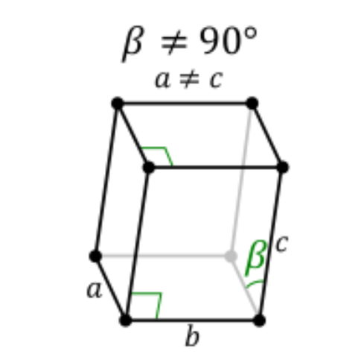
X-ray Linear Dichroism
Symmetry | x | y | z
c2 | b | b | a
Monoclinic
Images: A. Juhin

Slide 34
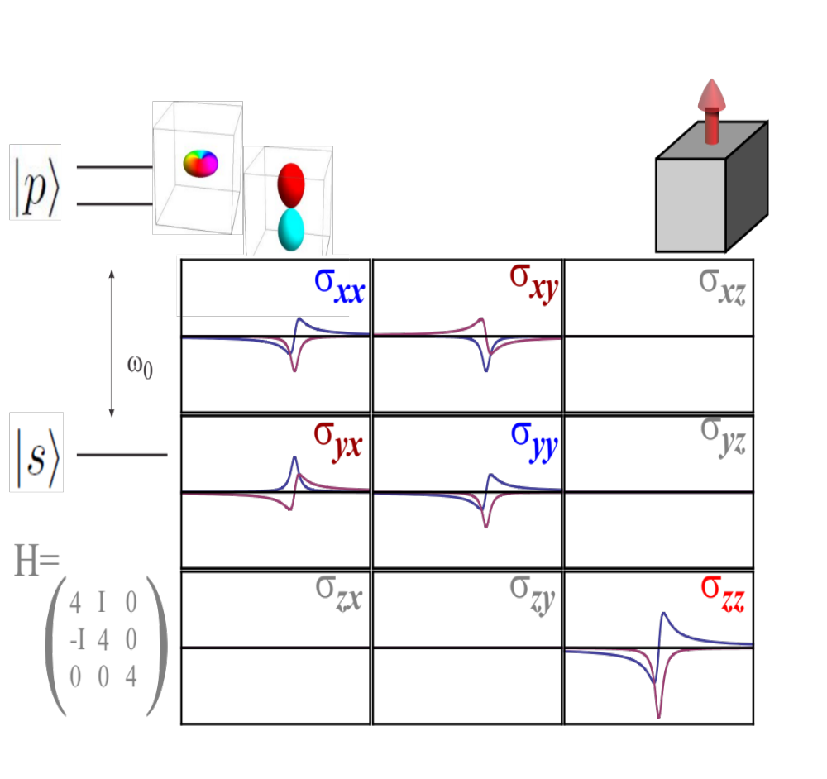
X-ray Magnetic Circular Dichroism
Magnetism breaks time reversal symmetry of <riGrj>.
This results in the asymmetry of the off-diagonal elements
Slide: H. Elnaggar

Slide 35
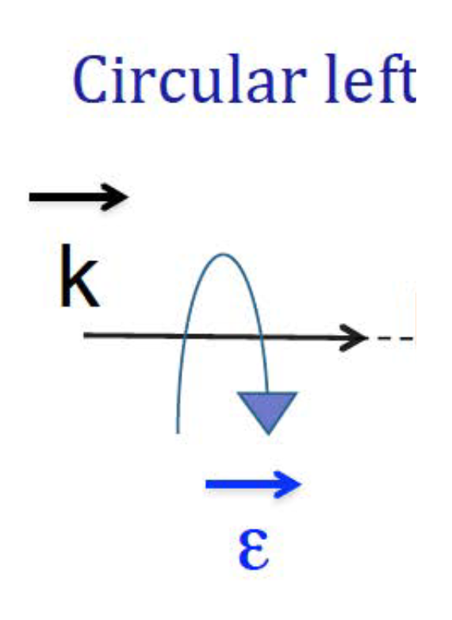
X-ray Magnetic Circular Dichroism
Images: H. Elnaggar

Slide 36
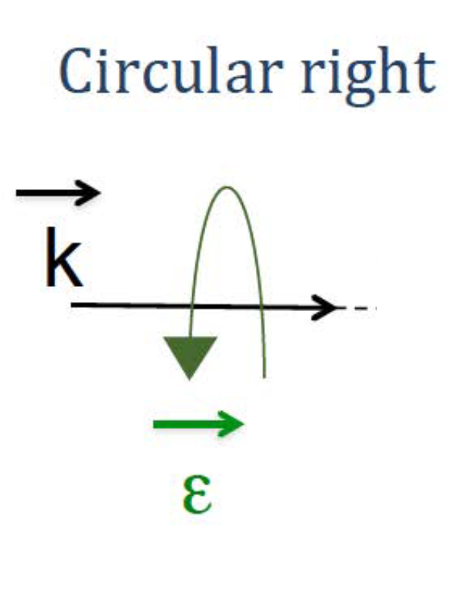
X-ray Magnetic Circular Dichroism
Images: H. Elnaggar

Slide 37
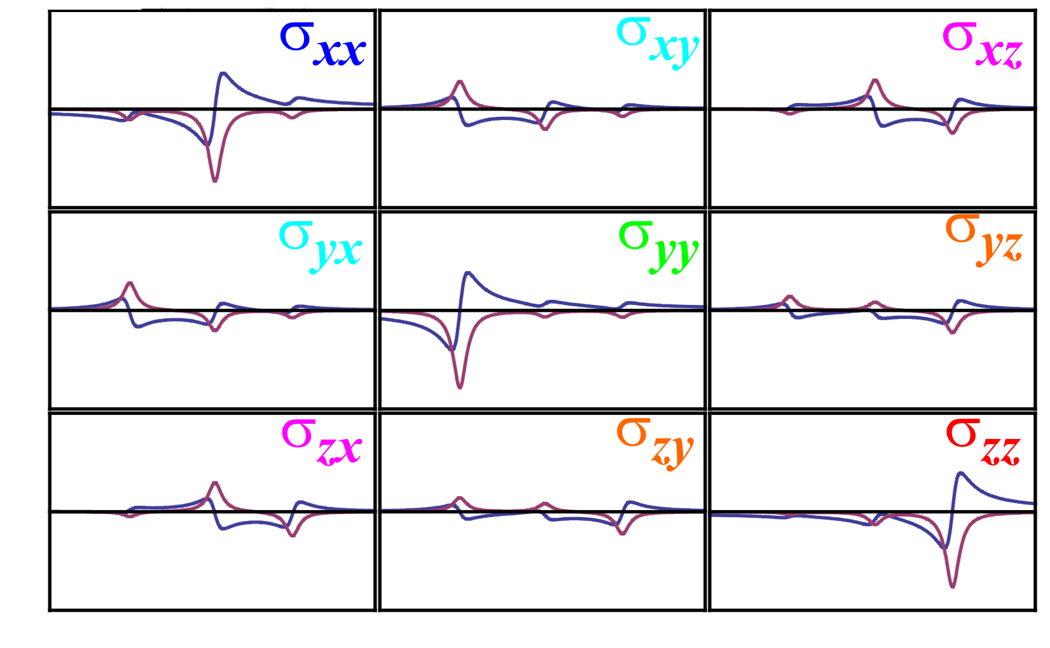
Rotations
e.g, rotate Oh
Images: A. Juhin

Slide 38

Solutions and Powders

Slide 39
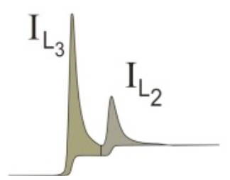
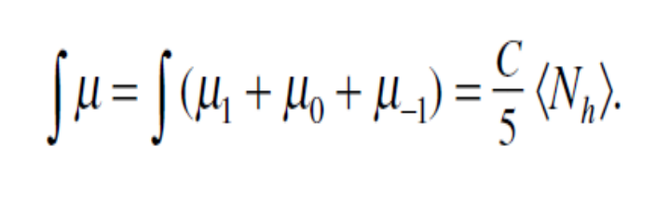
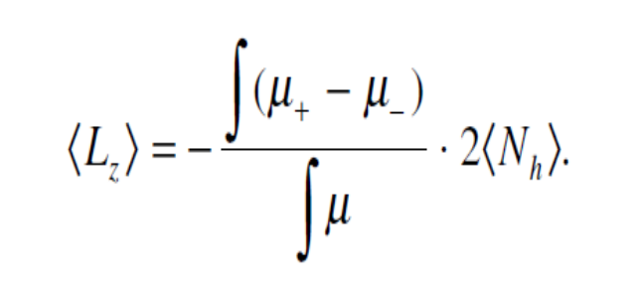
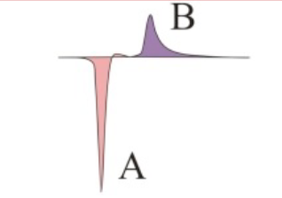
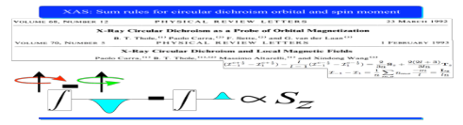
Sum Rules for XMCD
Thole et. al., Phys. Rev. lett, 68, 1992
Isotropic ∼ number of holes
XMCD ∼ avg orbital magnetic moment
XMCD ∼ avg spin magnetic moment
Slide: H. Elnaggar
Notes:
One can deduce ground state proper

Slide 40
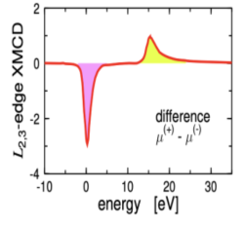
Sum Rules for XMCD
Thole et. al., Phys. Rev. lett, 68, 1992
XMCD ∼ avg spin magnetic moment
I^{1/2}(L2)
I^{3/2}(L3)
l is the angular momentum of the valence shell, here l=2.
Images: H. Elnaggar
Notes:
One can deduce ground state proper

Slide 41
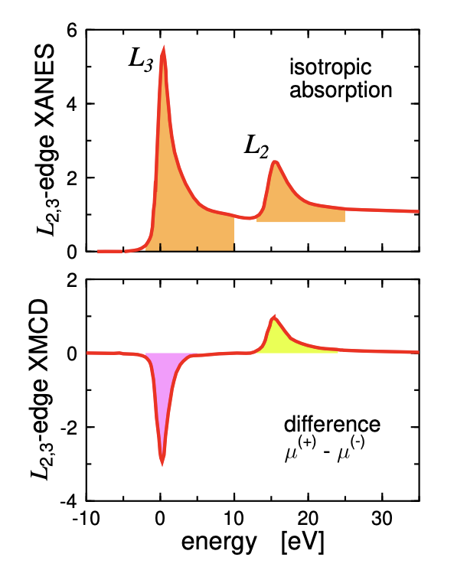

However …
Issues to consider:
Background removal
(edge position, mixing of edges, detection mode “FY?”)
Magnetic dipole term
Can be calculated by Quanty!
Slide: H. Elnaggar
Notes:
Tz : provides a measure of the anisotropy of the field of the spins when the atomic cloud is distorted, either by the spin-orbit interaction or by crystal-field effects [7].

Slide 42
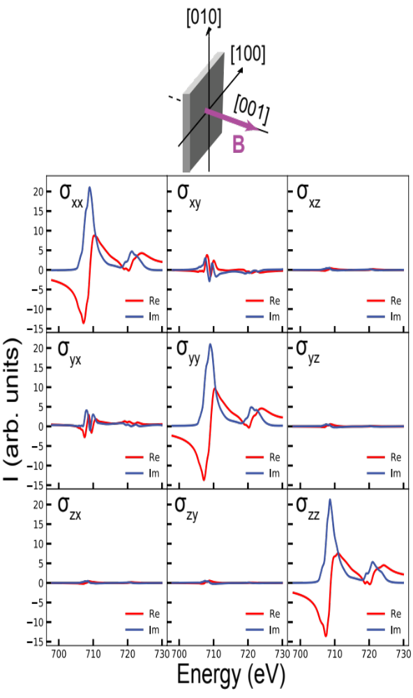
Measuring the Full XAS tensor
Here: Magnetite
(Fe3O4)
Nine linear independent measurements to construct the full tensor
Elnaggar et. al., J. Synchrotron Rad. (2021). 28, 247–258
Slide: H. Elnaggar

Slide 43
XAS- concluding Remarks
Dichroism is originated by local symmetry breaking of the system. Lower Symmetry (e.g. Oh to D4h)
    → Ground state degeneracy splits.
    → Final state energy also splits.
All dichroism effects can be represented in a compact way by the XAS conductivity tensor.
The XAS response function is time reversal symmetric. → asymmetry of the tensor is a signature of a magnetic system.
Sum rules can be used to extract occupation and orbital expectation values for the Ground state.

Slide 44
Repeat, but for RIXS
https://en.wikipedia.org/wiki/Rubber_duck

Slide 45
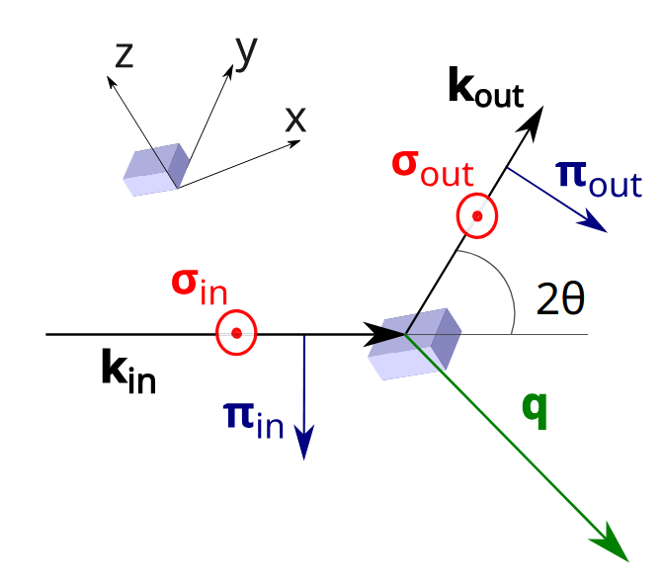

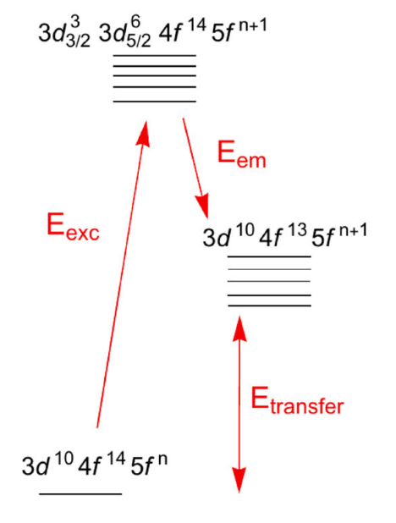


RIXS | Tensor formulation
Tagliavini, Wenzel, Haverkort, PRB 113, 195122 (2026)

Slide 46
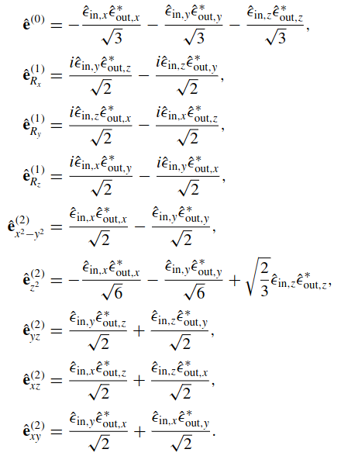
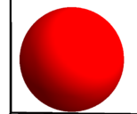
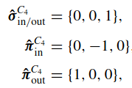
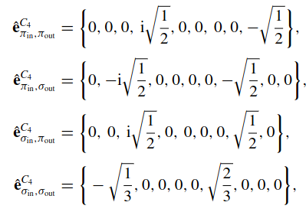
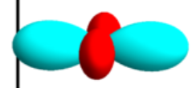
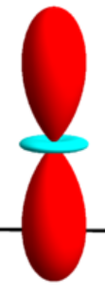



Polarization Basis in Cubic Harmonics
←Rotors.
l=1, but even
Mathematica Script in the tutorials!

Slide 47
Polarization Basis in Cubic Harmonics
Mathematica Script in the tutorials!

Slide 48
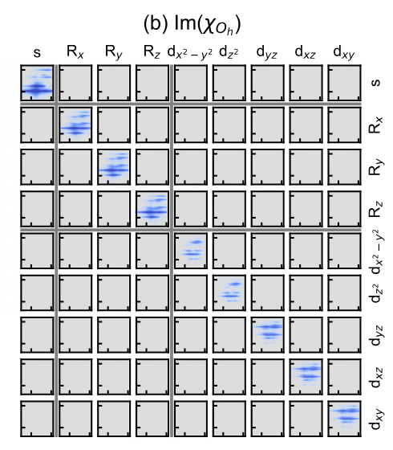


Spectrum in Oh

Slide 49


Spectrum in Oh

Slide 50



Point Group Theory → # of independent spectra
Here: q independent processes

Slide 51

Compute RIXS spectrum without polarization Filter
Fumagalli et. al. PHYSICAL REVIEW B 99, 134517 (2019)

Slide 52

Powder Averaging | Same as for XAS
Here: q independent processes

Slide 53



Powder Averaging
!New! Quanty function to compute powder spectra!
→ In order to get access to the third linear independent component, we need to have to measure in circular polarization for both ingoing and outgoing photons!

Slide 54


Dichroism Options in RIXS – “Linear Dichroism”
Fixed scattering Geometry, change linear and vertical ingoing polarization→ Change between composition of angular momentum transfer.
B. T, Chiogo, PHYSICAL REVIEW B 106, 075141 (2022)
2θ=90°

Slide 55



Dichroism Options in RIXS – Sample rotations
M. Moretti Sala et. al NewJ.Phys. 13 043026 (2011)
δ=+45°
2
-i2
2
LCO, 2θ=90°
*1/16
i2
2
2

Slide 56
Dichroism Options in RIXS – Sample rotations
M. Moretti Sala et. al NewJ.Phys. 13 043026 (2011)
δ=0°
4
2
-i2
2
1
*1/32
LCO, 2θ=90°
3
i2
2
2

Slide 57
Dichroism Options in RIXS – Sample rotations
M. Moretti Sala et. al NewJ.Phys. 13 043026 (2011)
δ=-45°
2
2
LCO, 2θ=90°
*1/16
2
2
Mathematica Script in the tutorials!

Slide 58


Dichroism Options in RIXS – RIXS-CD
I(left,z)-I(right,z)
Bext//z
-i
1
εout= z
+i
1
Circular right
-1
+i
-1
-i
Circular left
kin=z
Furo et. al. PHYSICAL REVIEW B 112, 214429 (2025)
RIXS tensor not invariant under time inversion→There is no symmetry of the tensor which are broken under magnetic ordering. → Cannot say if structural or magnetic driven

Slide 59


RIXS-CD – Chiral Magnons
Bext//z
“Altermagnons”?
εout= z
Circular right
Circular left
kin=z
Jost et. al. arXiv:2501.17380 (2025)
RIXS not invariant under time inversion→There is no symmetry of the tensor which are broken under magnetic ordering. → Cannot say if structural or magnetic driven

Slide 60


Selection rules for the RIXS final state: 3d⁹ D4h example
Due to the intermediate state spin-orbit interactions, double groups should be considered to get the exact selection rules. However, for shallow core holes or light elements, the main excitations are given by the single group selecton rules.

Slide 61
RIXS- concluding Remarks
The RIXS conductivity tensor is also sensitive to symmetry breaking.
  # Linear independent contributions depends on symmetry.
  Interpretation of RIXS tensor not straight forward.
Different way to control dichroism:
  Change polarization and scattering angle: vary χ⁽⁰⁾, χ⁽¹⁾ and χ⁽²⁾ spectral contribution.
  Rotate the sample: vary the dmixture of the sub-contributions for each l=1 and l=2.
Learned how to:
  Spectrum for no outgoing polarization analysis.
  Spectrum for Powders.
Extension to dispersive excitations and Quadrupole/Magnetic interactions possible.

Slide 62
Appendix
https://en.wikipedia.org/wiki/Rubber_duck

Slide 63

Spectrum in Oh

Slide 64

Dichroism Options in RIXS – “RIXS-CD” in coupled spherical harmonics basis
I(left)-I(right)
Bext//z
i2√3
εout= z
-i2√3
-3+√3
6
Circular right
-3+√3
6
kin=z

Slide 65

Bragg spectrometer as a polarization filter

Slide 66

Magnetite: Fe L_{3,2}-edge XAS
Magnetite: [Fe³⁺]_{Td} [Fe²⁺ , Fe³⁺]_{Oh}O₄
Ferrimagnetic system:
  We expect to measure XMCD and that the tensor has off-diagonal elements
The Fe²⁺ Oh are distorted to D_{3d}:
  We expect to measure XLD and that the tensor has different components in various directions
Slide: H. Elnaggar

Slide 67


Magnetite: Fe L_{3,2}-edge XAS
To get all elements:
9 independent measurements
Linear polarization (diagonals + symmetric off diagonals)
Circular polarization (asymmetric off diagonals)
Elnaggar et. al., J. Synchrotron Rad. (2021). 28, 247–258
Imaginary: measured
Real: transformation
Slide: H. Elnaggar

Slide 68

Building the tensor
Elnaggar et. al., J. Synchrotron Rad. (2021). 28, 247–258
Slide: H. Elnaggar

Slide 69

Analyzing the tensor: Diagonal XMLD
XMLD in dipole cubic
symmetry due to magnetism!
Elnaggar et. al., J. Synchrotron Rad. (2021). 28, 247–258
Slide: H. Elnaggar

Slide 70


Analyzing the tensor: XMCD
XMCD in cubic symmetry
Elnaggar et. al., J. Synchrotron Rad. (2021). 28, 247–258
Slide: H. Elnaggar

Slide 71


Analyzing the tensor: small distortion
Elnaggar et. al., J. Synchrotron Rad. (2021). 28, 247–258
XMLD signature of small non-cubic distortion leading to mixing of x-z direction
Slide: H. Elnaggar

