Slide 1
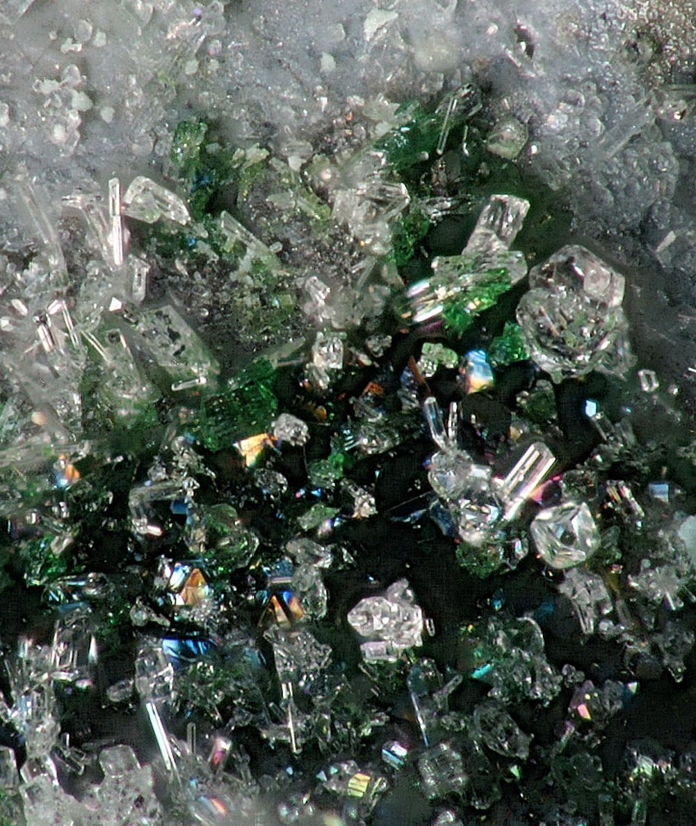
One Hamiltonian,
Many Approximations
An embedded-methods view of correlated electrons and core-level spectroscopy
Robert J. Green
Quanty Workshop · Heidelberg · 5 October 2026
Bunsenite (natural NiO), Kochhütte, Germany; field of view ≈ 1 mm.
Photo: Hannes Osterhammer, CC BY-SA 3.0 DE, cropped.

Slide 2
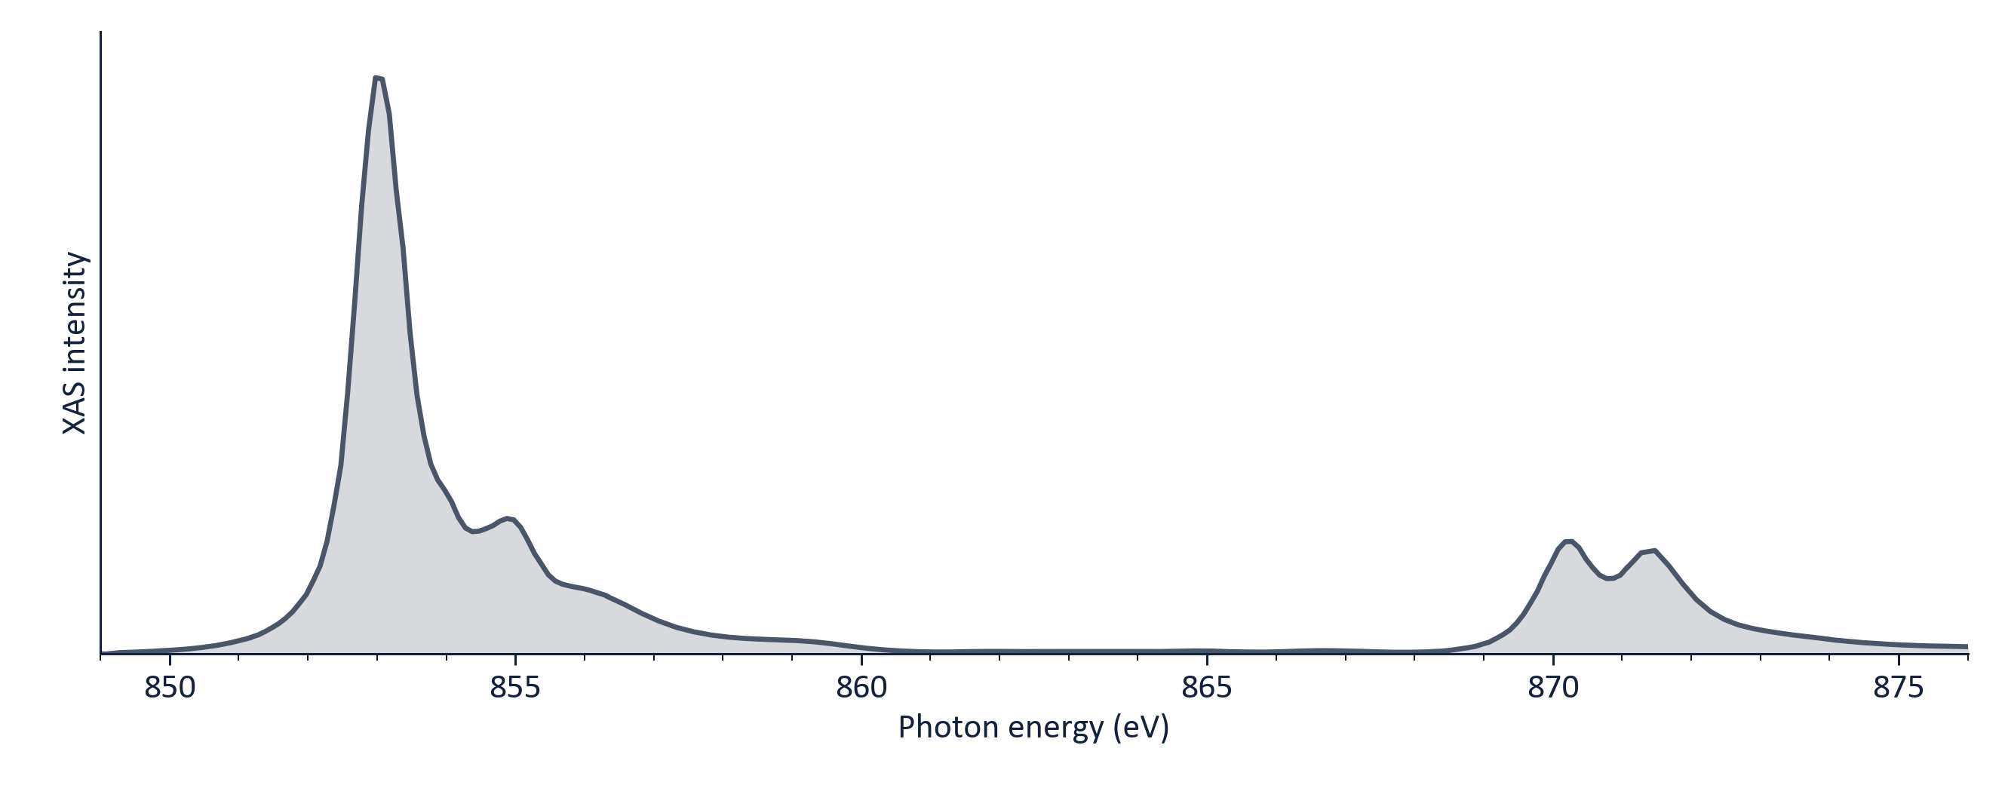
Here is a spectrum.
Where does every one of these peaks come from?
R. J. Green · Quanty Workshop, Heidelberg 2026
2

Slide 3
Why you're here
e⁻
↑↓
hν
Electronic structure
Magnetism
Spectroscopy
Which orbitals are occupied? How localized? How do they hybridize?
Spin and orbital moments, exchange, anisotropy, excitations
XAS, XPS, RIXS, PES, NIXS: using photons to ask the electrons
You want to know what the electrons in your material are doing, and you're using photons to ask them.
R. J. Green · Quanty Workshop, Heidelberg 2026
3

Slide 4
I
The dream
…and the exponential wall

Slide 5
The Theory of Everything
Electrons + nuclei: nothing in your sample is missing (to the accuracy spectroscopy needs)
electron kinetic
electron–nucleus
electron–electron
spin–orbit (relativistic)
nuclear kinetic
nucleus–nucleus
↑ the troublemaker
No new physics is needed to understand NiO. It is all in this one line.
cf. R. B. Laughlin & D. Pines, “The Theory of Everything”, PNAS 97, 28 (2000)
R. J. Green · Quanty Workshop, Heidelberg 2026
5

Slide 6
“
The underlying physical laws… are completely known,
…the difficulty is only that the exact application of these laws leads to equations much too complicated to be soluble.
P. A. M. Dirac, Proc. R. Soc. Lond. A 123, 714 (1929)
This whole week is about that “difficulty”.
R. J. Green · Quanty Workshop, Heidelberg 2026
6

Slide 7
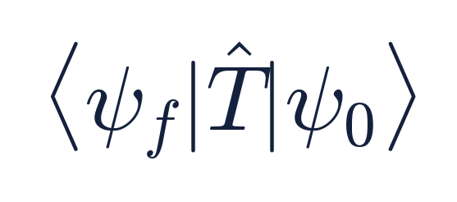
The dream workflow
Write down Ĥ
Solve ĤΨ = EΨ
|ψ₀⟩, |ψ_{f}⟩
Spectrum
For N electrons, Ψ is a function of 3N coordinates. That is the whole problem.
R. J. Green · Quanty Workshop, Heidelberg 2026
7

Slide 8
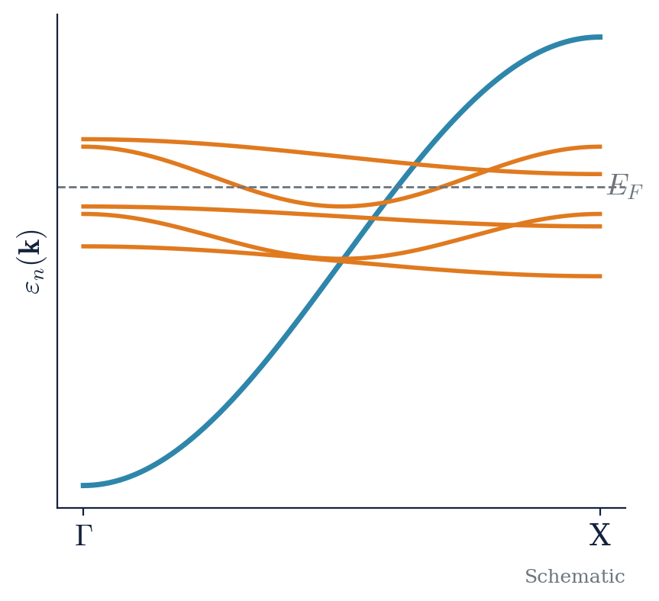
When the dream comes true
Non-interacting electrons: one-electron theory
N electrons → one 3-D equation
however large N is.
Every electron gets its own orbital φ_{n}
This is why band theory and DFT are everywhere
Thursday: how far DFT takes you (Shokri & Ackermann)
R. J. Green · Quanty Workshop, Heidelberg 2026
8

Slide 9
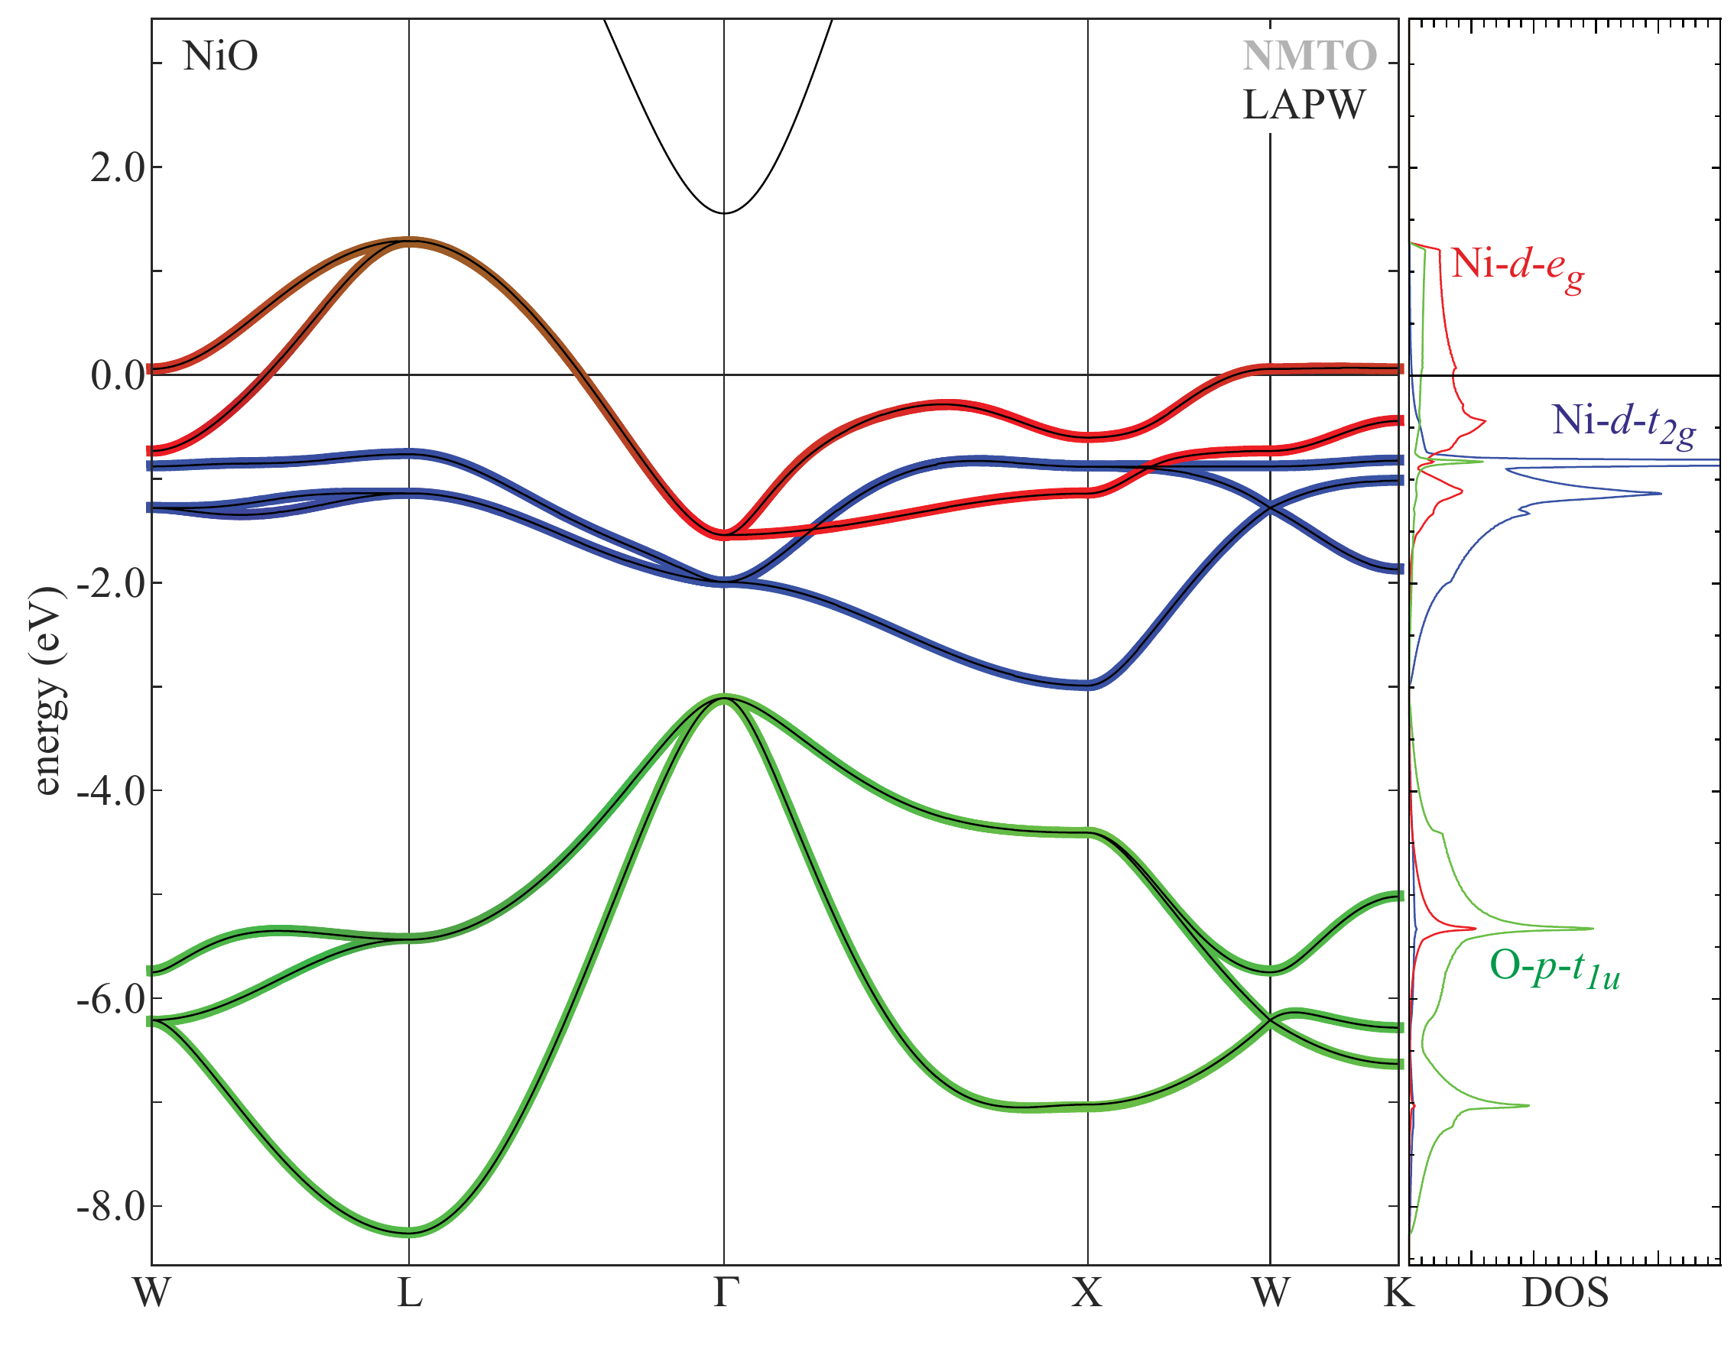
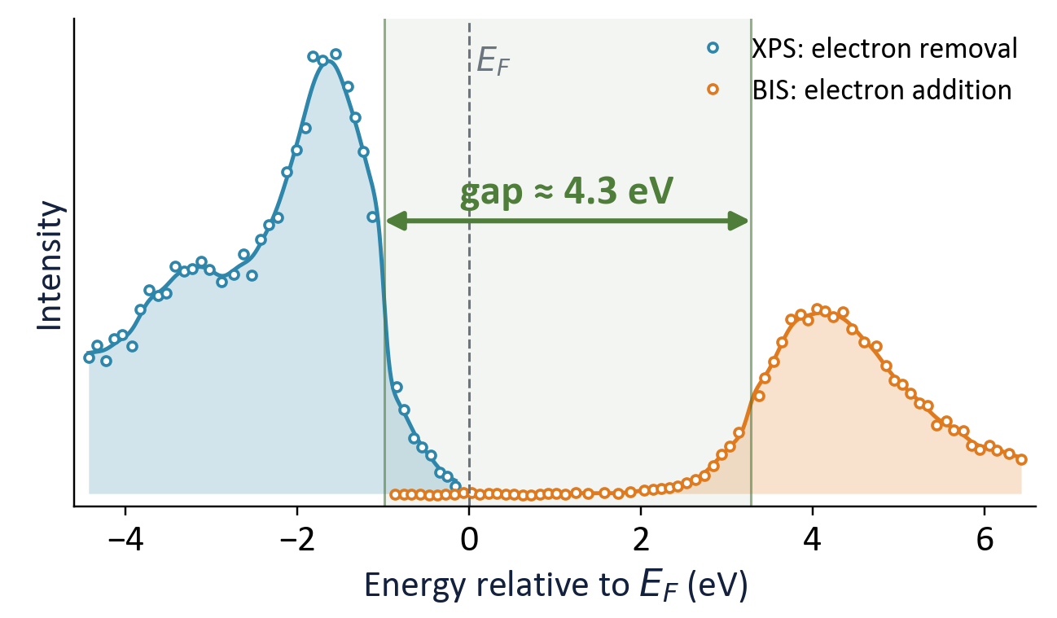
DFT meets NiO
The one-electron picture fails for our protagonist
Theory: LDA band structure
Experiment: photoemission + inverse photoemission
Non-magnetic LDA: E_{F} cuts through the Ni e_{g} bands, so NiO comes out a metal.
M. W. Haverkort, M. Zwierzycki & O. K. Andersen, PRB 85, 165113 (2012)
Cleaved NiO single crystal, XPS + BIS at 1486.6 eV. Data digitized from G. A. Sawatzky & J. W. Allen, PRL 53, 2339 (1984), Fig. 1, and re-plotted.
0–0.3 eV
LDA gap (0.3 eV only with AFM order)
≈ 4.3 eV
measured gap
T > 523 K
still insulating above T_{N}
R. J. Green · Quanty Workshop, Heidelberg 2026
9

Slide 10
Interacting electrons have no private wavefunction
Two sites, two electrons (one ↑, one ↓): the smallest correlated problem
U = 0
U = 8t
A
t
B
↓ on A
↓ on B
↓ on A
↓ on B
25%
25%
3%
47%
↑ on A
50%
↑ on A
50%
Hopping t
Electrons lower their kinetic energy by spreading over both sites, each ignoring the other.
25%
25%
47%
3%
↑ on B
50%
↑ on B
50%
50%
50%
totals
50%
50%
totals
Every entry = 50% × 50%: independent electrons.
Where ↓ is doesn't depend on where ↑ is, so Ψ = φ(1)·φ(2): one orbital each, one Slater determinant.
Each electron is still 50/50, but 50% × 50% ≠ 3%.
Find ↑ on A and ↓ is on B 95% of the time: correlated. No product of one-electron orbitals gives this table.
Repulsion U
Costs U whenever both sit on the same site, so each electron must avoid the other.
“Correlation” means exactly this: one electron's state depends on where the others are.
Why ↑ and ↓? Two ↑ electrons can never share a site anyway (Pauli). That “exchange hole” is already in a single Slater determinant; keeping opposite spins apart is what needs correlation.
R. J. Green · Quanty Workshop, Heidelberg 2026
10

Slide 11
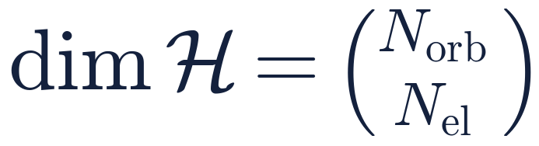
Counting the cost
Only the Ni 3d shell (10 spin-orbitals, 8 electrons per Ni), no oxygen
1 mm³ of NiO
≈ 10¹⁰²⁰
Each extra Ni multiplies the dimension by roughly 150.
R. J. Green · Quanty Workshop, Heidelberg 2026
11

Slide 12
Making the numbers felt
10¹⁶
10⁵⁷
10¹³⁸
8 Ni ions
27 Ni ions
64 Ni ions, a cube ≈ 1 nm across
One state vector ≈ 160 PB: more than 10× the memory of the largest supercomputer
More amplitudes than there are atoms in the Earth (~10⁵⁰)
10⁵⁸ × the number of atoms in the observable universe
…and we haven't even included the oxygen yet.
W. Kohn's “exponential wall”: no faster computer gets us over it. We have to go around it.
R. J. Green · Quanty Workshop, Heidelberg 2026
12

Slide 13
So we must approximate. The question is what.
Door 1
Treat every electron approximately
Mean field: DFT, Hartree–Fock
Fantastic for weakly correlated bands
Misses multiplets, satellites, Mott physics
Door 2
Treat a few electrons exactly, the rest approximately
Choose a small local subsystem
Exact many-body physics inside it
The rest of the crystal as an effective environment
This workshop is about Door 2.
R. J. Green · Quanty Workshop, Heidelberg 2026
13

Slide 14
II
The local idea
Be exact where it matters, and approximate the rest

Slide 15
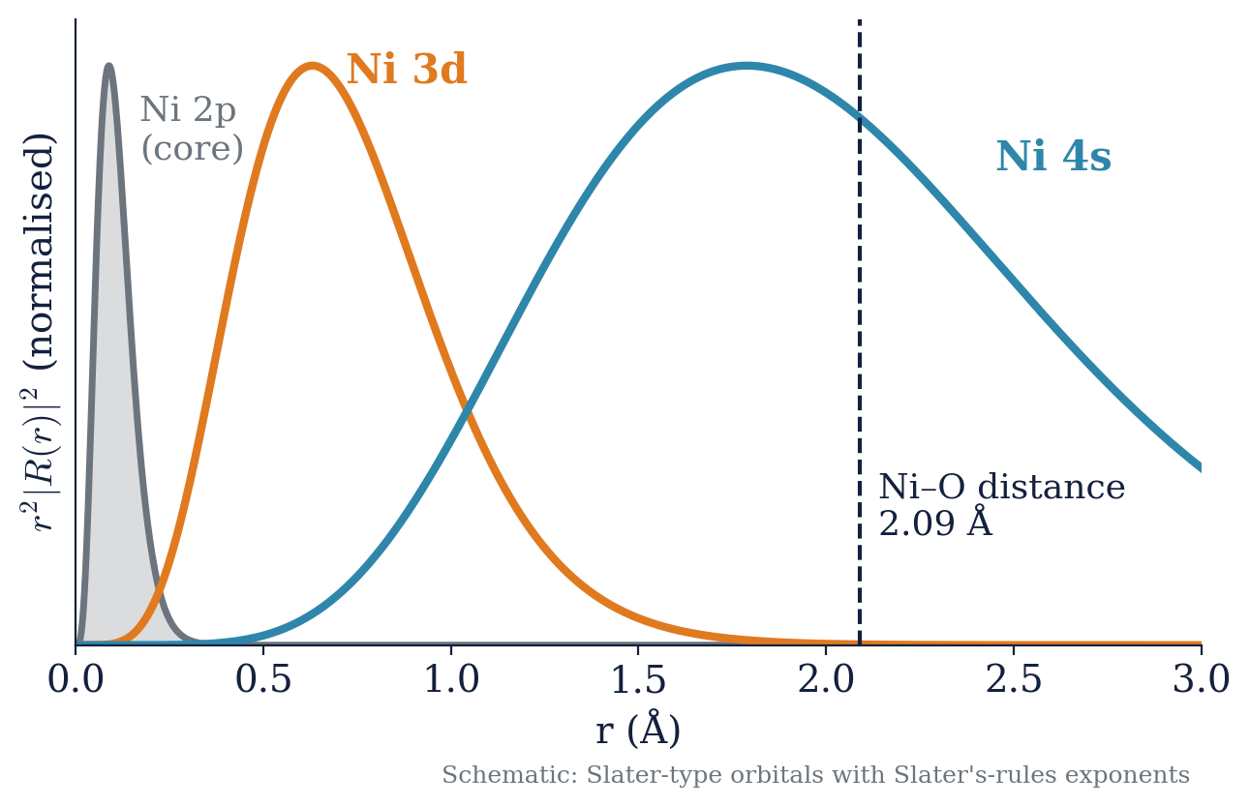
Correlation lives where orbitals are small
U_{3d} ≈ 7–8 eV
two 3d electrons on the same Ni
3d orbitals sit deep inside the ion: small, so electrons in them repel strongly
4s and O 2p are extended, so they form bands and screen well
So the strong correlation is local
R. J. Green · Quanty Workshop, Heidelberg 2026
15

Slide 16
The embedding picture
The local subsystem
Treated exactly: all of its many-body physics
The rest of the crystal
Treated approximately: an effective environment
Ni
The coupling
Electrons hop in and out: hybridization
R. J. Green · Quanty Workshop, Heidelberg 2026
16

Slide 17
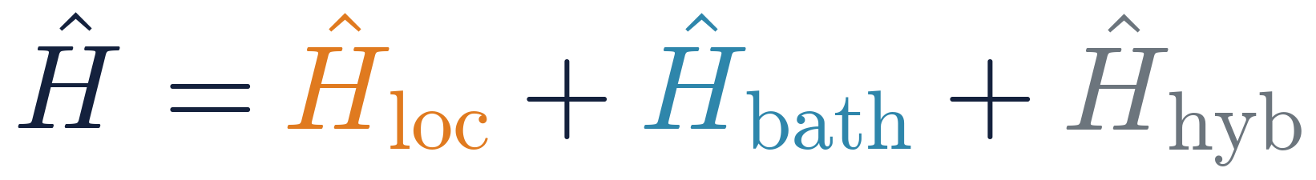
Write it down
The universal embedding Hamiltonian
Local
Everything on the subsystem: Coulomb multiplets, spin–orbit, crystal field. All the interactions.
Bath
Everything else, taken as non-interacting (one-body)
Hybridization
Electrons hopping between the two: Σ V (d†c + h.c.)
Every method this week is this equation, with different choices for the blue part.
R. J. Green · Quanty Workshop, Heidelberg 2026
17

Slide 18
Why core-level spectroscopy loves the local picture
1
The core hole sits on one atom
2p radius ≈ 0.1 Å: the transition happens at one site
Ni
2
Selection rules project onto that atom
Dipole 2p → 3d: you see the local d shell of that one Ni
3
The core hole pulls the electrons in
Core-hole potential U_{cd} ≈ 8–9 eV makes the final state more local
Nature has already done half the embedding for you: the core hole picks the site.
R. J. Green · Quanty Workshop, Heidelberg 2026
18

Slide 19
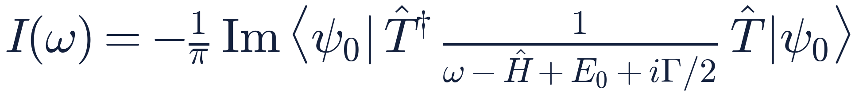

The spectrum, formally
The one formula used all week
|ψ₀⟩
ground state of Ĥ (initial state)
transition operator: dipole, quadrupole, …
Ĥ
the Hamiltonian, including the core hole
We'll see how we can increase the accuracy of Ĥ by moving up a ladder of complexity.
The rungs of the ladder differ only in the Ĥ in the middle of this formula.
R. J. Green · Quanty Workshop, Heidelberg 2026
19

Slide 20
The ladder
Atom
CFT
LFT
AIM
DMFT
Each rung is a wider camera shot of the same crystal.
DMFT …and the band is made of atoms just like them
Anderson impurity …and visit the whole band
Ligand field …and visit their neighbours
Crystal field …and feel their neighbours
Atom the electrons talk to each other
R. J. Green · Quanty Workshop, Heidelberg 2026
20

Slide 21
The rules of the climb
Atom
CFT
LFT
AIM
DMFT
At every rung we ask the same three questions
1
2
3
What's local, what's the bath?
What does it get right in NiO?
What does it miss?
Which part of Ĥ is exact, and what replaces the rest?
Overlay it on our spectrum
The miss is what pushes us up to the next rung
R. J. Green · Quanty Workshop, Heidelberg 2026
21

Slide 22
Atom
CFT
LFT
AIM
DMFT
III
Climbing the ladder
Atom → crystal field → ligand field → Anderson impurity → DMFT

Slide 23
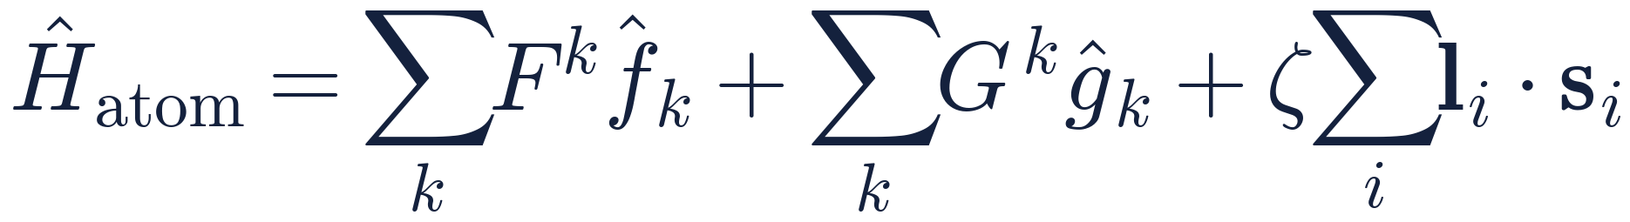
Rung 1: the free ion
Atom
CFT
LFT
AIM
DMFT
Zoom all the way in: one Ni²⁺ in empty space
Ni
Slater integrals F⁰, F², F⁴: the d–d Coulomb repulsion
Core–valence F^{k}, G^{k} for the 2p⁵3d⁹ final state
Spin–orbit ζ (2p: large; 3d: small)
Bath: none
dim = 45 (3d⁸) dim = 60 (2p⁵3d⁹)
R. J. Green · Quanty Workshop, Heidelberg 2026
23

Slide 24
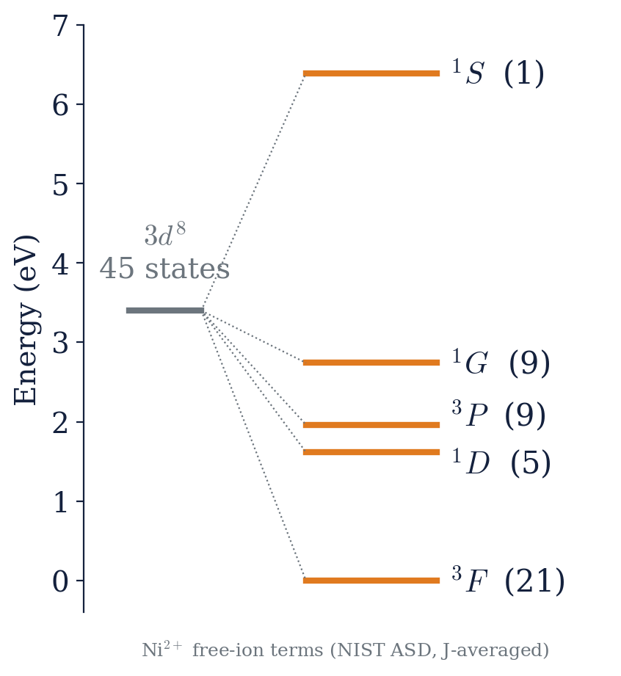
Multiplets
Atom
CFT
LFT
AIM
DMFT
The electrons talk to each other
45 states of d⁸ split into five LS terms
Spread over several eV, comparable to band widths
Hund's rules fall out: ³F ground state (S = 1, L = 3)
A spectrum is not a density of states. It is a map of these many-body states.
R. J. Green · Quanty Workshop, Heidelberg 2026
24

Slide 25
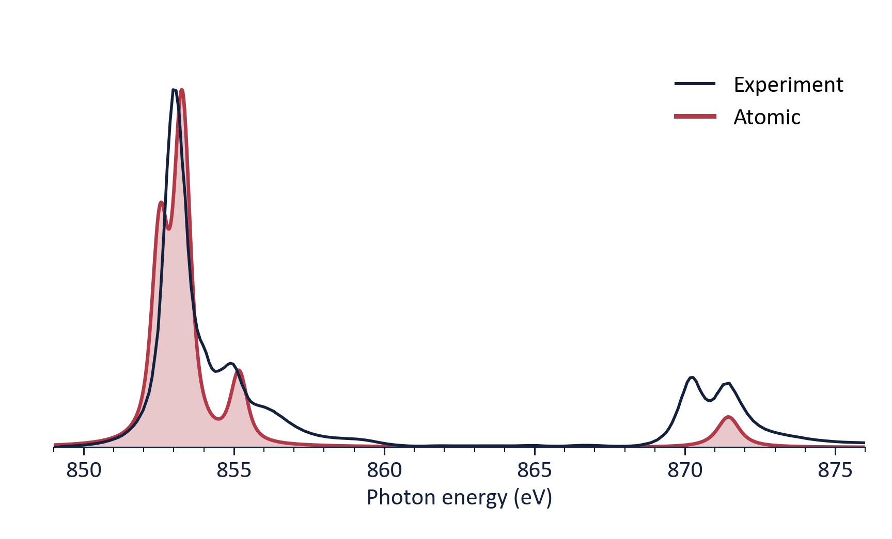
NiO checkpoint #1: the free ion
Atom
CFT
LFT
AIM
DMFT
Overlay the atomic calculation on our spectrum
✓ Gets right
Gross L₃ / L₂ splitting (2p spin–orbit)
Multiplet structure, not a DOS
The right orders of magnitude
✗ Misses
The L₃ main line splits in two
L₂ is far too weak and lacks its doublet
The ion doesn't know it's in a crystal
→ In depth: M.-A. Arrio (Tue 9:00), F. de Groot (Tue 13:30)
R. J. Green · Quanty Workshop, Heidelberg 2026
25

Slide 26
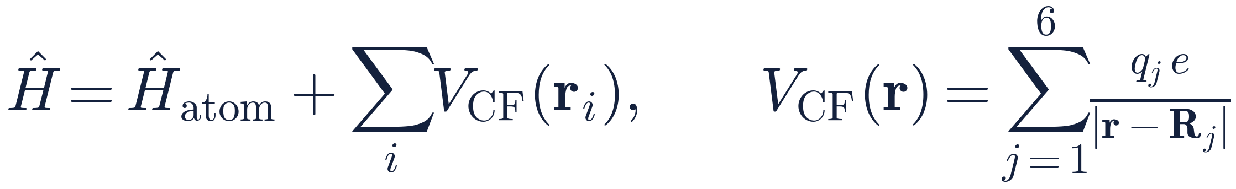
Rung 2: crystal field theory
Atom
CFT
LFT
AIM
DMFT
Zoom out: surround the ion by six point charges
−
O²⁻ ions replaced by point charges in an octahedron
The environment is a static one-body potential
Bath: still no electrons, only a field
Ni
−
−
−
dim = 45 same Hilbert space, lower symmetry: O_{h}
R. J. Green · Quanty Workshop, Heidelberg 2026
26

Slide 27
t_{2g} and e_{g}: feeling the neighbours
Atom
CFT
LFT
AIM
DMFT
↑
↑
Ni²⁺ (d⁸) in O_{h}
t_{2g}⁶ e_{g}²
³A_{2g} ground state, S = 1
10Dq ≈ 1.1 eV (optical)
e_{g} (+6Dq)
10Dq
free ion
(5-fold)
↑↓
↑↓
↑↓
t_{2g} (−4Dq)
Bonus: the Tanabe–Sugano diagram is just CFT multiplets vs. 10Dq.
R. J. Green · Quanty Workshop, Heidelberg 2026
27

Slide 28
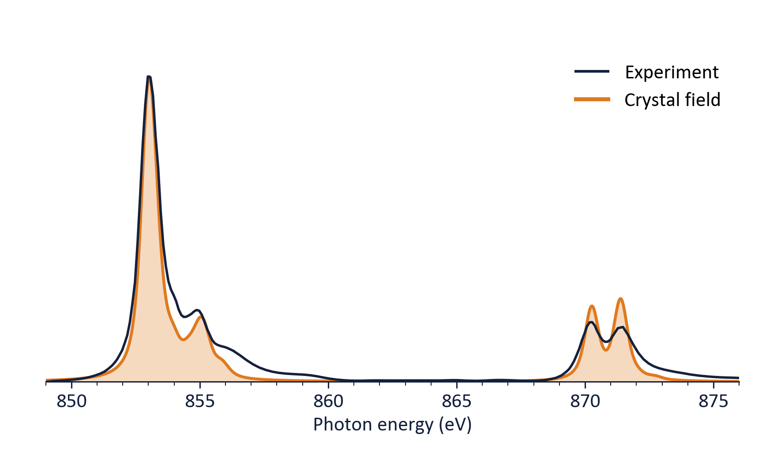
NiO checkpoint #2: crystal field
Atom
CFT
LFT
AIM
DMFT
Point charges around the ion: the L₂ doublet appears
✓ Gets right
The L₂ doublet and most of the line shape
High-spin S = 1 ground state
Orbital symmetry, dichroism
✗ Misses
The fitted 10Dq is much larger than point-charge electrostatics gives, and has the wrong origin
No charge-transfer satellites
L₂ doublet: right energies, but too sharp and the wrong intensity ratio
→ The point charges are a disguise: the oxygens have orbitals, and electrons go and visit them.
R. J. Green · Quanty Workshop, Heidelberg 2026
28

Slide 29
Rung 3: ligand field theory
Atom
CFT
LFT
AIM
DMFT
Zoom out: give the oxygens their orbitals (the NiO₆ cluster)
Ligand orbitals L: O 2p combinations with e_{g} and t_{2g} symmetry
Hopping V_{eg}, V_{t2g} between Ni 3d and L
Charge-transfer energy Δ: the cost of moving an electron L → d
Bath: one shell of discrete orbitals
Ni
first real bath …a tiny one
R. J. Green · Quanty Workshop, Heidelberg 2026
29

Slide 30
Configuration interaction
Atom
CFT
LFT
AIM
DMFT
The ground state mixes different charge states
d¹⁰L̲²
|ψ₀⟩ = α|d⁸⟩ + β|d⁹L̲⟩ + γ|d¹⁰L̲²⟩
Δ+U
V
d⁹L̲
One state, different numbers of d electrons: a genuine many-body state
L̲ = a hole in the ligand orbitals
For NiO, d⁹L̲ carries a large weight in the ground state
Final states mix too: satellites shift and trade weight with the main line
Δ
V
d⁸
R. J. Green · Quanty Workshop, Heidelberg 2026
30

Slide 31
Where 10Dq really comes from
Atom
CFT
LFT
AIM
DMFT
Solving the crystal field's puzzle
e_{g}* σ: strong V
10Dq_{eff} ≈ 10Dq_{ionic}
+ (V_{eg}² − V_{t2g}²)/Δ
10Dq_{eff}
Ni 3d
t_{2g}* π: weak V
e_{g} points at the oxygens: strong σ bonding, so the antibonding level is pushed up a lot
t_{2g}: weak π bonding, pushed up a little
Most of '10Dq' is covalency
O 2p (L)
bonding (mostly O 2p)
R. J. Green · Quanty Workshop, Heidelberg 2026
31

Slide 32
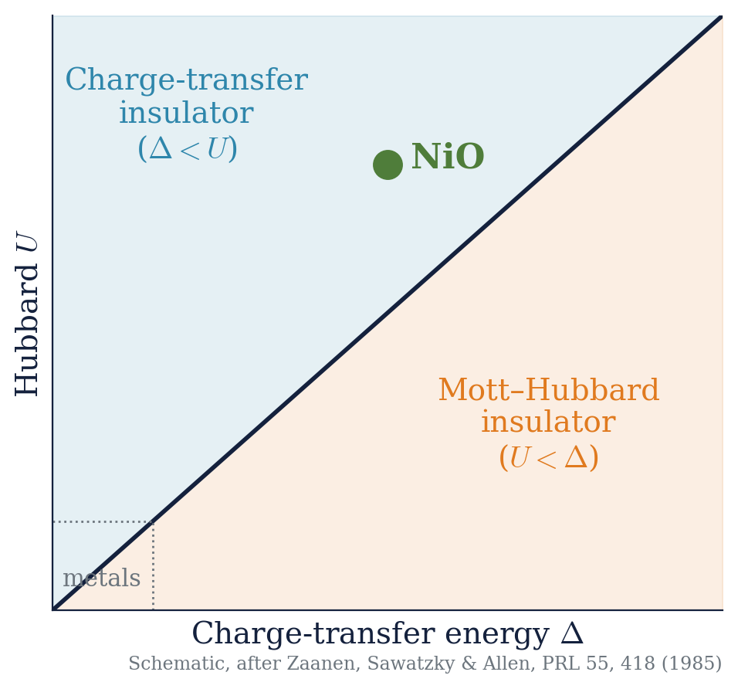
What kind of insulator is NiO?
Atom
CFT
LFT
AIM
DMFT
Zaanen, Sawatzky & Allen (1985)
NiO: Δ < U
a charge-transfer insulator
The gap is between O 2p and the upper Hubbard band, not between Ni d and Ni d
Set by Δ and U, which are local energies, not magnetic order
So it stays insulating above T_{N}
R. J. Green · Quanty Workshop, Heidelberg 2026
32

Slide 33
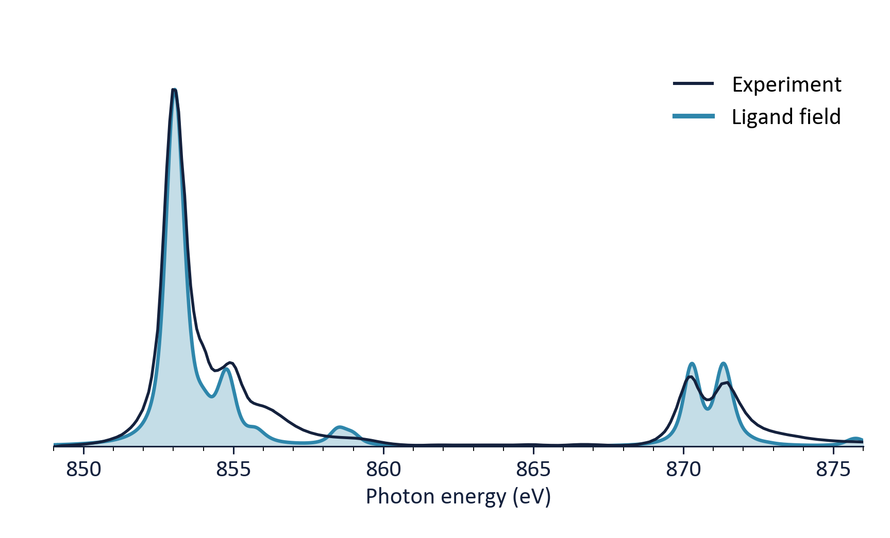
NiO checkpoint #3: ligand field
Atom
CFT
LFT
AIM
DMFT
Let the electrons visit the oxygens
✓ Gets right
XAS main lines and L₂ doublet: excellent
Charge-transfer satellites (XAS and 2p XPS)
dd excitations in RIXS
The real meaning of 10Dq
✗ Misses
A sharp CT satellite near 858.5 eV where experiment has only a broad tail
O 2p is a ~6 eV wide band, not one sharp level
RIXS: charge-transfer features come out as sharp lines that cannot disperse (Wednesday)
→ Hands-on: Tue 11:00 & 15:30, Wed 11:00 tutorials
R. J. Green · Quanty Workshop, Heidelberg 2026
33

Slide 34
Hilbert space check-in
Atom
CFT
LFT
AIM
DMFT
How did we get around the exponential wall?
45
free ion, d⁸
190
NiO₆ cluster: Ni 3d + ligand orbitals, 20 spin-orbitals, 2 holes
10¹³⁸
64 Ni ions, d only
A laptop-sized problem explains most of a core-level spectrum. That is the power of choosing the right subsystem.
R. J. Green · Quanty Workshop, Heidelberg 2026
34

Slide 35
Rung 4: the Anderson impurity model
Atom
CFT
LFT
AIM
DMFT
Zoom out: the bath becomes the whole crystal
Ni
Ni
Ligand field
one shell of ligand orbitals
Anderson impurity
many bath sites: a whole band, still non-interacting
R. J. Green · Quanty Workshop, Heidelberg 2026
35

Slide 36
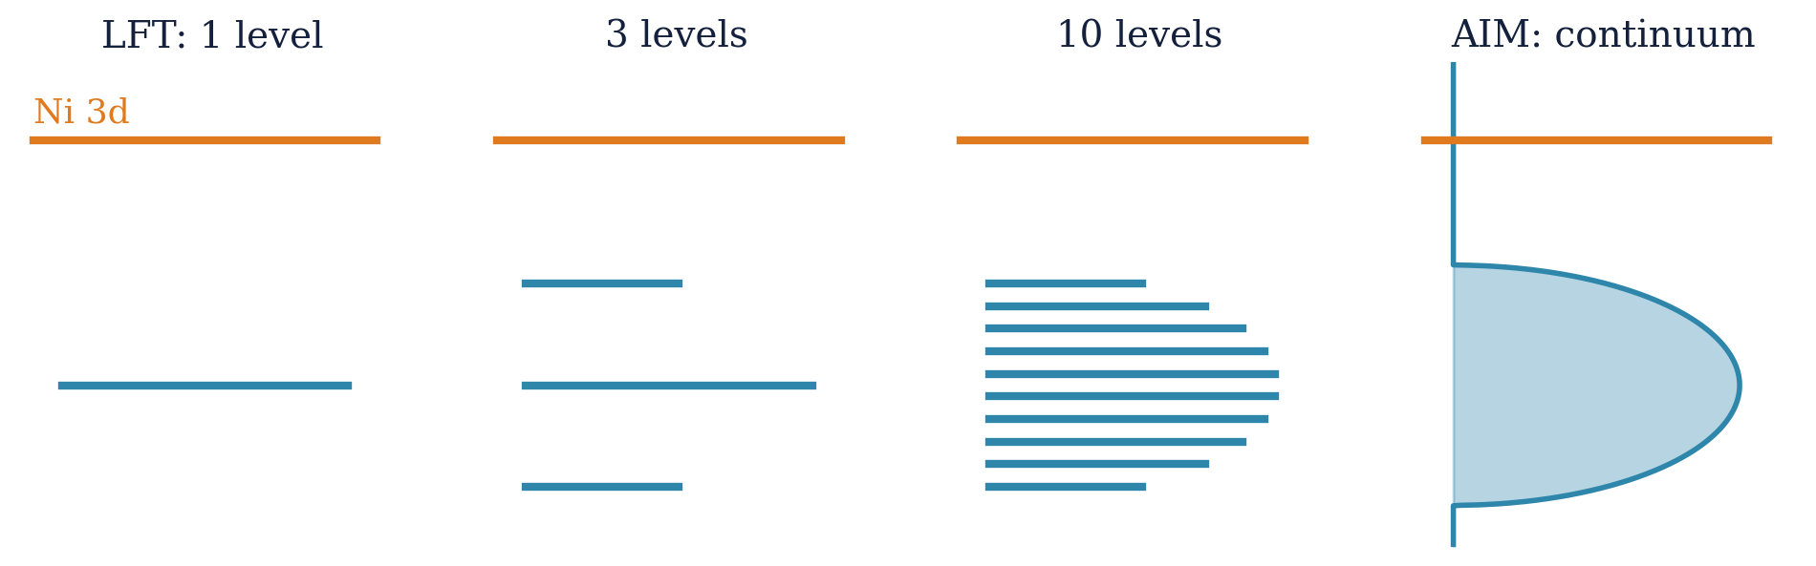
The bath becomes a band
Atom
CFT
LFT
AIM
DMFT
The same step, seen in energy: one ligand level → many → a continuum
The bath is now a continuum: the full O 2p (and Ni 4s…) band, still non-interacting.
R. J. Green · Quanty Workshop, Heidelberg 2026
36

Slide 37
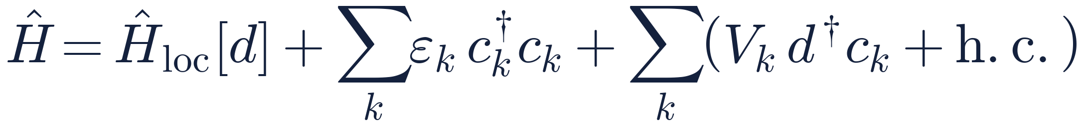
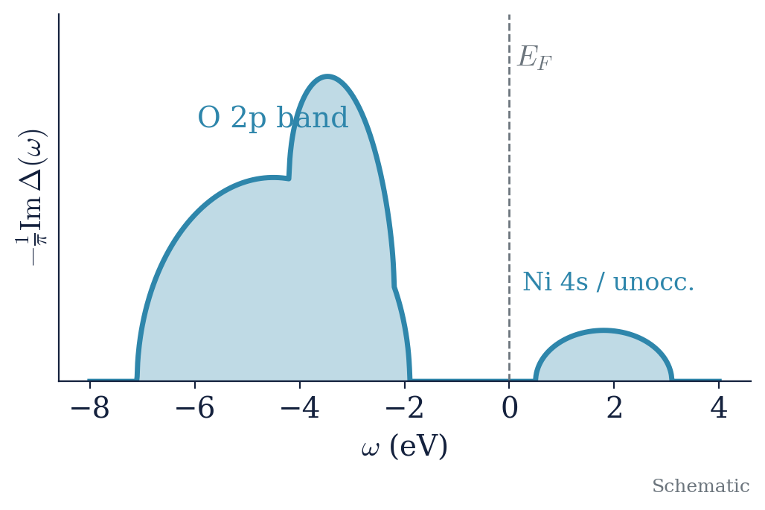
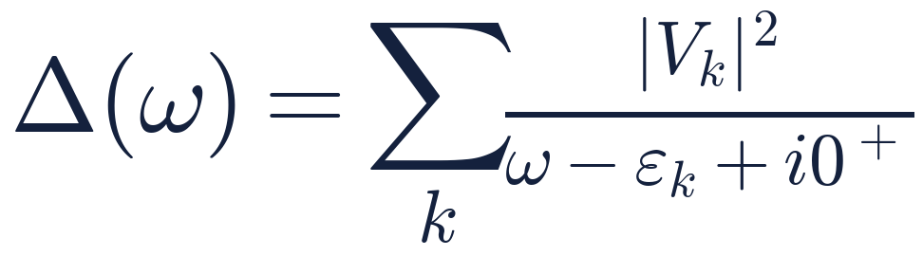
The hybridization function
Atom
CFT
LFT
AIM
DMFT
One function describes the entire environment
Everything the impurity knows about the rest of the crystal is in Δ(ω).
R. J. Green · Quanty Workshop, Heidelberg 2026
37

Slide 38
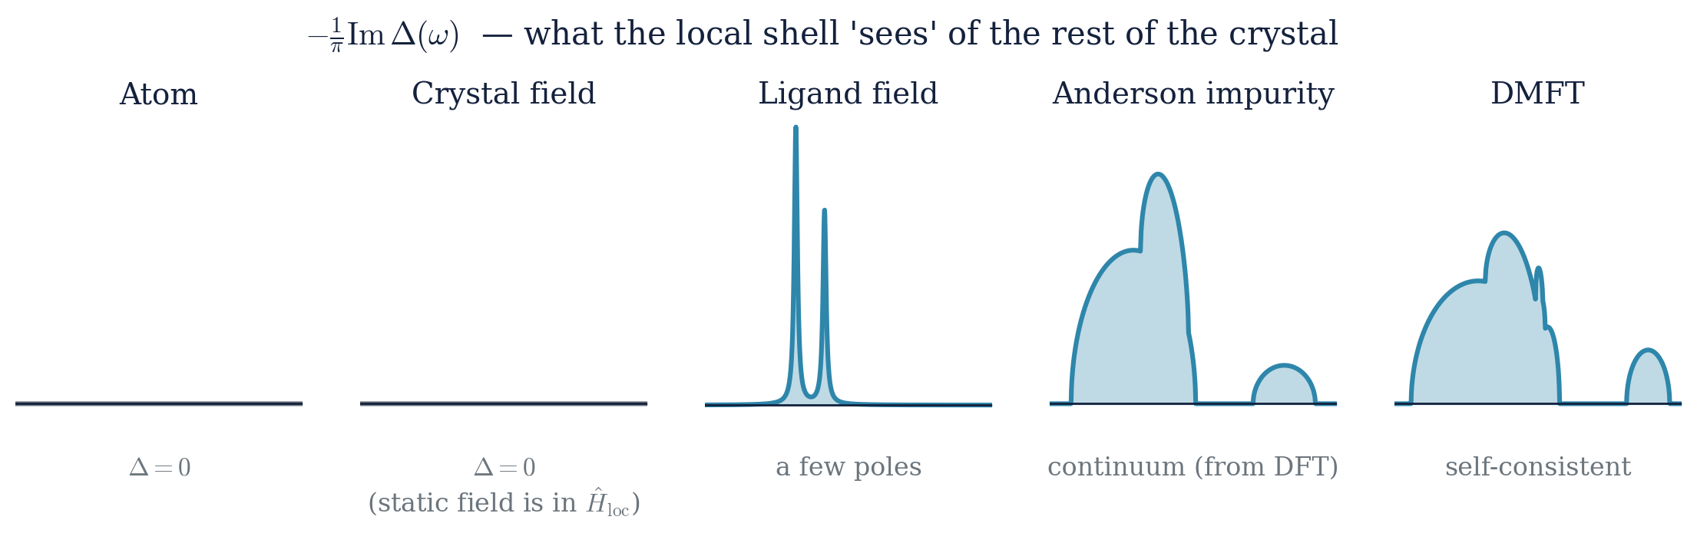
Every rung was an impurity model
Atom
CFT
LFT
AIM
DMFT
Looking back down the ladder
We haven't been building different theories. We've been drawing Δ(ω) more and more faithfully.
R. J. Green · Quanty Workshop, Heidelberg 2026
38

Slide 39
Where does Δ(ω) come from?
Atom
CFT
LFT
AIM
DMFT
Fitted to experiment, or from DFT, where the two doors meet
DFT band structure
Wannier projection onto Ni d
H_{bath}, V_{k} → Δ(ω)
Discretize: natural impurity orbitals
Solve AIM in Quanty
Empirical route: a model band (gapped, for an insulator) fitted to spectra, common for core-level work
DFT route: no fitted bath parameters, the environment comes from first principles
The local interactions (U, J) are still a choice, along with the double-counting correction
→ Thursday: Shokri & Ackermann (DFT / FPLO), Haverkort (DFT + MLFT, DFT + DMFT)
R. J. Green · Quanty Workshop, Heidelberg 2026
39

Slide 40
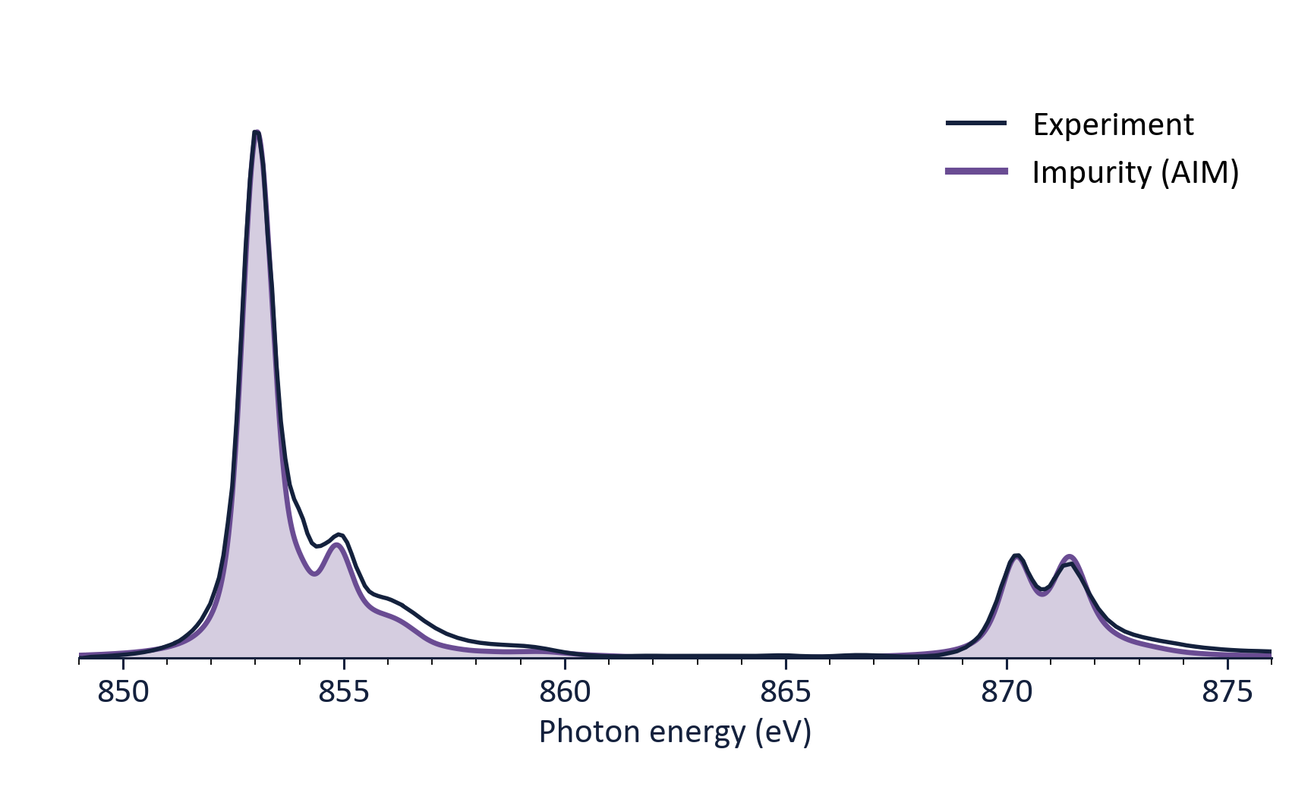
NiO checkpoint #4: Anderson impurity
Atom
CFT
LFT
AIM
DMFT
Bands and multiplets together
✓ Gets right
CT region: a broad tail, not a sharp satellite, with no broadening added by hand
Main lines and L₂ doublet kept from LFT
Same model: realistic PES / IPES, Zhang–Rice-like state
✗ Misses
The bath is an input (fitted or from DFT), not determined by the correlated solid itself
Its sites are non-interacting, though they are really other correlated Ni ions
One site only: no intersite or nonlocal physics (Wednesday)
→ In depth: F. de Groot (Tue 13:30), Tue/Wed tutorials, M. Haverkort (Thu 13:30)
R. J. Green · Quanty Workshop, Heidelberg 2026
40

Slide 41
Rung 5: dynamical mean-field theory
Atom
CFT
LFT
AIM
DMFT
Zoom out one last time
The environment of a Ni ion is… other Ni ions.
AIM: an impurity in a bath
DMFT: the bath is made of impurities
R. J. Green · Quanty Workshop, Heidelberg 2026
41

Slide 42
Two ways to split one level
Atom
CFT
LFT
AIM
DMFT
One level can become two peaks: through hopping, or through interaction
Hopping to a neighbour
Interaction U on the site
hopping V
antibonding
add an electron
the site is already occupied: pays U (IPES)
Ni 3d
U = 0: one level
U
ligand
remove the electron
no partner to pay U to (PES)
bonding
This comes from the environment: Δ(ω)
This comes from the interactions: Σ(ω)
A fixed correction (mean field) can only shift each level. To split one level into two, the correction must depend on the electron's energy: Δ(ω), Σ(ω).
R. J. Green · Quanty Workshop, Heidelberg 2026
42

Slide 43
Why does DMFT suddenly need Σ?
Atom
CFT
LFT
AIM
DMFT
We never needed it for clusters or the impurity model
Atom → CFT → LFT → AIM
The small problem is the whole calculation.
Write Ĥ for the cluster or impurity, diagonalize it, read off the spectrum. Nothing ever has to leave the cluster.
DMFT
Solve one site, then make every site in the crystal behave the same way.
But the crystal's band structure only understands one-electron energies. The impurity's many-body result has to be translated into that language: Σ(ω).
Σ(ω): the interactions, translated
One site
solved exactly, all its interactions
The crystal
band structure: one-electron levels
Δ(ω): the environment
Σ carries the interactions out to the lattice; Δ carries the environment back. That round trip is DMFT.
R. J. Green · Quanty Workshop, Heidelberg 2026
43

Slide 44
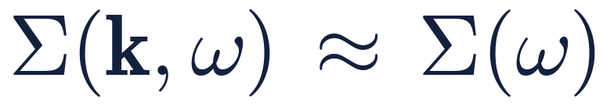
The DMFT loop
Atom
CFT
LFT
AIM
DMFT
Make one site look exactly like any site of the lattice
When it has converged
the bath Δ(ω) and the self-energy Σ(ω) stop changing, and the impurity is indistinguishable from a site of the crystal.
Details: M. Haverkort, Thursday 13:30
① Guess an environment
a bath Δ(ω)
④ Which bath would make one site look like that?
→ a new Δ(ω)
repeat until
nothing changes
② Solve one site exactly in it
AIM → its self-energy Σ(ω)
The one approximation:
③ Give every site that same Σ(ω)
lattice → what one site sees
Exact in infinite dimensions
Metzner & Vollhardt (1989); Georges & Kotliar (1992)
R. J. Green · Quanty Workshop, Heidelberg 2026
44

Slide 45
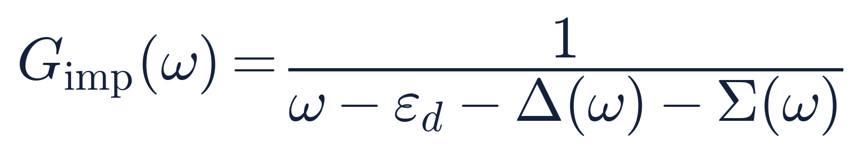
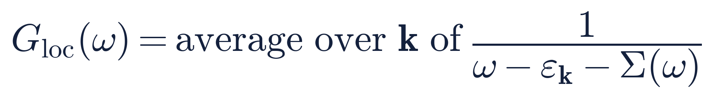
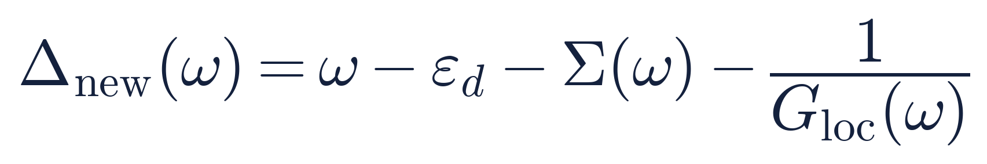
Closing the loop, in three lines
Atom
CFT
LFT
AIM
DMFT
G(ω): the one-site spectrum written as an equation. Its peaks are where an electron can be added or removed.
② The impurity in its bath
the bare level, minus the environment, minus the interactions
③ The crystal, every site carrying the same Σ
what one site sees: average over all k of the band energies ε_{k} (their average is ε_{d})
④ Make them agree, and solve for the bath
everything on the right is known: this is the new environment
In words: the new bath is whatever is left of what one site sees in the crystal, once the bare level and the interactions are taken out. In Quanty you then fit a few bath levels to it and solve again.
R. J. Green · Quanty Workshop, Heidelberg 2026
45

Slide 46
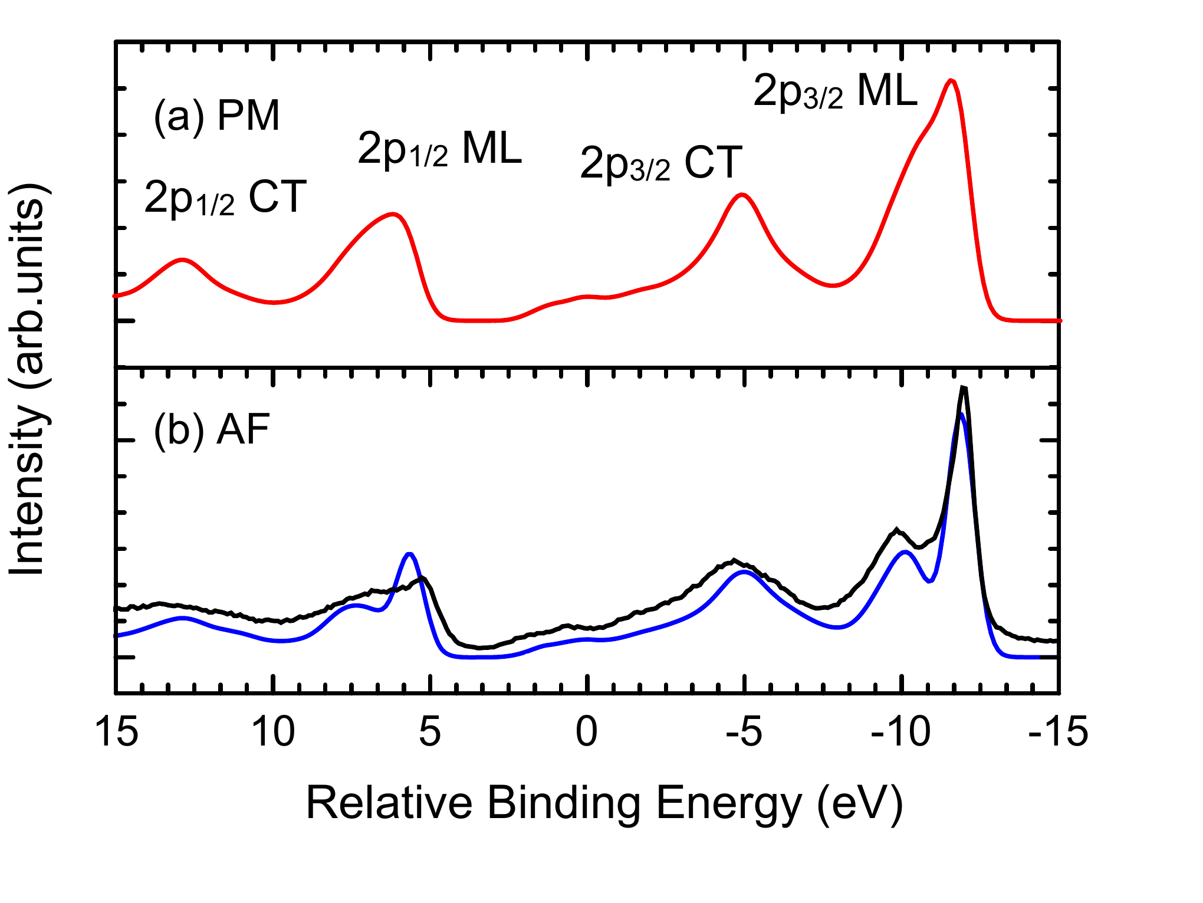
NiO checkpoint #5: DFT + DMFT
Atom
CFT
LFT
AIM
DMFT
Something no single-NiO₆ cluster gets: the Ni 2p XPS main line
✓ Gets right
Double-peak 2p₃/₂ main line: non-local screening via the self-consistent bath
Charge-transfer satellites, better than the cluster model
Valence band: CT gap, Zhang–Rice band, insulating above T_{N}
✗ Misses
Correlations between sites: Σ is local (we come back to this…)
LDA+DMFT Ni 2p XPS of NiO: (a) paramagnetic, (b) antiferromagnetic, with experiment (black). A. Hariki, T. Uozumi & J. Kuneš, PRB 96, 045111 (2017); arXiv:1704.01500.
→ Hands-on: DMFT of NiO in this morning's 11:00 tutorial. In depth: M. Haverkort (Thu 13:30) and the Thu 15:30 tutorial
R. J. Green · Quanty Workshop, Heidelberg 2026
46

Slide 47
Hilbert-space reality check
Atom
CFT
LFT
AIM
DMFT
What each rung costs (log₁₀ of the many-body dimension)
From 10¹⁰²⁰…
…to something a cluster node does overnight.
And we lost very little of what a core-level spectrum cares about.
DMFT ≈ AIM × number of iterations
R. J. Green · Quanty Workshop, Heidelberg 2026
47

Slide 48
The ladder, complete
Atom
CFT
LFT
AIM
DMFT
 | Local interactions | Bath | Δ(ω) | Typical use
Atom | full multiplets + SOC | none | 0 | gross multiplet structure
CFT | + static crystal field | none (static potential) | 0 (field is in Ĥ_{loc}) | XAS of ionic systems, RIXS dd
LFT | same | one ligand shell | a few poles | XAS, XPS satellites, RIXS dd
AIM | same | non-interacting band | continuous (fitted or DFT) | PES / IPES, line shapes, dispersing RIXS (CT, fluorescence)
DMFT | same | self-consistent lattice | continuous, self-consistent | spectral functions, non-local screening, dispersing RIXS
R. J. Green · Quanty Workshop, Heidelberg 2026
48

Slide 49
IV
One equation
…for the whole week

Slide 50

Remember this line?
↑
the local subsystem:
solved exactly
↑
the rest of
the crystal
↑
the coupling:
hopping
Atom / CFT
Local: the Ni 3d shell, all interactions (CFT: + a static field)
Bath: none
LFT
Local: the same
Bath: one shell of ligand orbitals
AIM
Local: the same
Bath: a whole band: many bath sites (fitted or DFT)
DMFT
Local: the same
Bath: chosen self-consistently: built from sites like this one
DFT
Local: nothing solved exactly
Bath: every electron in an average field
Every method on this week's programme is this one line, with a different choice of bath.
R. J. Green · Quanty Workshop, Heidelberg 2026
50

Slide 51
Which rung do I need?
More rungs aren't always better: pick the simplest one with the physics your spectrum sees
Localized d / f insulator, XAS or RIXS dd?
LFT is usually enough
XPS satellites, charge transfer, covalency?
LFT (or AIM)
PES line shapes, metallic screening, a Fermi sea?
AIM
Dispersion, spectral functions, phase diagrams?
DMFT
Parameters without fitting?
DFT-derived (Thursday)
R. J. Green · Quanty Workshop, Heidelberg 2026
51

Slide 52
Parameters: fitted or ab initio?
A tension the field lives with, and you'll see both this week
Semi-empirical
Δ, U, V, 10Dq fitted to spectra
Few parameters, physical insight
Excellent fits, fast
Risk: non-unique, not predictive
Ab initio
DFT + MLFT, DFT + DMFT
Predictive, material-specific
Bath from first principles
Risk: U and double counting are still choices
The best work uses both: ab initio as the starting point, spectra as the referee.
R. J. Green · Quanty Workshop, Heidelberg 2026
52

Slide 53
Your map of the week
Bold = lecture · plain = hands-on tutorial · blue = rung
Mon
Tue
Wed
Thu
Fri
Green: one Hamiltonian, many approximations
all rungs
Arrio: atomic multiplets & crystal field
Atom · CFT
Green: beyond one site
multi-site
Shokri & Ackermann: DFT calculations
the other door
Retegan: Crispy
Deep dive: bands, PES, XAS; DMFT of NiO
AIM · DMFT
Atomic, CFT, LFT ground states
Atom · CFT · LFT
K- & L₂,₃-edge XAS, fluorescence yield, RIXS
CFT · LFT · AIM
DFT with FPLO
Calculations with Crispy
de Groot: X-ray spectroscopy, overview & experiment
de Groot: interpreting XAS & XPS
Atom · CFT · LFT
Tagliavini: polarization, sum rules, tensors
Haverkort: DFT+MLFT, DFT+DMFT
AIM · DMFT
Intro to Quanty: orbitals, CI, Green's functions
CFT, LFT and AIM for spectroscopy
CFT · LFT · AIM
Polarization & geometry
From DFT to many-body models
AIM · DMFT
R. J. Green · Quanty Workshop, Heidelberg 2026
53

Slide 54
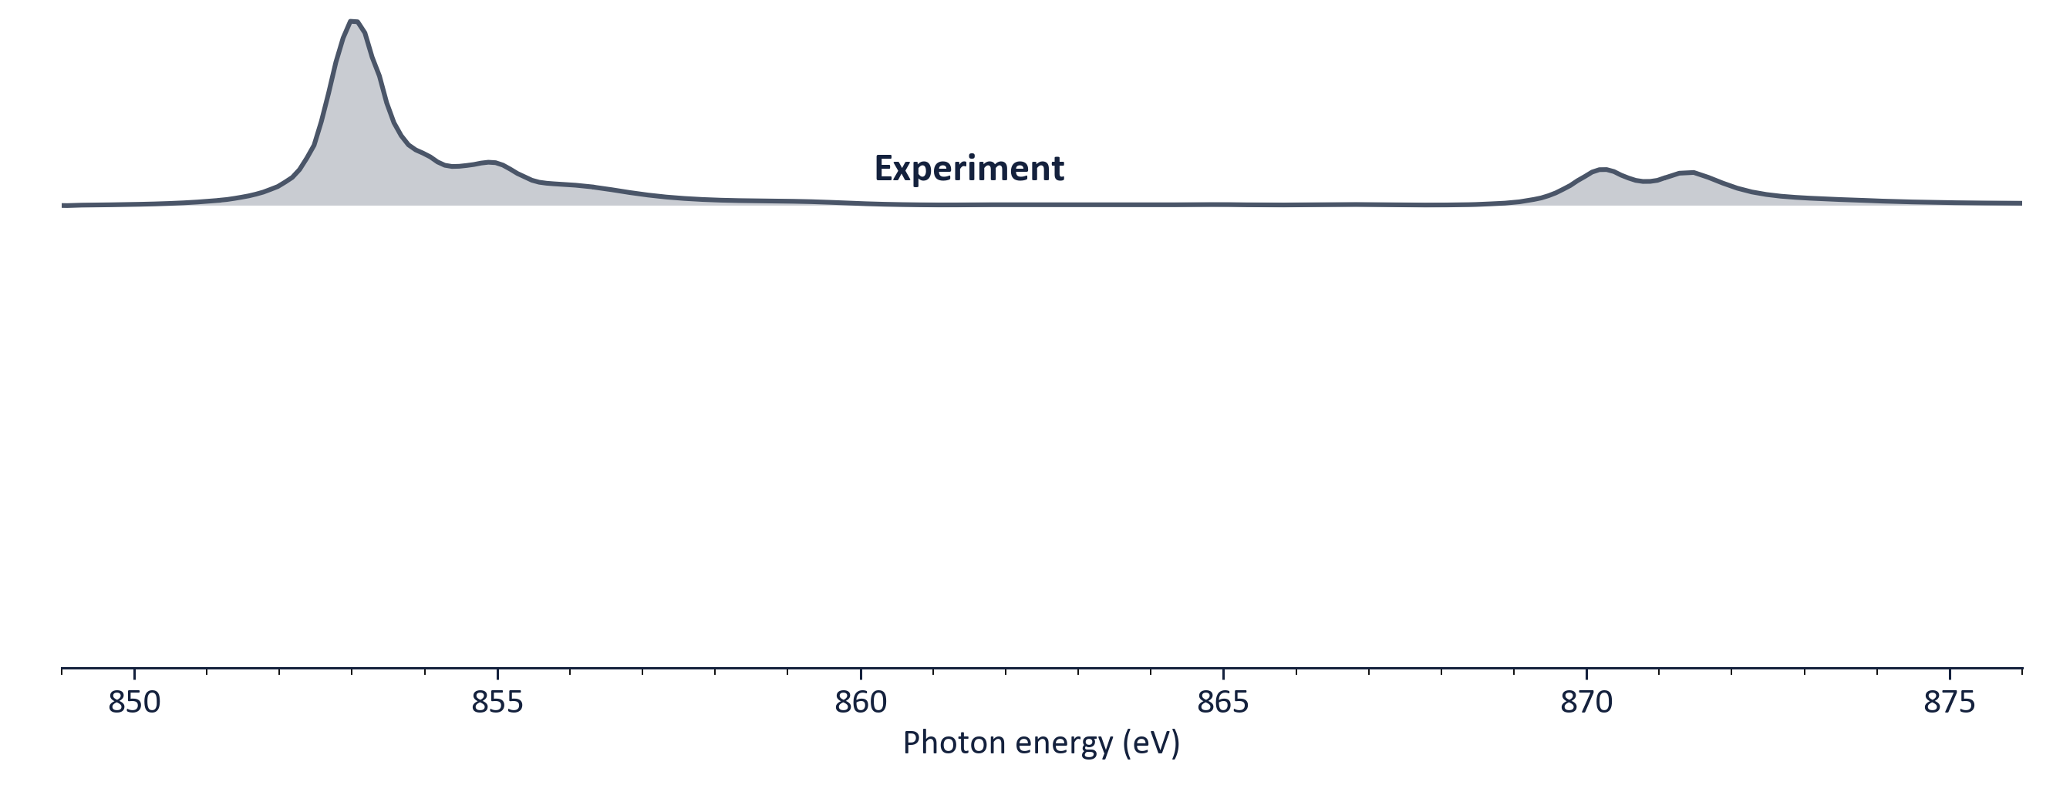
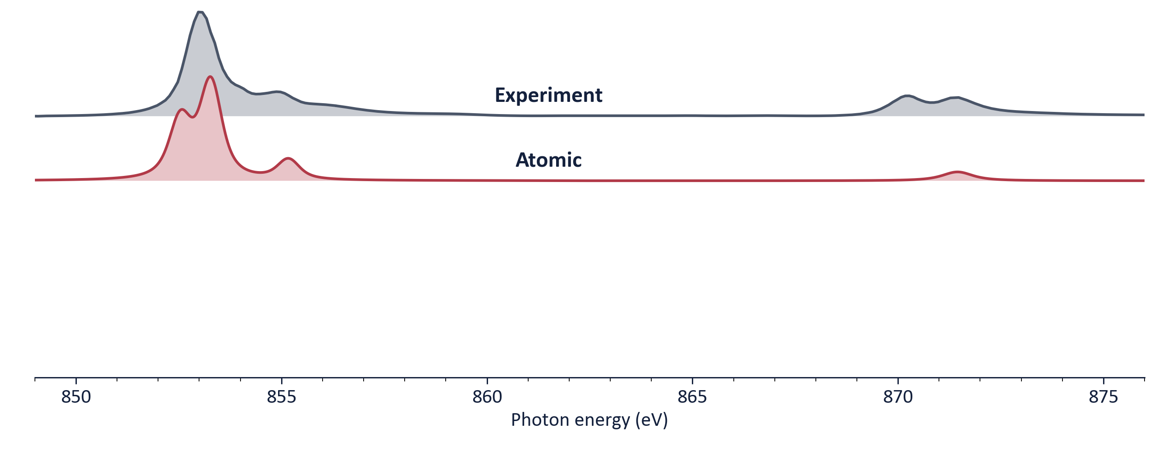
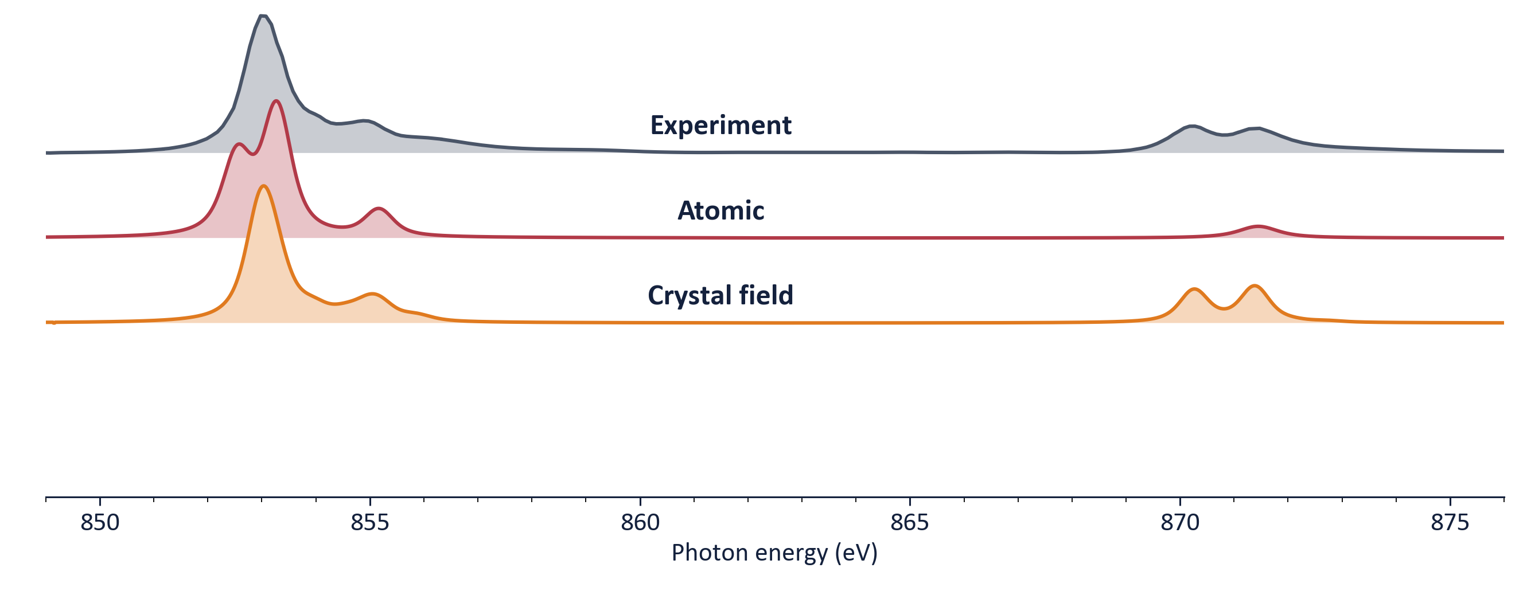
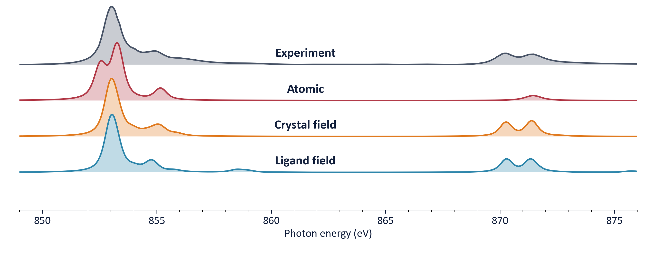
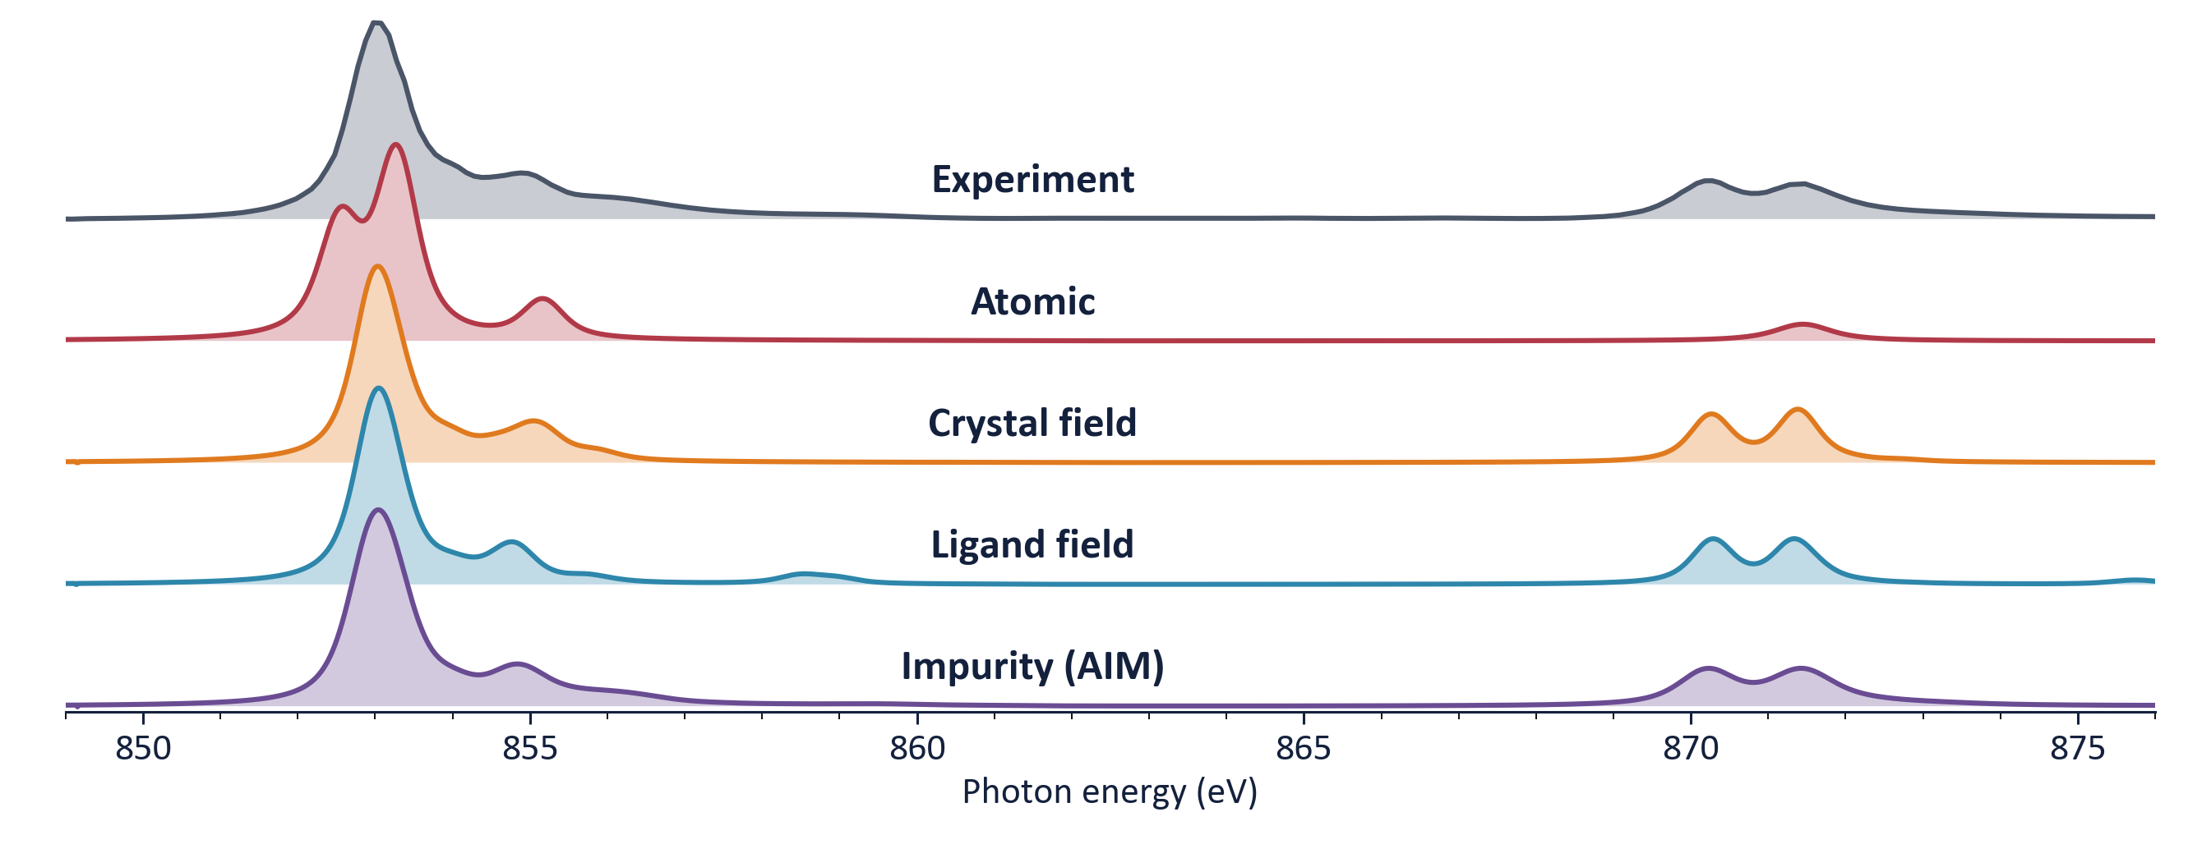
Back to the spectrum
This is where you'll be on Friday.
R. J. Green · Quanty Workshop, Heidelberg 2026
54

Slide 55
V
What 'local' misses
…a cliffhanger for Wednesday

Slide 56
The one thing we assumed
One site is special. Its neighbours are only a bath.
Is that always fine?
R. J. Green · Quanty Workshop, Heidelberg 2026
56

Slide 57
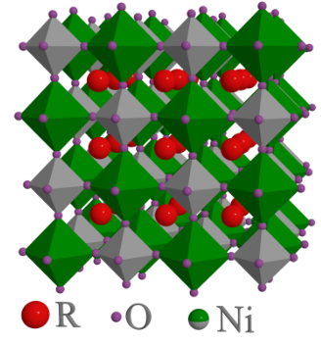
When one site isn't enough
Perovskite nickelates RNiO₃: the lattice breathes and the Ni sites pair up
d⁸L̲ + d⁸L̲ → d⁸ + d⁸L̲²
one ligand hole per NiO₆ hops between neighbours: “bond disproportionation”
Two single sites, two baths
e.g. site-selective DMFT
Captures two different Ni sites
Hopping between them enters through the lattice, but their correlation (Σ_{ij}) is left out
Both sites in the exact region
the double cluster
Captures two different Ni sites
Also the intersite charge fluctuations themselves, with full multiplets
Below the metal–insulator transition: alternating long- and short-bond NiO₆
Different sites are not enough: we need the correlations between them.
H. Park, A. J. Millis & C. A. Marianetti, PRL 109, 156402 (2012); S. Johnston et al., PRL 112, 106404 (2014); R. J. Green, M. W. Haverkort & G. A. Sawatzky, PRB 94, 195127 (2016)
R. J. Green · Quanty Workshop, Heidelberg 2026
57

Slide 58
Wednesday: grow the cluster, not just the bath
Multi-site / cluster embedding ?
DMFT
Anderson impurity
Ligand field
Crystal field
There is only one Hamiltonian. All week we choose which part of it to treat exactly. On Wednesday we make that part bigger than one atom.
Atom

