Slide 1
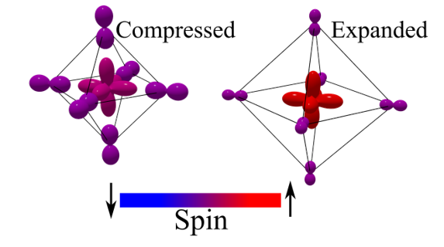
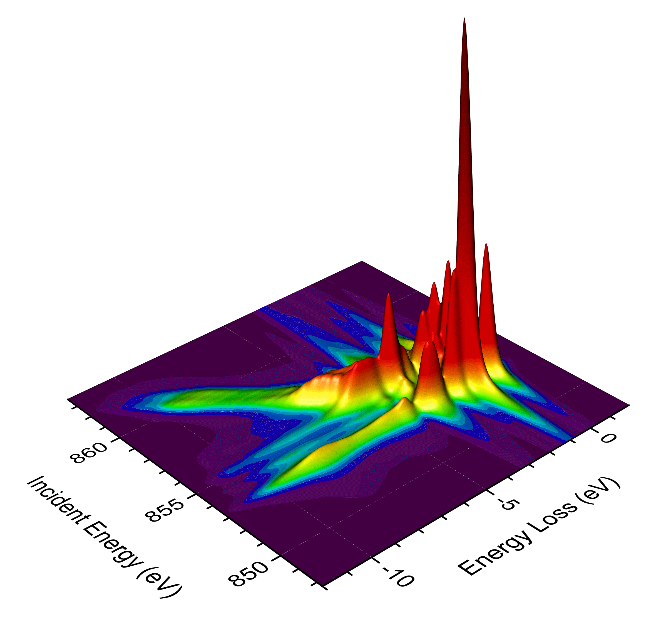
Beyond One Site
When the neighbour becomes a partner, and the ligand becomes a band
Case 1 · two sites: ligand holes pick a side
Robert J. Green
Quanty Workshop · Heidelberg · 7 October 2026
Case 2 · a real band: RIXS of NiO

Slide 2
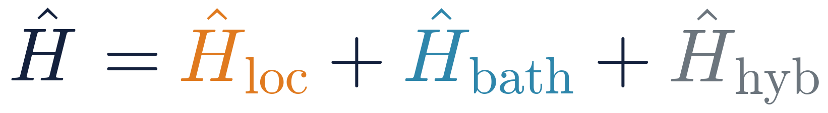
Previously, on Monday…
Recap
Sideways
Upward
The map
DMFT
Every method = a different choice of bath
Anderson impurity
One site is special. Its neighbours are only a bath.
Ligand field
Crystal field
Atom
R. J. Green · Quanty Workshop, Heidelberg 2026
2

Slide 3
Where we left off
Recap
Sideways
Upward
The map
Monday's last question: is one site always enough?
Every rung on Monday, DMFT included: one site solved exactly, its neighbours only a bath
Perovskite nickelates RNiO₃: two kinds of Ni, and ligand holes shared between neighbours
Different sites are not enough: we need the correlations between them.
Ni
Ni
Two NiO₆ units sharing an oxygen
Today: make the exact region bigger than one atom.
R. J. Green · Quanty Workshop, Heidelberg 2026
3

Slide 4
The ladder was really a map
Recap
Sideways
Upward
The map
how the rest of the crystal enters ↑
self-consistent
lattice
Sideways →
Make the exact region bigger: two metal sites. Case 1: the nickelates.
DMFT
Cluster DMFT
band
AIM
Two-impurity
AIM
ligand shell
LFT
Double cluster
Multi-site
clusters
Upward ↑
Make the bath richer: a real band. Case 2: RIXS of NiO.
static field
(in Ĥ_{loc})
CFT
nothing
Atom
Monday climbed the first column. Today we leave it.
1 site
2 sites
many sites
size of the exactly-treated region →
R. J. Green · Quanty Workshop, Heidelberg 2026
4

Slide 5
Today: two case studies, two directions
Recap
Sideways
Upward
The map
1
Sideways
2
Upward
Perovskite nickelates RNiO₃
NiO, again
The observation: XAS and magnetic scattering that no single cluster can reproduce
The observation: RIXS charge-transfer features that disperse with incident energy
The question: does bond disproportionation pass a spectroscopic test?
The question: what does a real bath look like?
Same rules as Monday: what's local, what does it get right, what does it miss?
R. J. Green · Quanty Workshop, Heidelberg 2026
5

Slide 6
Recap
Sideways
Upward
The map
II
Sideways
When the neighbour becomes a partner: putting bond disproportionation to the test

Slide 7
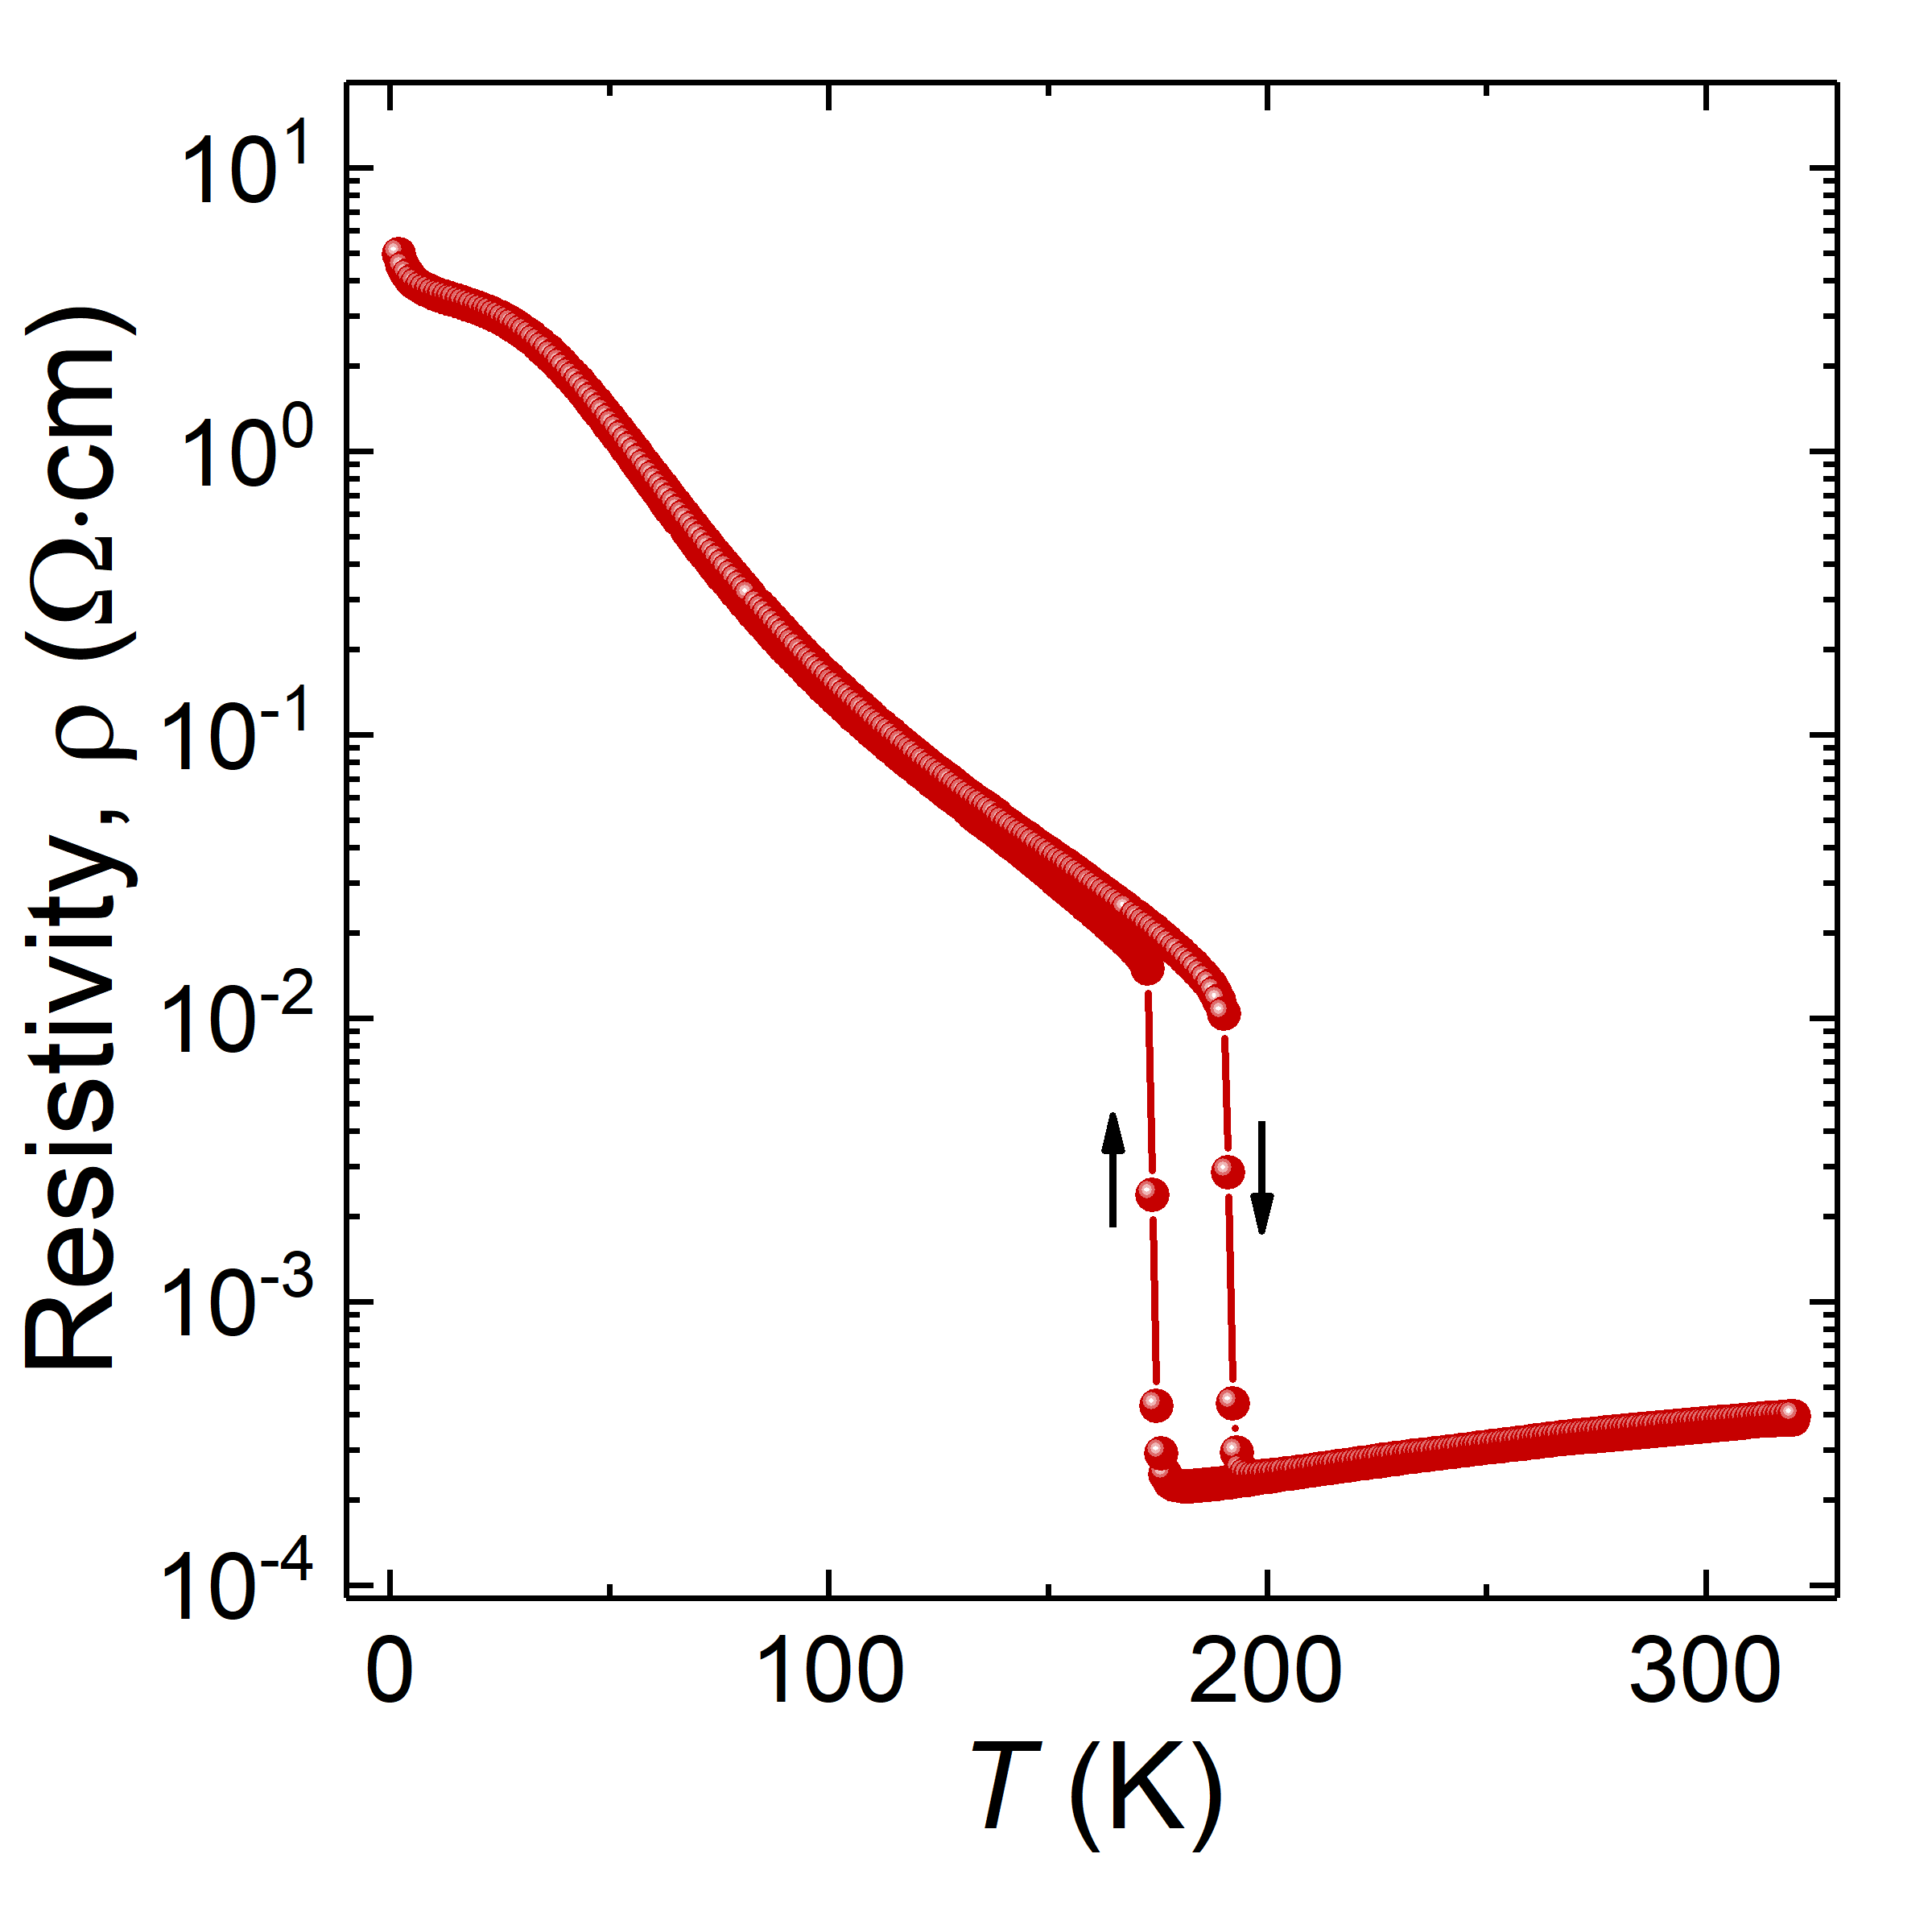
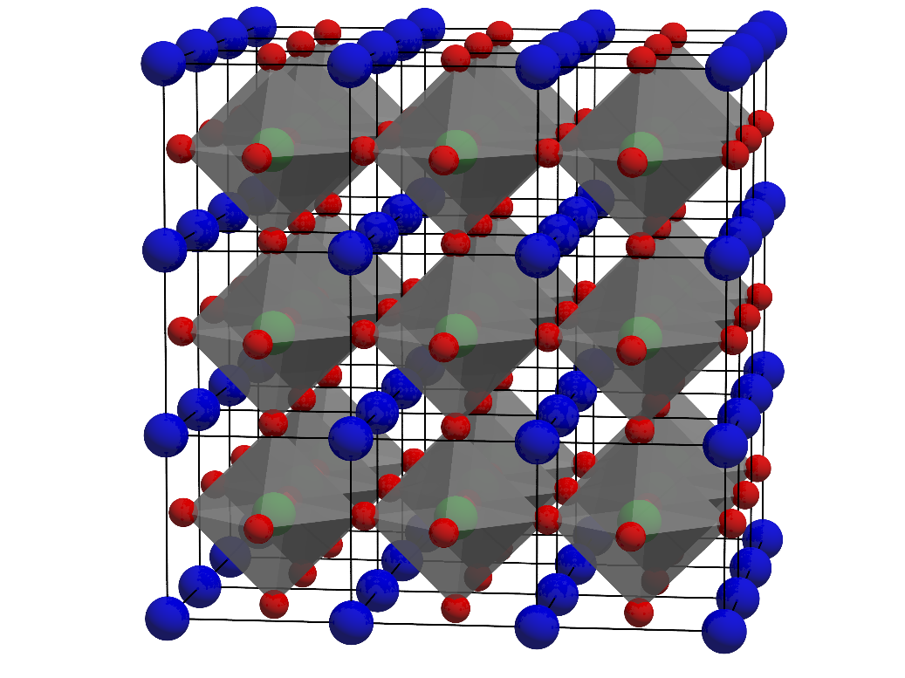
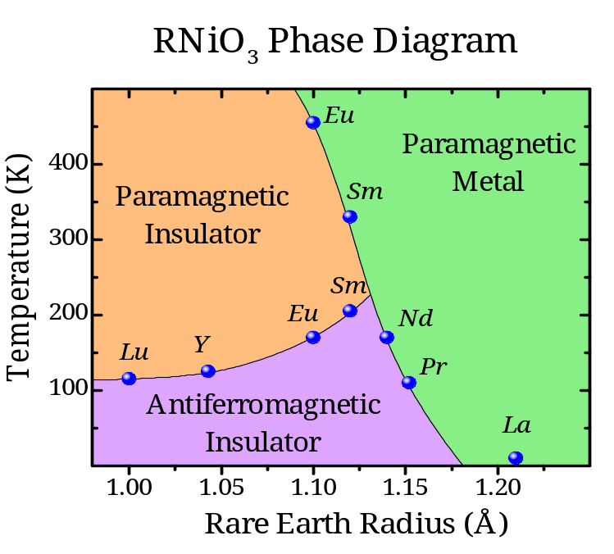
Meet NiO's troublesome cousin: RNiO₃
Recap
Sideways
Upward
The map
Perovskite ABO₃: corner-sharing NiO₆
Phase diagram vs. rare-earth size
NdNiO₃: metal–insulator transition
Formally Ni³⁺ (3d⁷). An MIT, unusual magnetic order, and a lattice that “breathes”.
R. J. Green · Quanty Workshop, Heidelberg 2026
7

Slide 8
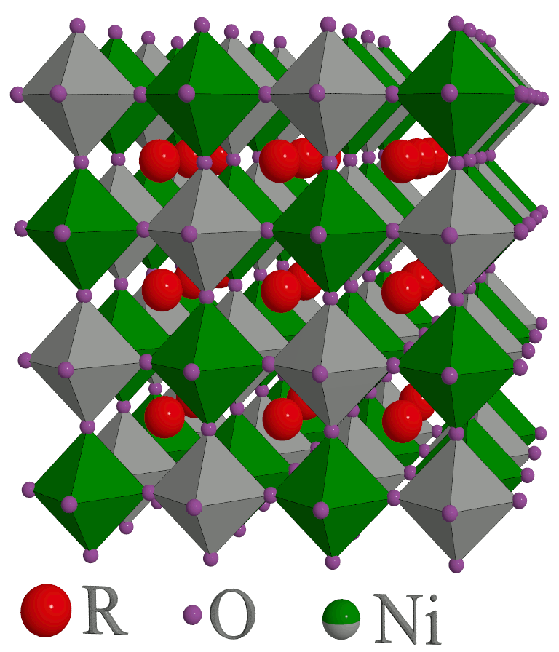
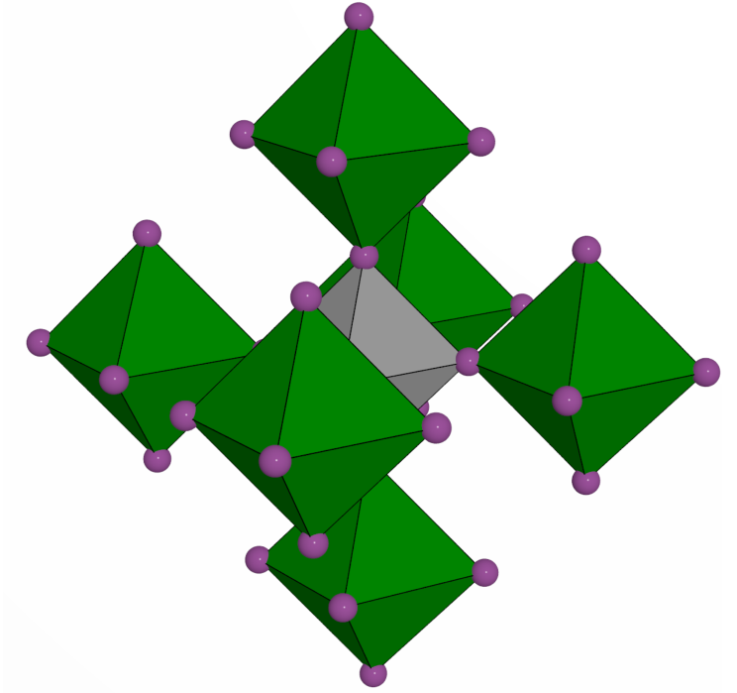
The lattice breathes
Recap
Sideways
Upward
The map
Below the MIT: alternating expanded and compressed octahedra
Long-bond (green) and short-bond (grey) octahedra in a rock-salt pattern
Each octahedron is surrounded by six of the other kind, in an octahedral arrangement
Remember that symmetry; it's about to save us
R. J. Green · Quanty Workshop, Heidelberg 2026
8

Slide 9
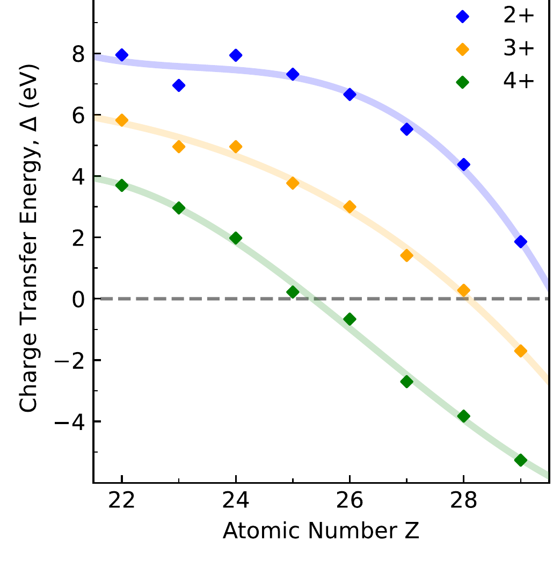
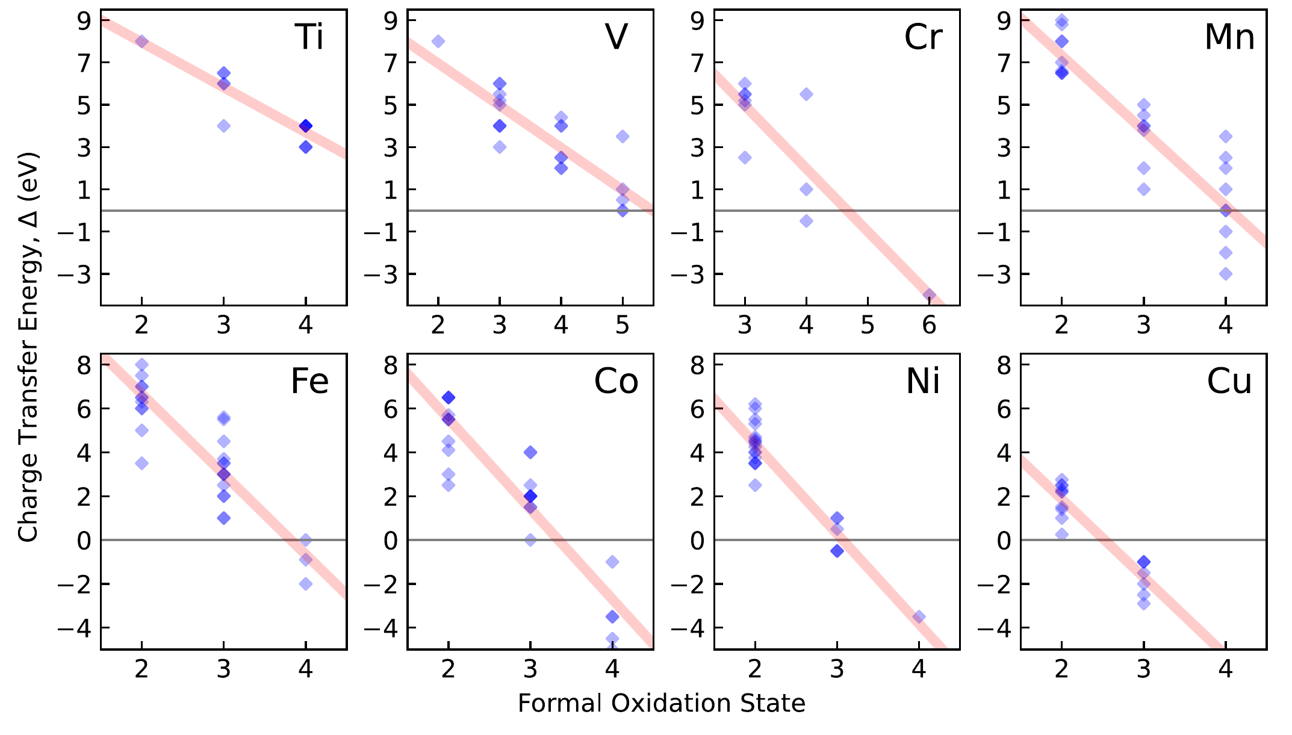
Why “Ni³⁺” is suspicious
Recap
Sideways
Upward
The map
The charge-transfer energy Δ falls with oxidation state and atomic number
Ni²⁺: Δ ≈ 4–6 eV → Ni³⁺: Δ ≈ 0 or below
R. J. Green & G. A. Sawatzky, J. Phys. Soc. Jpn. 93, 121007 (2024)
R. J. Green · Quanty Workshop, Heidelberg 2026
9

Slide 10
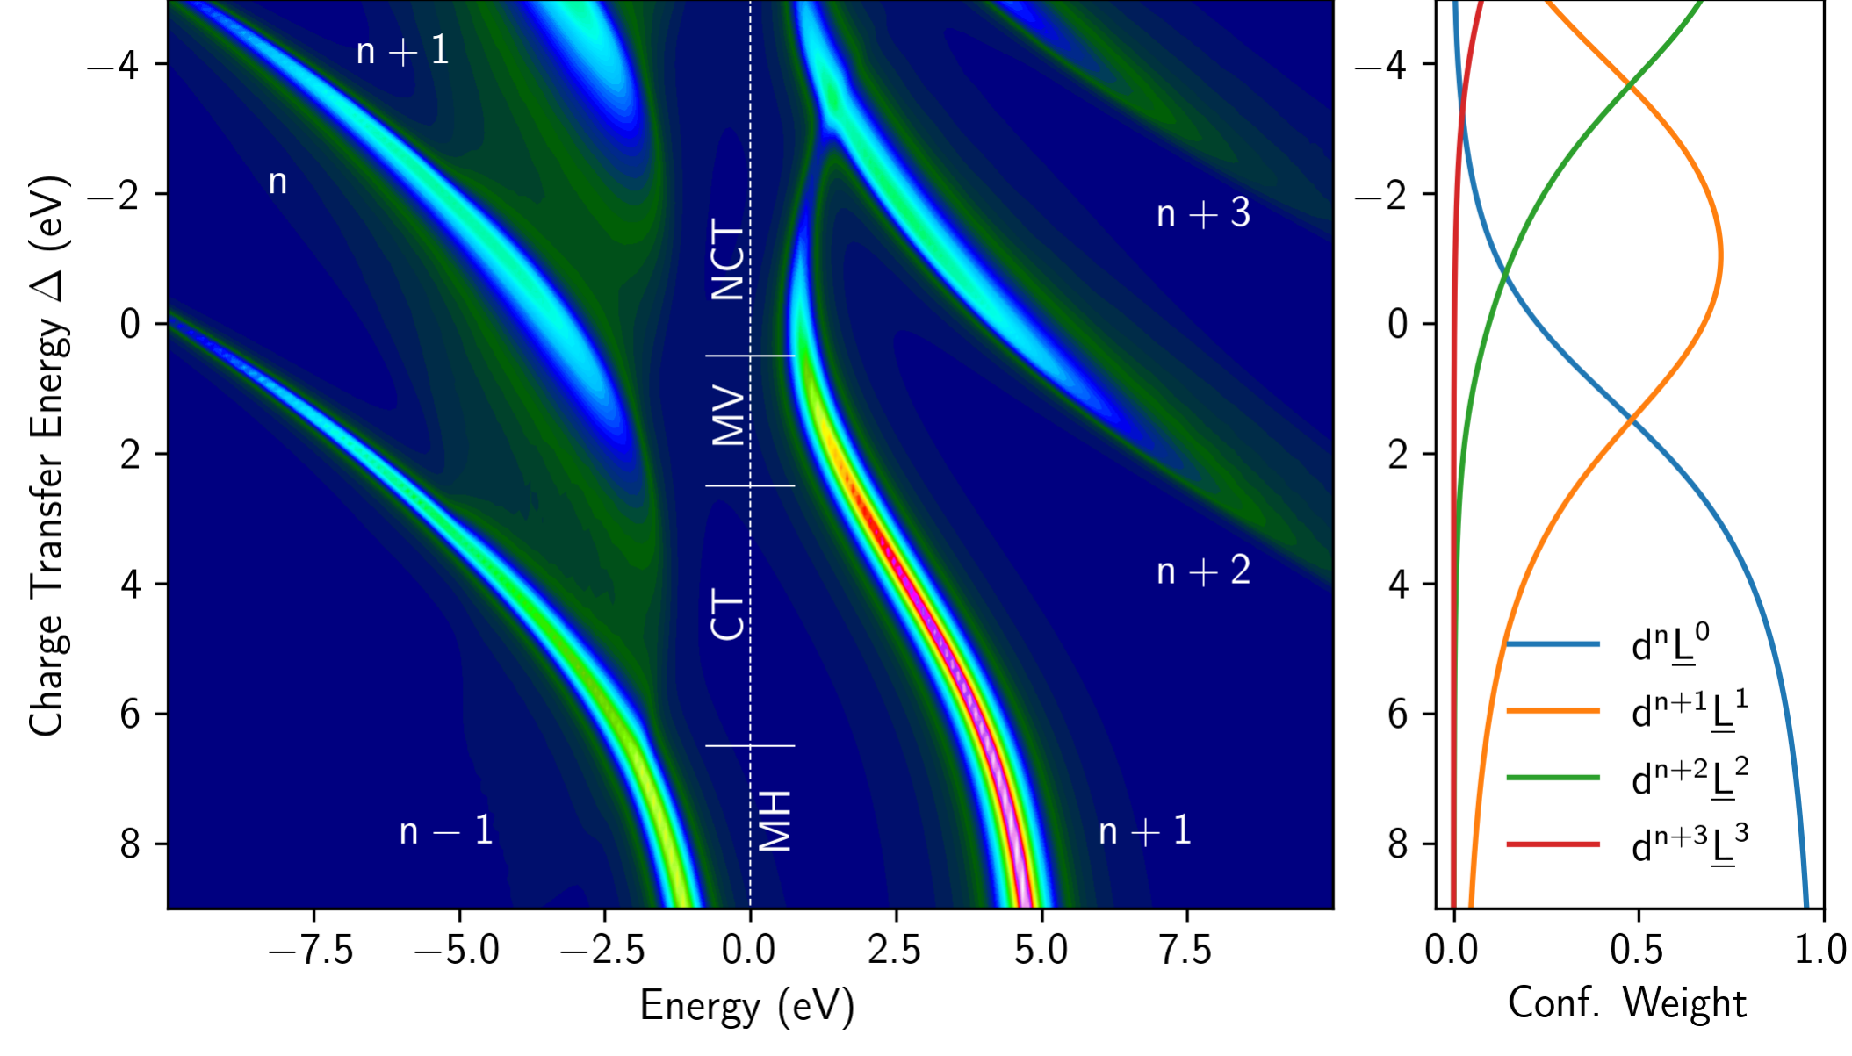
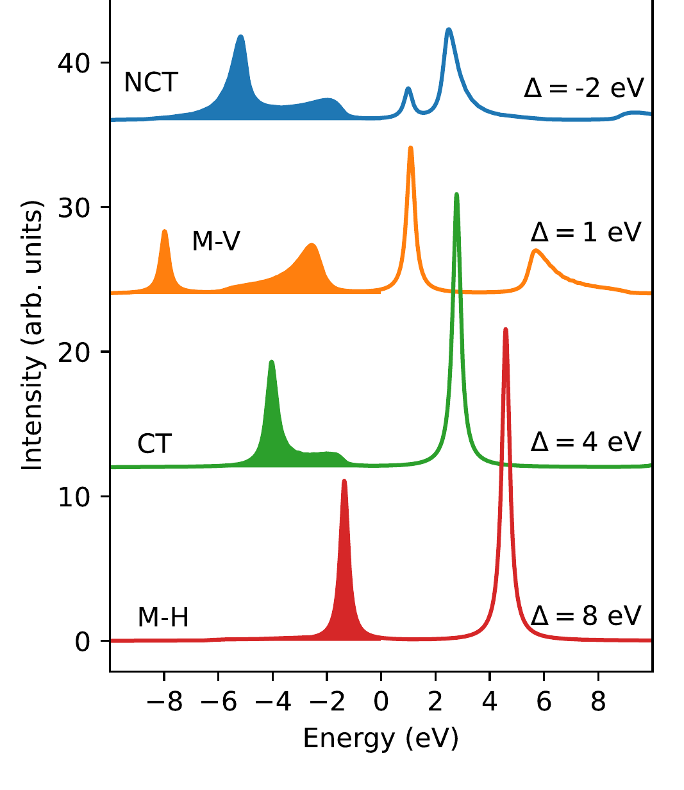
Off the bottom of the ZSA diagram
Recap
Sideways
Upward
The map
Four regimes, computed with the Anderson impurity model in Quanty
Mott–Hubbard → charge transfer → mixed valence → negative charge transfer (NCT)
R. J. Green & G. A. Sawatzky, J. Phys. Soc. Jpn. 93, 121007 (2024)
R. J. Green · Quanty Workshop, Heidelberg 2026
10

Slide 11
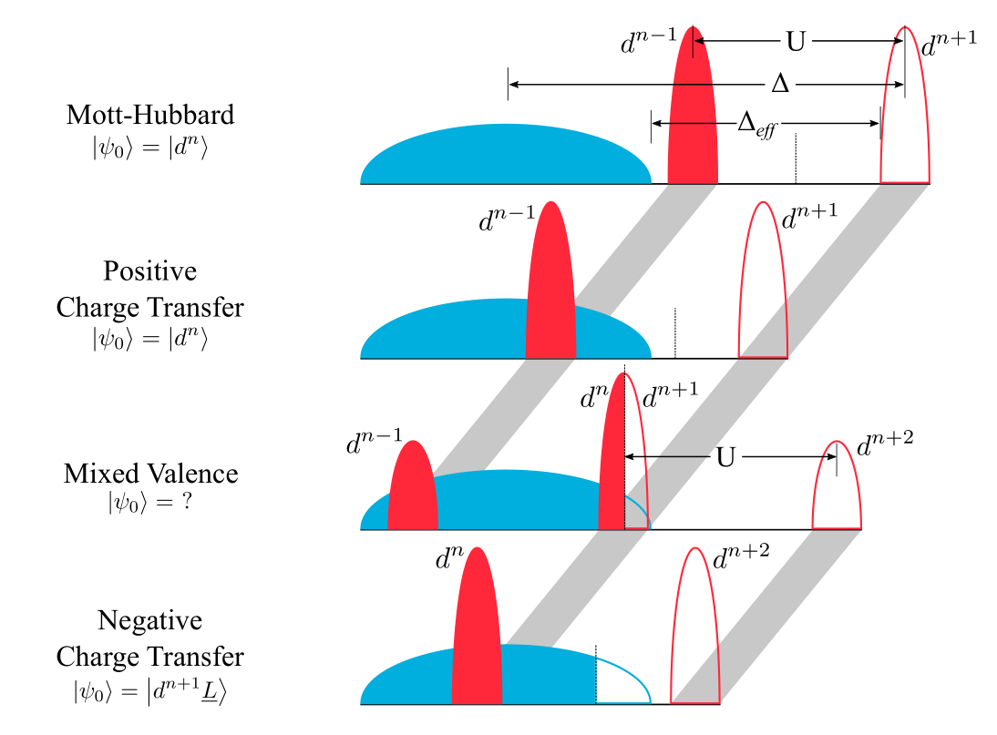
Negative Δ: the ligands dope themselves
Recap
Sideways
Upward
The map
R³⁺ Ni³⁺ (O₃)⁶⁻ → R³⁺ Ni²⁺ (O₃)⁵⁻
d⁷ → d⁸L̲ (S = ½)
Nickel “prefers” to stay 2+ (d⁸)
The missing electron is a hole in the O 2p band: self-doping
One ligand hole per NiO₆, but every O is shared by two Ni
Classification figure: G. A. Sawatzky & R. J. Green, Autumn School on Correlated Electrons (2016); T. Mizokawa et al., PRB 61, 11263 (2000)
R. J. Green · Quanty Workshop, Heidelberg 2026
11

Slide 12
Bond disproportionation
Recap
Sideways
Upward
The map
The ligand holes pick sides
d⁸L̲
S = ½
d⁸L̲
S = ½
d⁸L̲⁰
long bond · S = 1
d⁸L̲²
short bond · S = 0
+
+
The MIT as a bond-centred ordering of the ligand holes, with very little change in Ni 3d occupation
Long bond: the Ni moment is bare (S = 1). Short bond: two ligand holes screen it (S = 0)
If this is right, the two Ni sites must have different spectra and different moments
R. J. Green · Quanty Workshop, Heidelberg 2026
12

Slide 13
A hypothesis waiting for a test
Recap
Sideways
Upward
The map
Bond disproportionation in theory, 2000–2014
2000
Mizokawa, Khomskii & Sawatzky
Negative Δ: self-doped O 2p holes order on alternate sites
PRB 61, 11263
2012
Park, Millis & Marianetti
Site-selective Mott transition: one Ni sublattice localizes (DFT + DMFT)
PRL 109, 156402
2013
Lau & Millis
Magnetic and metal–insulator transitions of bulk and layered RNiO₃
PRL 110, 126404
2014
Johnston, Mukherjee, Elfimov, Berciu & Sawatzky
Charge disproportionation without charge transfer, driven by the lattice
PRL 112, 106404
What was missing
No full multiplets or core hole, so no XAS or magnetic scattering to compare with. And a single NiO₆ cluster can't hold the hypothesis at all.
The test: build it into a model that computes the spectra, then compare.
See also I. I. Mazin et al., PRL 98, 176406 (2007); A. Subedi, O. E. Peil & A. Georges, PRB 91, 075128 (2015)
R. J. Green · Quanty Workshop, Heidelberg 2026
13

Slide 14
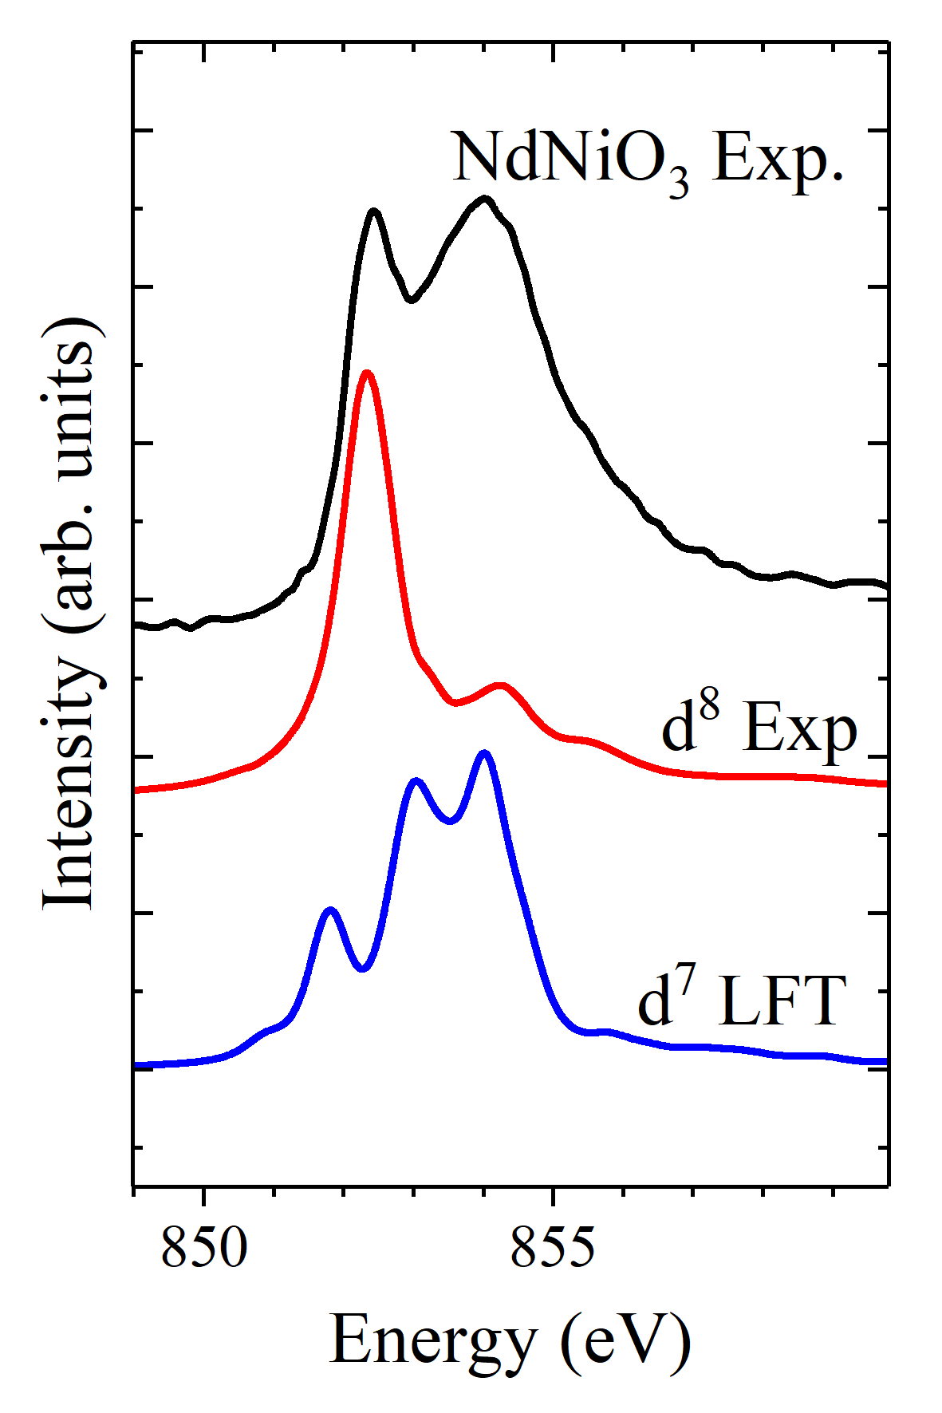
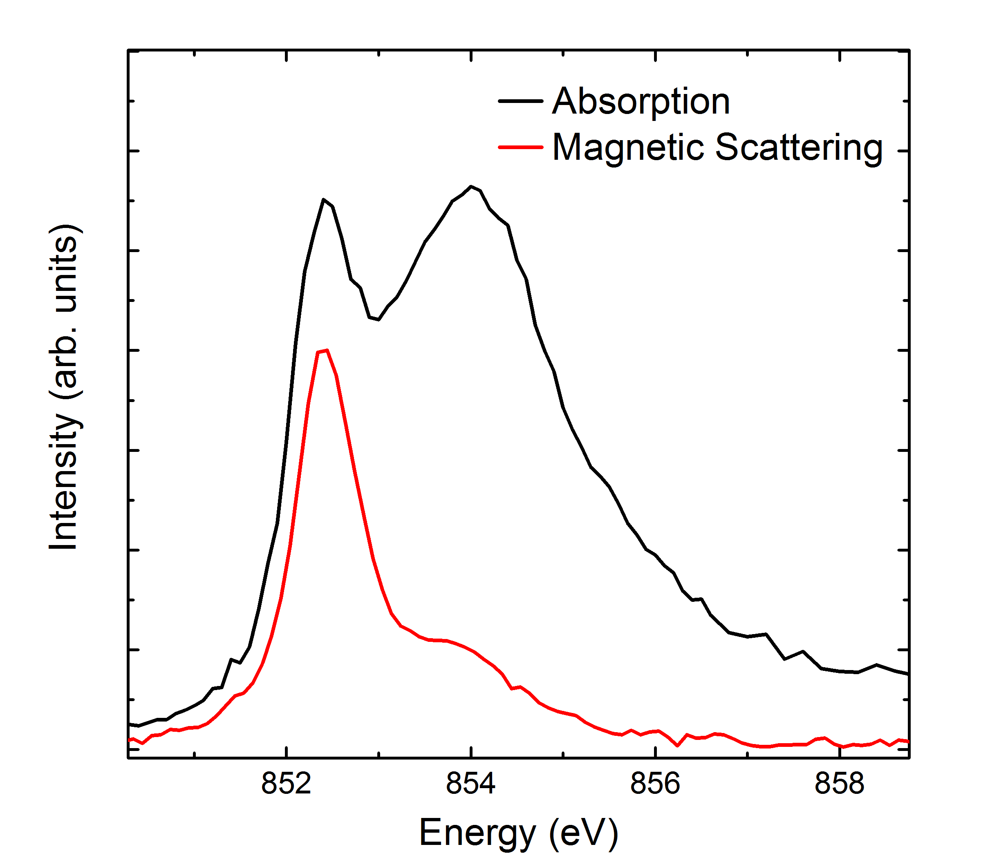
Single-cluster checkpoint
Recap
Sideways
Upward
The map
Ligand field theory, one NiO₆, d⁷
✓ Gets right
With “creative” broadening, a passable XAS
Ni d count close to 8
✗ Misses
The sharp first XAS peak and its magnetic response
Resonant magnetic diffraction: fails
Bond disproportionation itself: there is no second site
NdNiO₃: XAS + magnetic scattering
d⁷ LFT vs. experiment
R. J. Green · Quanty Workshop, Heidelberg 2026
14

Slide 15
Why one cluster must fail
Recap
Sideways
Upward
The map
A ligand hole between two nickels
A single cluster starts from a full ligand shell: only |d^{n+m}L̲^{m}⟩ are possible
A self-doped hole can't move to the neighbour, because there is no neighbour
The disproportionation itself, d⁸L̲ + d⁸L̲ → d⁸ + d⁸L̲², is simply not in the Hilbert space
Monday's words: different sites are not enough; we need the correlations between them
Ni
Ni
R. J. Green · Quanty Workshop, Heidelberg 2026
15

Slide 16
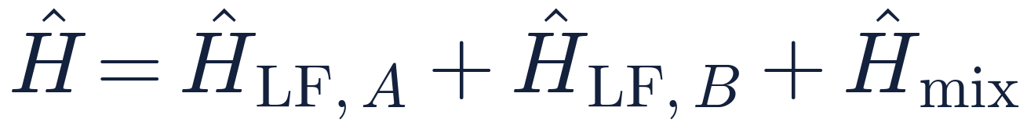
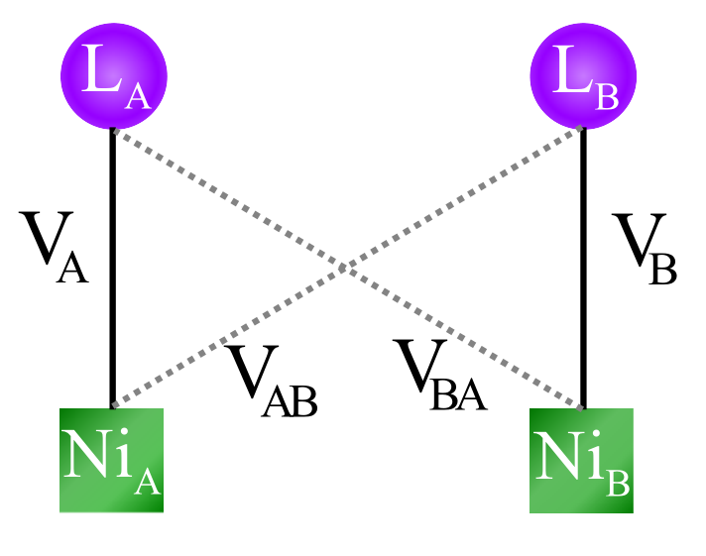
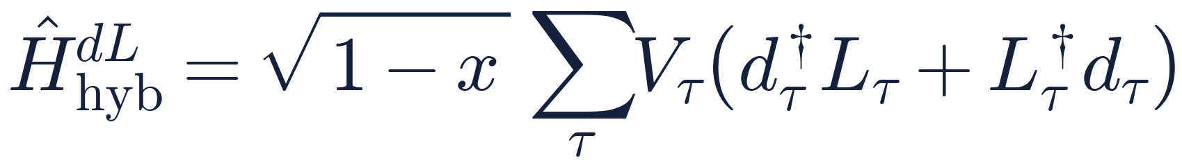
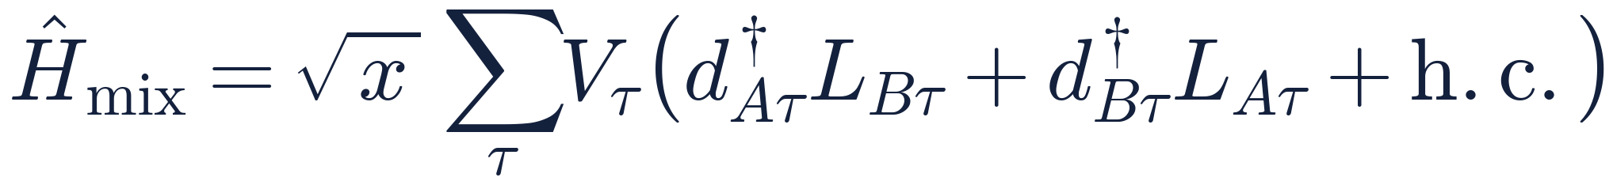
The double-cluster model
Recap
Sideways
Upward
The map
Two full ligand-field clusters, coupled by symmetry-adapted hopping
Each cluster: full multiplets, 2p core, spin–orbit, crystal field. Monday's LFT, twice.
x splits the hybridization between own and neighbour: total covalency is unchanged
R. J. Green, M. W. Haverkort & G. A. Sawatzky, PRB 94, 195127 (2016)
R. J. Green · Quanty Workshop, Heidelberg 2026
16

Slide 17
Why two ligand shells, not one?
Recap
Sideways
Upward
The map
Each Ni keeps its own covalency; x dials in the neighbour
Two shells = one orthogonalized ligand shell per Ni, as in the Zhang–Rice construction. Not two copies of the oxygens.
L_{A}
L_{B}
L
Each Ni keeps its covalency; x only switches on the neighbour
Ni_{A}
Ni_{B}
Ni_{A}
Ni_{B}
two shells (this model)
solid √(1−x) V · dashed √x V
one shared shell
both bonds V
Why not one shared shell?
Both Ni would bond at full strength to the same ligand orbitals: the strongest possible Ni–Ni coupling, which overestimates the exchange
x = 0: single cluster, no neighbour
x = ½: acts as one shared shell
the crystal lies in between
F. C. Zhang & T. M. Rice, PRB 37, 3759 (1988); PRB 94, 195127 (2016), Supplemental Material
R. J. Green · Quanty Workshop, Heidelberg 2026
17

Slide 18
The symmetry trick
Recap
Sideways
Upward
The map
Why perovskites are ideal for two clusters
In the idealized rock-salt pattern, the six neighbours of the other kind form an octahedral environment
So the neighbour's ligand orbitals can be written with the same e_{g} / t_{2g} symmetry as one's own
In the model, H_{mix} is then O_{h}-symmetric: same orbitals, same parameters, no new bookkeeping
Expected: x ≈ 1/6
one shared O per neighbour
Best fit: x = 0.35² ≈ 0.12
octahedral tilts reduce Ni–O–Ni overlap
R. J. Green · Quanty Workshop, Heidelberg 2026
18

Slide 19
Breathing, and the recipe card
Recap
Sideways
Upward
The map
Bond lengths enter through Harrison's scaling rules
Parameter | Value (eV)
U_{dd} / U_{pd} | 6 / 7
Δ | −0.5
10Dq | 0.95
T_{pp} | 0.75
V_{eg} / V_{t2g} | 3.0 / 1.74
√x | 0.35
F², F⁴ (dd, pd), G¹, G³ | 80% of Hartree–Fock
Distortion δd: long bond d₀ + δd, short bond d₀ − δd
Hopping and crystal field rescale on each site; nothing else is refit
Standard values: nothing exotic, just the extra site.
PRB 94, 195127 (2016), Supplemental Material; J. M. Wills & W. A. Harrison, PRB 28, 4363 (1983)
R. J. Green · Quanty Workshop, Heidelberg 2026
19

Slide 20
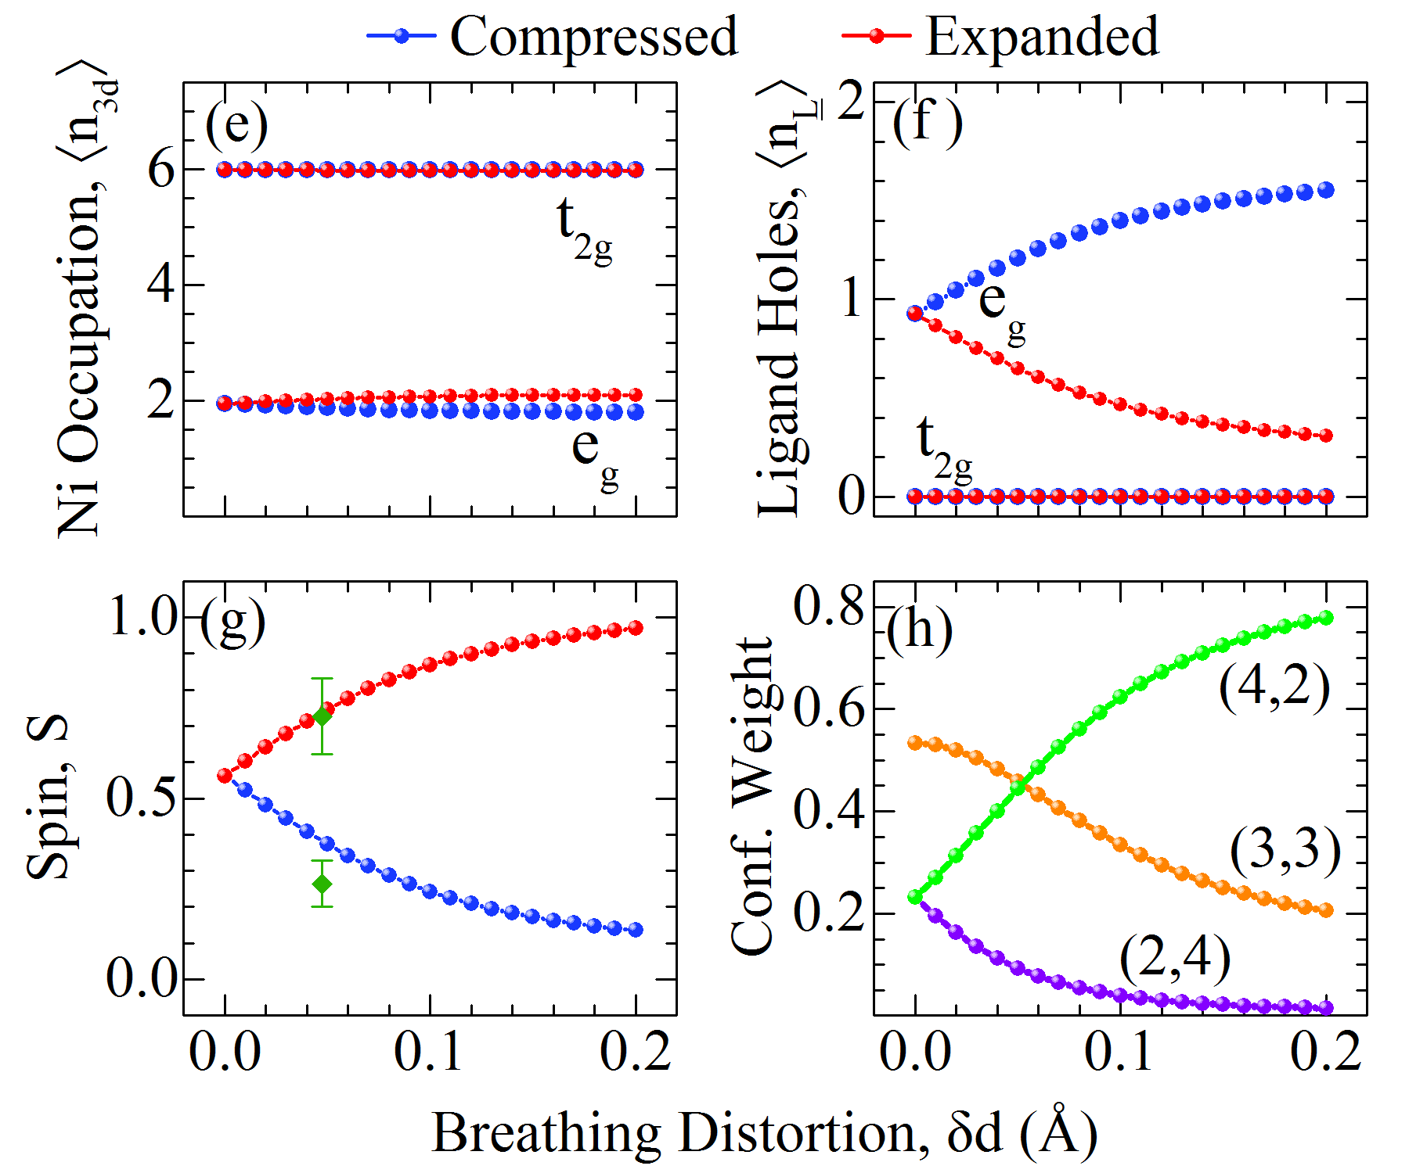
Test 1: the ground state disproportionates
Recap
Sideways
Upward
The map
Ground-state properties vs. breathing distortion, standard parameters
hole densities at δd = 0.05 Å, coloured by spin
Ni 3d count ≈ 8 on both sites: little Ni charge order
Ligand holes move to the compressed octahedron: (3,3) → (4,2)
S → 0 (short), S → 1 (long): moments agree with HoNiO₃
PRB 94, 195127 (2016), Fig. 1. HoNiO₃: J. A. Alonso et al., PRB 61, 1756 (2000); M. T. Fernández-Díaz et al., PRB 64, 144417 (2001)
R. J. Green · Quanty Workshop, Heidelberg 2026
20

Slide 21
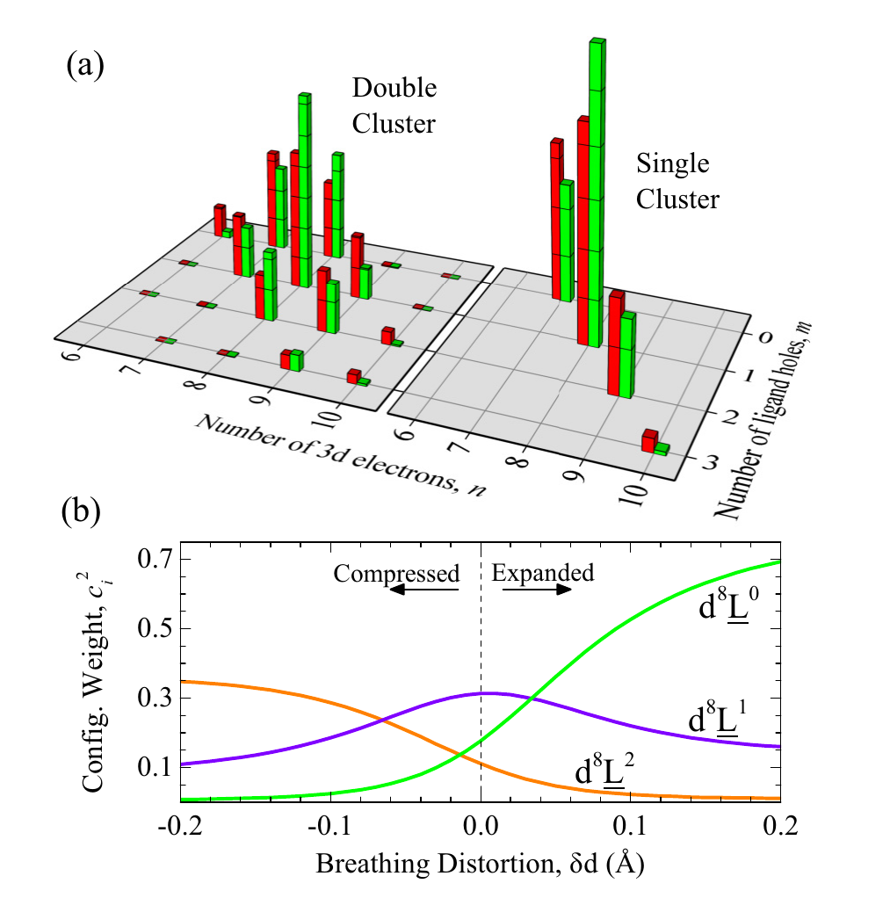
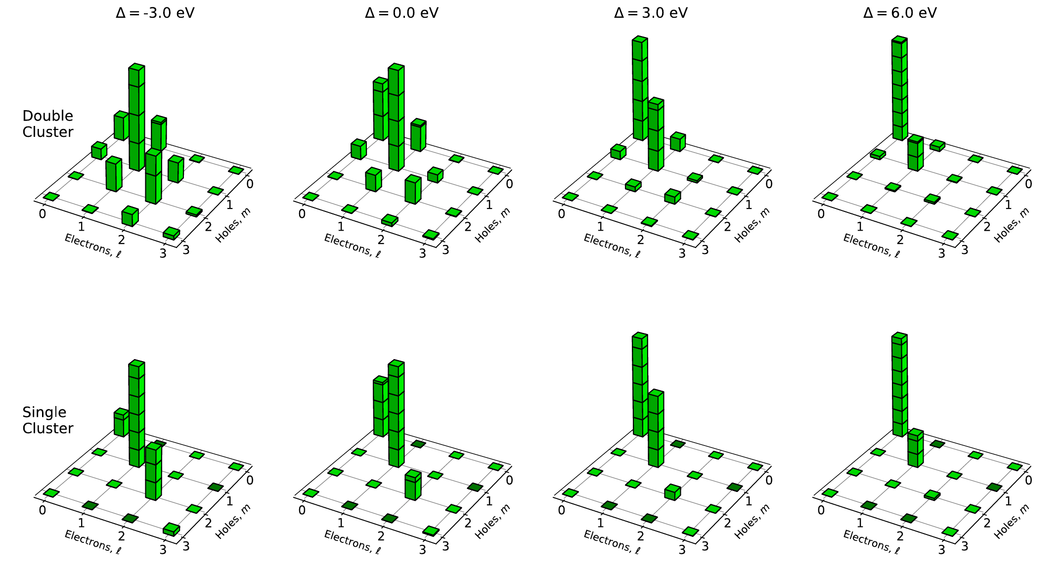
The wavefunction leaves the diagonal
Recap
Sideways
Upward
The map
Weights of the configurations dⁿ⁺ˡL̲ᵐ: double vs. single cluster
Single cluster: confined to the diagonal d^{n+m}L̲^{m}
Double cluster: off-diagonal weight = intersite charge fluctuations
It grows as Δ goes negative
R. J. Green · Quanty Workshop, Heidelberg 2026
21

Slide 22
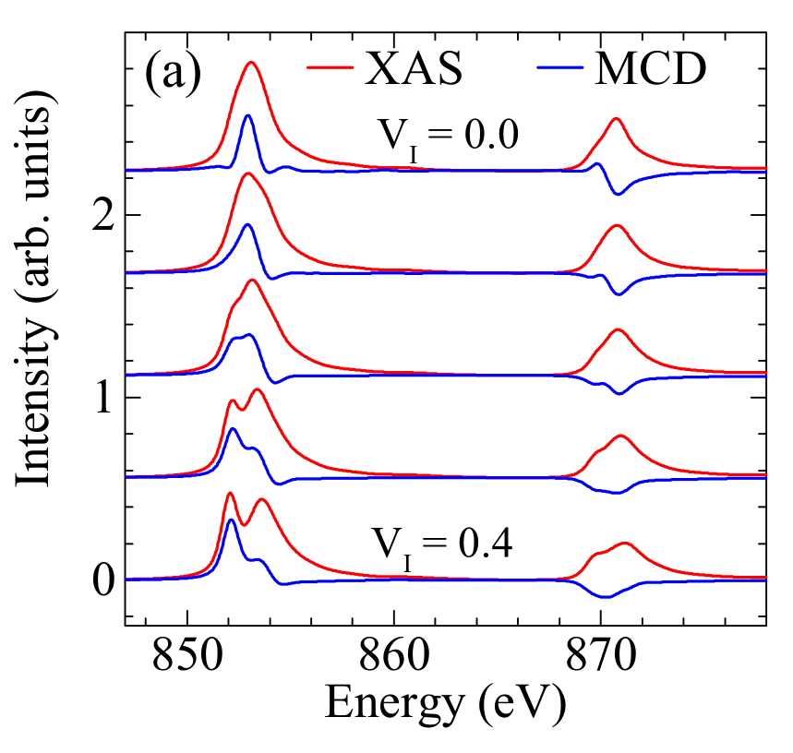
Very sensitive to intersite fluctuations
Recap
Sideways
Upward
The map
The XAS and MCD spectrum as the intercluster hopping is switched on
V_{I} = √x = 0: the ordinary single-cluster spectrum
Turn on V_{I}: the first peak separates off below both L₃ and L₂
It carries strong MCD, just like the experimental magnetic scattering
No breathing distortion yet: intersite fluctuations alone reshape the spectrum
R. J. Green · Quanty Workshop, Heidelberg 2026
22

Slide 23
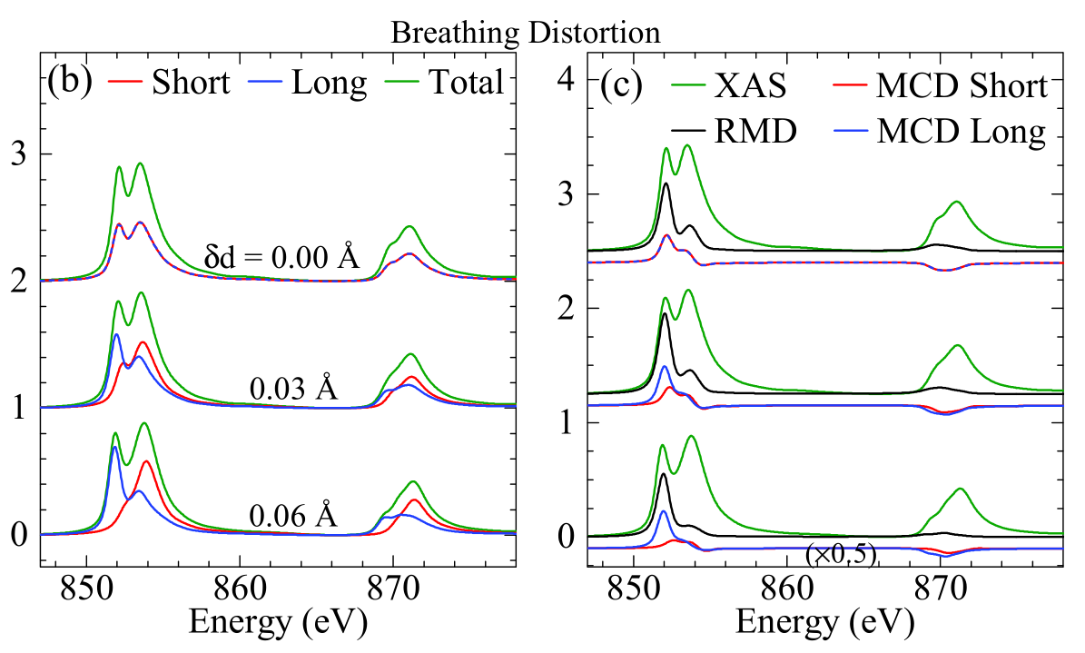
Test 2: two sites, two spectra
Recap
Sideways
Upward
The map
XAS and MCD of each site as the breathing distortion grows
Long-bond spectrum moves down in energy, short-bond spectrum up
The sharp first peak comes entirely from the long-bond Ni
Its MCD grows (S → 1) while the short-bond MCD fades (S → 0)
So magnetic scattering should peak at the first XAS peak
Smaller R, larger δd, larger splitting: the trend across the series
PRB 94, 195127 (2016), Fig. 2(b, c). Trends: C. Piamonteze et al., PRB 71, 020406 (2005); J. W. Freeland et al., J. Electron Spectrosc. 208, 56 (2015)
R. J. Green · Quanty Workshop, Heidelberg 2026
23

Slide 24
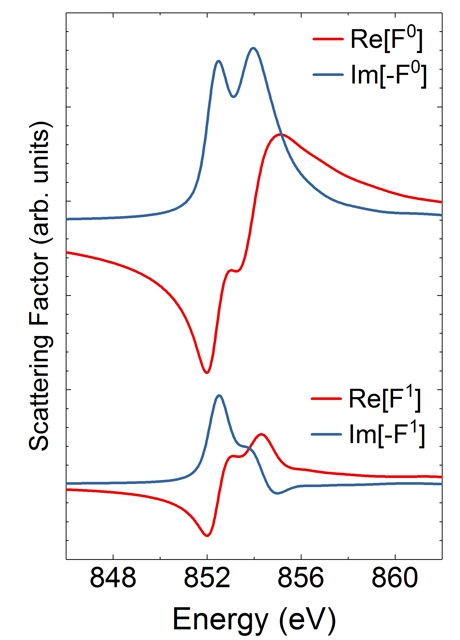
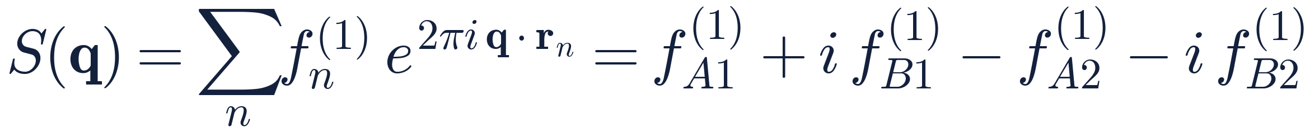
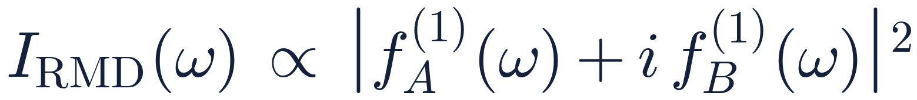
Computing the magnetic scattering
Recap
Sideways
Upward
The map
Resonant magnetic diffraction at q = (¼, ¼, ¼), from the two clusters
1
Each site gives a magnetic scattering factor
f⁽¹⁾ᵢ(ω): the magnetic part of site i's complex resonant scattering factor. Imaginary part: the XMCD; real part: Kramers–Kronig.
2
Add the four sites of the ↑↑↓↓ period
Successive (111) planes, A B A B, pick up phases 1, i, −1, −i
3
Antiferromagnetic planes: f⁽¹⁾_{A2} = −f⁽¹⁾_{A1}, and the same for B
f_{A} and f_{B} interfere: the signal needs both sites, from one ground state
one site: charge (F⁰) and magnetic (F¹ = f⁽¹⁾)
PRB 94, 195127 (2016), Supplemental Material
R. J. Green · Quanty Workshop, Heidelberg 2026
24

Slide 25
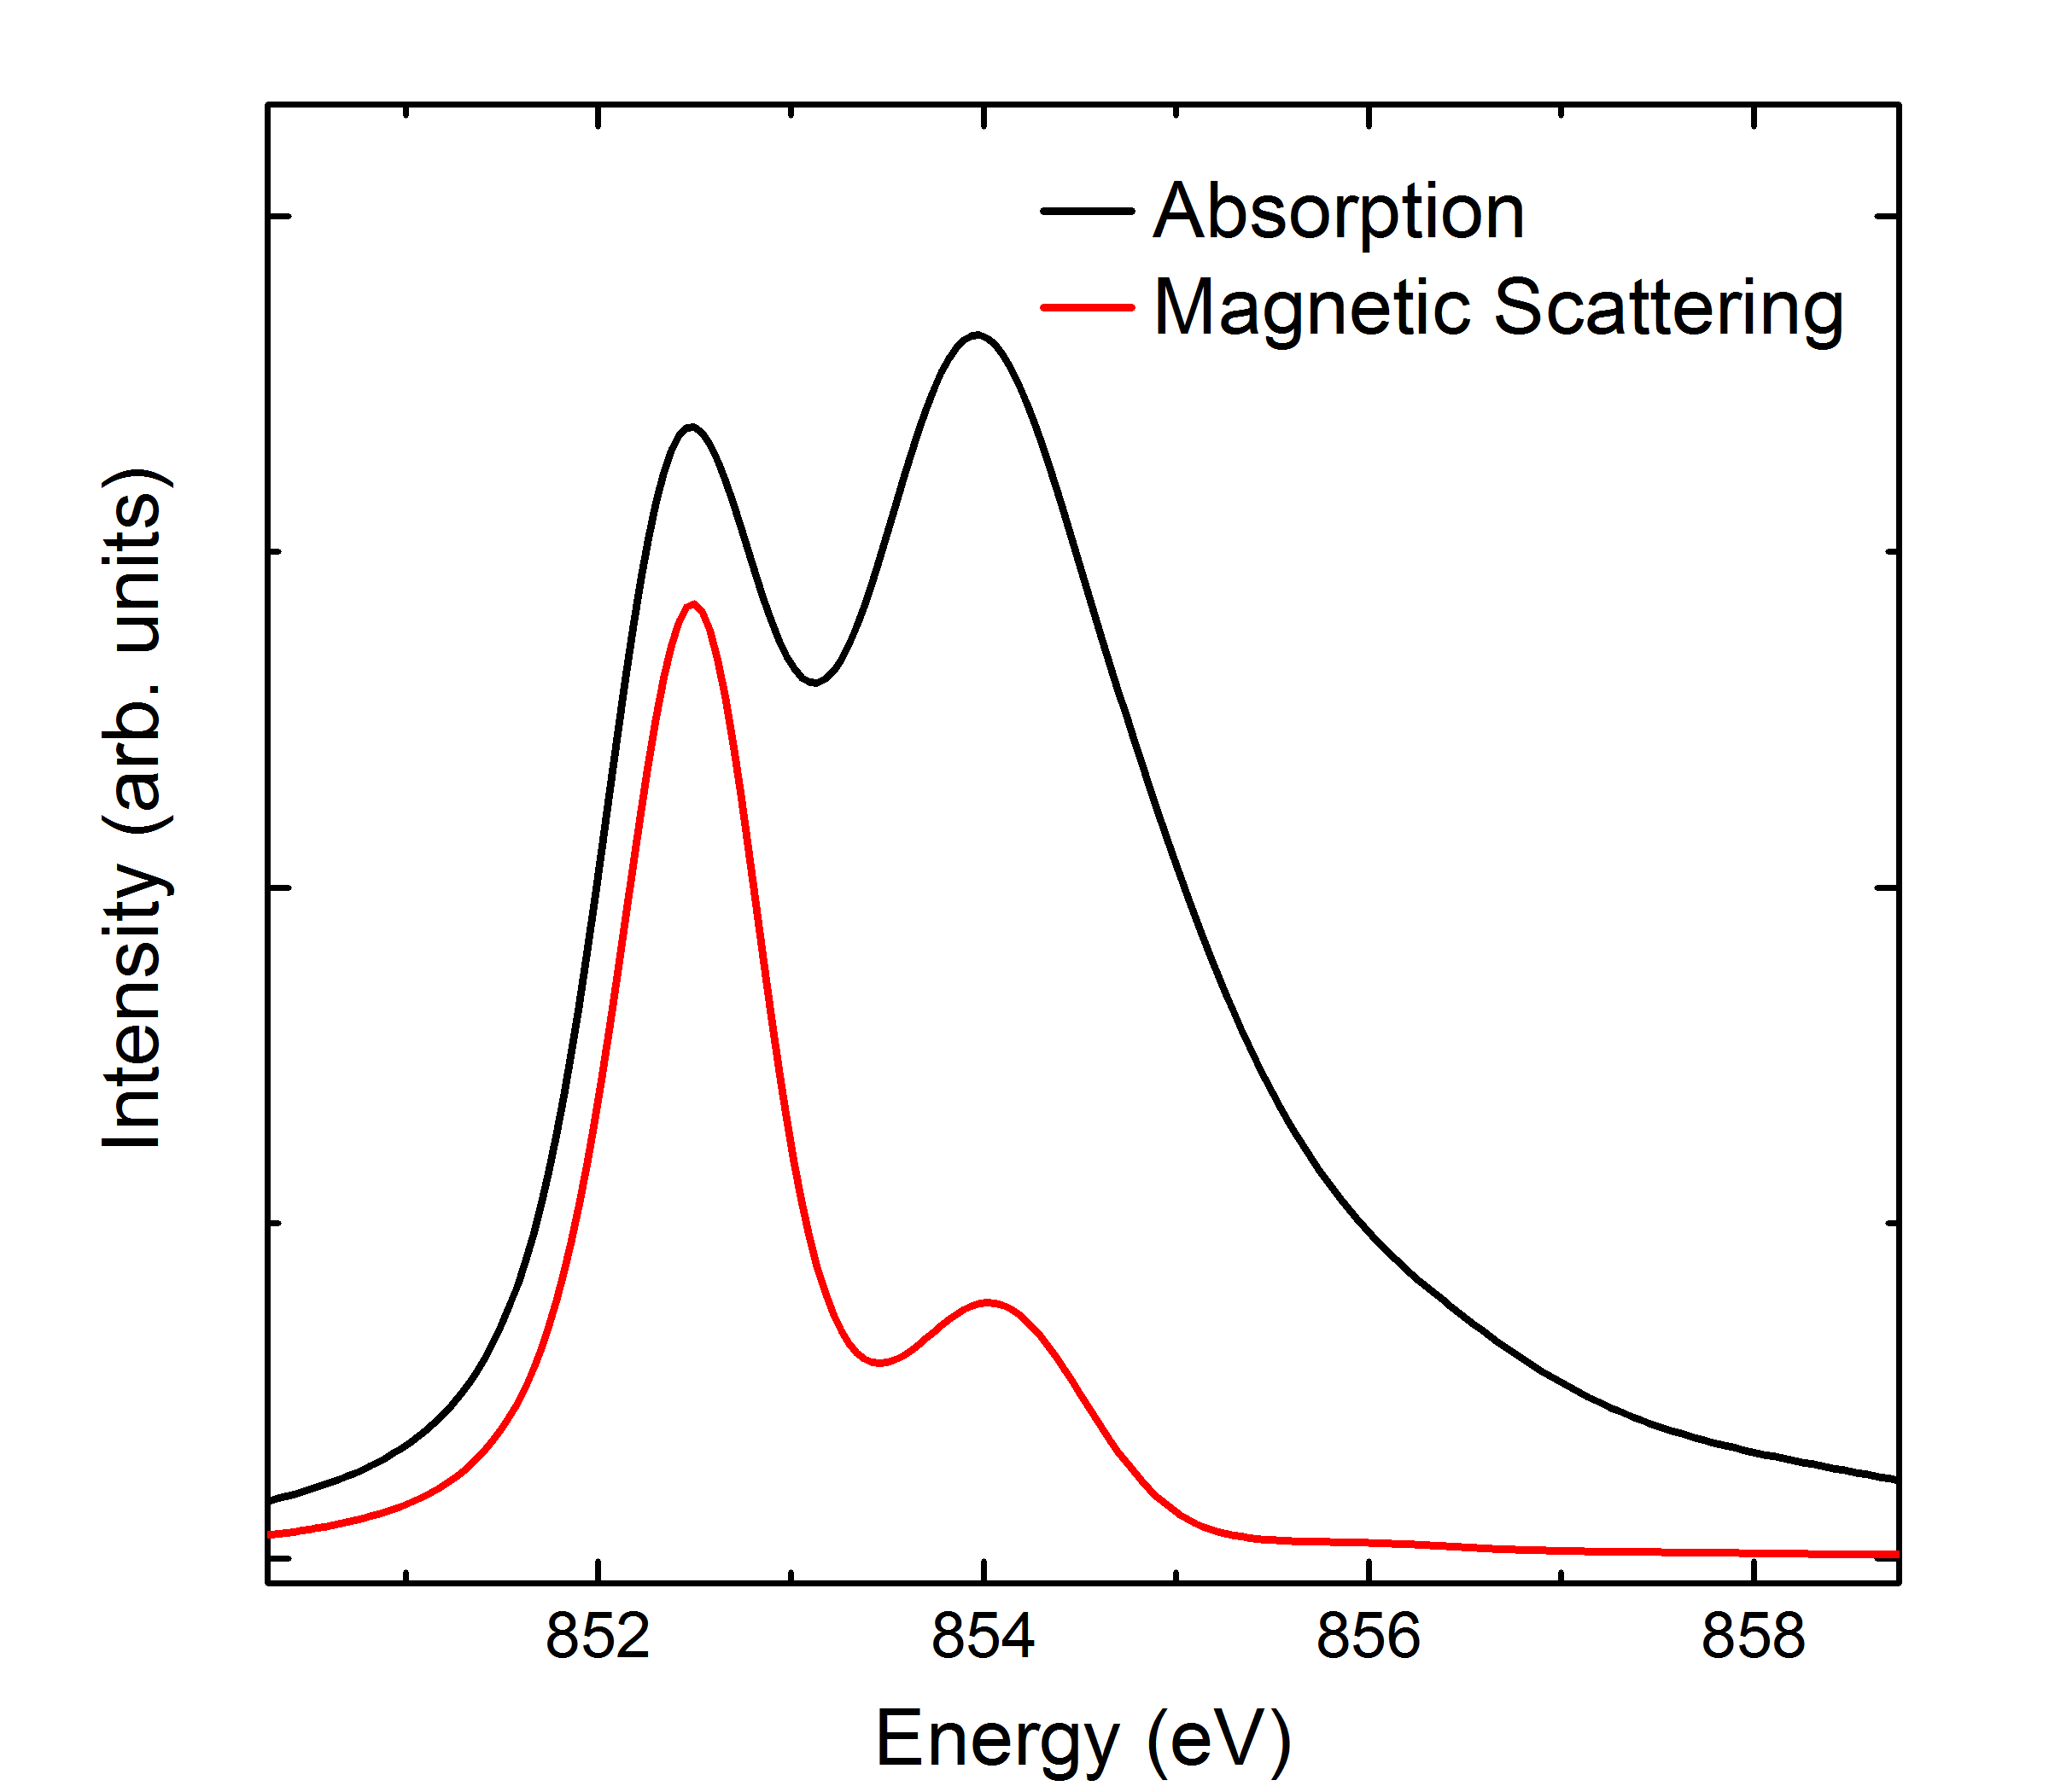
Double-cluster checkpoint
Recap
Sideways
Upward
The map
Test 3: XAS and magnetic scattering against experiment
✓ Gets right
XAS line shape, including the sharp first peak
Energy dependence of resonant magnetic diffraction
Moments on the two sublattices; trends across the R series
✗ Misses
Cluster-size convergence (x is empirical)
Band dispersion and k-dependence
The metallic phase
Double-cluster theory
NdNiO₃ experiment
PRB 94, 195127 (2016). Experimental trends: Piamonteze et al. PRB 71, 020406 (2005); Bisogni et al. Nat. Commun. 7, 13017 (2016)
R. J. Green · Quanty Workshop, Heidelberg 2026
25

Slide 26
Bond disproportionation passes the test
Recap
Sideways
Upward
The map
A spectroscopic validation, and then the model became a tool
Hypothesis
theory, 2000–2014: the ligand holes pick sides
Double cluster
the hypothesis + full multiplets + the core hole
Experiment
XAS, magnetic scattering and moments all match
The previously missing link between theory and the spectra people actually measure
Then it became a tool for reading experiments:
Hepting et al., Nature Phys. 14, 1097 (2018)
NdNiO₃ slabs: magnetic scattering + double cluster give the moment on each sublattice. Thin slabs: breathing suppressed, moments equalize.
Li et al., PRL 126, 187602 (2021)
Oxygen-deficient films: a doped double cluster shows electron doping erasing the bond disproportionation.
Li et al., Nat. Commun. 15, 7427 (2024)
Chiral spin disproportionation: on the compressed site, Ni and ligand spins lock antiparallel.
R. J. Green · Quanty Workshop, Heidelberg 2026
26

Slide 27
What going sideways costs
Recap
Sideways
Upward
The map
Hilbert-space dimension, valence shells only
1 140
single cluster, d⁷ (20 spin-orbitals, 3 holes)
3.8 × 10⁶
double cluster, d⁷ + d⁷ (40 spin-orbitals, 6 holes)
Adding one site multiplies the cost by ~3 000: the exponential wall, felt from close up
Still a laptop problem with Lanczos. Three clusters: ~10¹⁰ states, which is not.
R. J. Green · Quanty Workshop, Heidelberg 2026
27

Slide 28
When do you need to go sideways?
Recap
Sideways
Upward
The map
Small or negative Δ
High oxidation states: Ni³⁺, Cu³⁺, Fe⁴⁺, Co⁴⁺ … heavier anions (S, Se)
Self-doped ligand holes
Holes on shared anions that can pick a side: bond disproportionation
Nonlocal screening
Screening by a specific neighbouring site: NiO 2p XPS, cuprates. (If a continuum of screening states will do, going up may be enough.)
Intersite excitations
Features that need two sites: bond order, dimers, intersite charge-transfer excitons, exchange excitations
Examples: RNiO₃, CaFeO₃ / SrFeO₃, NaCuO₂, the pyrites, Ni-rich battery cathodes
R. J. Green · Quanty Workshop, Heidelberg 2026
28

Slide 29
Recap
Sideways
Upward
The map
III
Upward
When the ligand becomes a band: RIXS of NiO

Slide 30
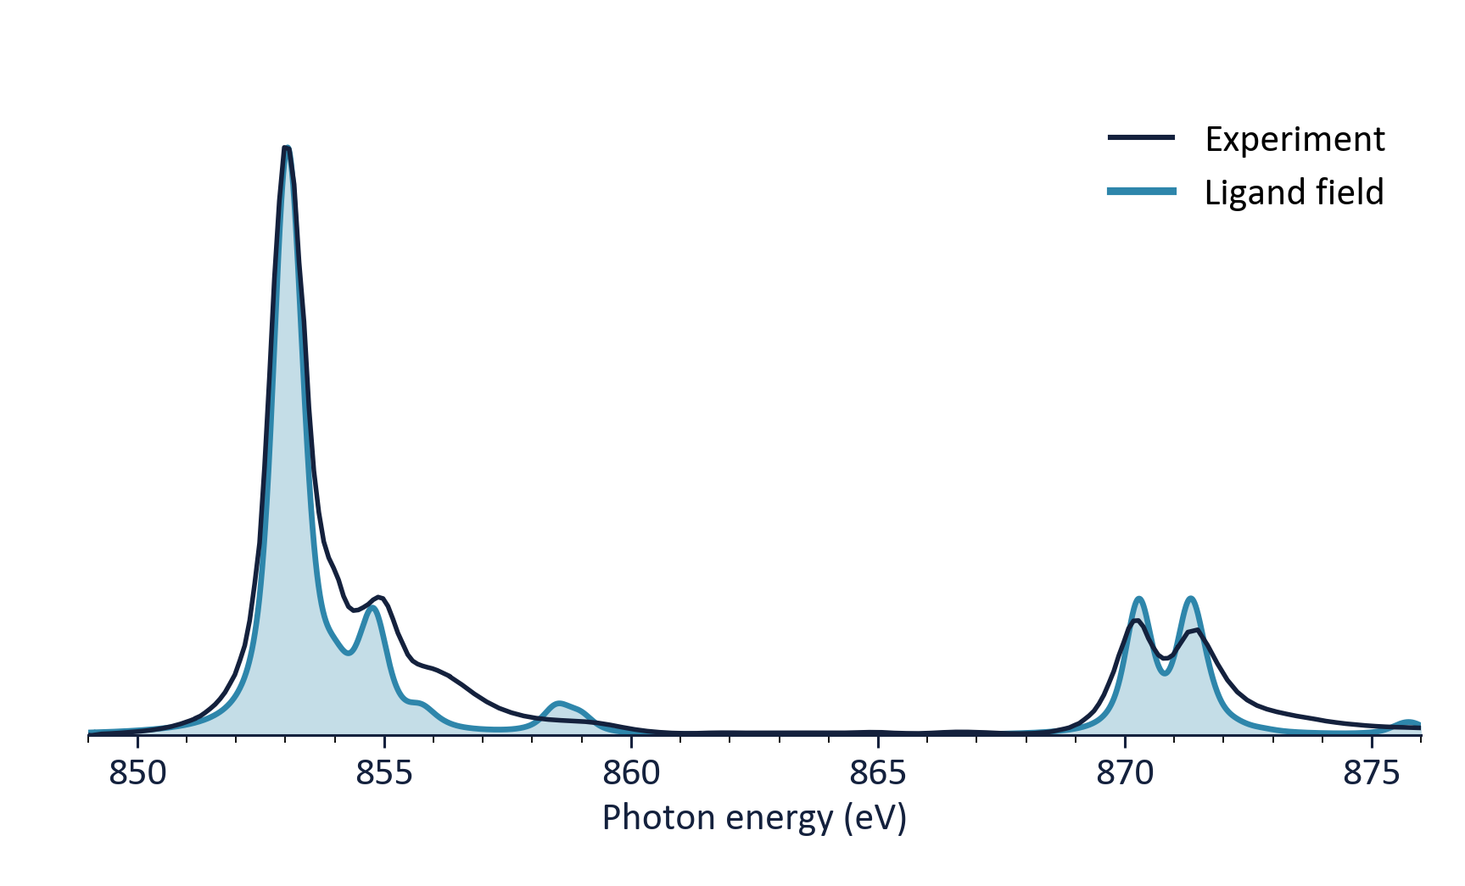
Back to NiO: LFT looks great…
Recap
Sideways
Upward
The map
Single-cluster LFT reproduces the XAS main lines
But the charge-transfer satellite near 858.5 eV comes out too sharp
XAS integrates over final states. What happens with a probe that resolves them?
NiO L₂,₃ XAS: ligand field vs. experiment (Monday's checkpoint #3)
R. J. Green · Quanty Workshop, Heidelberg 2026
30

Slide 31
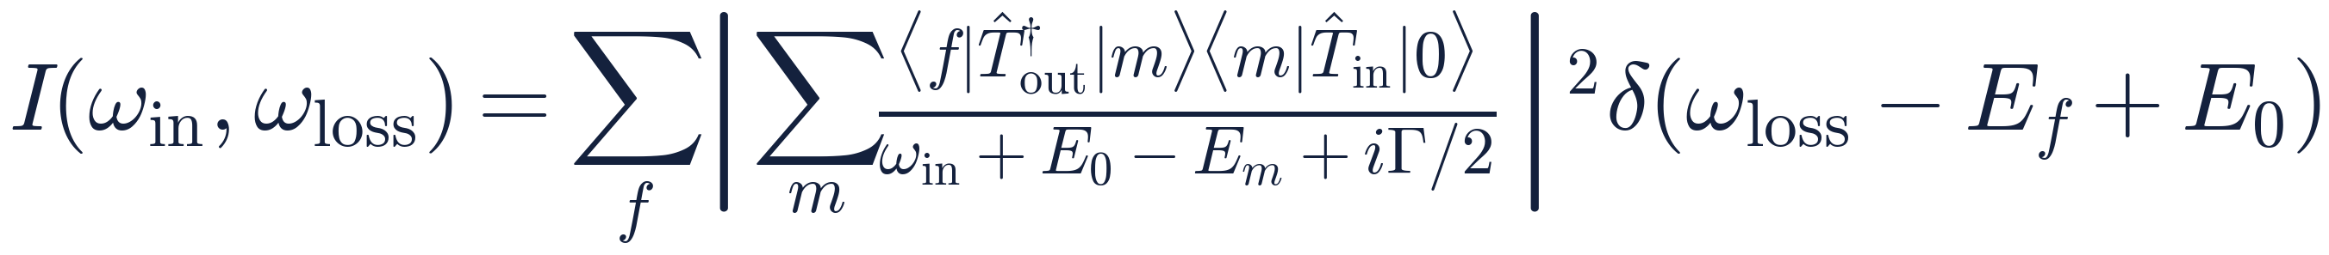
RIXS in one equation
Recap
Sideways
Upward
The map
Absorb, then emit: a second-order process
|m⟩ intermediate
the XAS final states, with a core hole
|f⟩ final
no core hole: dd, charge transfer, magnons …
Raman vs. fluorescence
fixed energy loss vs. fixed emission energy
The same Ĥ as Monday, used twice: once with a core hole, once without.
R. J. Green · Quanty Workshop, Heidelberg 2026
31

Slide 32
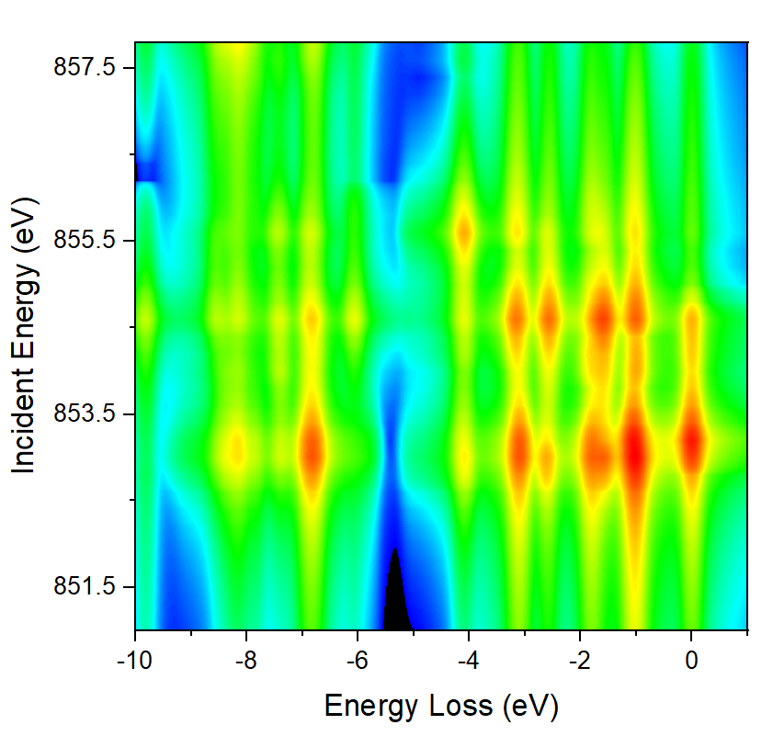
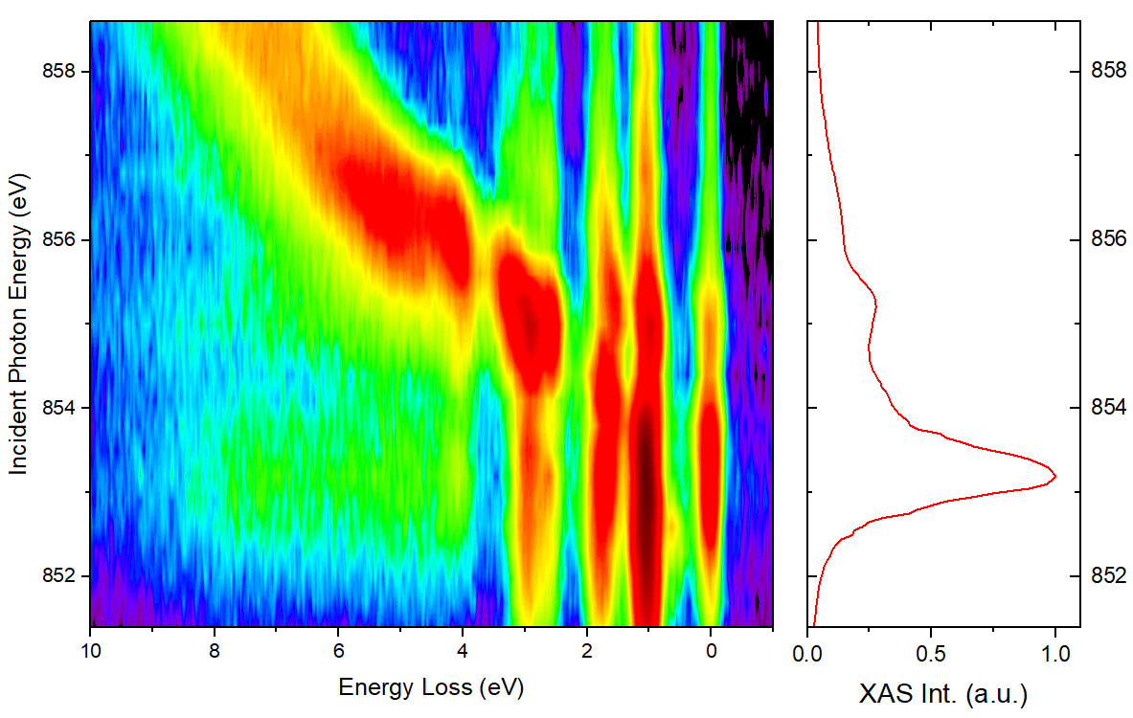
NiO 2p3d RIXS: the observation
Recap
Sideways
Upward
The map
Experiment vs. single-cluster ligand field theory
Experiment
Ligand field theory
LFT misses the charge-transfer features that disperse with incident energy.
Experimental data: G. Ghiringhelli et al., PRL 102, 027401 (2009), courtesy G. Ghiringhelli
R. J. Green · Quanty Workshop, Heidelberg 2026
32

Slide 33
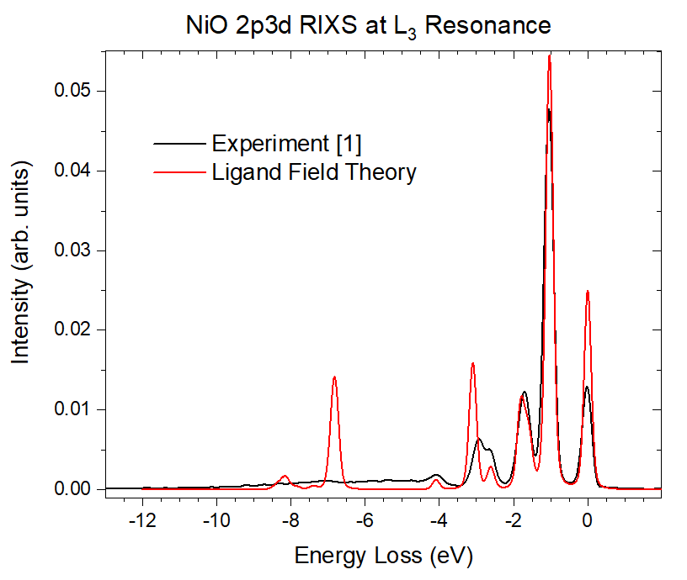
At resonance: lines where there should be a band
Recap
Sideways
Upward
The map
dd excitations (0–3 eV): LFT is good
Charge-transfer region: LFT gives a few sharp lines
Experiment: a broad, structured continuum
Our one ligand level is the suspect
Experimental data: G. Ghiringhelli et al., PRL 102, 027401 (2009), courtesy G. Ghiringhelli
R. J. Green · Quanty Workshop, Heidelberg 2026
33

Slide 34
RIXS through ligand-field eyes
Recap
Sideways
Upward
The map
One ligand level gives sharp, non-dispersing charge transfer
2p⁵d¹⁰L̲
Each final state is a single level
So each loss feature is one sharp line at a fixed energy loss, whatever the incident energy.
Raman-like, by construction.
2p⁵d⁹
emit
absorb
d⁹L̲ (CT)
d⁸* (dd)
ground d⁸
R. J. Green · Quanty Workshop, Heidelberg 2026
34

Slide 35
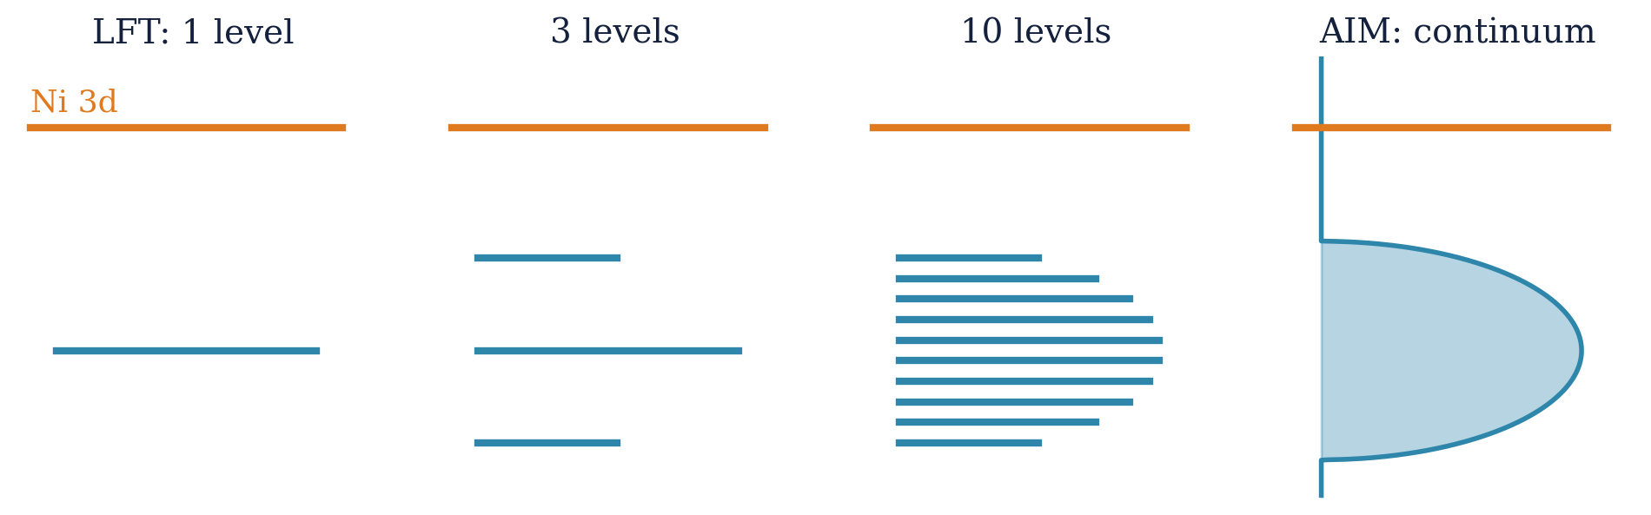
Upward: the ligand level becomes a band
Recap
Sideways
Upward
The map
Monday's rung 4, now doing real work
Charge-transfer final states d⁹L̲ now form a continuum: the hole can be anywhere in the O 2p band
Exciting into different parts of that band selects different emission: fluorescence that disperses
R. J. Green · Quanty Workshop, Heidelberg 2026
35

Slide 36
RIXS through Anderson-impurity eyes
Recap
Sideways
Upward
The map
A band of final states gives fluorescence that disperses
2p⁵d¹⁰L̲ band
The ligand hole stays where you put it
To first approximation it's a spectator: absorb into one part of the band, and the same part of the final-state band lights up.
Raise ω_{in}: the bright part moves up in energy loss by the same amount.
Fixed emission energy: fluorescence-like.
ω₂
d⁹L̲ band
2p⁵d⁹
ω₁
d⁸* (dd)
ground d⁸
R. J. Green · Quanty Workshop, Heidelberg 2026
36

Slide 37
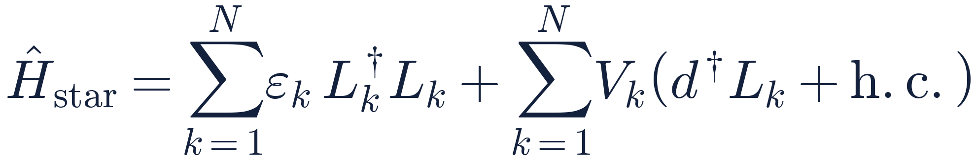
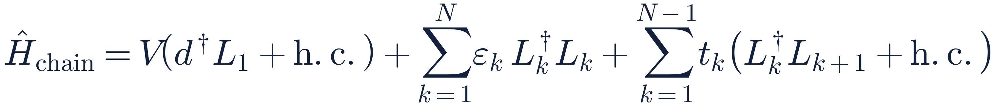
Building the bath in Quanty
Recap
Sideways
Upward
The map
One extra 10-orbital shell per bath site
Star (Anderson) geometry
Chain (Wilson) geometry
L1
L2
d
d
L3
L1
L2
L3
L4
L_N
L4
L_N
For intuition: each bath site is one energy in the band
For computing: compact ground states; core-hole potential easy to add
Star ↔ chain: a unitary transformation of the bath orbitals. Same eigenvalues, same physical states in a new basis, same spectra.
R. J. Green · Quanty Workshop, Heidelberg 2026
37

Slide 38
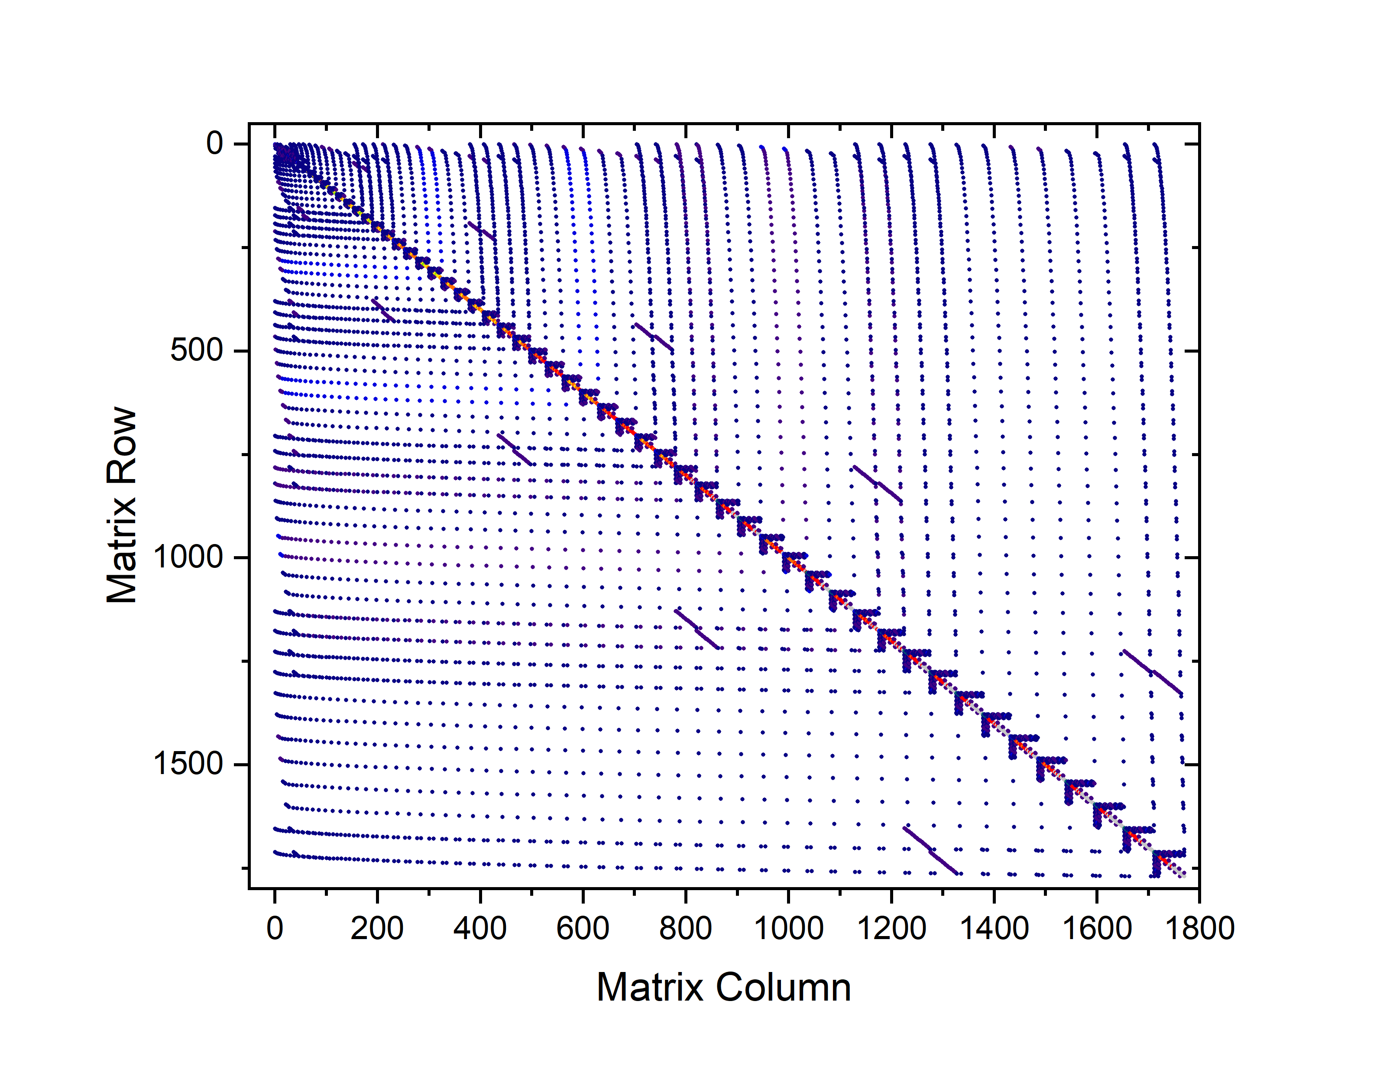
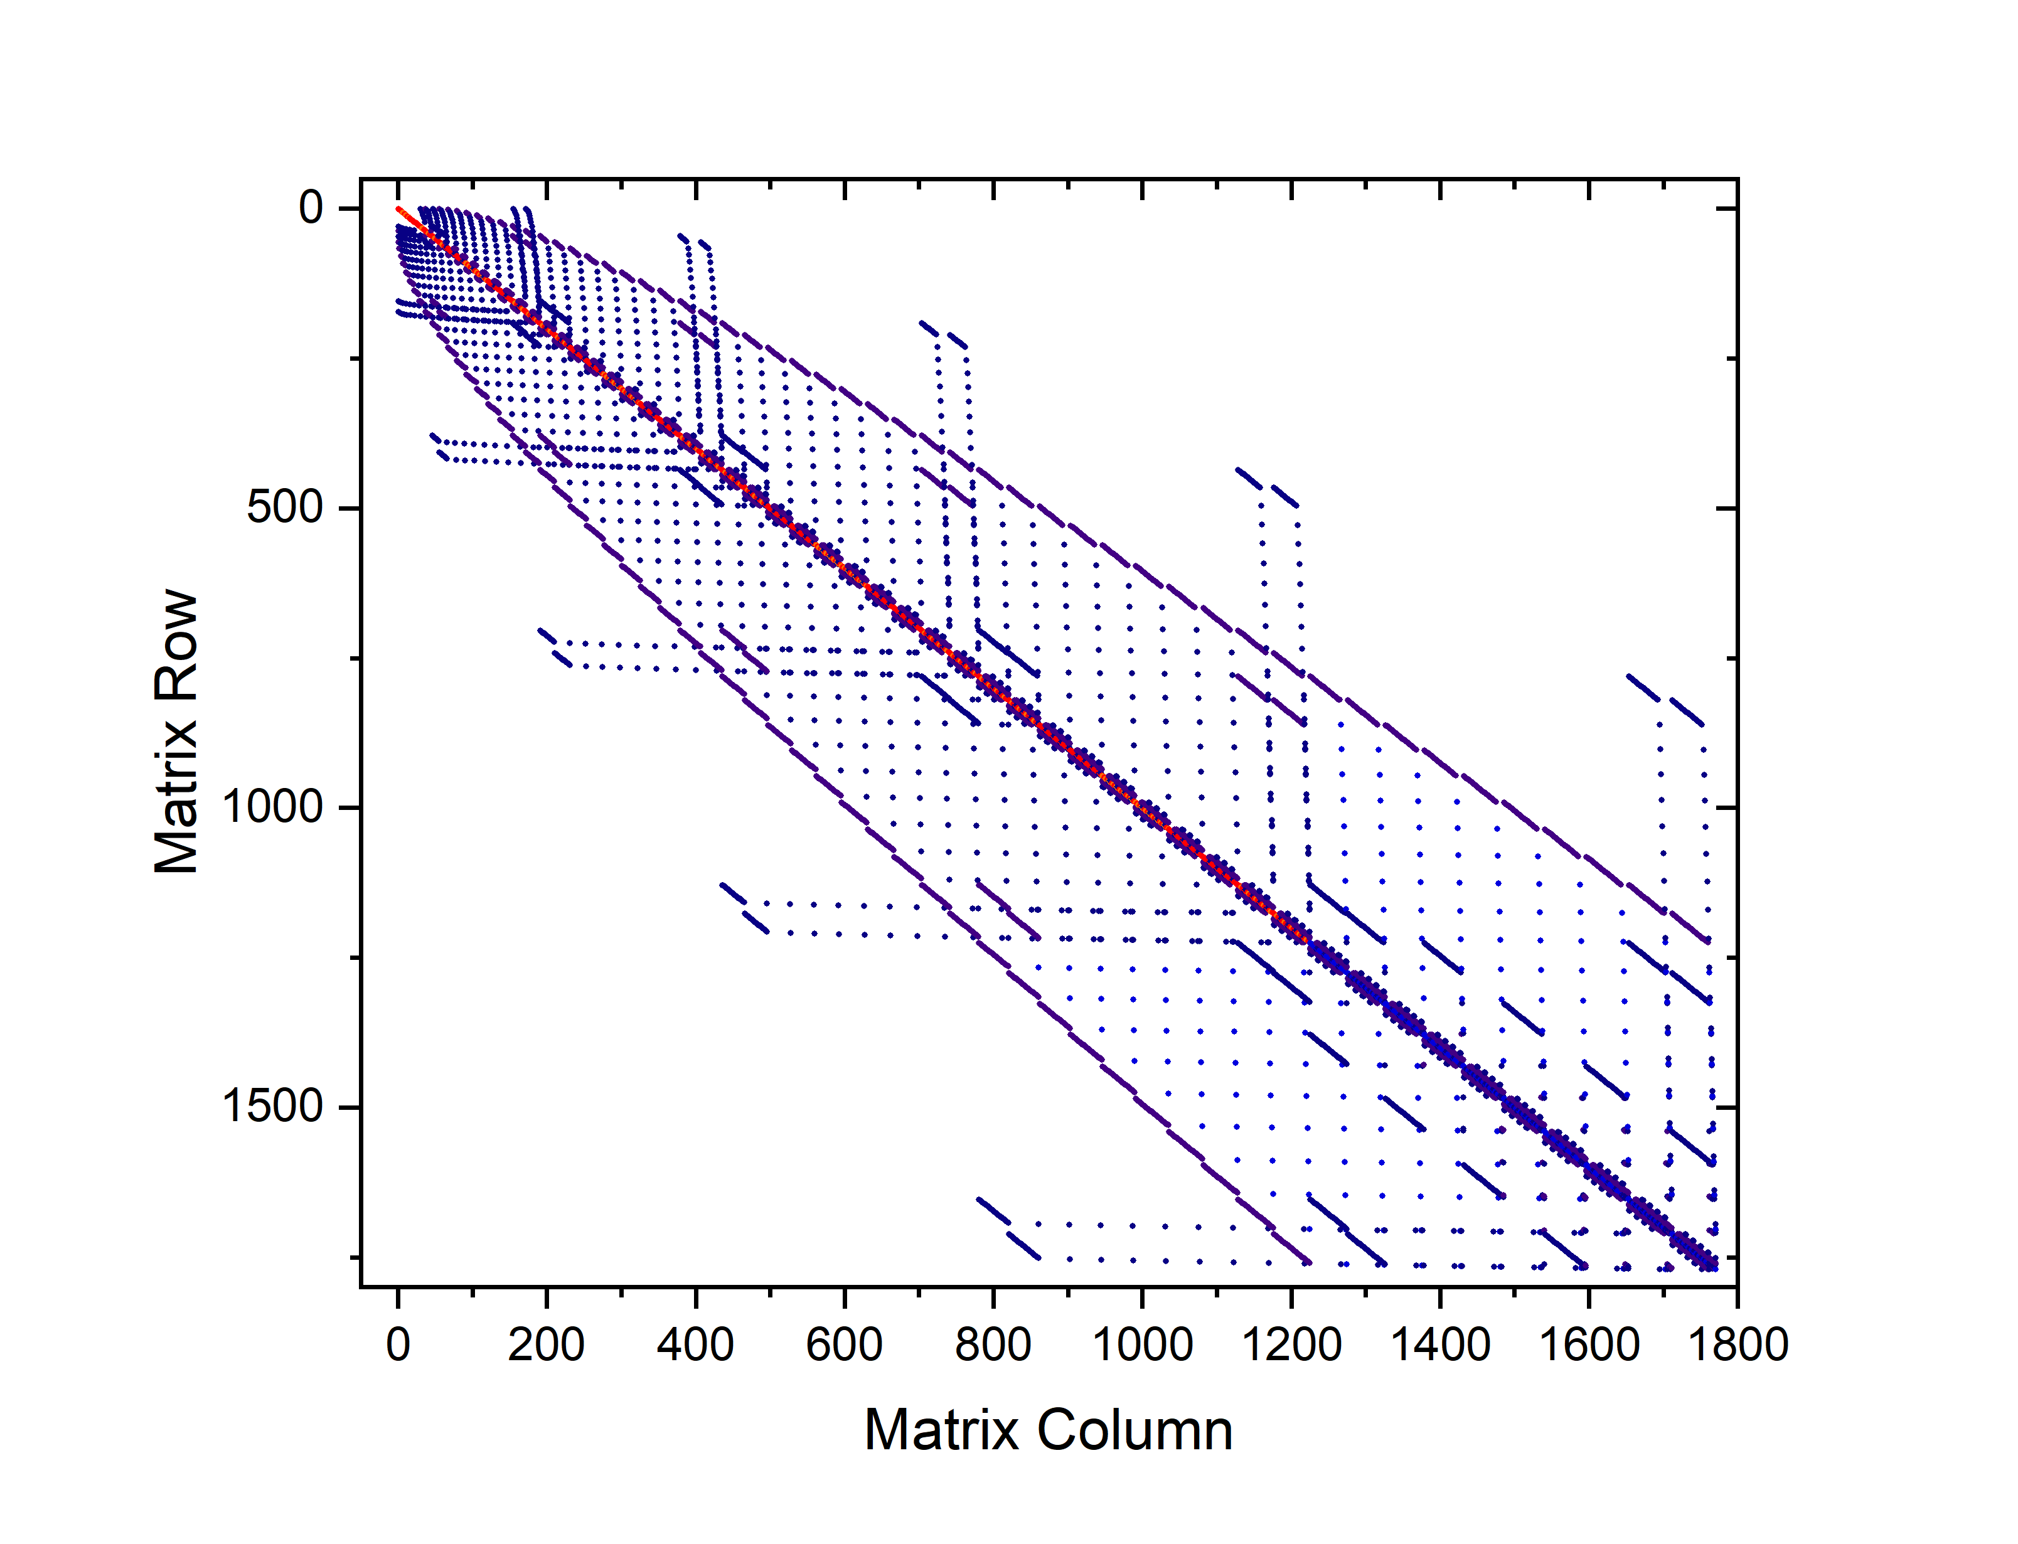
Same physics, different matrices
Recap
Sideways
Upward
The map
The many-body Hamiltonian in two bath bases
Identical spectra
Very different sparsity and ground-state complexity
Best of all: natural impurity orbitals
(Lu, Höppner, Gunnarsson & Haverkort, PRB 90, 085102 (2014))
star geometry
chain geometry
R. J. Green · Quanty Workshop, Heidelberg 2026
38

Slide 39
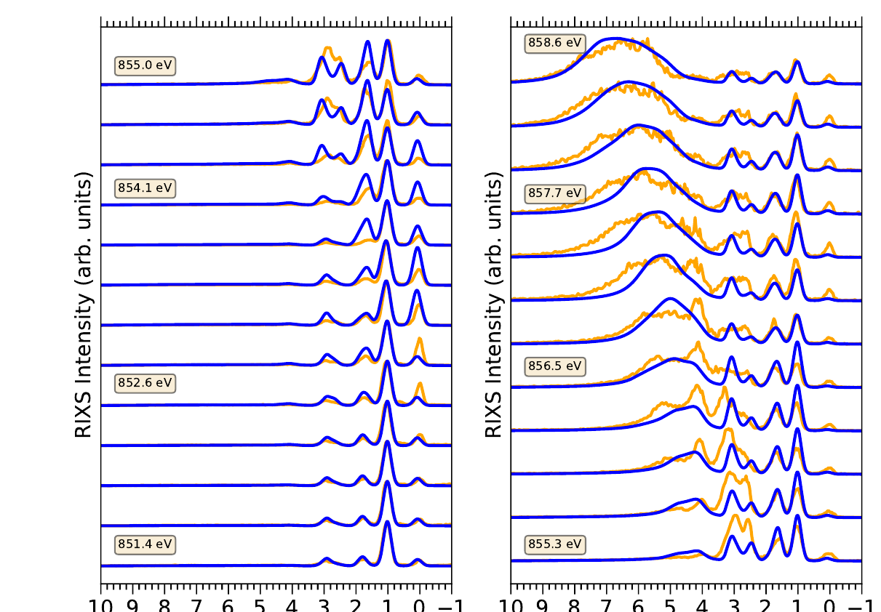
Impurity-model checkpoint
Recap
Sideways
Upward
The map
The charge-transfer band disperses
✓ Gets right
Dispersing (fluorescence-like) charge-transfer features
Broad CT continuum at resonance
dd excitations, across the whole L₃ edge
✗ Misses
Excitations that live on two Ni sites (magnons, nonlocal CT)
Momentum dependence
Self-consistency of the bath
NiO L₃ RIXS, incident energy rising upward: experiment (orange), impurity model (blue)
Experiment: G. Ghiringhelli et al., PRL 102, 027401 (2009). Theory: P. M. Braun, L. Korol, A. Moewes & R. J. Green, unpublished
R. J. Green · Quanty Workshop, Heidelberg 2026
39

Slide 40
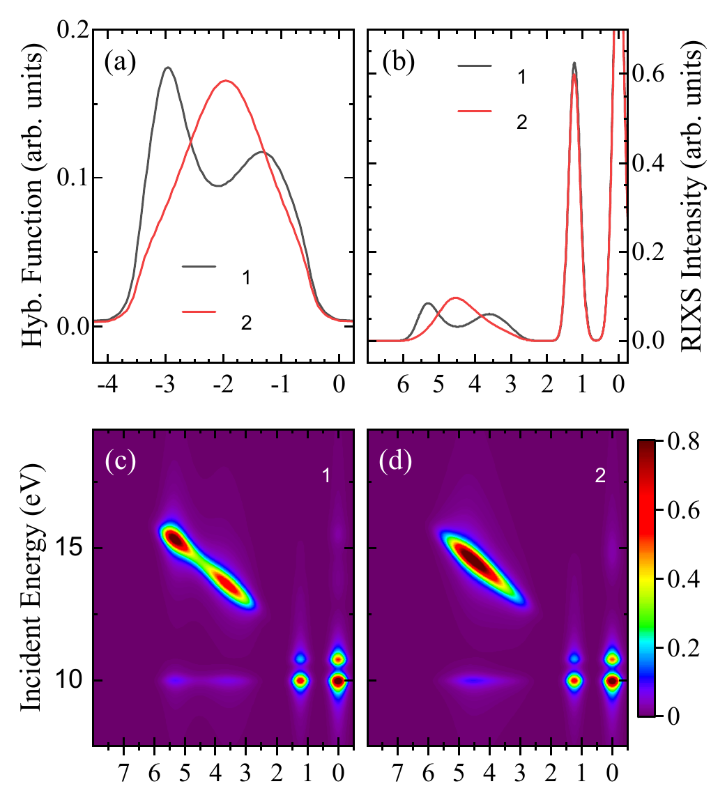
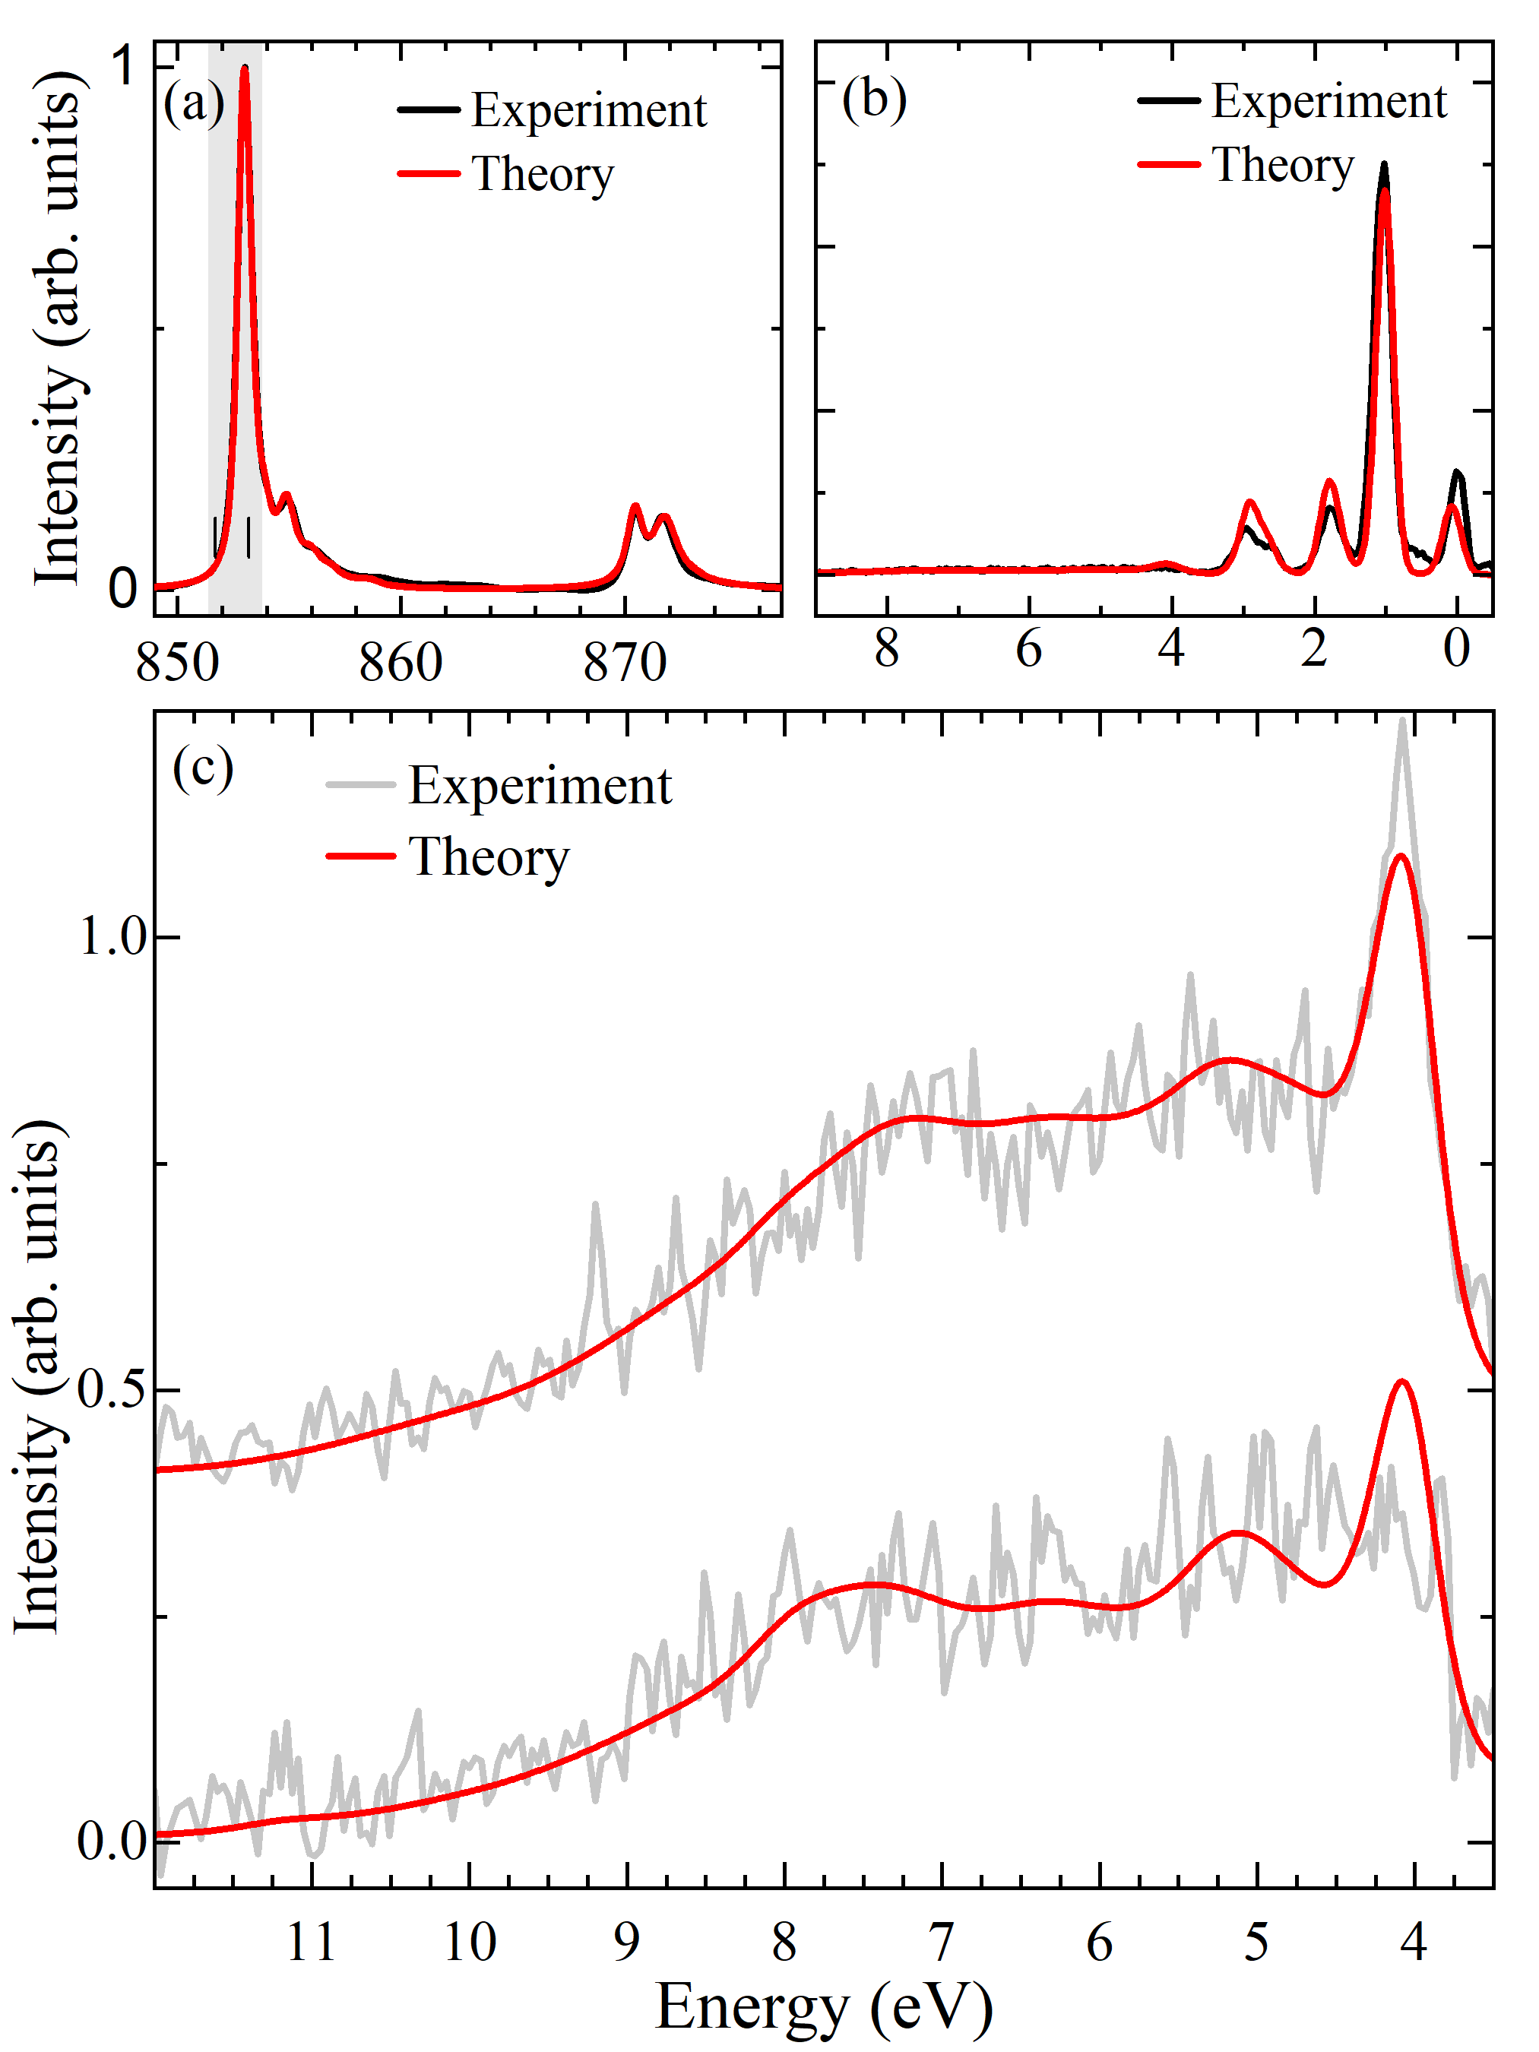
Turning it around: RIXS reads the bath
Recap
Sideways
Upward
The map
The charge-transfer continuum is a fingerprint of Δ(ω)
Same 4 eV width, different shape: the charge-transfer continuum follows Δ(ω)
So run it backwards: with the local Hamiltonian fixed, fit Δ(ω) for e_{g} and t_{2g} to NiO XAS and RIXS
Fine structure across the 4–10 eV continuum is reproduced
An experiment-constrained bath: a direct test for DFT + DMFT
Two model baths: their RIXS spectra and maps
NiO, fitted: XAS, RIXS, charge-transfer region
P. M. Braun, L. Korol, A. Moewes & R. J. Green, unpublished
R. J. Green · Quanty Workshop, Heidelberg 2026
40

Slide 41
What going upward costs
Recap
Sideways
Upward
The map
Hilbert-space dimension (valence shells only) vs. number of bath shells N
 | LFT (N = 1) | AIM, N = 20 | AIM, N = 100
NiO, d⁸ (2 holes) | 190 | 21,945 | 509,545
RNiO₃, d⁷ (3 holes) | 1,140 | 1.5 × 10⁶ | 1.7 × 10⁸
A full bath only contributes holes: the cost grows polynomially in N, not exponentially.
Compare going sideways: one more site × ~3 000. An insulating bath is cheap; a metallic bath is not (that is where natural orbitals earn their keep).
R. J. Green · Quanty Workshop, Heidelberg 2026
41

Slide 42
Recap
Sideways
Upward
The map
IV
The map
…and where it leads

Slide 43
Today's journeys on the map
Recap
Sideways
Upward
The map
how the rest of the crystal enters ↑
self-consistent
lattice
Sideways: × ~3 000 per site
adds processes impossible in one cluster
nickelates: bond disproportionation
DMFT
Cluster DMFT
band
AIM
Two-impurity
AIM
Upward: polynomial in N
a realistic environment for allowed processes
NiO RIXS: a real CT band
ligand shell
LFT
Double cluster
Multi-site
clusters
static field
(in Ĥ_{loc})
CFT
Both, self-consistently
cluster DMFT: the frontier
nothing
Atom
1 site
2 sites
many sites
size of the exactly-treated region →
R. J. Green · Quanty Workshop, Heidelberg 2026
43

Slide 44
From the observation to the direction
Recap
Sideways
Upward
The map
Small / negative Δ, shared ligand holes, a specific neighbour that matters?
Sideways: double cluster
Charge-transfer continuum, fluorescence in RIXS, screening by a continuum?
Upward: impurity bath
Dispersion, k-dependence, phase diagrams?
Further up: (cluster) DMFT
Isolated, ionic, positive Δ?
Stay home: LFT
Sideways asks: have I thrown away an essential correlated degree of freedom?
Upward asks: have I represented the environment too crudely?
R. J. Green · Quanty Workshop, Heidelberg 2026
44

Slide 45
The frontier: both directions at once
Recap
Sideways
Upward
The map
Cluster extensions of DMFT: several sites exact, embedded self-consistently in the lattice
Restores short-range k-dependence: d-wave pairing, singlet formation, bond order
For core-level spectra: double-cluster intersite physics plus a self-consistent band environment
R. J. Green · Quanty Workshop, Heidelberg 2026
45

Slide 46
There is still only one Hamiltonian.
Today the exact region grew sideways, to two nickels, and the bath moved up the map, into a band. Nothing new was added to Ĥ. We just stopped throwing parts of it away.
DMFT
Cluster DMFT
AIM
Two-impurity
AIM
Thank you. Questions?
LFT
Double cluster
Multi-site
clusters
CFT
Atom

