Slide 1
XAS, XMCD and XPS spectral shapes
Atomic multiplet theory of XAS
Crystal field theory of XAS
Screening in XAS and XPS spectral shapes
Charge transfer theory of XPS

Slide 2
XAS: spectral shapes in
atoms and solids
atom
solid
atomic
multiplet
theory
empty
density
of states
spin-orbit coupling
Intra-atomic
electron-electron interactions
Inter-atomic
electron-electron interactions

Slide 3
XAS: spectral shapes in
atoms and solids
atomic
multiplet
theory
empty
density
of states
spin-orbit coupling
Intra-atomic
electron-electron interactions
Inter-atomic
electron-electron interactions
(only symmetry
as effective field)
crystal field
multiplet
theory

Slide 4
2p XAS of TiO₂
Atomic multiplets: 2p XAS of Ti⁴⁺
2p XAS of Ti⁴⁺ ions
Ground state of Ti⁴⁺ is 3d⁰
Dipole transition 3d⁰→2p⁵3d¹
Ground state symmetry: ¹S₀
Final state symmetry: ²P⊗²D gives
¹P, ¹D, ¹F, and ³P, ³D, ³F

Slide 5
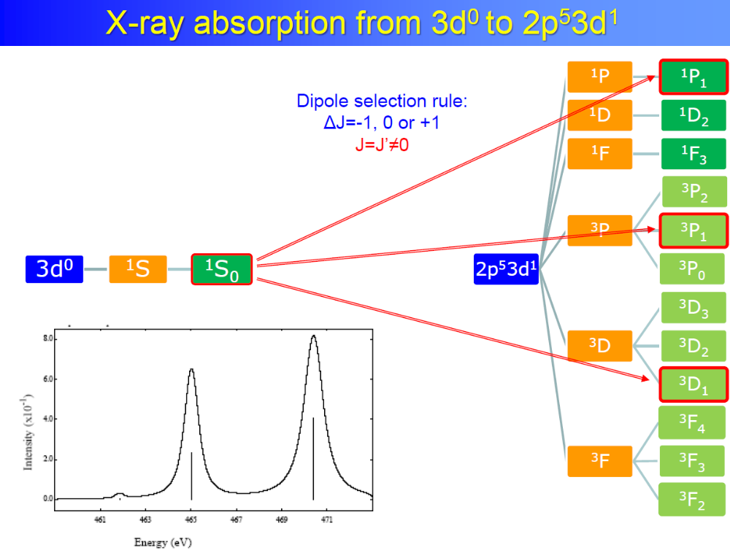

Slide 6
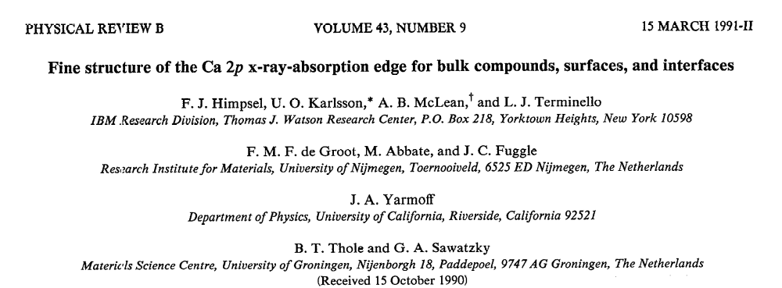
3d⁰ XAS calculation
Atomic multiplets: 2p XAS of Ca atoms

Slide 7
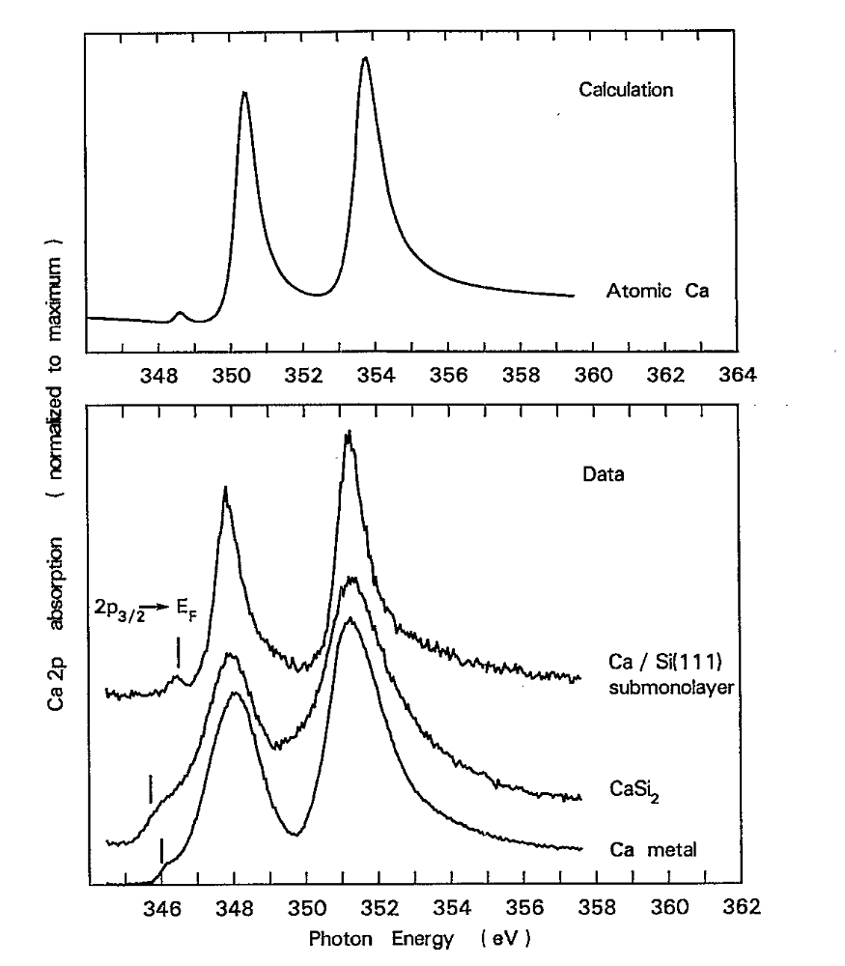
3d⁰ XAS calculation
Atomic multiplets: 2p XAS of Ca atoms

Slide 8
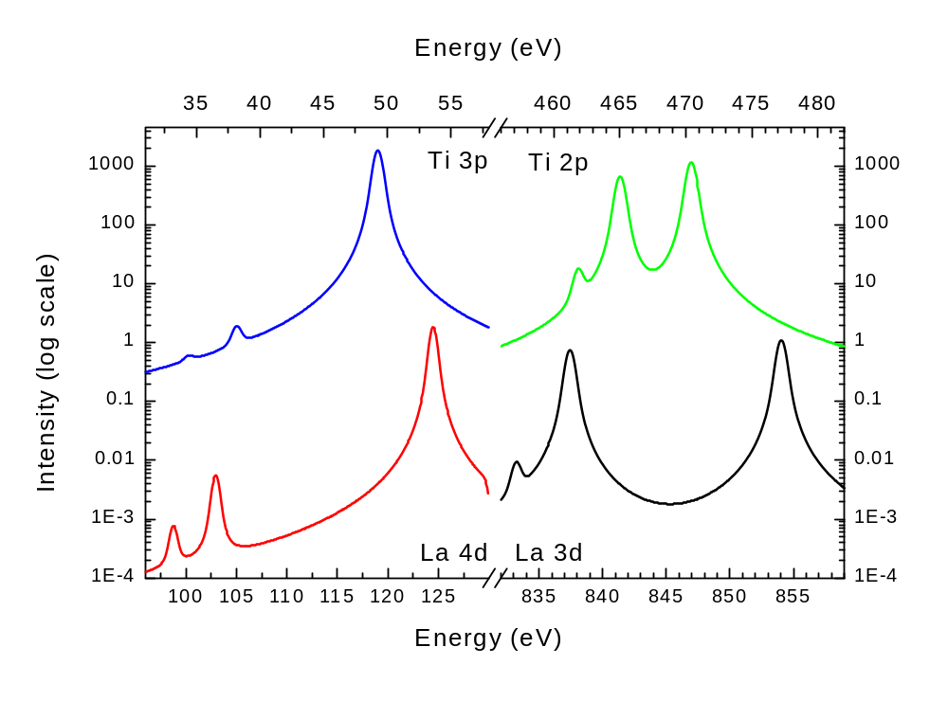
3d⁰ XAS calculation
Atomic multiplets: 2p XAS of Ti⁴⁺
Spin-orbit = 4.0 eV
Electron-electron = 5.0 eV
Spin-orbit = 0.4 eV
Electron-electron = 9 eV

Slide 9
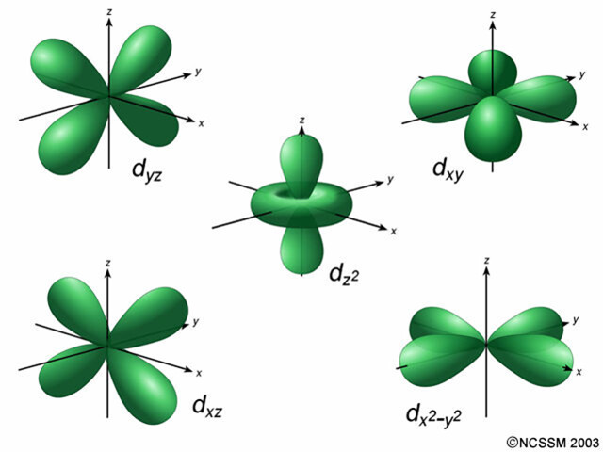
ATOMIC MULTIPLETS 3d¹
5 orbitals (each spin-up or spin-down) >> total 10 states
No electron-electron interaction: all states have the same energy
Quantum numbers: L=2 and S=½, notation as term symbol: ^{2S+1}L= ²D

Slide 10
ATOMIC MULTIPLETS 3d¹
Spin-orbit coupling couples L and S quantum numbers to a total quantum number J
J_{max}= L+S = 5/2, J_{min}= |L-S|= 3/2, Integer steps of J.
Two term symbols: L=2, S=½, and J = 5/2 >> notation as term symbol: ^{2S+1}L_{J}= ²D_{5/2}
L=2, S=½, and J = 3/2 >> notation as term symbol: ^{2S+1}L_{J}= ²D_{3/2}

Slide 11
ATOMIC MULTIPLETS 3d¹
Atomic Multiplet Theory
electron-electron
interaction
spin-orbit
coupling
3d¹
²D
²D_{3/2}
²D_{5/2}
(~50 meV)

Slide 12
2p XAS of TiO₂
Atomic multiplets: 2p XAS of Cu²⁺
2p XAS of Cu²⁺ ions
Ground state of Cu²⁺ is 3d⁹
Dipole transition 3d⁹→2p⁵3d¹⁰
Ground state symmetry: ²D_{5/2}
Final state symmetry: ²P gives
²P_{3/2} and ²P_{1/2}

Slide 13
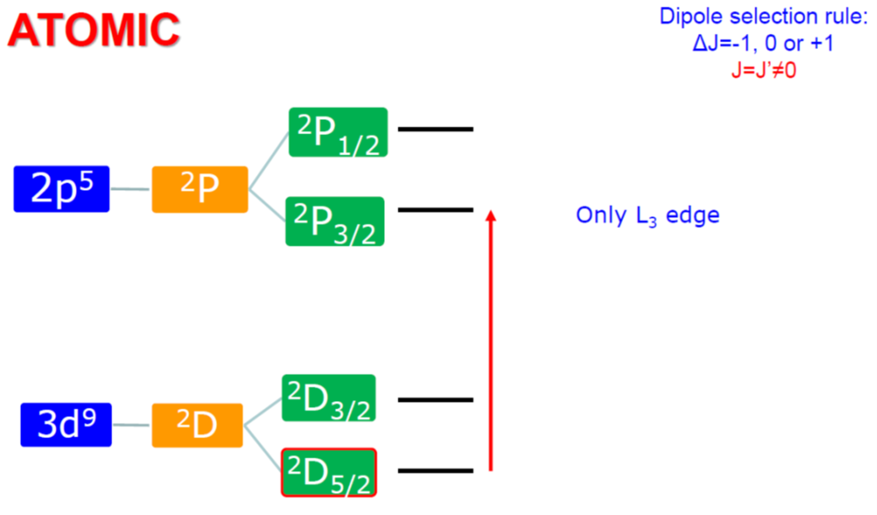
X-ray absorption from 3d⁹ to 2p⁵3d¹⁰
Atomic Multiplet Theory

Slide 14
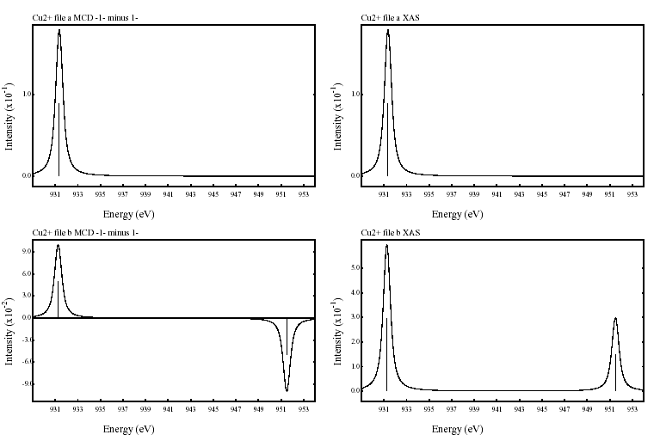
X-ray absorption from 3d⁹ to 2p⁵3d¹⁰
X-MCD
MCD
m_{J}=-5/2
to
m_{J’}=-3/2
no LS
MCD

Slide 15
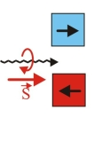
Operator symmetry in X-MCD
Atomic Multiplet Theory
SO₃ | O_{h} | D_{4h} | C₄
S | A₁ | A₁ | z
P | A₂ | B₁ | left
D | E | E | right
F | T₁ | A₂
G | T₂ | B₂

Slide 16
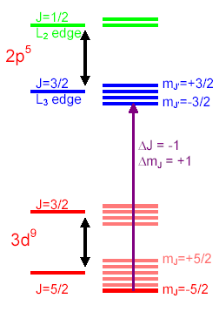
X-MCD
X-ray MCD
Cu²⁺: 3d⁹

Slide 17
X-MCD
X-ray MCD
MCD
m_{J}=-5/2
to
m_{J’}=-3/2
no LS
MCD

Slide 18
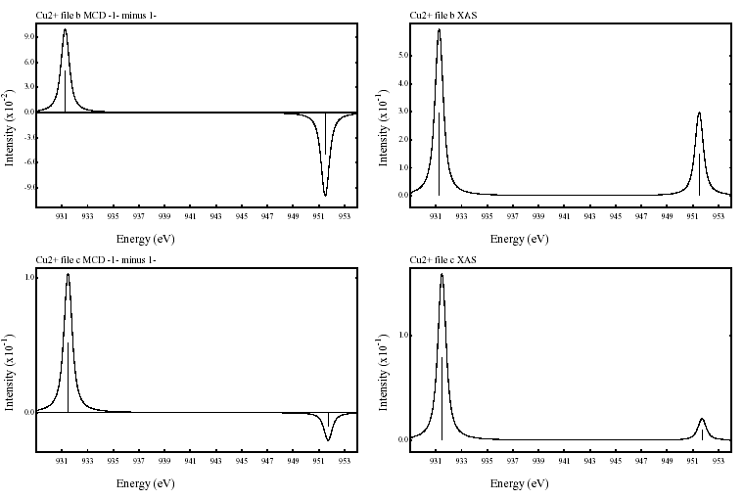
X-MCD
X-ray MCD
MCD
no LS
MCD
+ crystal field

Slide 19
ATOMIC MULTIPLETS 3d²
5 spin-up orbitals give 4 + 3 + 2 + 1 = 10 paired 3d² states
5 spin-down orbitals give 10 paired down-down 3d² states
There are 5x5 = 25 up-down states
In total 10+10+25 = 45 states
Can also be calculated as 10 x 9 / 2 = 45 states
Electron-electron interaction is different for different orbital combinations
There will be a number of different states with different energies.
Analysis shows that the states are ¹S, ³P, ¹D, ³F and ¹G

Slide 20
ATOMIC MULTIPLETS 3d²
Atomic Multiplet Theory
electron-electron
Interaction
(~2 eV)
spin-orbit
coupling
(~50 meV)
3d²
¹S
³F
¹G
³P
¹D
¹S₀
³P₂
¹G₄
³P₁
³P₀
³F₄
³F₂
³F₃
¹D₂
    Ground state:
    Given by Hunds rules
    max S
    max L
    min J (if less than half full)

Slide 21
ATOMIC MULTIPLETS 3d⁸
Atomic Multiplet Theory
electron-electron
Interaction
(~2 eV)
spin-orbit
coupling
(~50 meV)
3d⁸
¹S
³F
¹G
³P
¹D
¹S₀
³P₂
¹G₄
³P₁
³P₀
³F₄
³F₂
³F₃
¹D₂
    Ground state:
    Given by Hunds rules
    max S
    max L
    max J (if more than half full)

Slide 22
X-ray absorption from 3d⁸ to 2p⁵3d⁹
Atomic Multiplet Theory
2p⁵3d⁹
¹P
³F
¹D
³P
³D
¹P₁
³P₂
¹D₂
³P₁
³P₀
³F₄
³F₂
³F₃
³D₃
¹F
¹F₃
³D₁
³D₂
Dipole selection rule:
ΔJ=-1, 0 or +1
3d⁸
¹S
³F
¹G
³P
¹D
¹S₀
³P₂
¹G₄
³P₁
³P₀
³F₄
³F₂
³F₃
¹D₂

Slide 23
X-ray absorption from 3d⁸ to 2p⁵3d⁹
Atomic Multiplet Theory
2p⁵3d⁹
¹P
³F
¹D
³P
³D
¹P₁
³P₂
¹D₂
³P₁
³P₀
³F₄
³F₂
³F₃
³D₃
¹F
¹F₃
³D₁
³D₂
Dipole selection rule:
ΔJ=-1, 0 or +1
3d⁸
¹S
³F
¹G
³P
¹D
¹S₀
³P₂
¹G₄
³P₁
³P₀
³F₄
³F₂
³F₃
¹D₂

Slide 24
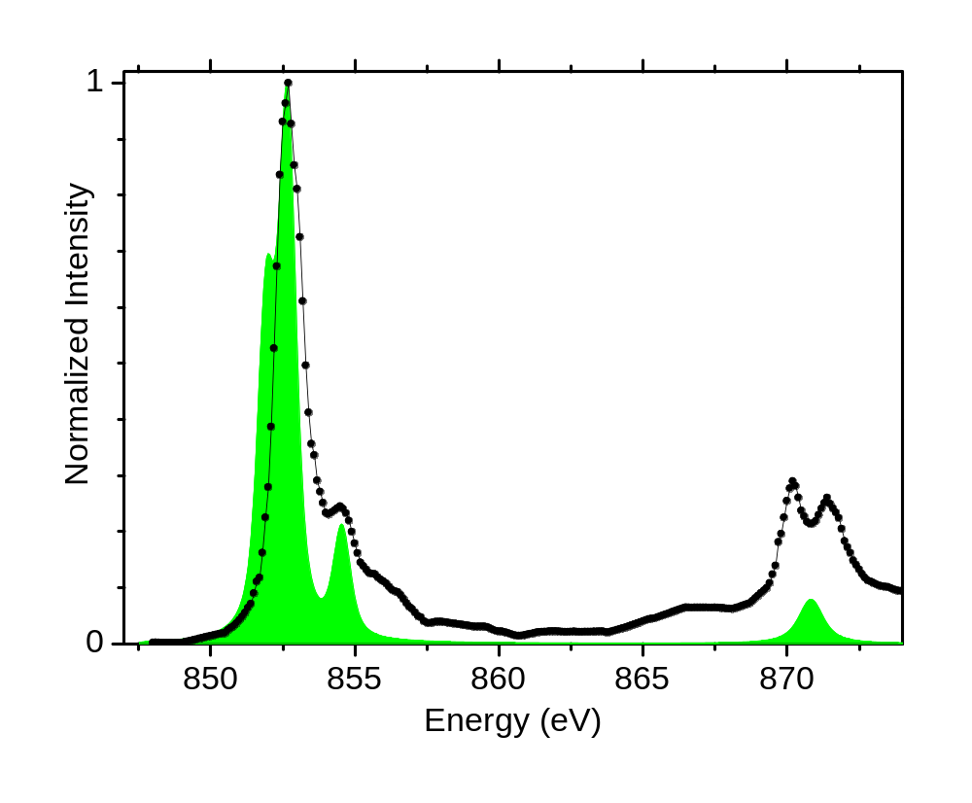
2p XAS of NiO with atomic multiplets
Atomic multiplets

Slide 25
Term Symbols of 2p²
Energies of the term symbols
Slater & Racah & Kanamori parameters
Slater-Condon | Electron-electron interaction | Slater | Racah | Kanamori
F⁰ | Direct term | F₀=F⁰ | A= F₀ -49 F₄ | U= F⁰- 2/9 J
F² 10 | Dipole term | F₂=F²/49 0.20 | B= F₂ -5 F₄ 0.13 | J = 1/14(F²+F⁴) 1.15
F⁴ 6.2 | Quadrupole term | F₄=F⁴/441 0.014 | C= 35 F₄ 0.49 | C = 1/14(9/7F²-5/7 F⁴) 0.60

Slide 26
3d XAS of rare earths
4f electrons are localized
No effect of surroundings (crystal field < lifetime broadening)
3d XAS is self screened > no charge transfer effect
Initial state
electron-electron interaction.
Valence spin-orbit coupling
Final state
+ core hole – valence hole ‘multiplet’ interaction.
+ core hole spin-orbit coupling

Slide 27
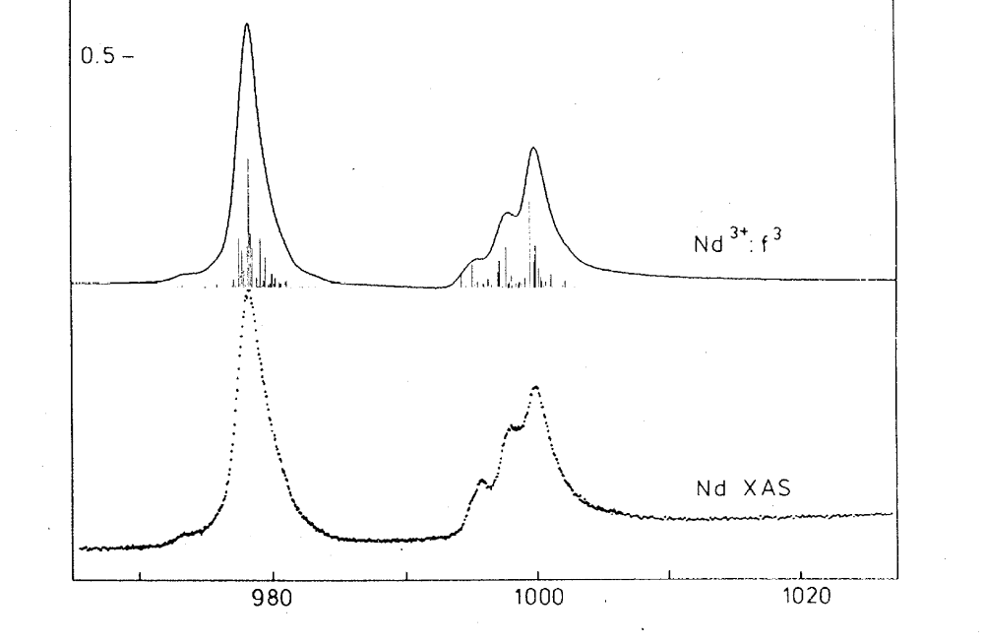
3d XAS of rare earths
Nd³⁺ 4f³ system: ground state is ^{2S+1}L_{J}

Slide 28
3d XAS of rare earths
Nd³⁺ 4f³ system: ground state is ⁴I_{9/2}

Slide 29
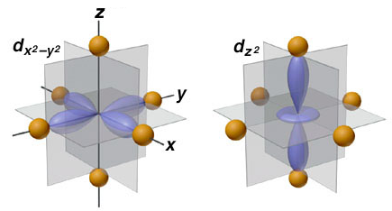
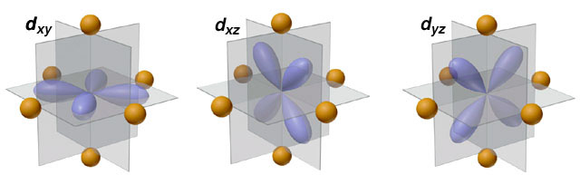
crystal field effect
Crystal Field Effects
e_{g} states
t_{2g} states

Slide 31
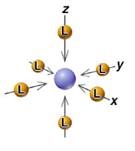
CRYSTAL FIELD EFFECT
Octahedral crystal field splitting
3d¹
²D
²E_{g}
²T_{2g}
metal ion
in free space
in symmetrical field
in octahedral ligand field
e_{g}
x²-y² z²
t_{2g}
yz xz xy
x²-y² yz z² xz xy

Slide 32
CRYSTAL FIELD EFFECT
Atomic Multiplet Theory
3d^{N}
J=0
J=4
J=1
J=2
J=3
A₁
T₂
T₁
E
A₁
E
T₂
A₂
T₂
T₁
T₁
    Branching rules:
    Same rules for any quantum number
    S, L or J

Slide 33
X-ray absorption from 3d⁰ to 2p⁵3d¹
Atomic Multiplet Theory
2p⁵3d¹
¹P
³F
¹D
³P
³D
¹P₁
³P₂
¹D₂
³P₁
³P₀
³F₄
³F₂
³F₃
³D₃
¹F
¹F₃
³D₁
³D₂
T₁
T₂
E
T₂
E
T₂
E
T₂
E
T₁
T₁
A₂
T₁
T₂
A₂
T₁
T₂
A₂
T₁
T₂
A₁
A₁
T₁
T₂
E
3d⁰
¹S
¹S₀
A₁
ee LS CFS

Slide 34
X-ray absorption from 3d⁰ to 2p⁵3d¹
Atomic Multiplet Theory
2p⁵3d¹
¹P
³F
¹D
³P
³D
¹P₁
³P₂
¹D₂
³P₁
³P₀
³F₄
³F₂
³F₃
³D₃
¹F
¹F₃
³D₁
³D₂
T₁
T₂
E
T₂
E
T₂
E
T₂
E
T₁
T₁
A₂
T₁
T₂
A₂
T₁
T₂
A₂
T₁
T₂
A₁
A₁
T₁
T₂
E
3d⁰
¹S
¹S₀
A₁
ee LS CFS
2 3 7 8 5

Slide 35
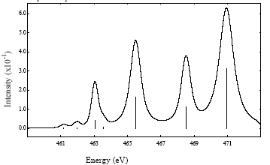
X-ray absorption from 3d⁰ to 2p⁵3d¹
Atomic Multiplet Theory
Dipole selection rule:
ΔJ=T₁
(cubic symmetry)
2p⁵3d¹
¹P
³F
¹D
³P
³D
¹P₁
³P₂
¹D₂
³P₁
³P₀
³F₄
³F₂
³F₃
³D₃
¹F
¹F₃
³D₁
³D₂
T₁
T₂
E
T₂
E
T₂
E
T₂
E
T₁
T₁
A₂
T₁
T₂
A₂
T₁
T₂
A₂
T₁
T₂
A₁
A₁
T₁
T₂
E
3d⁰
¹S
¹S₀
A₁
ee LS CFS
2 3 7 8 5

Slide 36
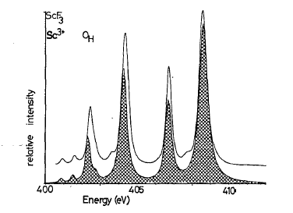
2p XAS of ScF3 with crystal field multiplets
Comparison with Experiment
PHYS. Rev. B. 41, 928 (1990) [google drive]

Slide 37
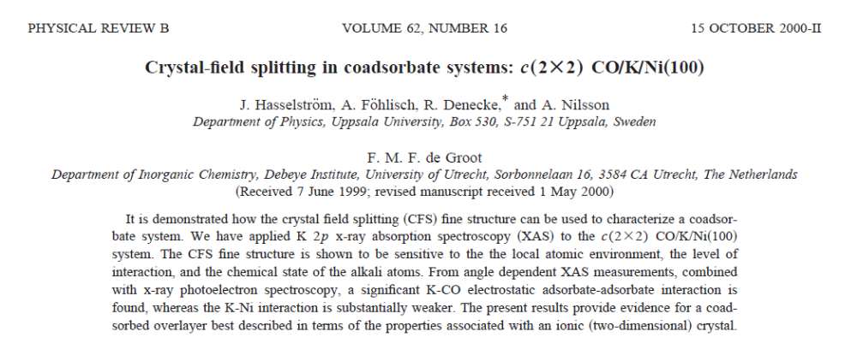
Crystal Field in square planar symmetry
Atomic Multiplet Theory
Approximate CO layer as square planar in symmetry
(Ignore Ni surface)

Slide 38
Crystal Field in D4h symmetry
Atomic Multiplet Theory
SO₃ | O_{h} | D_{4h}
S | A₁ | A₁
P | A₂ | B₁
D | E | E
F | T₁ | A₂
G | T₂ | B₂

Slide 39
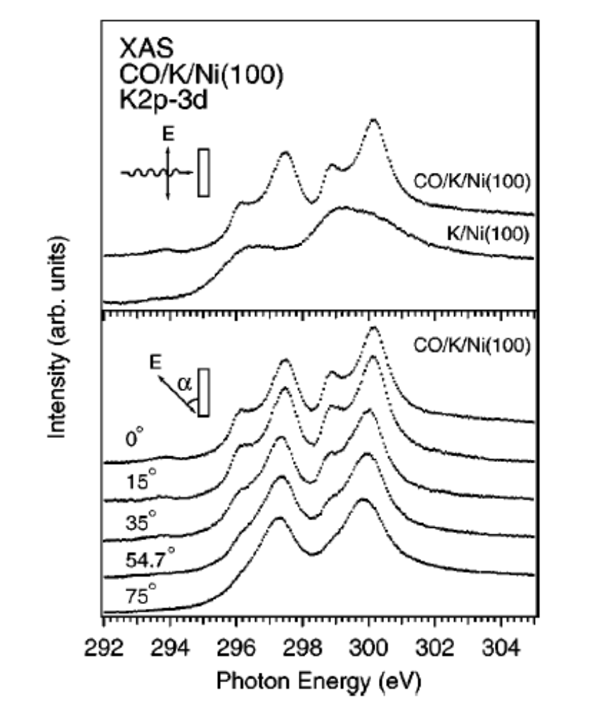
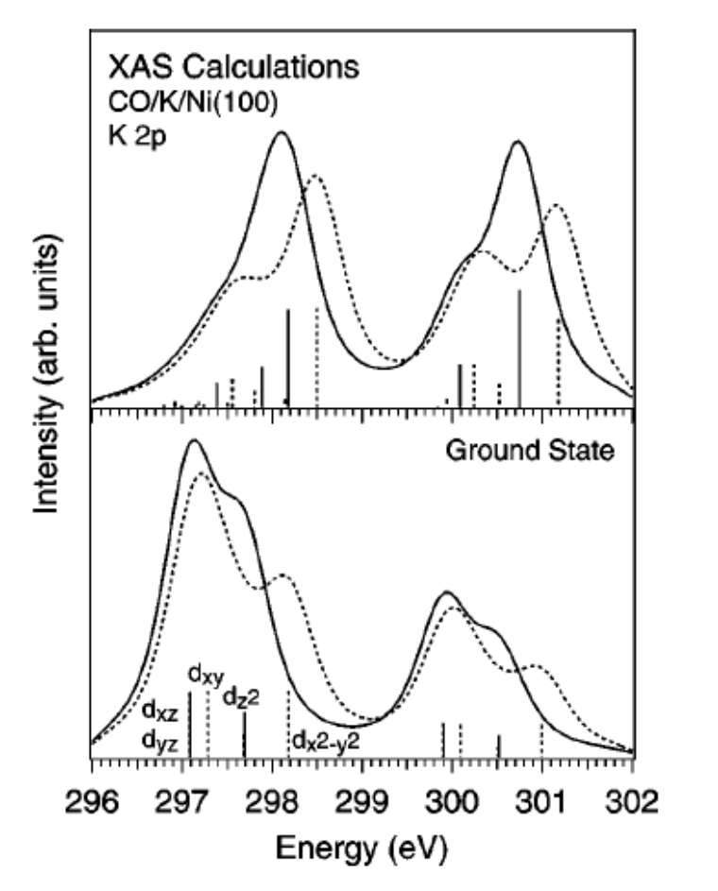
Crystal Field in square planar symmetry
Atomic Multiplet Theory
Simulate angular dependent XAS spectra from the (perpendicular) E
and (parallel) A2 operators

Slide 40
Switch off 2p3d interactions (multiplets)
Atomic Multiplet Theory
The orbital energy positions (bottom) are different from the spectral peak positions due to the 2p3d electron-electron interactions.
[Difference between DFT and multiplets]

Slide 41
Why different theory in XAS and XPS?
Charge Transfer Effects
X-ray absorption and x-ray photoemission both involve the same interaction of x-rays with matter.
The theory of XAS and XPS is quite different

Slide 42
Charge transfer effects in XAS and XPS
Charge Transfer Effects
Transition metal oxide: Ground state: 3d⁸ + 3d⁹L
9
3d⁹L
Δ
8
3d⁸

Slide 43
Charge transfer effects in XAS and XPS
Charge transfer effects in XAS and XPS
Transition metal oxide: Ground state: 3d⁸ + 3d⁹L
3d⁹L
XPS
2p⁵3d⁸
Δ
3d⁸
Ground State

Slide 44
Charge transfer effects in XAS and XPS
Charge transfer effects in XAS and XPS
Transition metal oxide: Ground state: 3d⁸ + 3d⁹L
Energy of 3d⁹L: Charge transfer energy Δ
3d⁹L
XPS
2p⁵3d⁸
Δ
3d⁸
Δ-Q
Ground State
2p⁵3d⁹L

Slide 45
Charge transfer effects in XAS and XPS
Charge transfer effects in XAS and XPS
Transition metal oxide: Ground state: 3d⁸ + 3d⁹L
Energy of 3d⁹L: Charge transfer energy Δ
3d⁹L
XPS
2p⁵3d⁸
XAS
2p⁵3d¹⁰L
Δ
3d⁸
Δ-Q
Ground State
Δ+U-Q ≈ Δ
2p⁵3d⁹L
2p⁵3d⁹

Slide 46
Charge transfer effects in XAS and XPS
Charge transfer effects in XAS and XPS
XPS:
Screening of the core hole
(charge transfer > Anderson impurity model)
+ multiplet effects + crystal field effects
XAS:
Screening of the core hole is small
(self screened excitation)
Multiplet effects + crystal field effects (CFM)

Slide 47
When is charge transfer needed in XAS
Charge transfer effects in XAS and XPS
XAS: Screening of the core hole is small
Charge transfer needed in XAS:
High-valent ions (negative charge transfer)
CO and CN ligands (π-backbonding)
[Metallic & covalent systems]

Slide 48
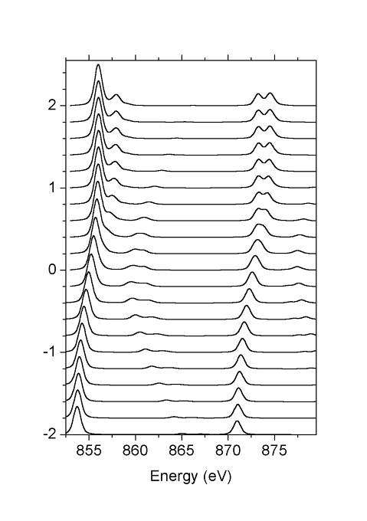
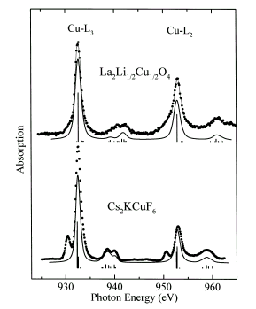
Charge transfer effects in XAS
Charge Transfer effects
3d⁸ + 3d⁹L
Δ=10
30% 3d⁸
¹A₁
Δ=5
NiO
Δ=0
La₂Li_{½}Cu_{½}O₄
30% 3d⁸
³A₂
Δ=-5
Δ=-10
Chem. Phys. Lett. 297, 321 (1998)

Slide 49
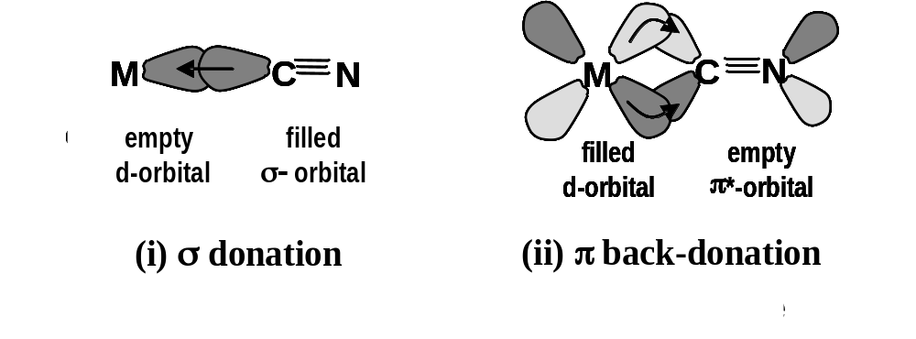
LMCT and MLCT: π - bonding
Fe^{III}: Ground state: 3d⁵ + 3d⁶L
3d⁶L
3d⁵
2p⁵3d⁷L
2p⁵3d⁶
Δ
Δ+U-Q ≈ Δ
with Ed Solomon (Stanford) JACS 125, 12894 (2003),
JACS 128, 10442 (2006), JACS 129, 113 (2007)

Slide 50
LMCT and MLCT: π - bonding
Fe^{III}: Ground state: 3d⁵ + 3d⁶L + 3d⁴L
2p⁵3d⁵L
2p⁵3d⁷L
2p⁵3d⁶
3d⁴L
3d⁶L
3d⁵
Δ_{π}-U+Q ≈ Δ_{π} + 2
Δ_{π}
Δ
Δ+U-Q ≈ Δ - 2
with Ed Solomon (Stanford) JACS 125, 12894 (2003),
JACS 128, 10442 (2006), JACS 129, 113 (2007)

Slide 51
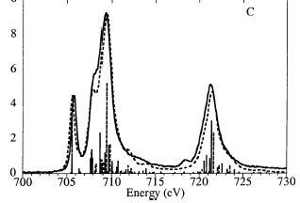
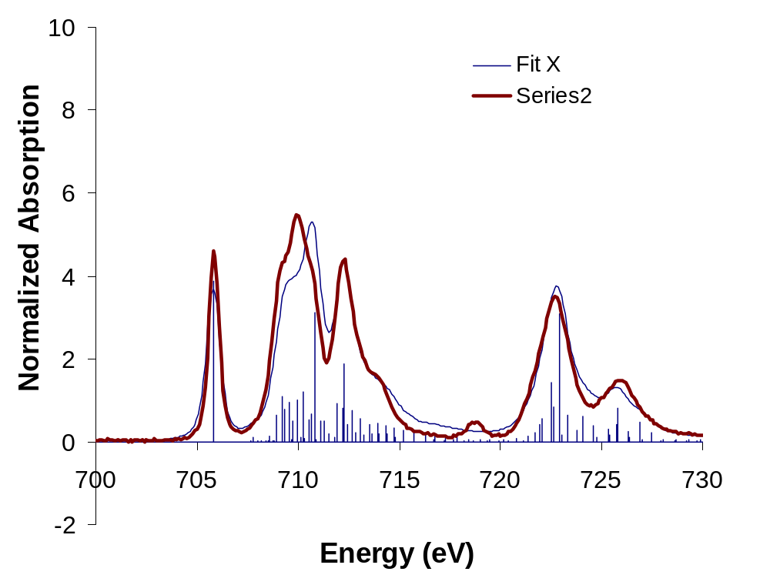
LMCT and MLCT: π - bonding
Fe^{III}(tacn)₂
Fe^{III}(CN)₆
with Ed Solomon (Stanford) JACS 125, 12894 (2003),
JACS 128, 10442 (2006), JACS 129, 113 (2007)

Slide 52
Multiplet calculations
valence e-e interactions F_{dd}
core-valence e-e F_{pd} G_{pd}
core & valence spin-orbit ζ
crystal field 10Dq, Ds, Dt
molecular field, M or H
e-e screening κ
charge transfer Δ, U, Q
hopping T_{Γ}
ionic 3d
(4d, 5d)
4f, 5f
3d ions
covalent 3d
mixed valence f
ATOMIC
SYMMETRY
BONDING

Slide 54
The 2-state cluster model for core XPS and XAS
Charge transfer effects in XAS and XPS
XPS:
Screening of the core hole dominates
Use the 2-state cluster model
XAS:
Core hole is screened by excited electron (exciton)
Second state can be ignored
Use the 1-state cluster model
- [a.k.a. the crystal field model]
[de Groot & Kotani, core level spectroscopy of solids (2008)]

Slide 55
Model parameters & Spectroscopic parameters
Charge transfer effects in XAS and XPS
Model parameters (eg 2-state cluster model):
No direct relation to spectrum
Δ, V(Γ), U, Q, etc.
Spectrum follows from parameters
Spectroscopic parameters:
Derived from spectral shape
U, Auger parameter, chemical potential, etc.
Useful to derive relations between both parameter sets

Slide 56
2-state cluster model for 3d XPS of LaF₃
Charge transfer effects in XAS and XPS
LaF₃: La³⁺ ionic system: Δ = 13 eV
Ground state: 99% pure 4f⁰, less than 1% 4f¹L
4f¹L
Δ=13 eV
4f⁰
Ground State

Slide 57
2-state cluster model for 3d XPS of LaF₃
Charge transfer effects in XAS and XPS
LaF₃: La³⁺ ionic system: Δ = 13 eV
Ground state: 99% pure 4f⁰, less than 1% 4f¹L
4f¹L
XPS
3d⁹4f⁰
Δ=13 eV
3d⁹4f¹L
4f⁰
Δ-Q ≈0
Ground State

Slide 58
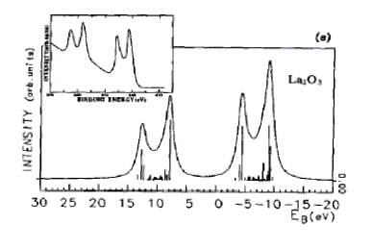
2-state cluster model for 3d XPS of LaF₃
Charge transfer effects in XAS and XPS
LaF₃: La³⁺ ionic system: Δ = 13 eV
Ground state: 99% pure 4f⁰, less than 1% 4f¹L
Anti-bonding
combination
XPS
3d⁹4f⁰
3d⁹4f¹L
Δ-Q ≈0
Bonding
combination

Slide 59
2-state cluster model for 3d XPS of LaF₃
Charge transfer effects in XAS and XPS
[Wrongly assigned on
ThermoFischer XPS pages]
3d spin-orbit
Invisible:
4f spin-orbit ≈ 100 meV
Crystal field ≈ 20 meV
3d4f multiplets
charge transfer
[Kotani & Ogasawara, J. Elec. Spec. 60, 257 (1992)]

Slide 60
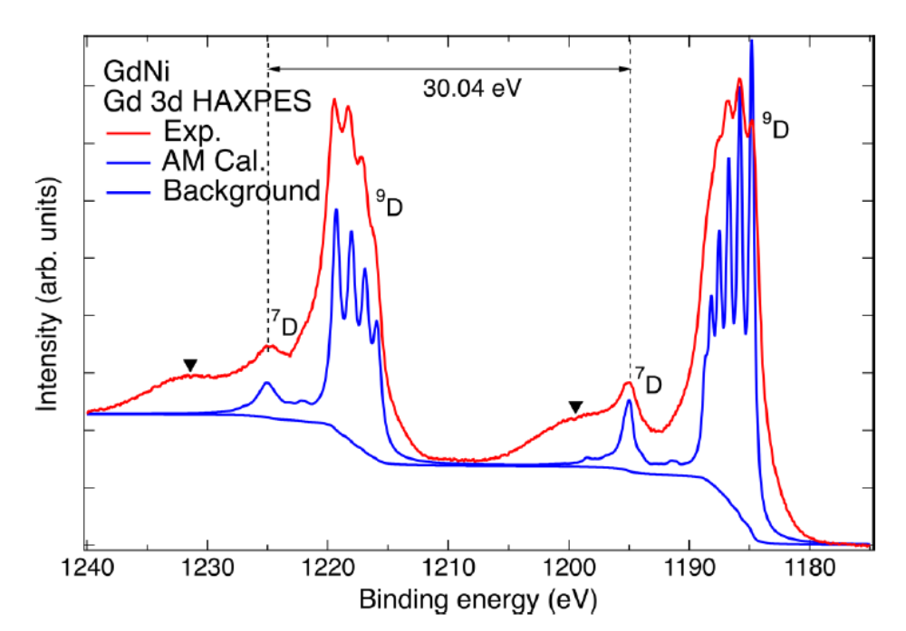
2-state cluster model for 3d XPS of GdNi
Charge transfer effects in XAS and XPS
4f spin-orbit
3d spin-orbit
3d4f multiplets
Invisible:
Crystal field ≈ 20 meV
Charge transfer?
[Chuang et al. PRB 101, 115137 (2020)]

Slide 61
2-state cluster model for 3d XPS of Gd systems
Charge transfer effects in XAS and XPS
Gd³⁺ system: Δ = 15 eV
4f⁷ has many configurations due to 4f4f interactions
Q < Δ, so Δ-Q >0 and weak mixing
4f⁸L
XPS
3d⁹4f⁷
3d⁹4f⁸L
Δ_{(eff)}=15 eV
4f⁷
Δ-Q > 0
Ground State

Slide 62
2-state cluster model for 2p XPS of CuBr₂
Charge transfer effects in XAS and XPS
Transition metal oxide: Ground state: 3d⁹ + 3d¹⁰L
Energy of 3d⁹L: Charge transfer energy Δ
3d¹⁰L
XPS
2p⁵3d⁹
Δ=3
3d⁹
Δ-Q
=-4
Ground State
2p⁵3d¹⁰L

Slide 63
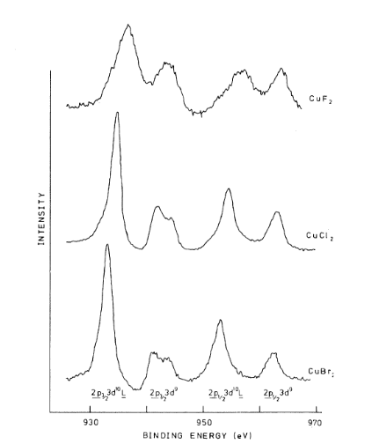
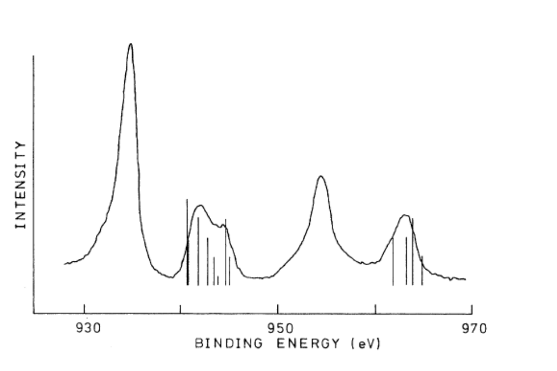
2-state cluster model for 2p XPS of CuBr₂
Charge transfer effects in XAS and XPS
Experiment and calculation from 1981
2p spin-orbit
2p3d multiplets
3d spin-orbit ≈ 50 meV (invisible)
crystal field ≈ 1 eV (not sensitive)
charge transfer
[van der Laan et al., PRB 23, 4369 (1981)]

Slide 64
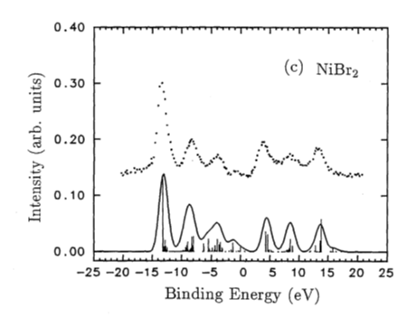
2-state cluster model for 2p XPS of NiBr₂
Charge transfer effects in XAS and XPS
2-state model can explain 2 features: 3d⁸ + 3d⁹L
Need third state for third feature
[Okada et al. J. Elec. Spec. 58, 325 (1992)]

Slide 65
The 3-state cluster model for core XPS
Charge transfer effects in XAS and XPS
Transition metal oxide: Ground state: 3d⁸ + 3d⁹L + 3d¹⁰L²
Energy of 3d⁹L: Charge transfer energy Δ
Energy of 3d¹⁰L² : 2Δ + U (due to extra 3d3d interaction)
3d¹⁰L²
2Δ+U = 7.5
3d⁹L
Δ=0.5
3d⁸

Slide 66
The 3-state cluster model for core XPS
Charge transfer effects in XAS and XPS
3d¹⁰L²
2p⁵3d⁸
2Δ+U = 7.5
Δ-Q = -7.0
2Δ+U-2Q
=-7.5
3d⁹L
2p⁵3d⁹L
Δ=0.5
2p⁵3d¹⁰L²
3d⁸
[Okada et al. J. Elec. Spec. 58, 325 (1992)]

Slide 67
What is the value of U (NiO)
U_{ZSA} = 6
U_{DFT} =U _{ZSA}
time
(ZSA) LDA GGA meta-GGA (SCAN)
1985

Slide 68
What is the value of U (NiO)
U_{ZSA} = 6
U_{DFT} =U _{ZSA}
Self-consistent U_{DFT}
U_{DFT} = ~ 0
time
(ZSA) LDA GGA meta-GGA (SCAN)
1985

Slide 69
What is the value of U (of NiO)
{XAS, XPS, AES, RPES, RIXS}
U_{ZSA} = 6 U_{ZSA} = 6
U_{DFT} =U _{ZSA}
Self-consistent U_{DFT}
U_{DFT} = ~ 0
time
(ZSA) LDA GGA meta-GGA (SCAN)
1985

Slide 70
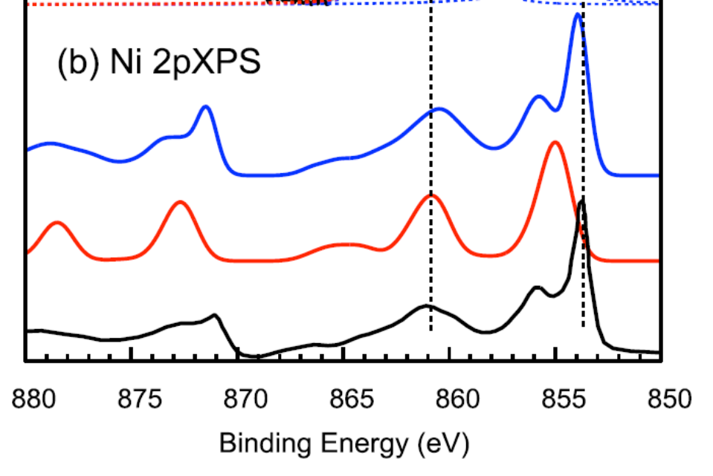
3-state cluster model for 2p XPS of NiO
Charge transfer effects in XAS and XPS
3-state model does not explain feature at 855 eV
DMFT + multiplets
3-state model
Experiment
New screening channel: non-local screening
Electron hops from neighboring metal ion to metal ion with core hole
All channels can be included by coupling to density-of-states (DOS)
DOS calculated by Dynamical Mean Field Theory (DMFT)
[Ghiasi et al., PRB 100, 075146 (2019)]

Slide 71
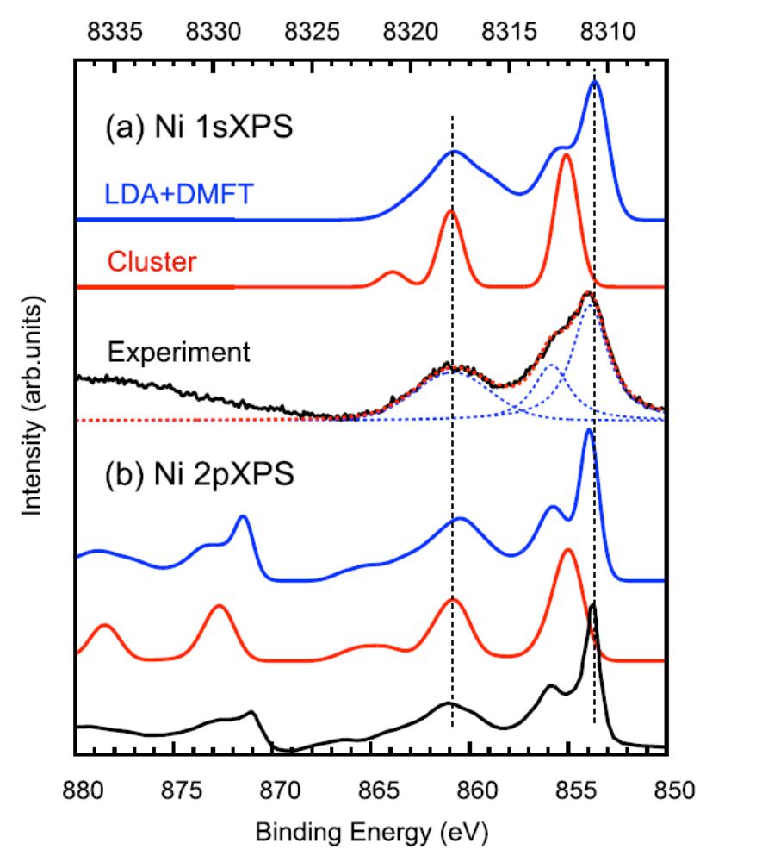
1s XPS spectra
charge transfer
multiplet effects (2p3d)
non-local screening
[Ghiasi et al., PRB 100, 075146 (2019)]

Slide 72
1s XPS spectra
1s XPS spectrum has multiple peaks
One photon energy relates to many different electron kinetic energies:
>>> K edge XAS is influenced by photo-excitation
>>> Kα XES is influenced by photo-excitation
[Ghiasi et al., PRB 100, 075146 (2019)]

Slide 73
Interpretation of core XPS (XAS)
Intra-atomic e-e
interactions
Interatomic interactions
(mean field)
charge fluctuations
(Δ, U, Q)
4f ionic 3d covalent 3d (f) no open l d or f
atomic
multiplet
theory
crystal field
multiplet
theory
impurity
multiplet
theory
DMFT+
multiplets
(DFT)
BSE
GW+C
X
X
X
The d and f states react much stronger to core holes
>> This is true for oxides and also for metals

