Slide 1
X-ray Absorption Spectroscopy
Introduction to XAS
Overview of x-ray and electron spectroscopies
Interpretation of XAS
XAS experiments
  Transmission
  Electron Yield
  Fluorescence Yield

Slide 2
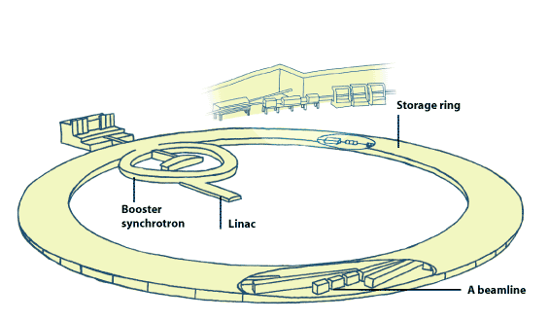
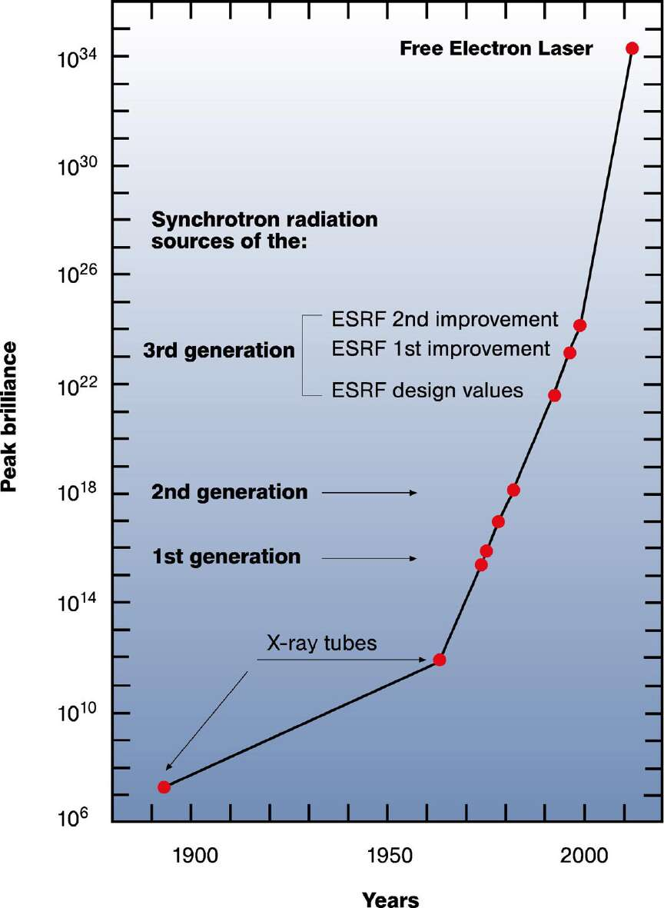
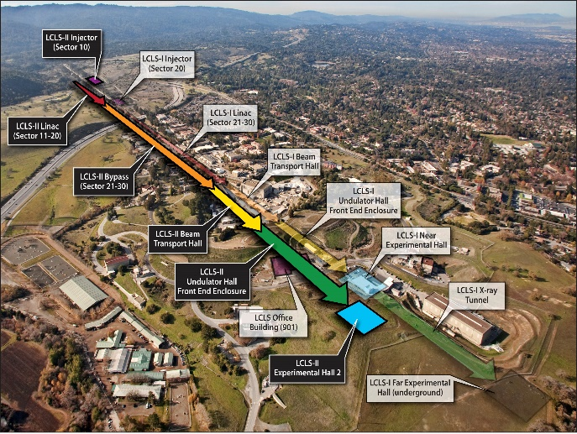
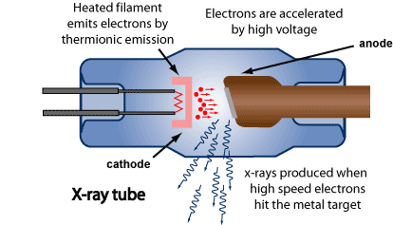
X-ray sources

Slide 3
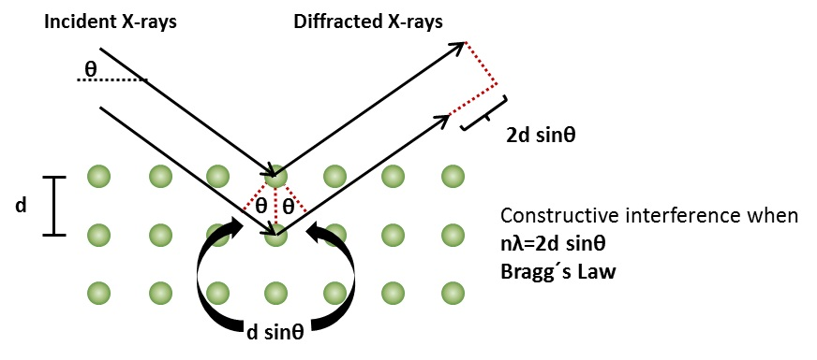
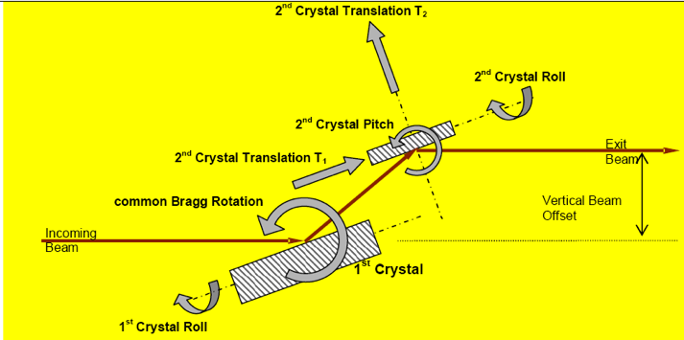
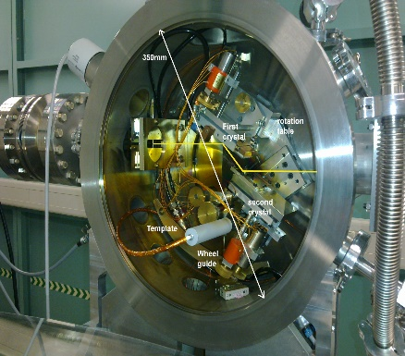
x-ray monochromator
X-ray monochromator

Slide 4
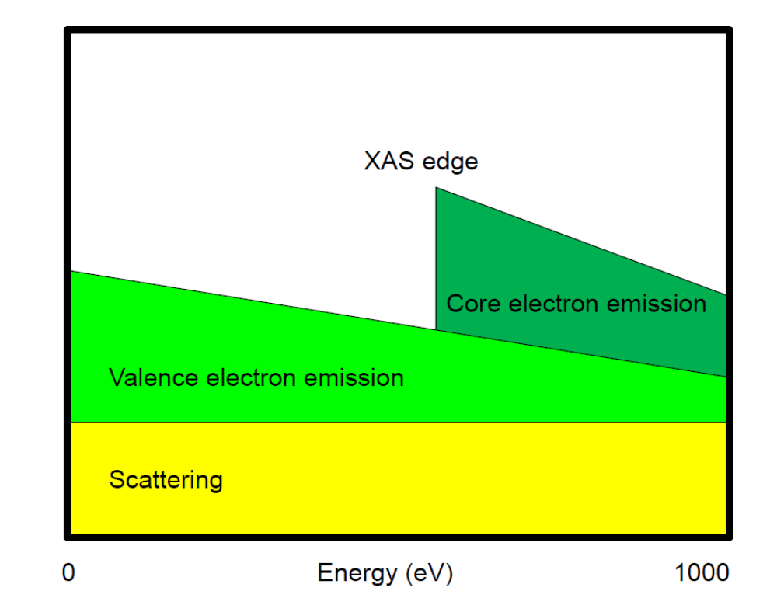
X-ray Absorption Spectroscopy
Notes:
XAS is element specific because each element has specific binding energies for its core levels.
The XAS edge energy is essentially given by the core level binding energy.

Slide 5
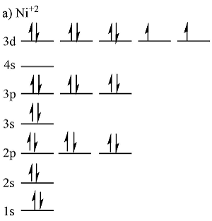
X-ray spectroscopies
3d⁸ + ω

Slide 6
X-ray spectroscopies
3d⁸ + ω
XAS
2p⁵3d⁹

Slide 7
X-ray spectroscopies
3d⁸ + ω
XAS
XPS
2p⁵3d⁹
2p⁵3d⁸+e’

Slide 8
XAS: decay of the core hole
X-ray absorption
core holes live only a few femtoseconds
Notes:
8

Slide 9
XAS: decay of the core hole: x-ray emission
X-ray emission
Notes:
9

Slide 10
XAS: decay of the core hole: Auger
Auger
Notes:
10

Slide 11
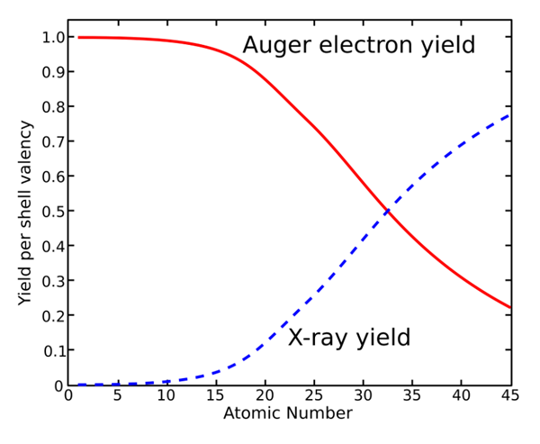
XAS: decay of the core hole: Auger and XES
Below 1000 eV: 99% Auger decay

Slide 12
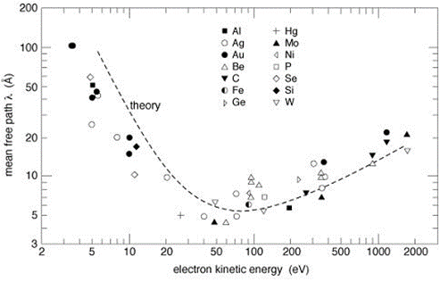
Electron escape depth
Electron yield has few nm probing depth

Slide 13
X-ray spectroscopies
3d⁸ + ω
XAS
XPS
2p⁵3d⁹
2p⁵3d⁸+e’

Slide 14
X-ray spectroscopies
3d⁸ + ω
XAS
XPS
2p⁵3d⁹
2p⁵3d⁸+e’
AES
AES
XES
3p⁴3d⁹+e’
XES
3p⁴3d⁸
+e’+e ’’
IXS
RAES
AES
3d⁸ + ω’
3d⁷ +e’+ω’
RXES (RIXS)
XES

Slide 15
X-ray spectroscopies
Negative -1 -2
3d⁸ + ω
XAS
XPS
2p⁵3d⁹
2p⁵3d⁸+e’
AES
AES
XES
3p⁴3d⁹+e’
XES
3p⁴3d⁸
+e’+e ’’
IXS
RAES
AES
3d⁸ + ω’
3d⁷ +e’+ω’
RIXS
XES

Slide 16
Neutral experiments
Charge Transfer Effects
Neutral experiments are self-screened
XAS, RIXS, (optical, EPR)
>> small screening satellites
>> crystal field theory can be used
Ionising experiments are not self-screened
XPS, RAES
>> large screening > large satellites
>> crystal field theory can not be used

Slide 17
Electron spectroscopies 1
3d⁸ + e

Slide 18
Electron spectroscopies 1
3d⁸ + e
cEELS
cEELS
2p⁵3d⁹ +e’
2p⁵3d⁸+e’

Slide 19
Electron spectroscopies 1
3d⁸ + e
cEELS
cEELS
2p⁵3d⁹
+e’
2p⁵3d⁸+e’
AES
AES
XES
3p⁴3d⁹+e’
XES
3p⁴3d⁸
+e’+e ’’
AES
3d⁸ + ω’
3d⁷ +e’+ω’
XES (EDX)

Slide 20
Electron spectroscopies 1
negative
3d⁸ + e
cEELS
cEELS
2p⁵3d⁹
+e’
2p⁵3d⁸+e’
AES
all excitations at once,
no resonant experiments
XES
3p⁴3d⁸
+e’+e ’’
AES
3d⁷ +e’+ω’
XES (EDX)

Slide 21
Electron spectroscopies 2
positive
3d⁸ + e
EAS (APS)
2p⁵3d¹⁰
EELS
XES
AES
3d⁹ + ω’
3d⁸+e’
RIPES
REELS

Slide 22
Neutral experiments
Charge Transfer Effects
Neutral experiments are self-screened
XAS, RIXS, (optical, EPR), EELS
>> small screening satellites
>> crystal field theory can be used
Ionising experiments are not self-screened
(R)XPS, (R)Auger. (R)IPES, APS
>> large screening > large satellites
>> crystal field theory can not be used

Slide 23
X-ray spectroscopies
3d⁸ + ω
XAS
XPS
2p⁵3d⁹
2p⁵3d⁸+e’
AES
AES
XES
3p⁴3d⁹+e’
XES
3p⁴3d⁸
+e’+e ’’
IXS
RAES
AES
3d⁸ + ω’
3d⁷ +e’+ω’
RIXS
XES

Slide 24
X-ray spectroscopies
3d⁸ + ω
XAS
2p⁵3d⁹

Slide 25
X-ray Absorption Spectroscopy
Element specific
Sensitive to low concentrations
Applicable under extreme conditions
SPACE: x-ray spectromicroscopy
TIME: femtosecond XAS
RESONANCE: RIXS, RAES
+ scattering, +reflectivity
Notes:
XAS is element specific because each element has specific binding energies for its core levels.
The XAS edge energy is essentially given by the core level binding energy.

Slide 26
X-ray absorption edges
X-ray Absorption Spectroscopy
Label
Orbital
eV
K
1s
6539
L _{I}
2s
769
sharp
principal
diffuse
fundamental
L _{II}
2p_{1/2}
650
L _{III}
2p_{3/2}
639
M _{I}
3s
82
M _{II}
3p_{1/2}
47
J. Chem. Educ. 84, 757 (2007)
M _{III}
3p_{3/2}
47
BarKLa
The Nobel Prize in Physics 1917 was awarded to Charles Glover Barkla "for his discovery of the characteristic Röntgen radiation of the elements."

Slide 27
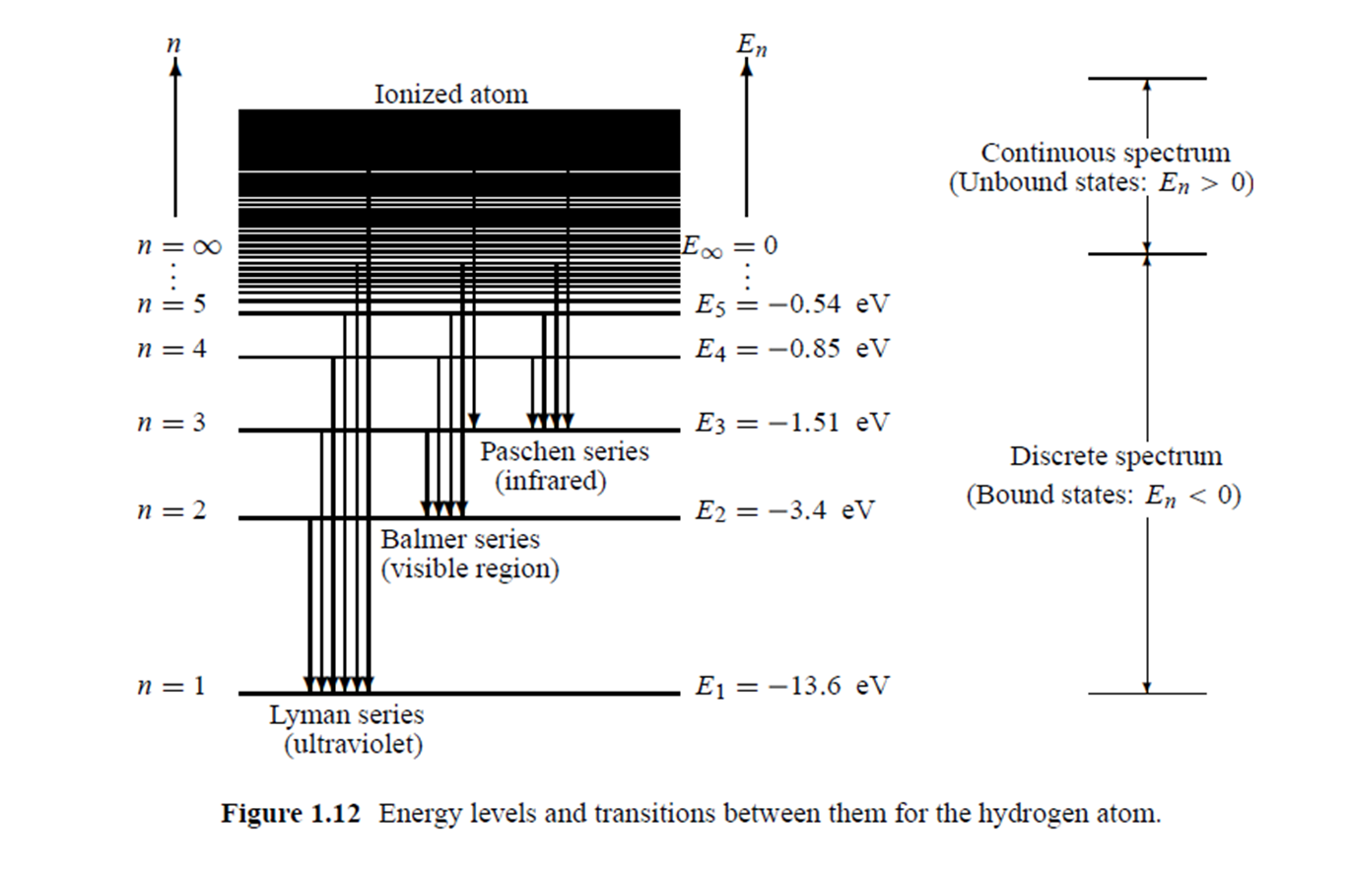
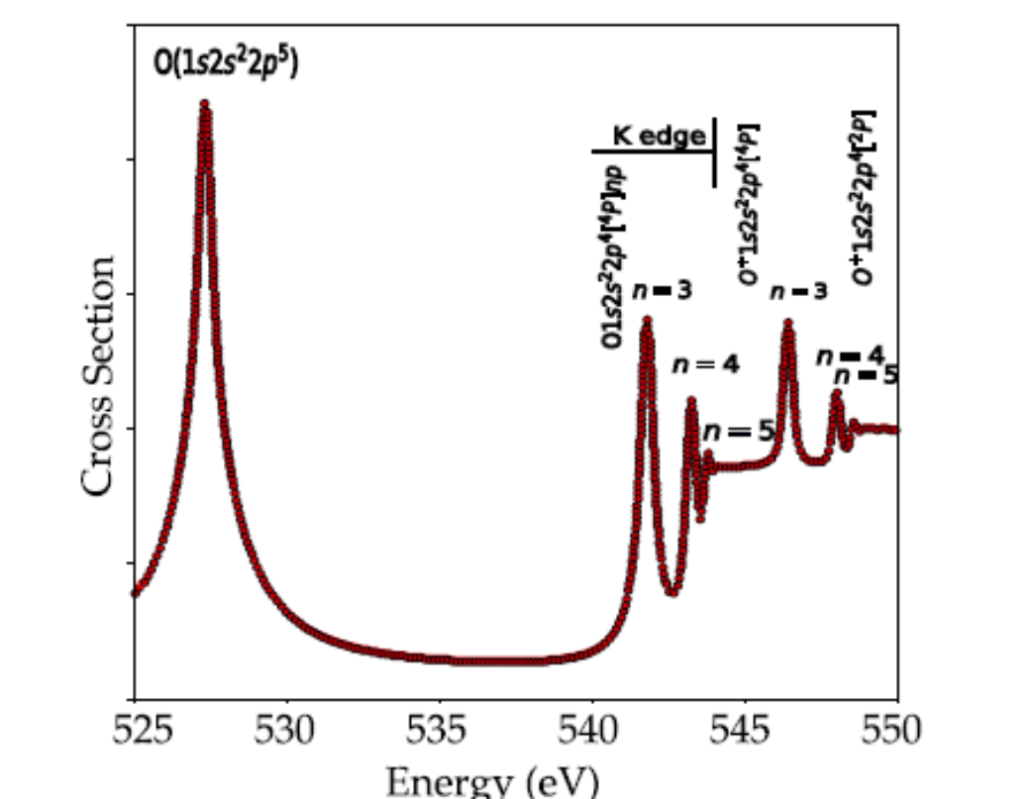
X-ray Absorption Spectroscopy
(Rydberg states)
Atomic electronic structure X-ray absorption of an oxygen atom

Slide 28
XAS of oxygen ions
ion electrons binding energy (eV)
O 8 528.8
O1+ 7 533.3
O2+ 6 537.2
O3+ 5 545.8
O4+ 4 554.6
O5+ 3 562.3
Higher binding energy indicates a higher valence

Slide 29
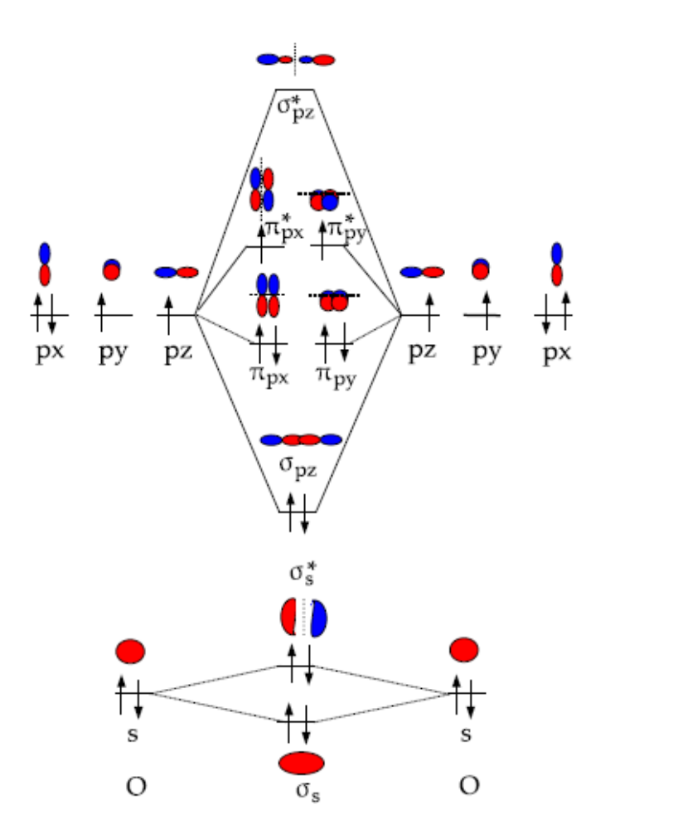
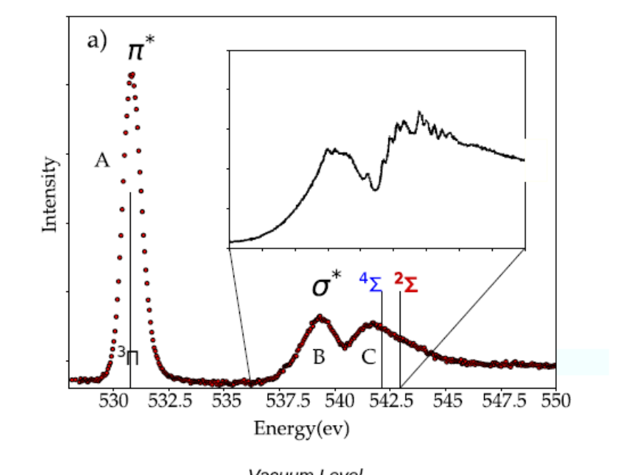
X-ray Absorption Spectroscopy
(σ* mixed with Rydberg states)
Molecular electronic structure X-ray absorption of an O2 molecule

Slide 30
XAS: spectral shape (O 1s)
Electronic structure of a transition metal oxide
Main bonding:
O2p with metal 4sp
Gives valence band and conduction band,
Mixed in character
Additional bonding
O2p with metal 3d;
Gives mixed 3d bands split by crystal field in octahedral symmetry, T2g states have pi-bonding and Eg states have sigma-bonding.
oxygen 1s core state
is localized at an oxygen atom
4sp
E_{g}
T_{2g}
O2p
O2s
O 1s ~530 eV
Notes:
30

Slide 31
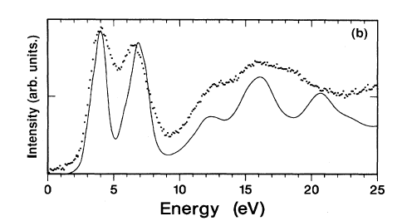
XAS: spectral shape (O 1s)
transition from oxygen 1s state
to an empty state
oxygen 1s core state
is localized at an oxygen atom
local empty DOS
dipole selection rule:
p-projected DOS
4sp
E_{g}
T_{2g}
O2p
O2s
O 1s ~530 eV
Fermi Golden Rule:
I_{XAS} = |<Φ_{f}|dipole| Φ_{i}>|² δ_{[ΔE=0]}
[Phys. Rev. B. 40, 5715 (1989); review in Chem. Rev. 120, 4056 (2020)]
Notes:
31

Slide 32
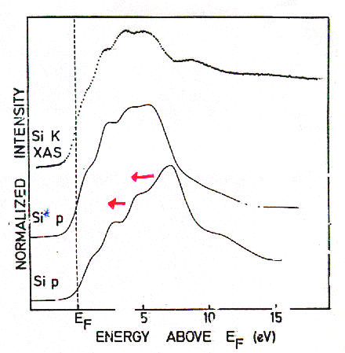
XAS: spectral shape
TiSi₂
Final State Rule: Spectral shape of XAS looks like final state DOS
Phys. Rev. B. 41, 11899 (1991)

Slide 33
XAS: Final State Rule
E_{g}
T_{2g}
O 2p
valence
band
Oxygen 1s XAS
O 2p states more localized
Reduced bonding
Reduced crystal field
Ground state
Occupied O 2p valence band
Empty Ti 3d conduction band
Crystal field split 3d band
The crystal field splitting is reduced in the oxygen K edge

Slide 34
XAS: Final State Rule
E_{g}
T_{2g}
XAS crystal field is smaller than
the optical crystal field
(& the DFT ground state crystal field)
O 2p
valence
band
Oxygen 1s XAS
O 2p states more localized
Reduced bonding
Reduced crystal field
Ground state
Occupied O 2p valence band
Empty Ti 3d conduction band
Crystal field split 3d band
Titanium 2p XAS
Ti 3d states more localized
Reduced bonding
Reduced crystal field
The crystal field splitting is reduced in the oxygen 1s XAS and also in metal 2p XAS

Slide 35
XAS: spectral shape (O 1s)
Crystal structure
Electronic structure calculation,
for example Density Functional Theory (DFT)
(in the presence of the core hole)
Calculation of the oxygen
p-projected local empty DOS
Compare with experiment
CODES: FEFF, Wien2K, VASP, QE, etc.

Slide 36
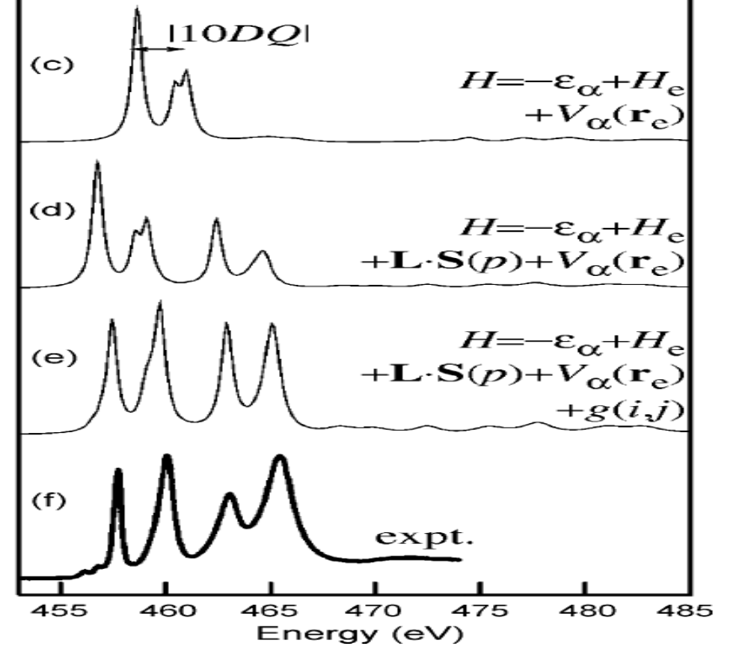
XAS: spectral shape (Ti 2p)
2p > 3d
4sp
E_{g}
T_{2g}
O2p
O2s
Ti 2p ~460 eV
Expect the d (and s-) projected Ti DOS
Why is experiment different?
Notes:
36

Slide 37
XAS: spectral shape (Ti 2p)
2p > 3d
4sp
E_{g}
T_{2g}
O2p
O2s
Ti 2p ~460 eV
Expect the d (and s-) projected Ti DOS
2p spin-orbit coupling (~6 eV)
Notes:
37

Slide 38
XAS: spectral shape (Ti 2p)
2p3d 2-electron integrals
4sp
E_{g}
T_{2g}
O2p
O2s
Ti 2p ~460 eV
Expect local d-projected Ti DOS
Core spin-orbit splitting
Overlap of core 2p and valence 3d states
>> many electron excitations dominate
Notes:
38

Slide 39
XAS: spectral shape (Ti 2p)
X-ray absorption
Fermi Golden Rule:
I_{XAS} = |<Φ_{f}|dipole| Φ_{i}>|² δ_{[ΔE=0]}
I_{XAS} = |< 2p⁵ 3d¹ |dipole| 3d⁰>|² δ_{[ΔE=0]}
Can NOT approximate 2p-3d interaction as extra potential
Large core hole spin-orbit coupling
Single electron (excitation) approximation breaks down :
I_{XAS} = |<3d |dipole| 2p>|² ρ

Slide 40
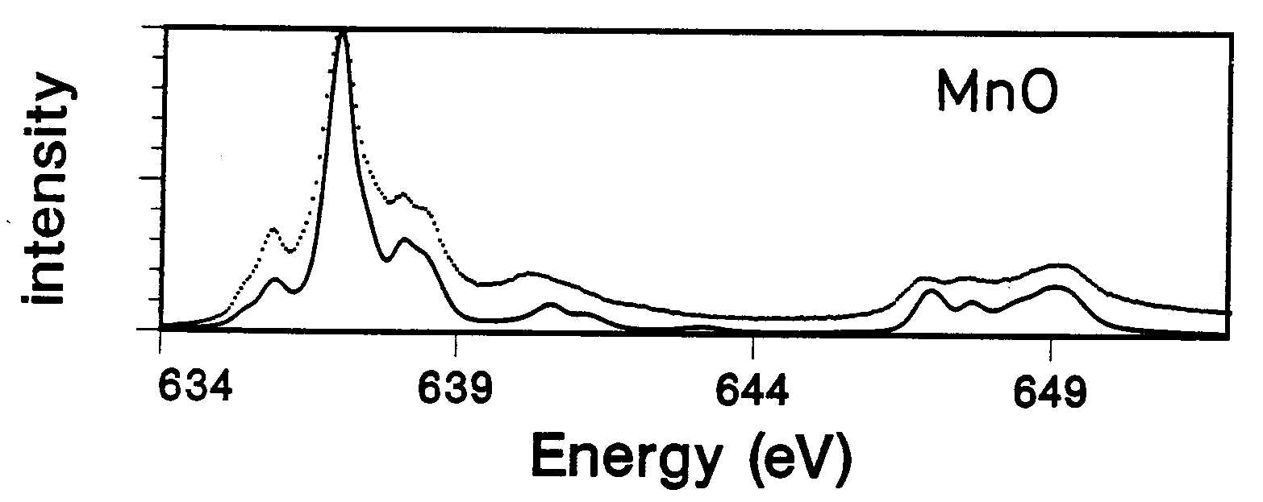
XAS: multiplet effects
Core-valence electron-electron interactions NOT screened in solids
Single Particle (excitation) models break down [both DFT & BSE]
3d
<2p3d|1/r|2p3d>
2p_{3/2}
2p_{1/2}
[Phys. Rev. B. 42, 5459 (1990)]

Slide 41
XAS: spectral shape (O 1s)
X-ray absorption
Fermi Golden Rule:
I_{XAS} = |<Φ_{f}|dipole| Φ_{i}>|² δ_{[ΔE=0]}
I_{XAS} = |< 1s¹ 2p⁵ |dipole| 2p⁴>|² δ_{[ΔE=0]}
Can neglect local 2p-2p interaction
Can approximate 1s-2p interaction as extra potential
No core hole spin-orbit coupling
Single electron (excitation) approximation :
I_{XAS} = |<2p |dipole| 1s>|² ρ

Slide 42
Interpretation of XAS
Intra-atomic e-e
interactions
Interatomic interactions
(mean field)
Strong correlations
4f ionic 3d covalent 3d (f) closed shell
atomic
multiplet
theory
crystal field
multiplet
theory
impurity
multiplet
theory
(GW+C)?
DMFT+
multiplets
(DFT)
TD-DFT
BSE

Slide 43
Interpretation of XAS
1-particle excitation
(electron – core hole)
Neglect many-electron interactions
3d3d multiplets
2p3d multiplets
Ligand-metal charge transfer (Δ)
Metal-metal charge transfer (U)
Two core holes
TD-DFT
BSE

Slide 44
X-ray Absorption Spectroscopy
Experiments

Slide 45
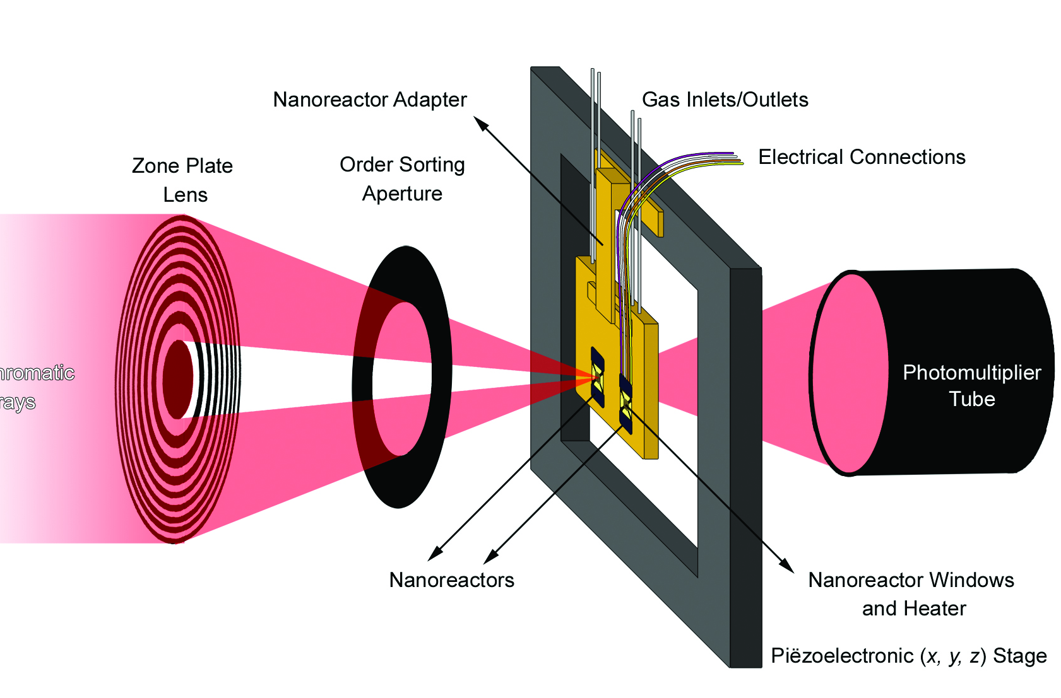
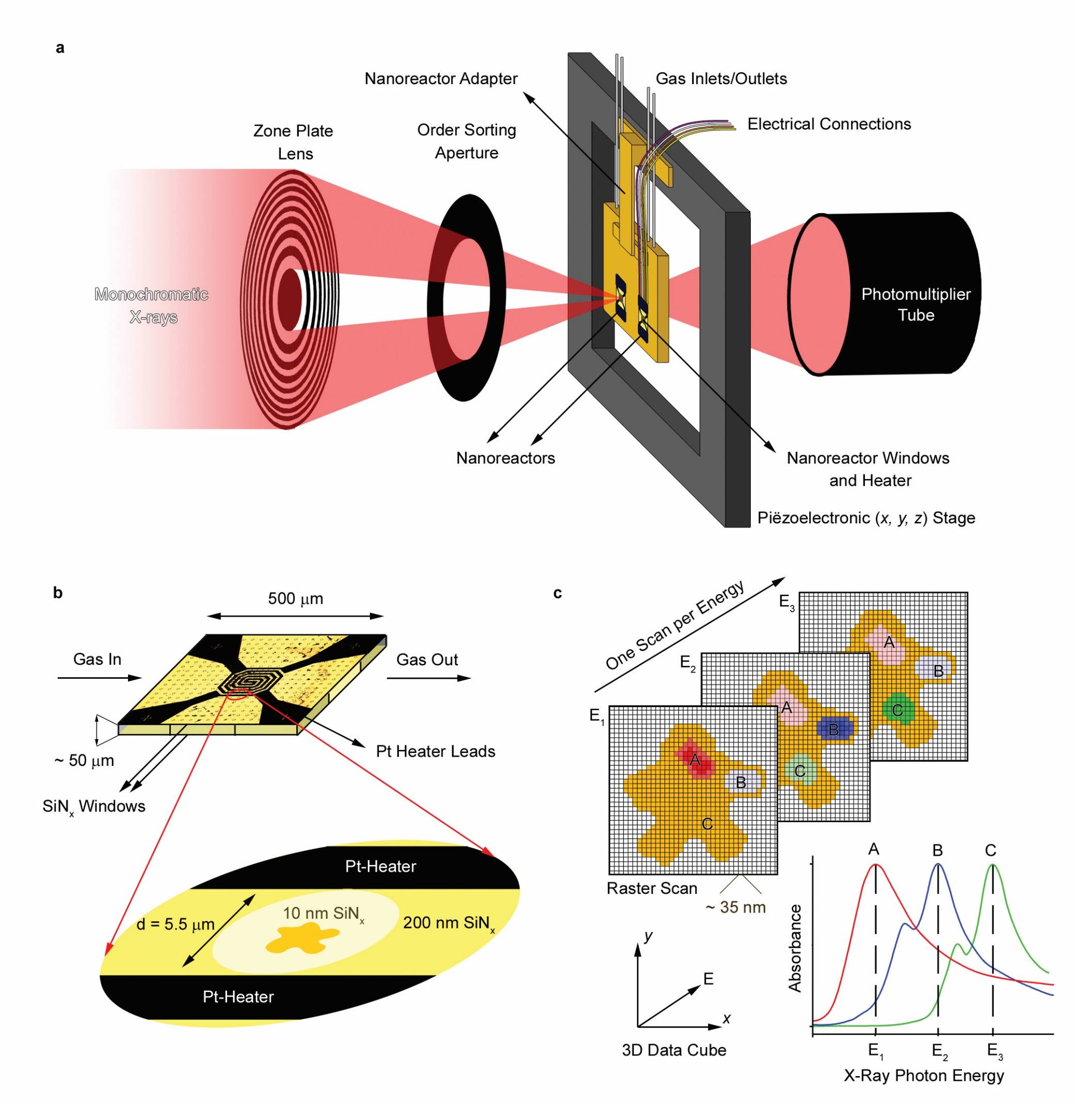
XAS in transmission: STXM example
Nanoscale chemical imaging of a working catalyst

Slide 46
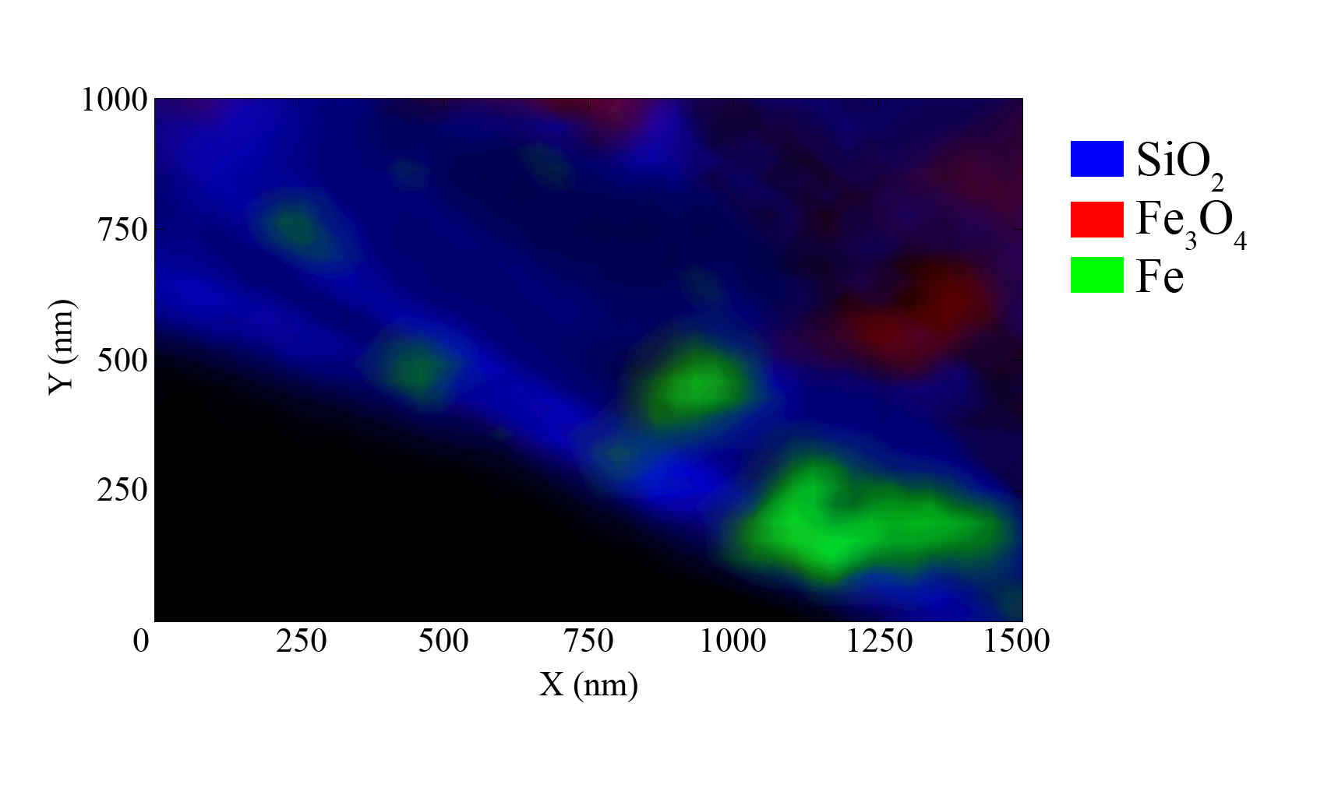
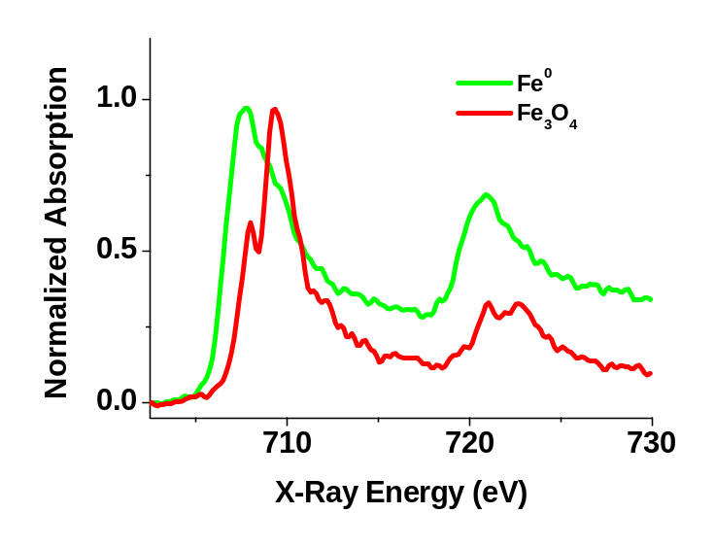
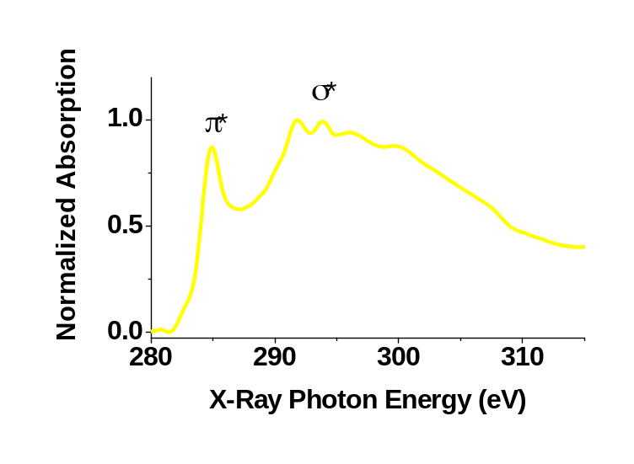
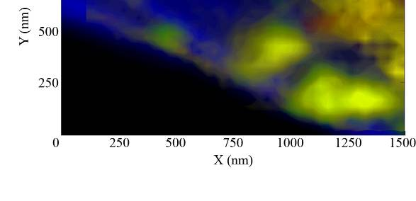
XAS in transmission: STXM example
Nanoscale chemical imaging of a working catalyst
Carbon K-edge
[de Smit, Nature 456, 222 (2008)]

Slide 47
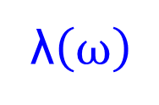
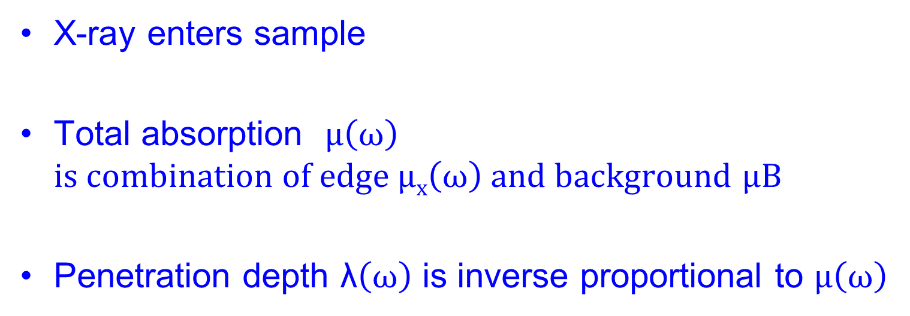
Yield detection
XAS measured with total electron yield
λ$\left(ω\right)$
X-ray enters sample
Total absorption $μ\left(ω\right)$
$is combination of edge μx\left(ω\right) and background$ $μB$
Penetration depth λ$\left(ω\right)$ is inverse proportional to $μ\left(ω\right)$

Slide 48
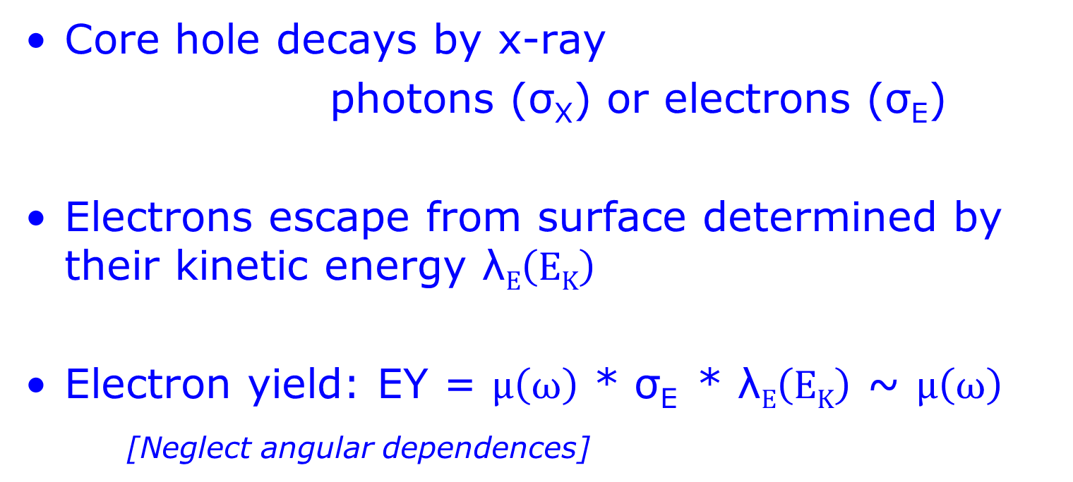
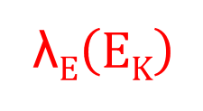
Electron Yield detection
XAS measured with total electron yield
λ$E\left(EK\right)$
λ$\left(ω\right)$
Core hole decays by x-ray
photons (σ_{X}) or electrons (σ_{E})
Electrons escape from surface determined by their kinetic energy λ$E\left(EK\right)$
Electron yield: EY = $μ\left(ω\right)$ * σ_{E} * λ$E\left(EK\right)$ ~ $μ\left(ω\right)$
[Neglect angular dependences]

Slide 49
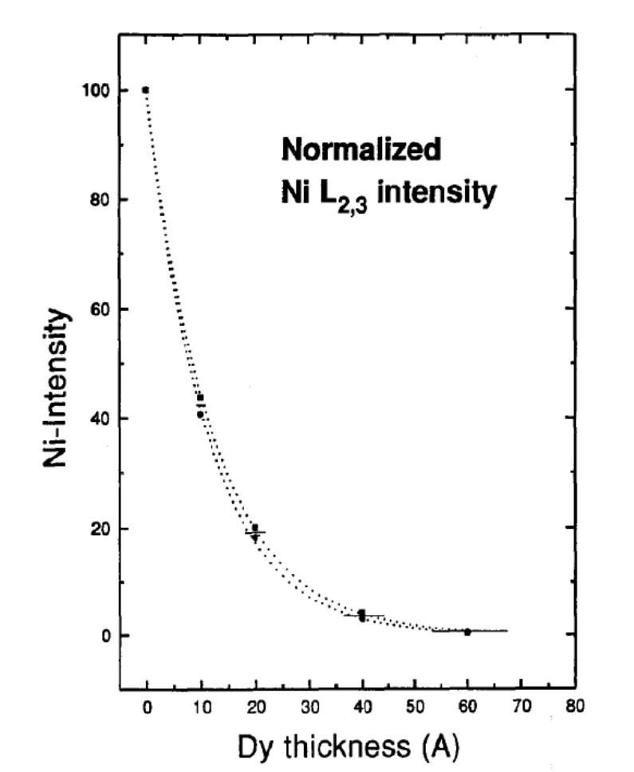

XAS with TEY: electron escape depth
Electron escape depth (TEY):
Detect Ni 2p XAS as function of Dy layer thickness: Intensity can be simulated with escape depth d = 1,1 nm
vacuum Dy Ni
X-rays
[Vogel, J Elec Spec 67, 181 (1994)]

Slide 50
Partial and conversion EY:
Partial Electron yield:
Detect kinetic energy of electrons:
Select specific photoemission or Auger yield
(position of detector to study angular effects)
Conversion Electron Yield (in gas environment):
Electrons ionize gas ions
> Separate signal from direct x-ray ionization of gas
> Determine linearity between intensity and ionization
> Avoid (indirect FY effects)

Slide 51
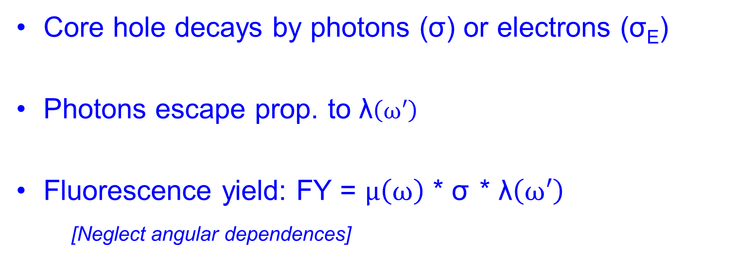
Fluorescence Yield detection
λ$\left(ω\right)$
Core hole decays by photons (σ) or electrons (σ_{E})
Photons escape prop. to λ$\left(ω′\right)$
Fluorescence yield: FY = $μ\left(ω\right)$ * σ * λ$\left(ω′\right)$
[Neglect angular dependences]

Slide 52
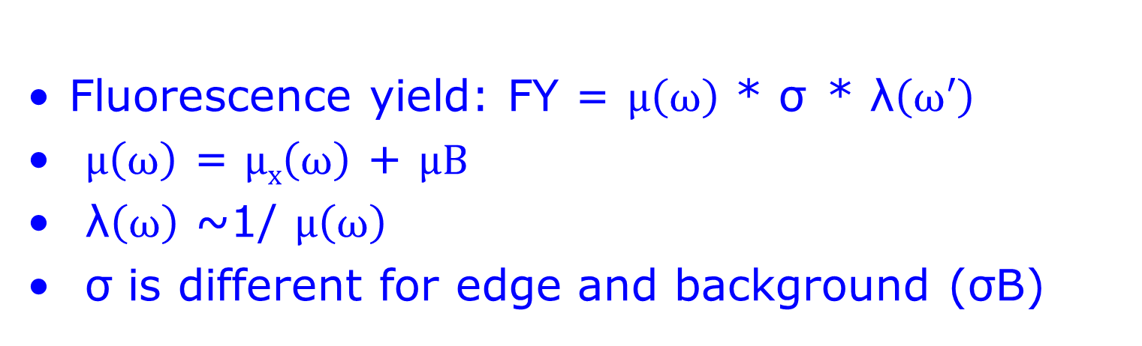
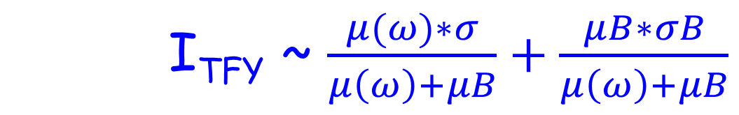
Fluorescence Yield detection
Fluorescence yield: FY = $μ\left(ω\right)$ * σ * λ$\left(ω′\right)$
$μ\left(ω\right)$ = $μx\left(ω\right)$ + $μB$
λ$\left(ω\right)$ ~1/ $μ\left(ω\right)$
σ is different for edge and background (σB)
I_{TFY} ~ $\frac{μ(ω)∗σ}{μ\left(ω\right)+μB}+\frac{μB∗σB}{μ\left(ω\right)+μB}$

Slide 53
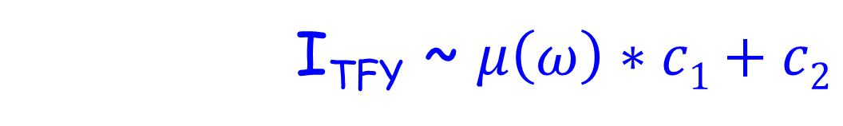
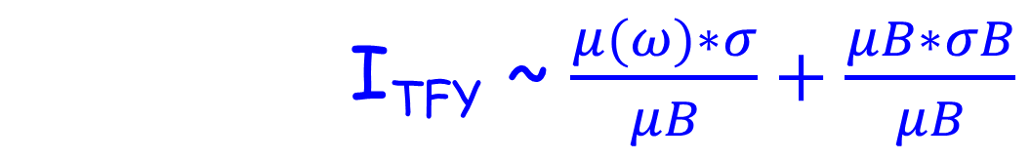
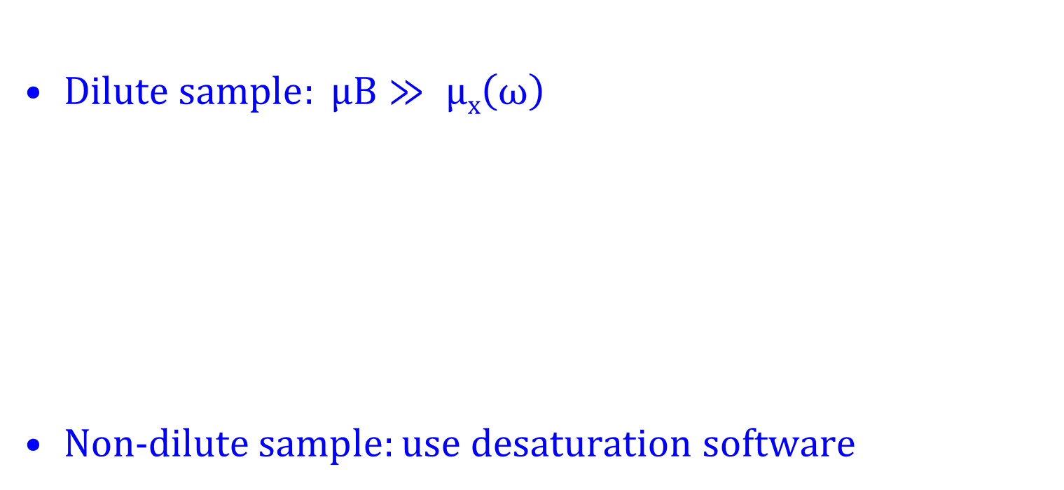
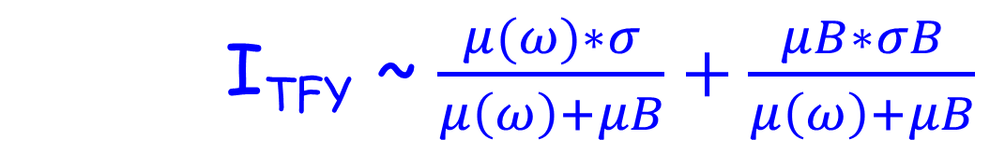
FY detection: dilute sample
I_{TFY} ~ $\frac{μ(ω)∗σ}{μ\left(ω\right)+μB}+\frac{μB∗σB}{μ\left(ω\right)+μB}$
$Dilute sample: μB≫ μx\left(ω\right)$
Non-d$ilute sample:use \text{desaturation} \text{software}$
I_{TFY} ~ $\frac{μ(ω)∗σ}{μB}+\frac{μB∗σB}{μB}$
I_{TFY} ~ $μ\left(ω\right)∗c1+c2$

Slide 54
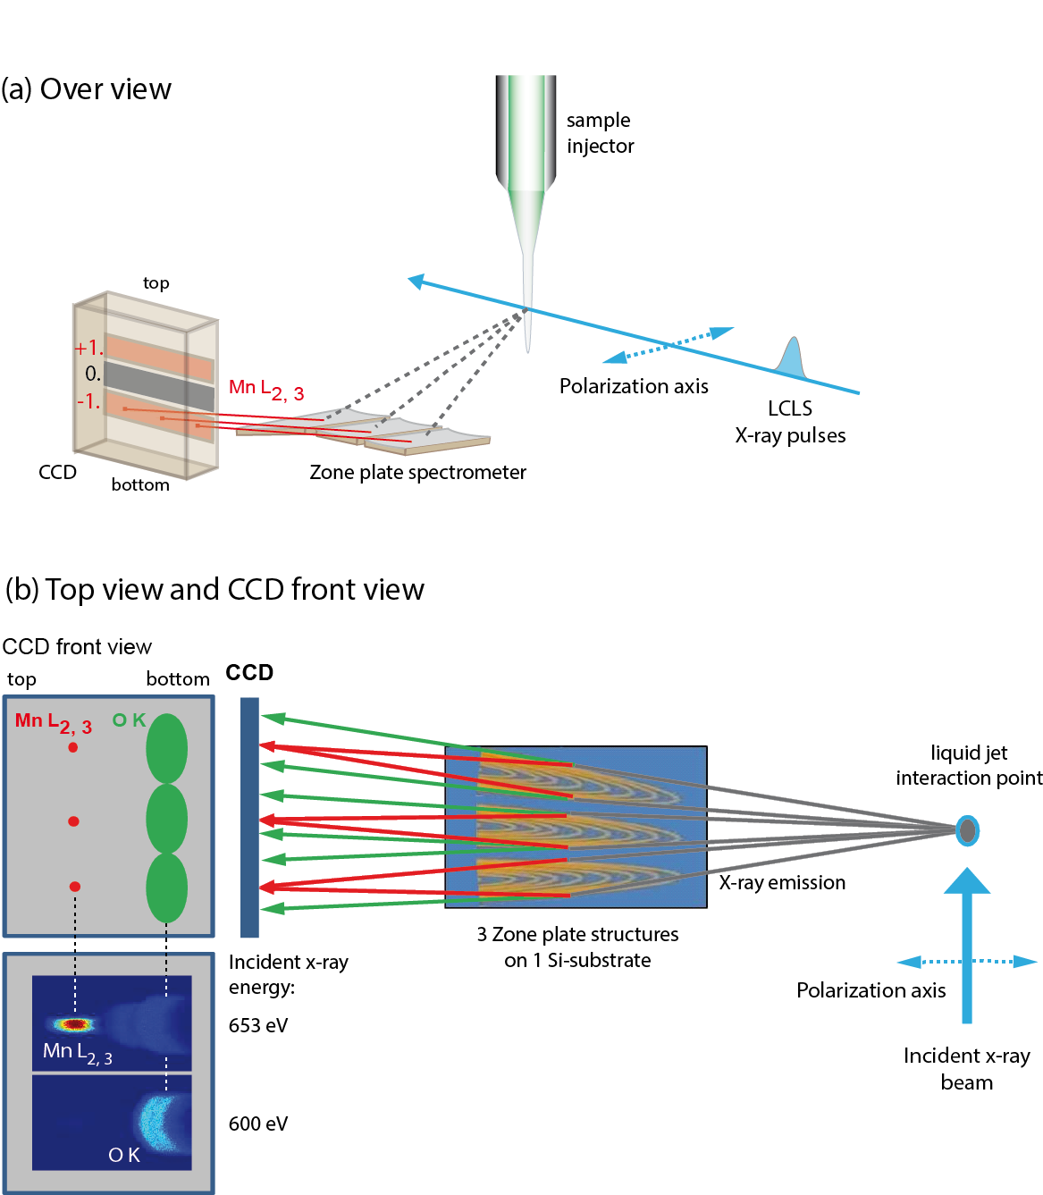
FY detection: state dependent decay
Single synchrotron pulselength is too long
Mitzner, J. Phys. Chem. Lett. 4, 3641 (2013)
Notes:
54

Slide 55
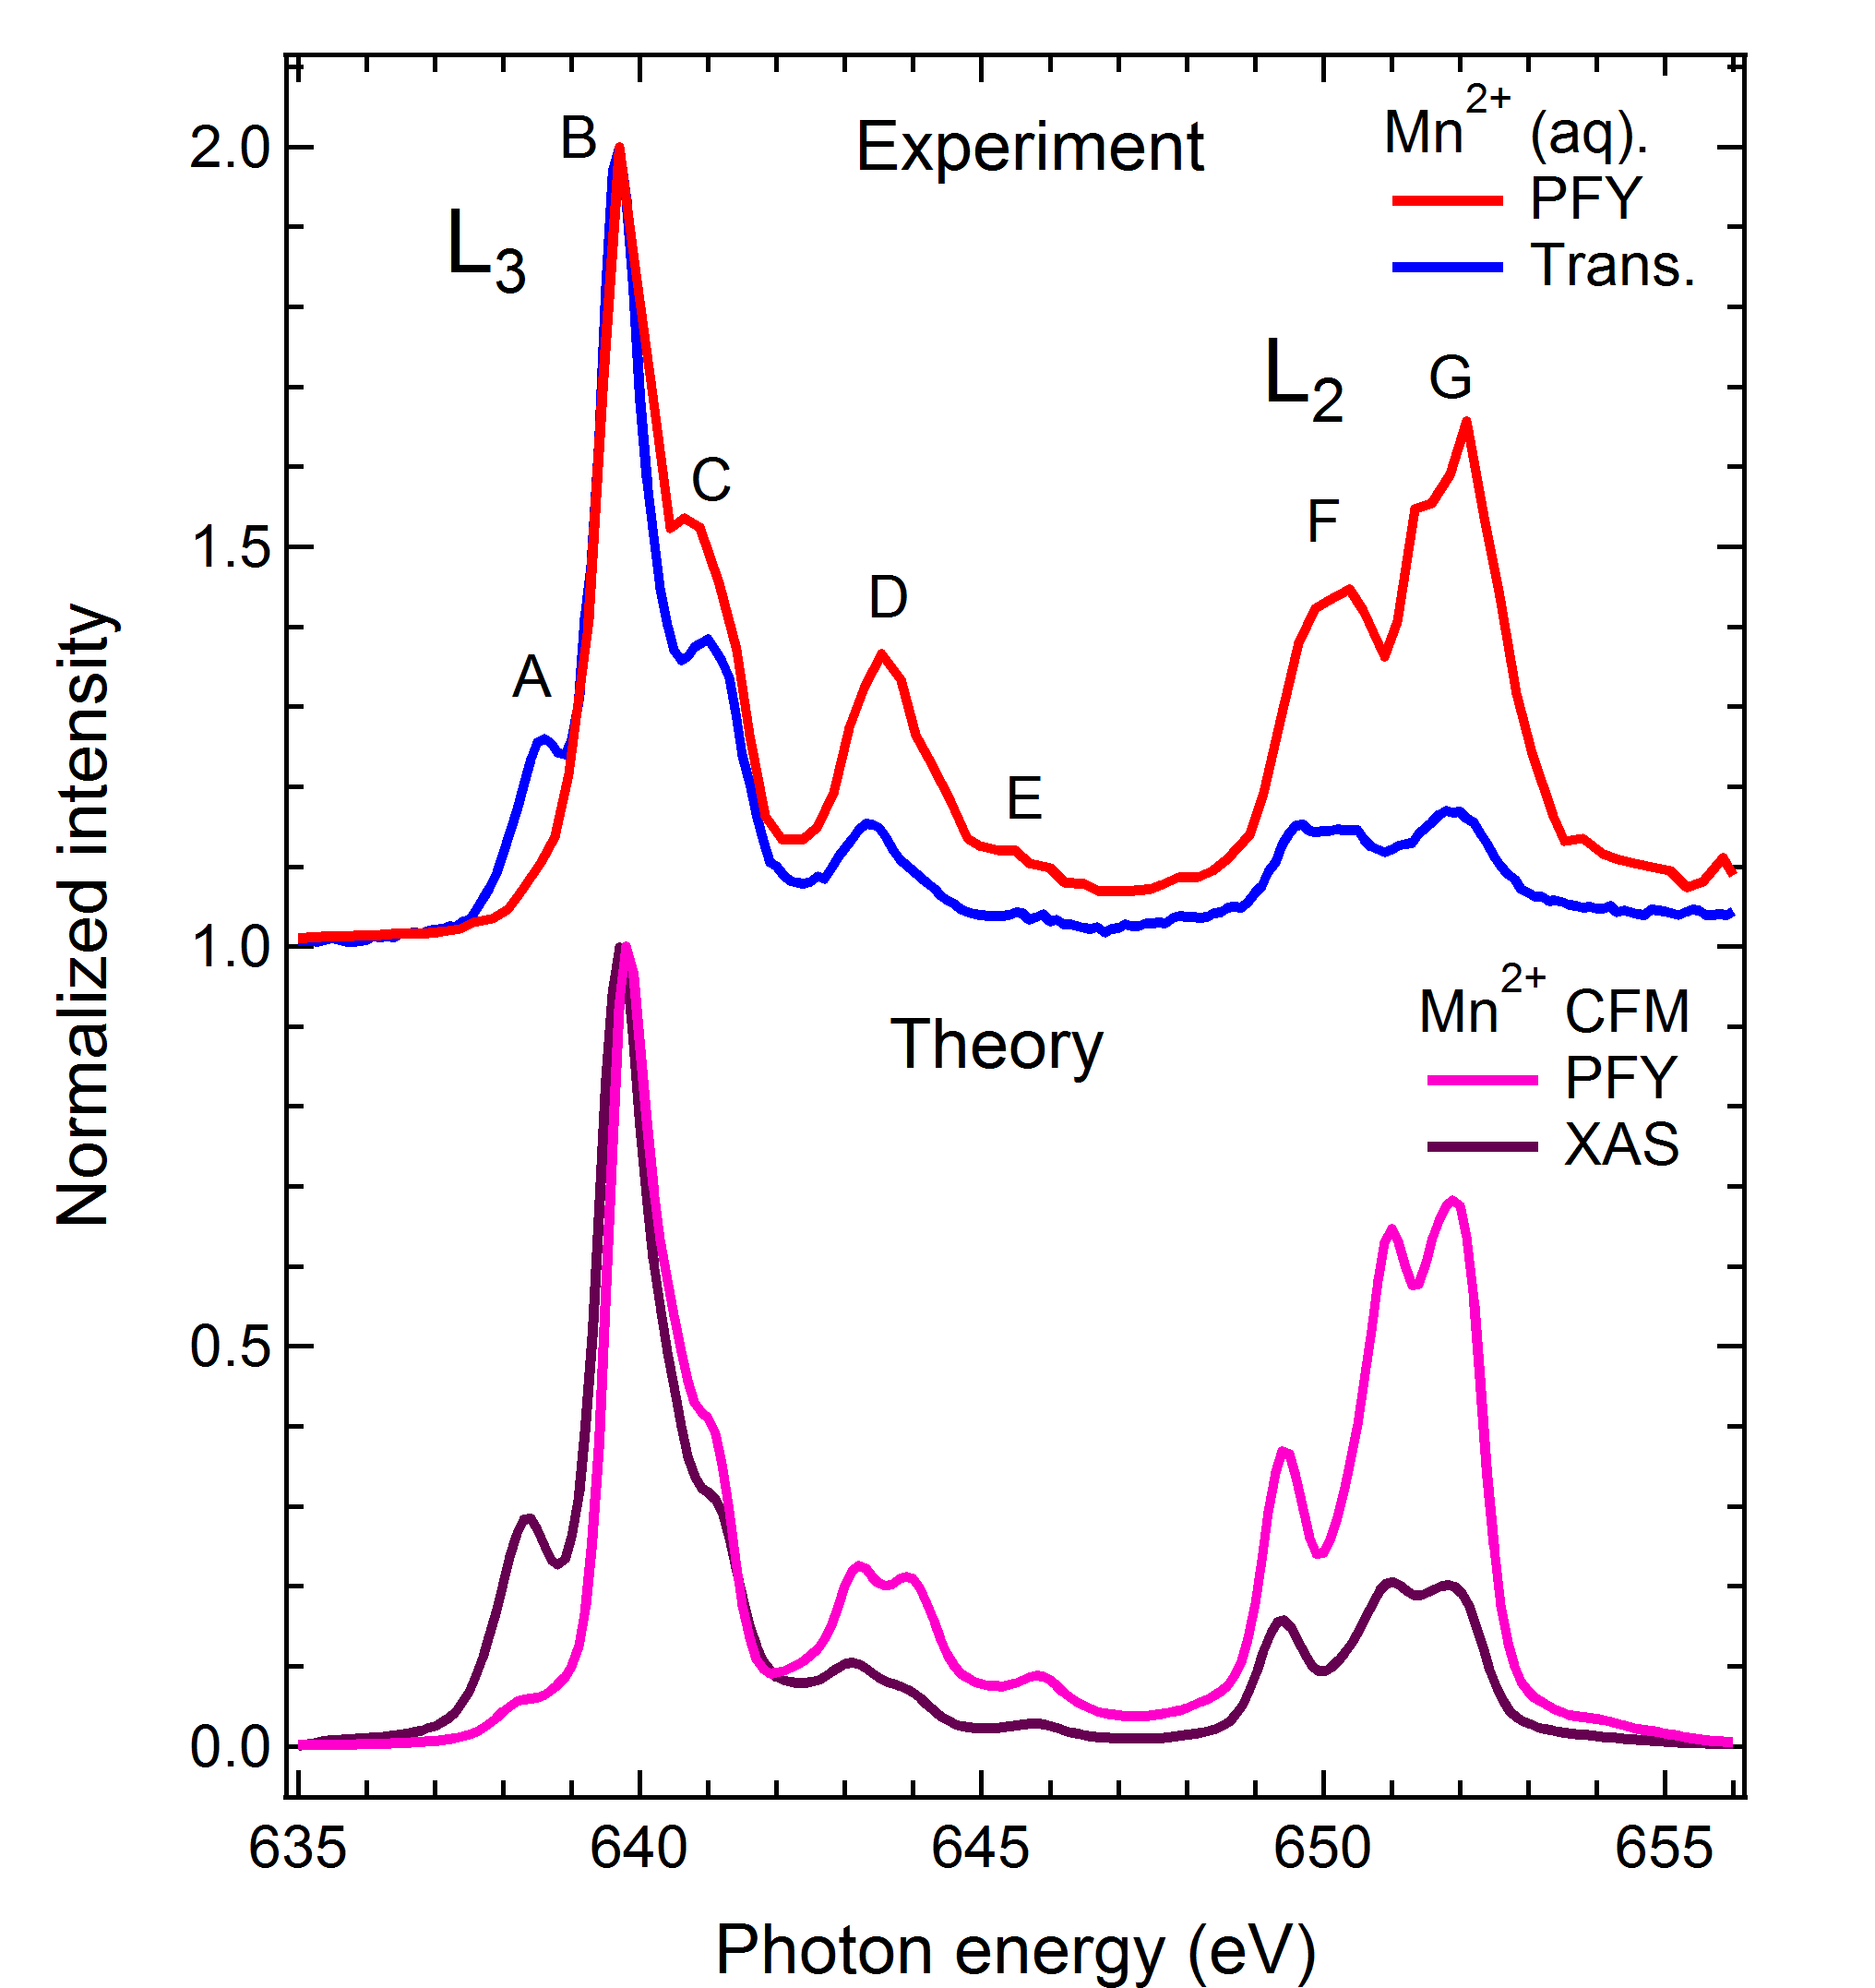
FY detection: state dependent decay
Fluorescence does not measure XAS spectrum
Saturation ?
Mitzner, J. Phys. Chem. Lett. 4, 3641 (2013)
Notes:
55

Slide 56
FY detection: state dependent decay
Fluorescence does not measure XAS spectrum
NO Saturation
State-dependent decay
Mitzner, J. Phys. Chem. Lett. 4, 3641 (2013)
Notes:
56

Slide 57
FY detection: state dependent decay
Yield methods assume a constant ratio between radiative and non-radiative decay
If this ratio is state (= energy) dependent than the related yield methods do not measure XAS.
The dominant yield method is not visibly affected, thus for soft X-rays only FY is affected, not electron yield.

Slide 58
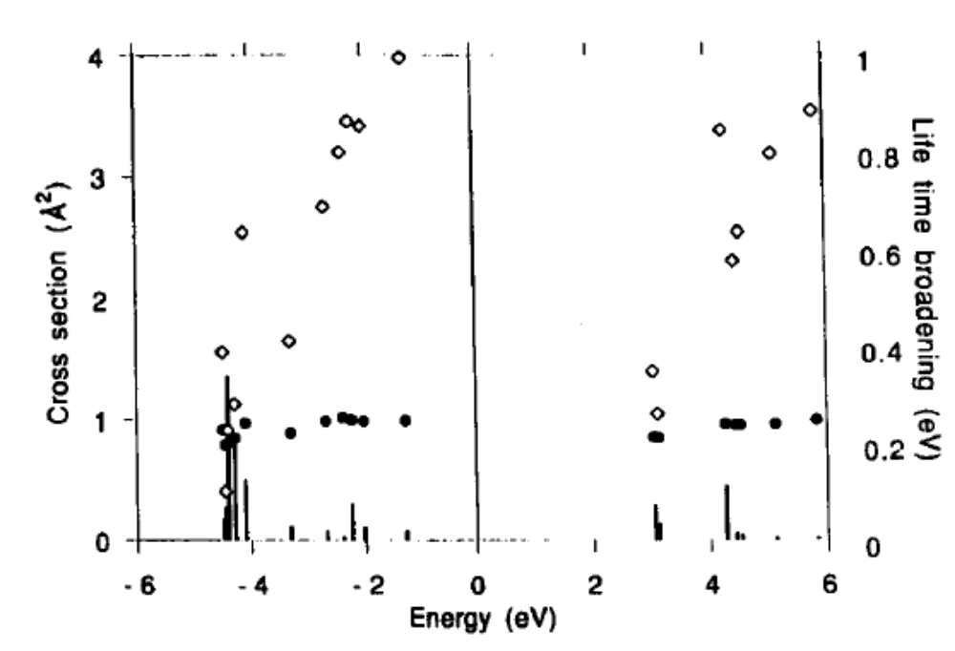
FY detection: state dependent decay
FY*500
L₃
L₂
EY
Solid State Comm. 92, 991 (1994)

Slide 59
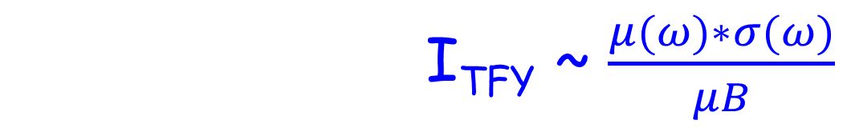
FY detection (state-dependent, dilute)
I_{TFY} ~ $\frac{μ(ω)∗σ}{μ\left(ω\right)+μB}+\frac{μB∗σB}{μ\left(ω\right)+μB}$
I_{TFY} ~ $\frac{μ(ω)∗σ(ω)}{μB}$
Main decay of 2p core hole is 2p3d RIXS
Integrate RIXS spectrum to 2p3d PFY
TFY ~ 2p3d PFY
NOTE: “RIXS” has angular dependence effects

Slide 60
FY detection: state dependent decay
Mitzner et al, J. Phys. Chem. Lett. 4, 3641 (2013)
Notes:
60

Slide 61
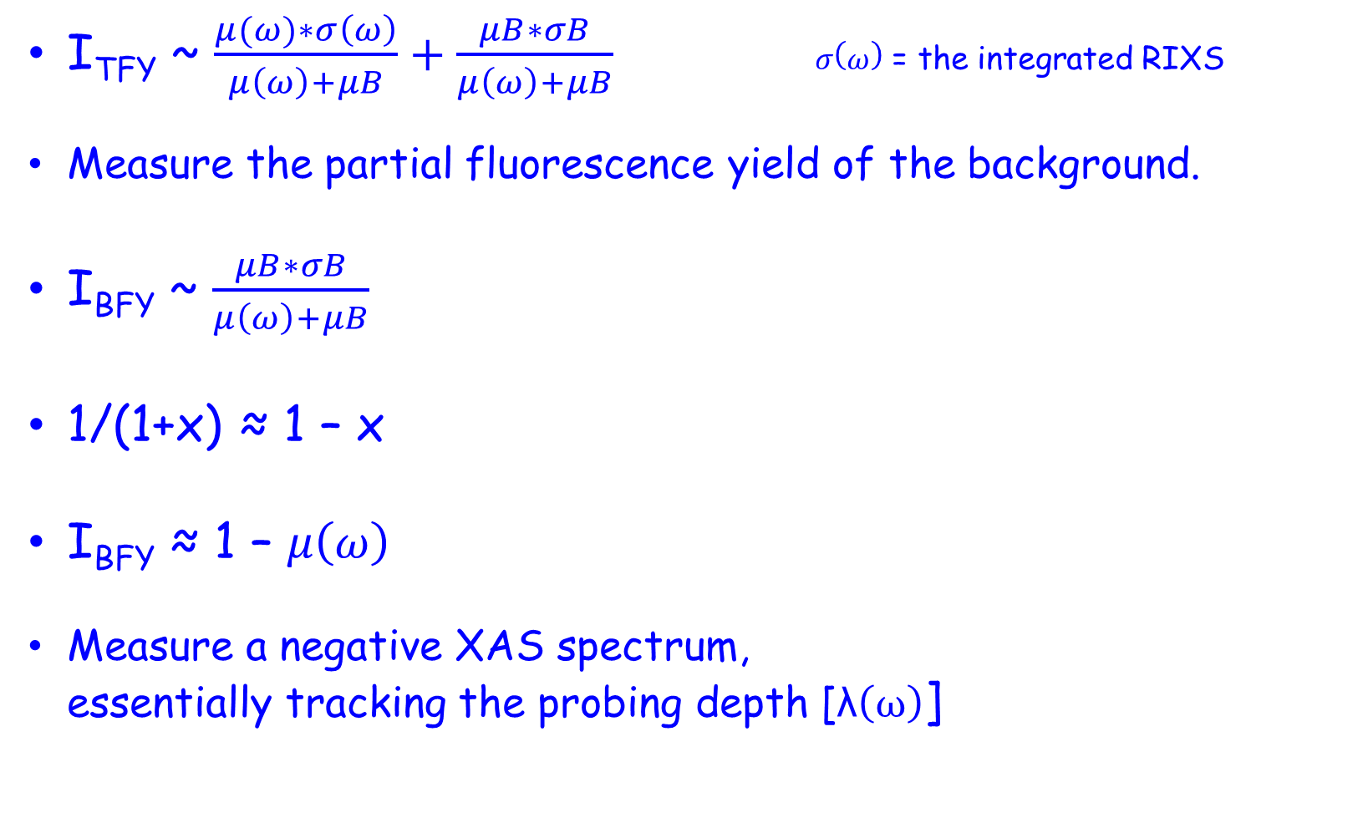
Inverse PFY
I_{TFY} ~ $\frac{μ(ω)∗σ\left(ω\right)}{μ\left(ω\right)+μB}+\frac{μB∗σB}{μ\left(ω\right)+μB} σ\left(ω\right)$ = the integrated RIXS
Measure the partial fluorescence yield of the background.
I_{BFY} ~ $\frac{μB∗σB}{μ\left(ω\right)+μB}$
1/(1+x) ≈ 1 – x
I_{BFY} ≈ 1 – $μ\left(ω\right)$
Measure a negative XAS spectrum,
essentially tracking the probing depth [λ$\left(ω\right)$]
Achkar, scientific reports 1, 82 (2011)

Slide 62
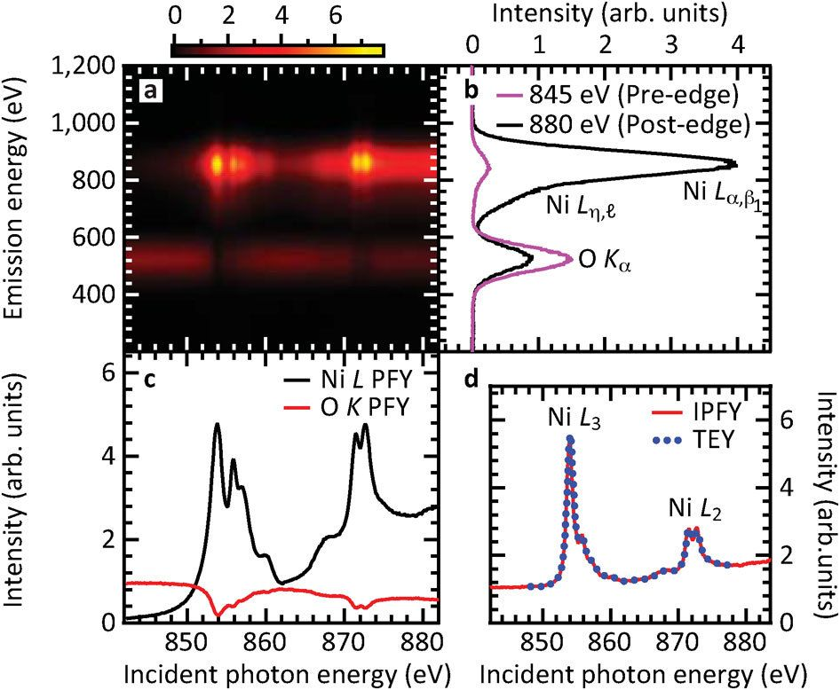
Inverse PFY
Achkar, scientific reports 1, 82 (2011)

Slide 63
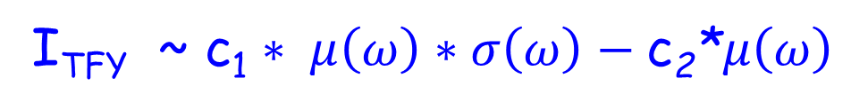
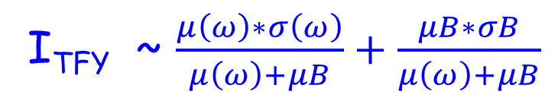
FY detection: dips and peaks
Measure the total fluorescence yield
Positive (saturated) state-dependent metal PFY
+ Negative inverse oxygen PFY
I_{TFY} ~ $\frac{μ\left(ω\right)∗σ\left(ω\right)}{μ\left(ω\right)+μB}+\frac{μB∗σB}{μ\left(ω\right)+μB}$
I_{TFY} ~ c₁ $∗ μ\left(ω\right)∗σ\left(ω\right)−\text{c}\text{2}\text{∗}μ\left(ω\right)$

Slide 64
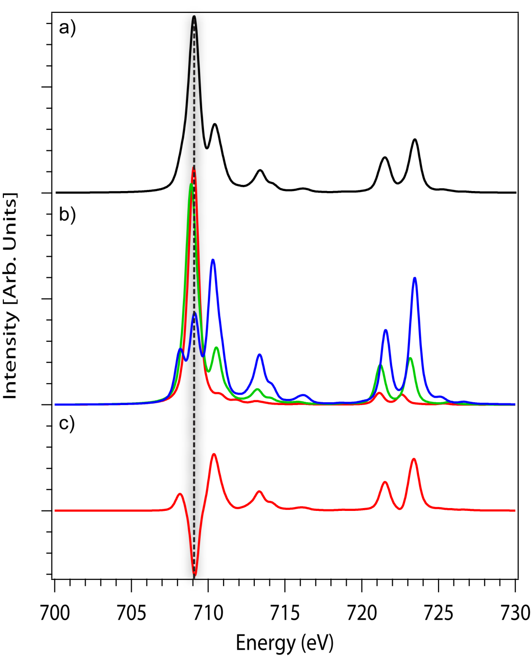
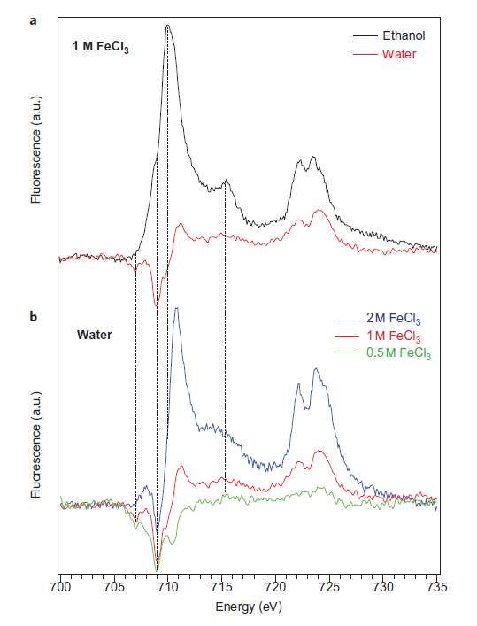
FY detection: dips and peaks
Nature Chem. 4, 766 (2012) & Phys. Rev. Letter discussions (2014)

Slide 65
Different PFY signals
IPFY: small signal, no saturation
2p3s PFY: minor saturation, large sCK effect
2p3d PFY: large saturation, state-dependent decay
Chiu, Nature Rep. 11, 5250 (2021)

Slide 66
Different PFY signals
PFY/RIXS:
10 meV: Few RIXS beamlines; small signal,
conceptually possible to measure XAS with 10 meV resolution (put detector at sharp peak)
100 meV: Most RIXS beamlines
1 eV: TES detector
10 eV: Dedicated fluorescence detectors
100 eV: Fluorescence detectors
Inverse relation between resolution and intensity

Slide 67
XAS: detection techniques
Transmission
(pinhole, saturation > thin samples)
Electron Yield
(surface sensitive)
Fluorescence Yield
(saturation & self-absorption:
> dilute samples)
[L edges are intrinsically distorted]

