Slide 1

Crispy: A Graphical User Interface for X-Ray Spectroscopy Calculations
Marius Retegan
Algorithms & scientific Data Analysis (ADA) Group

Slide 2
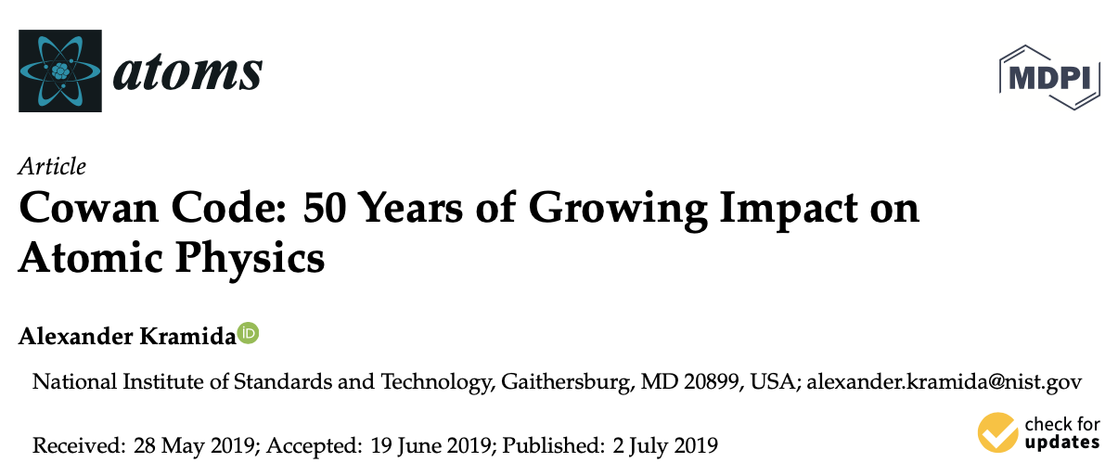
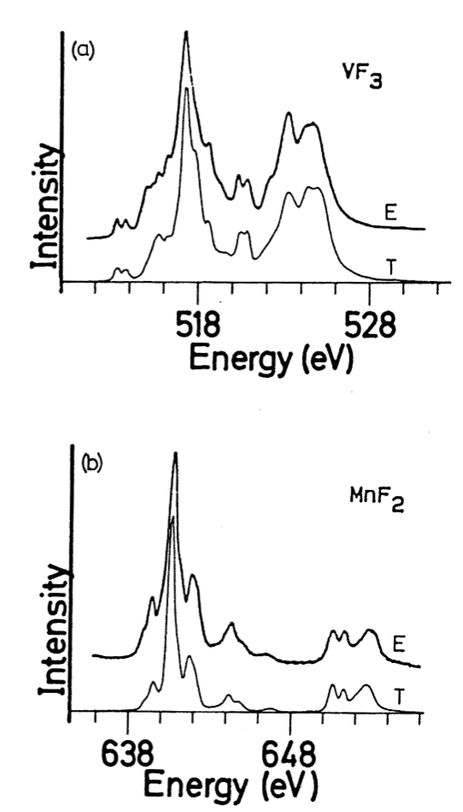
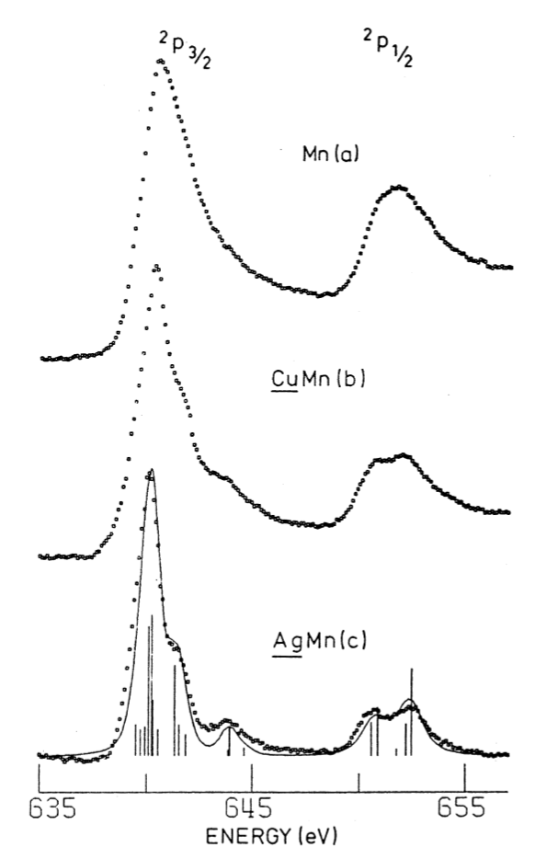
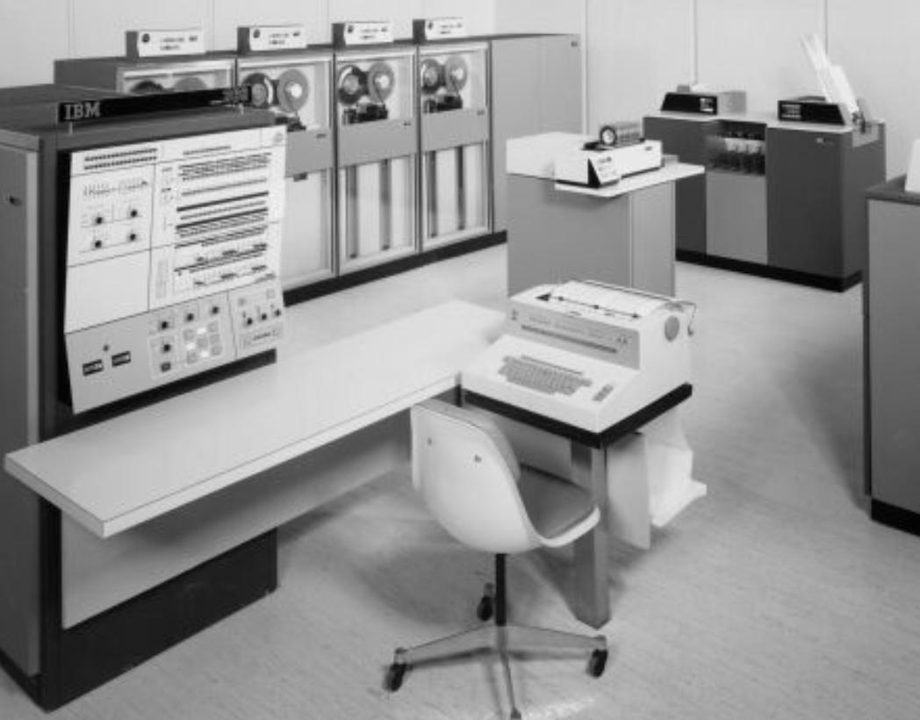
Semi-Empirical MultipletS: the early days
B.T. Thole et al.,
Phys. Rev. B, 1985, 35, 6856
F.M.F. de Groot et al.,
Phys. Rev. B, 1990, 42, 5459
Notes:
- In the early days
- The ground state of the diluted manganese in silver is d5

Slide 3
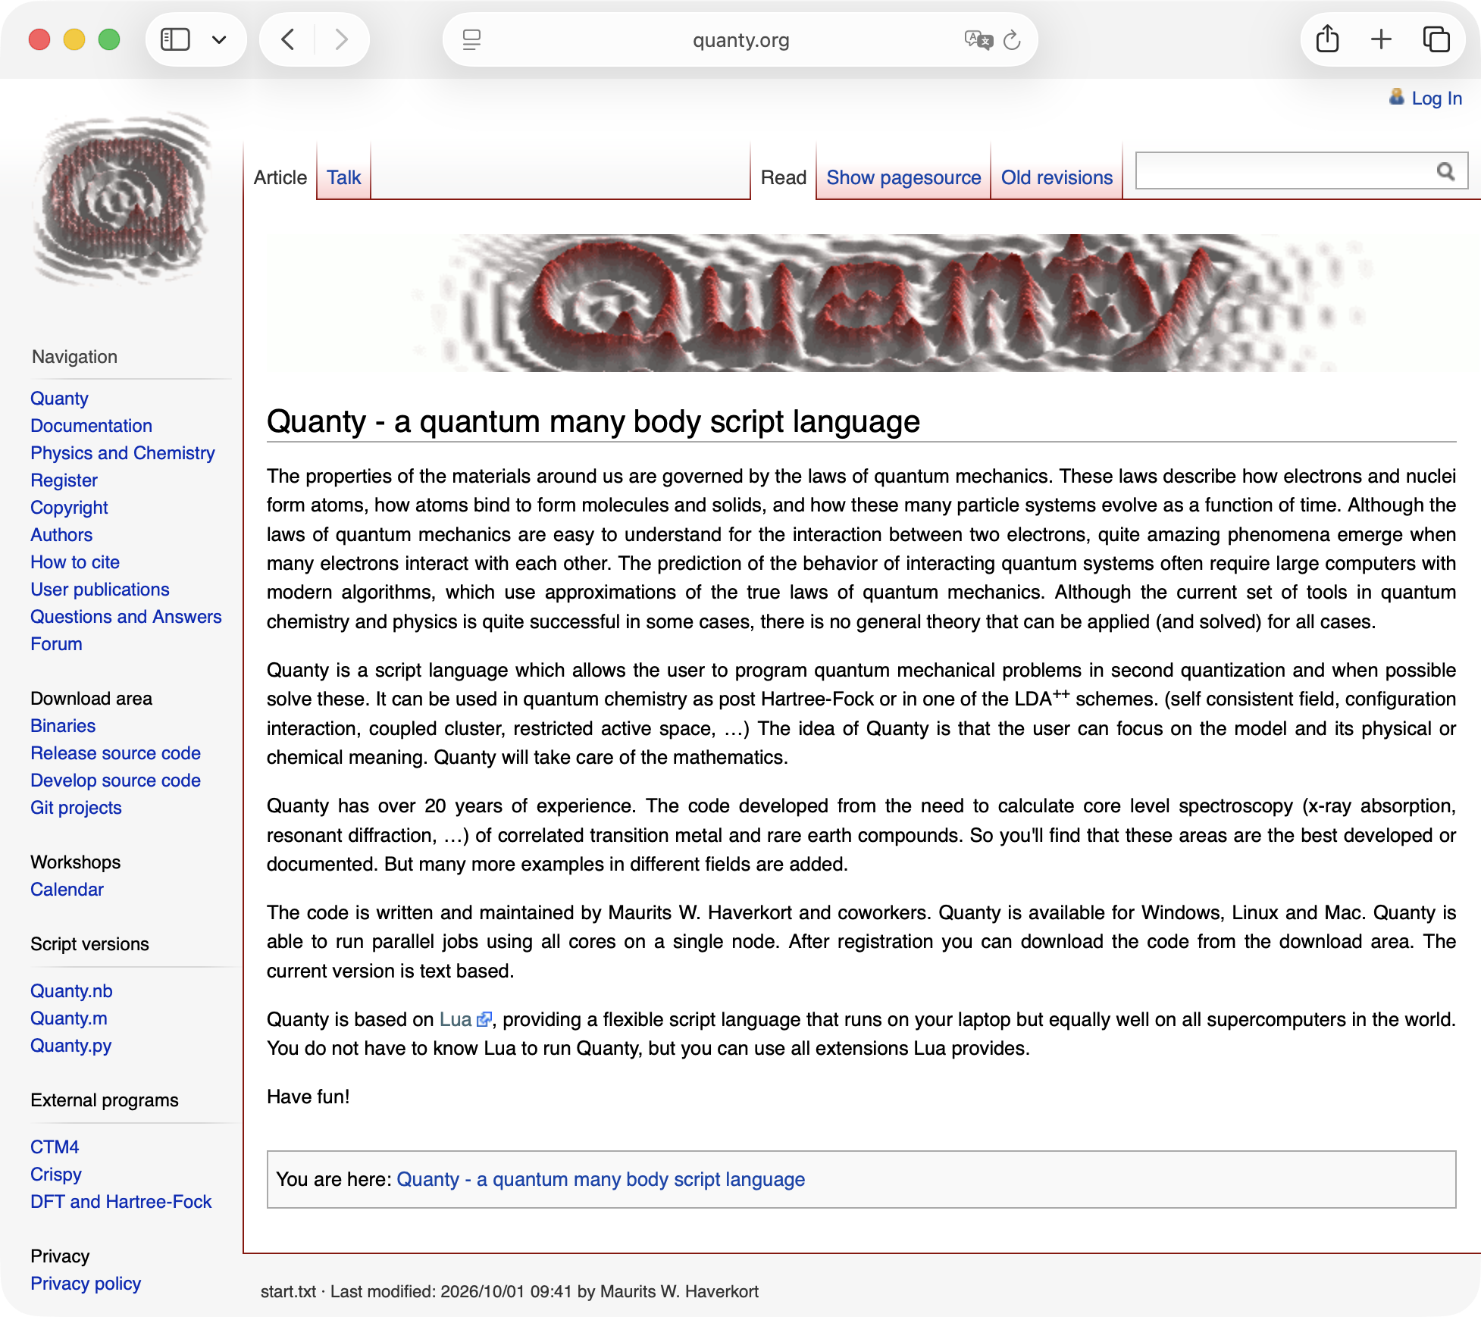

Quanty: a modern approach to multiplets calculations

Slide 4
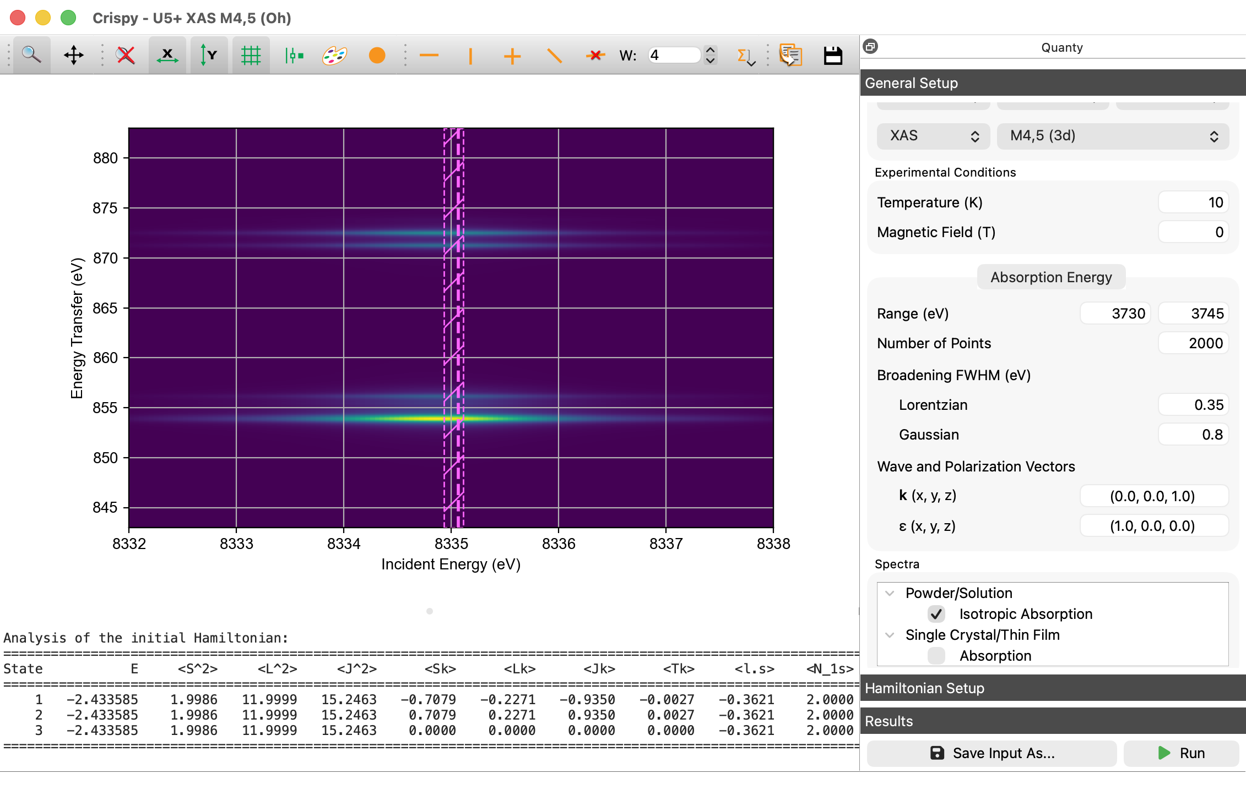

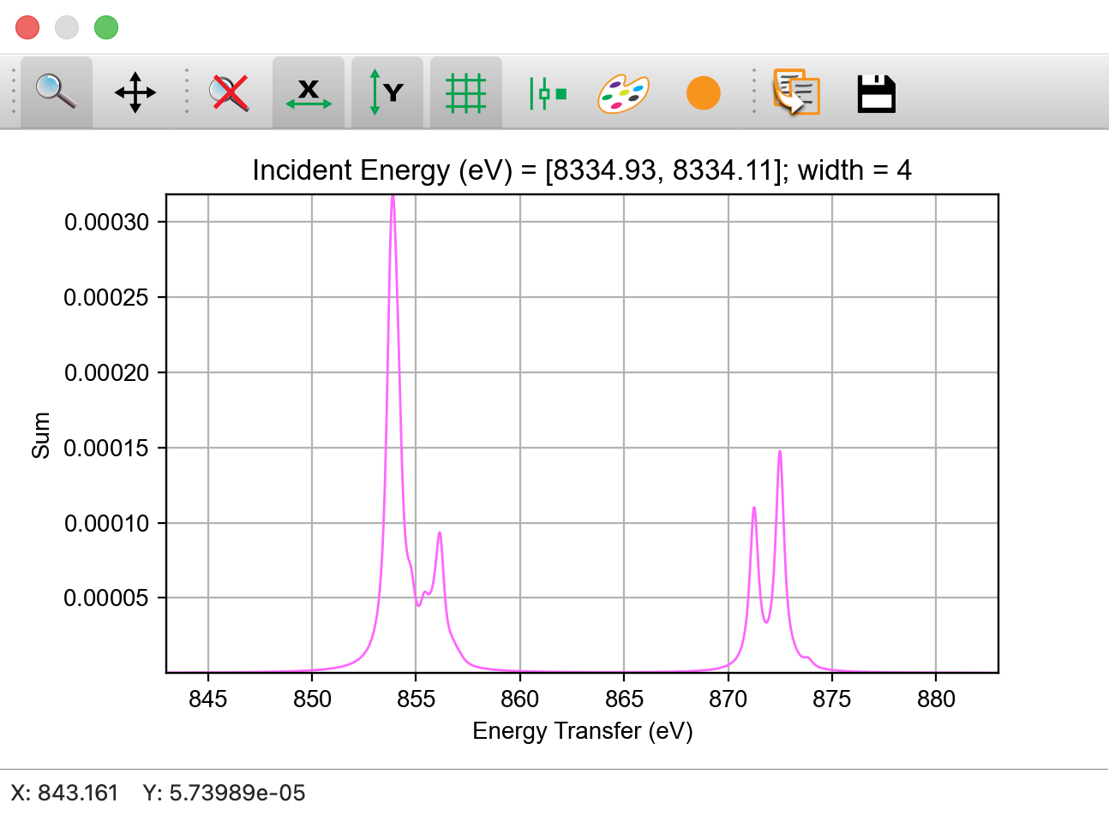
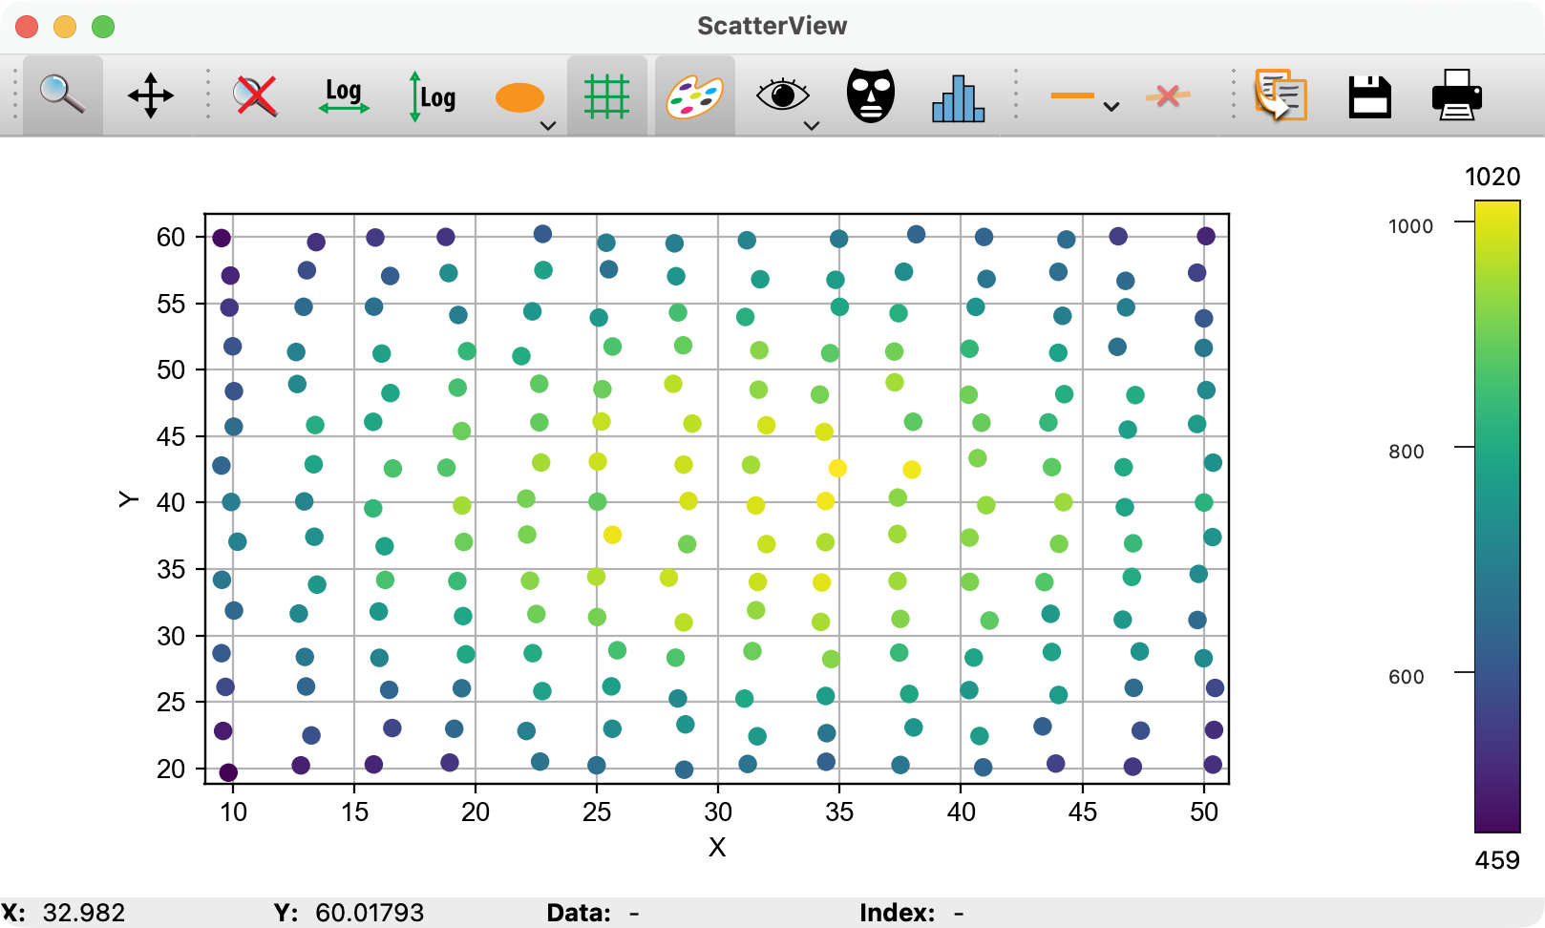
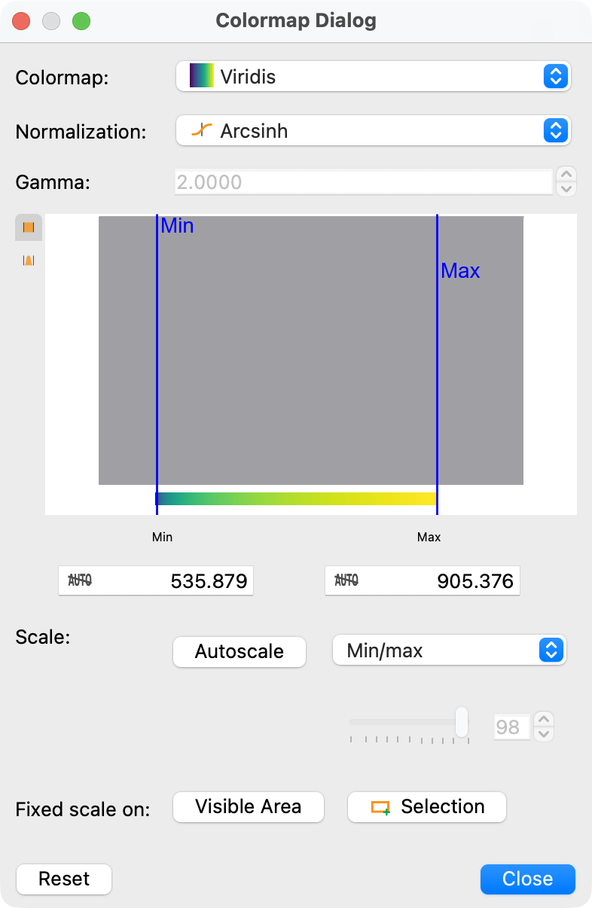
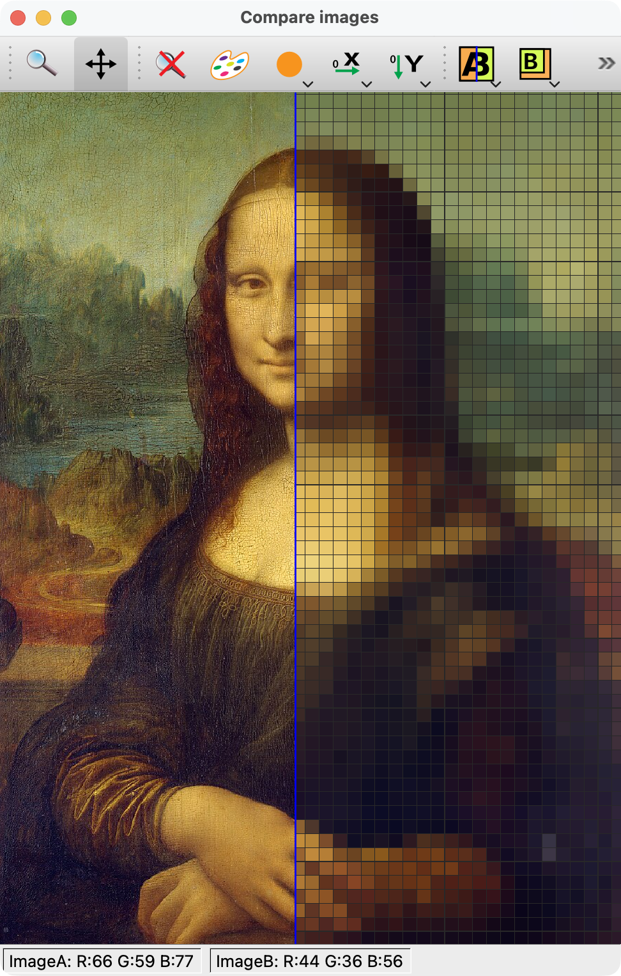
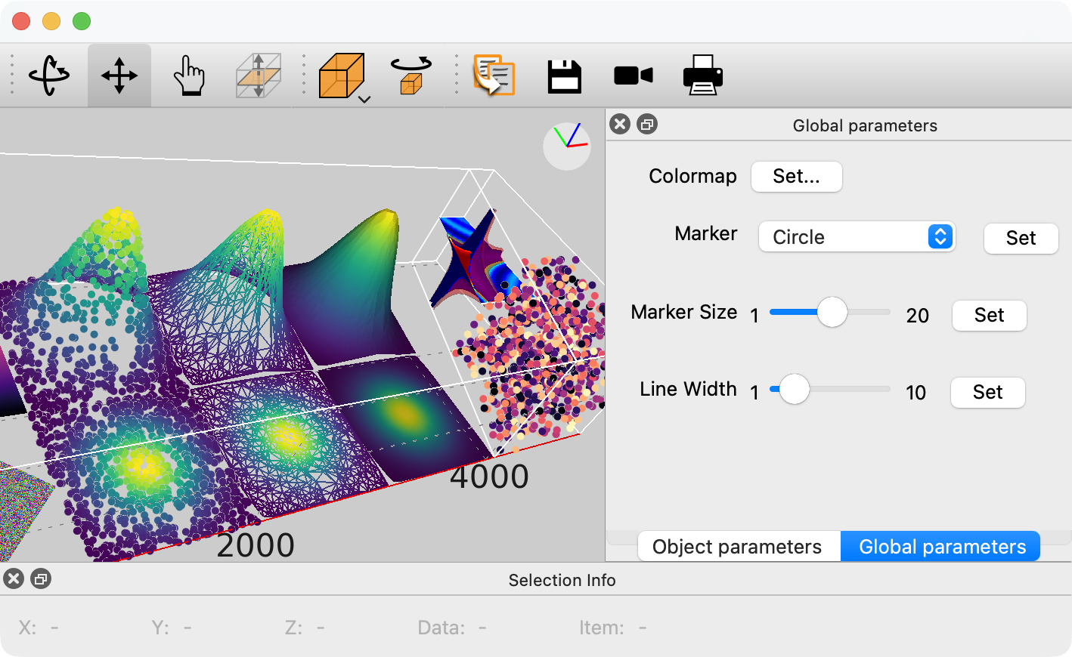
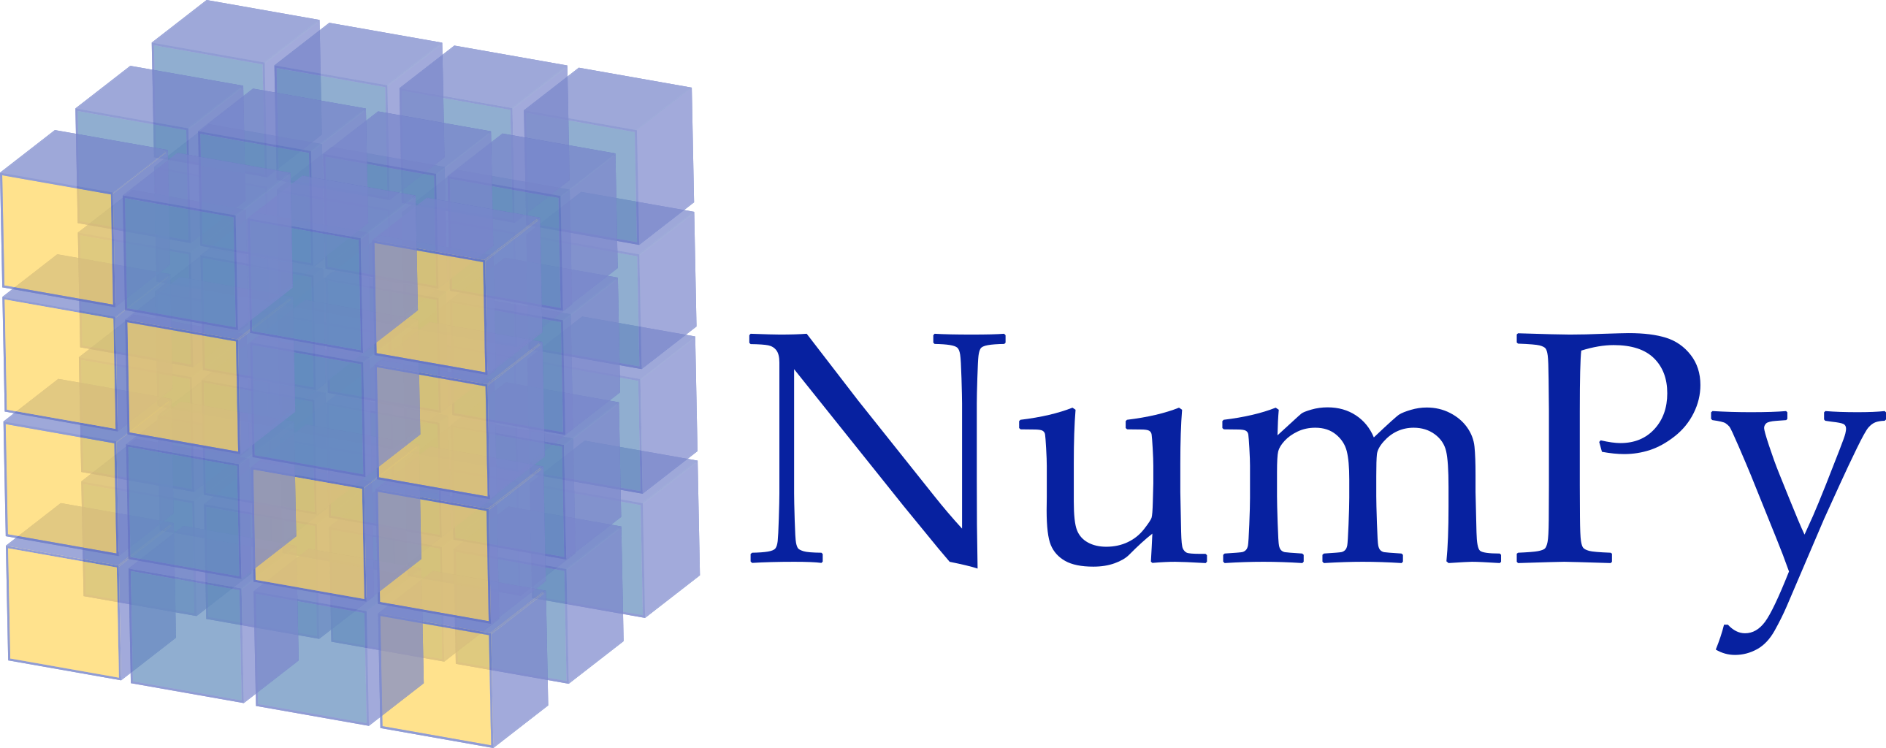


Crispy: A user interface for Semi-empirical multiplets
https://silx.org
Read/write tools for various data formats
Data reduction routines
A set of Qt widgets to browse and visualize the data

Slide 5
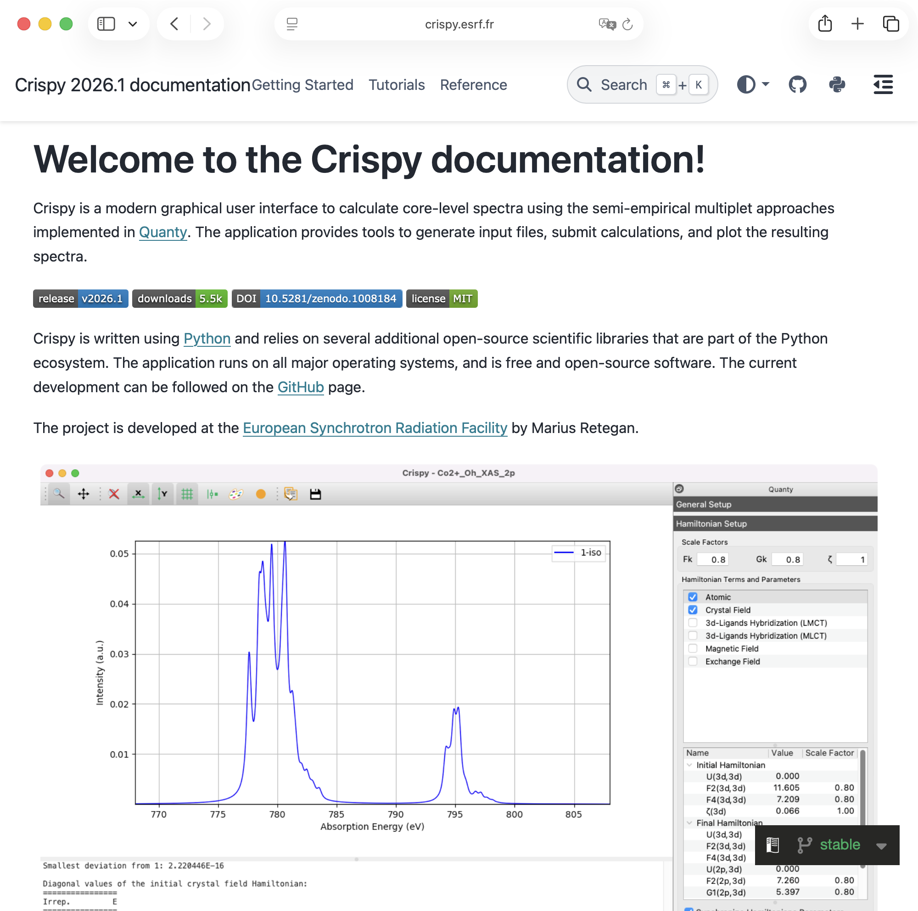

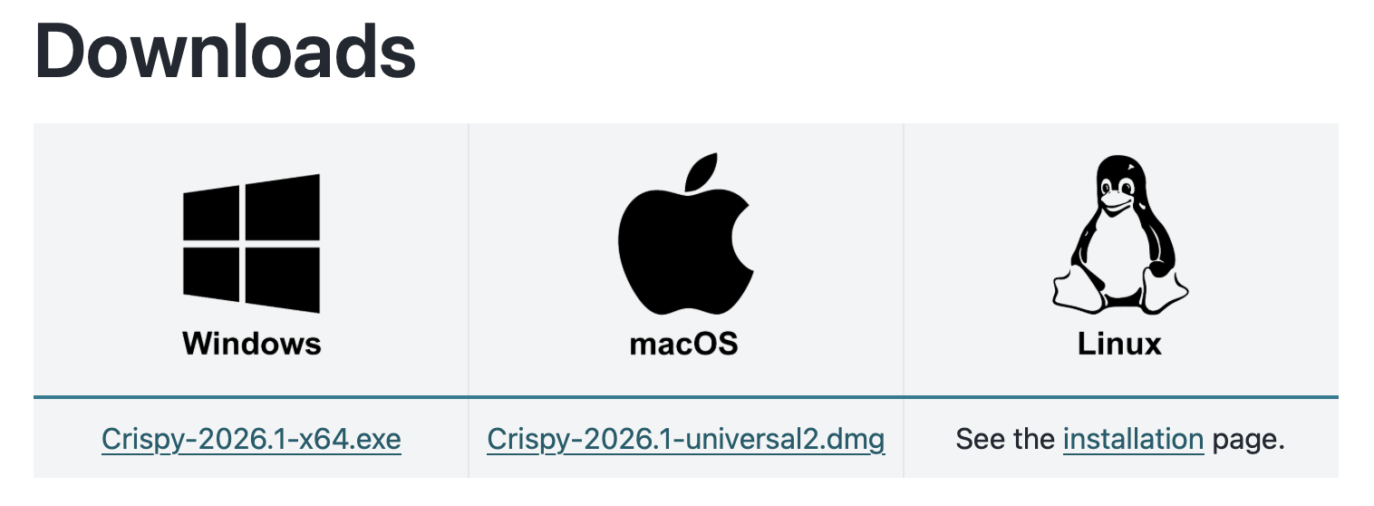
Getting the software
https://crispy.esrf.fr
crispy + esrf

Slide 6
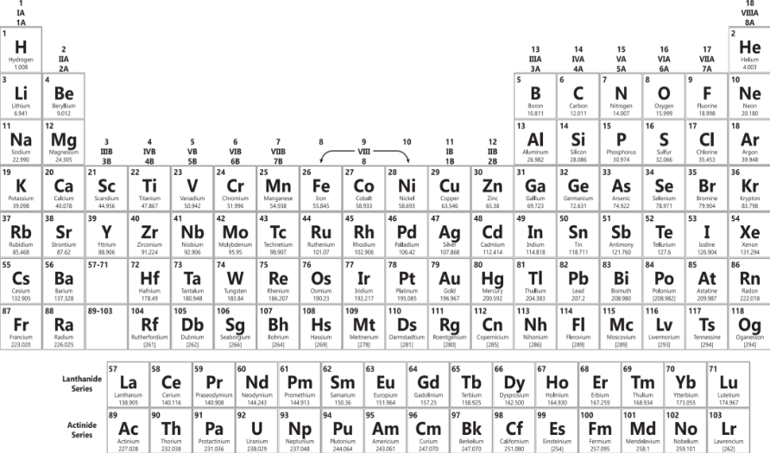
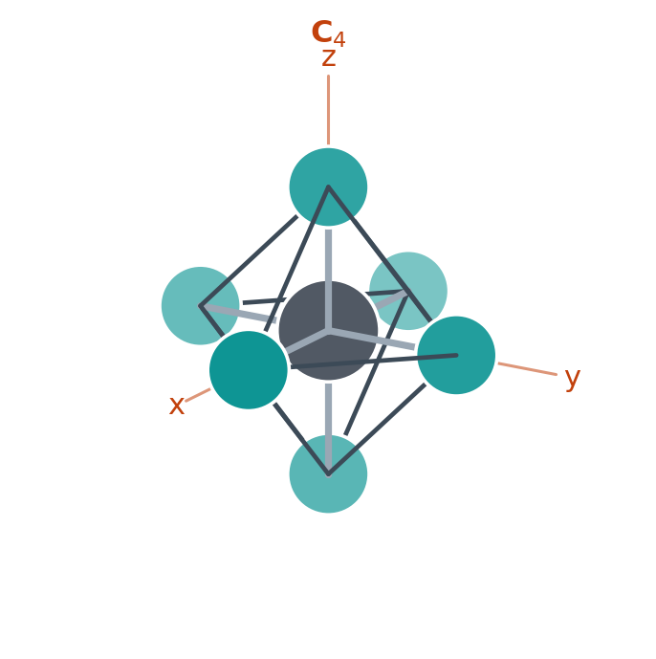
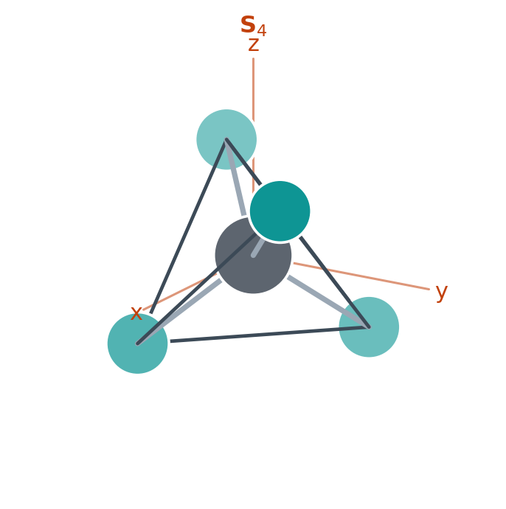
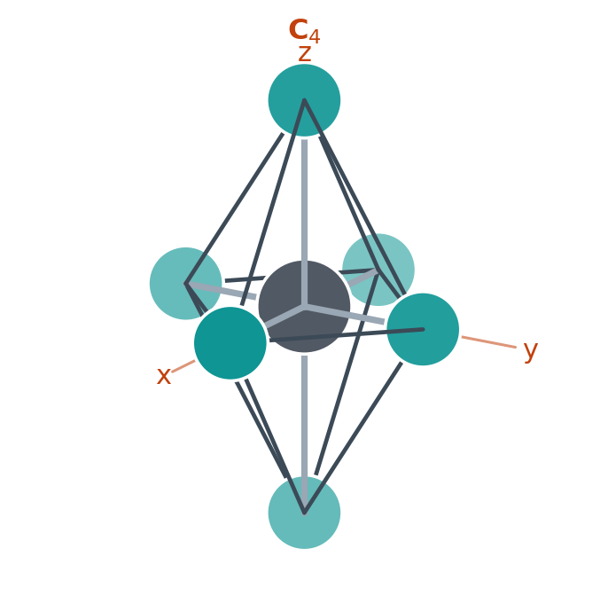
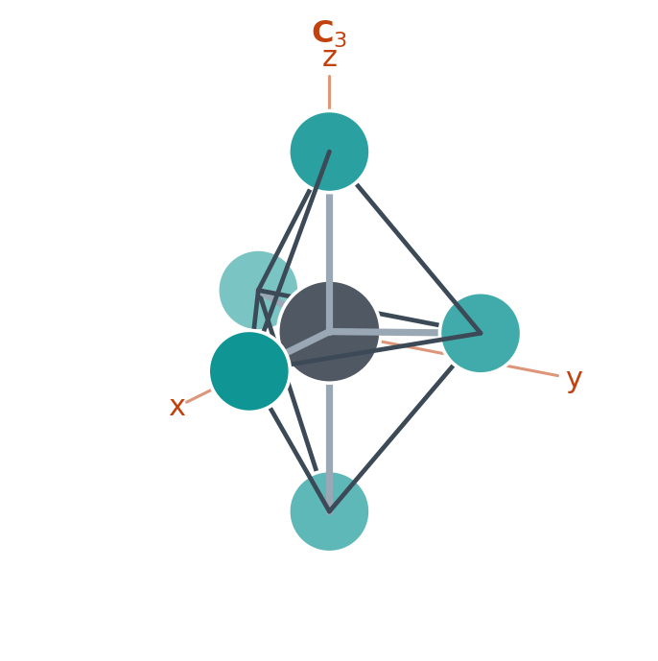
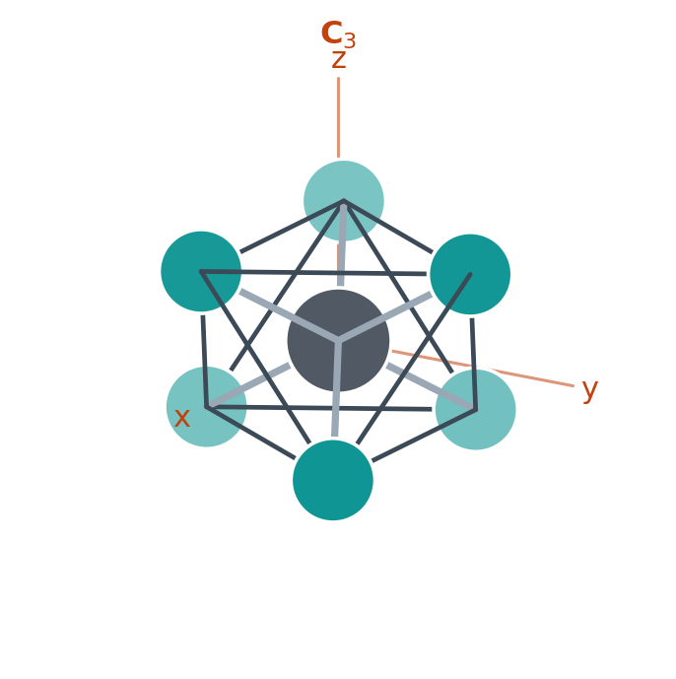
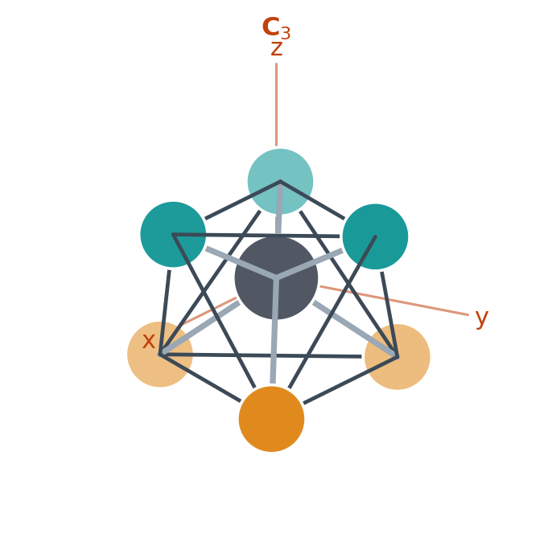
Supported Systems
O_{h}
T_{d}
D_{4h}
D_{3h}
3d
Sc – Cu
XAS / XPS: K, L₁, L_{2,3}, M₁, M_{2,3} · XES: Kα, Kβ
RIXS: K-L_{2,3}, K-M_{2,3}, L_{2,3}-M_{4,5}
3d
4d
Y – Ag
XAS / XPS: L₁, L_{2,3}, M₁, M_{2,3}, M_{4,5}, N₁, N_{2,3}
RIXS: L_{2,3}-N_{4,5}
D_{3d}
C_{3v}
5d
Hf – Au
XAS / XPS: L_{2,3}, M_{2,3}, M_{4,5}, N_{2,3}, N_{4,5}, O_{2,3}
RIXS: L_{2,3}-O_{4,5}
4f
La – Yb
XAS / XPS: L_{2,3}, M_{2,3}, M_{4,5}, N_{2,3}, N_{4,5}
RIXS: L_{2,3}-M_{4,5}, L_{2,3}-N_{4,5}, M_{4,5}-N_{6,7}
5f
Ac – Cf
XAS / XPS: L_{2,3}, M_{2,3}, M_{4,5}, N_{2,3}, N_{4,5}
RIXS: L_{2,3}-M_{4,5}, L_{2,3}-N_{4,5}, M_{4,5}-O_{6,7}

Slide 7
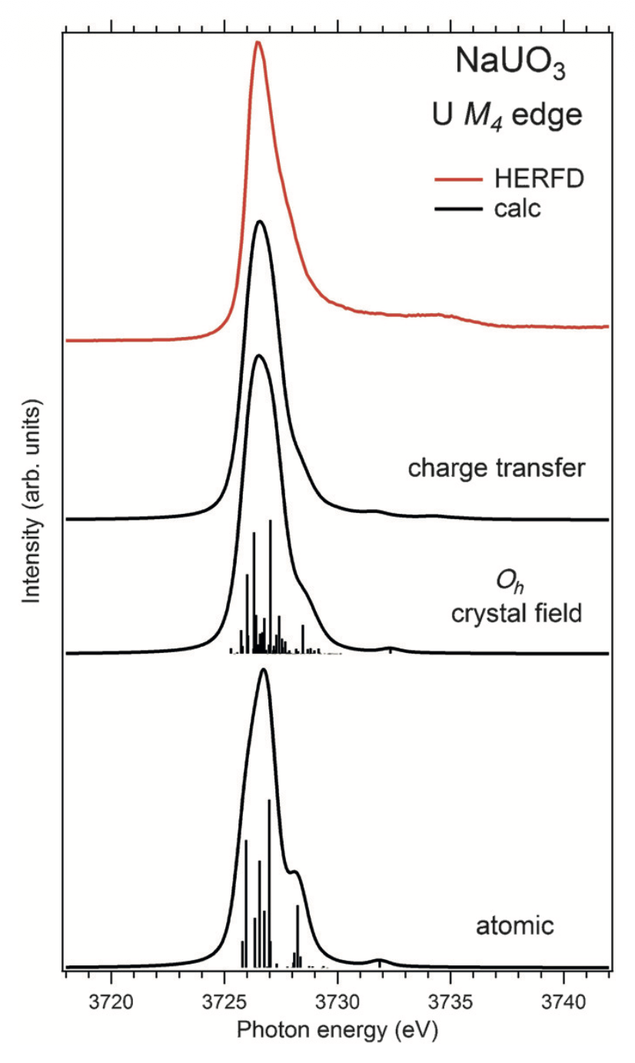
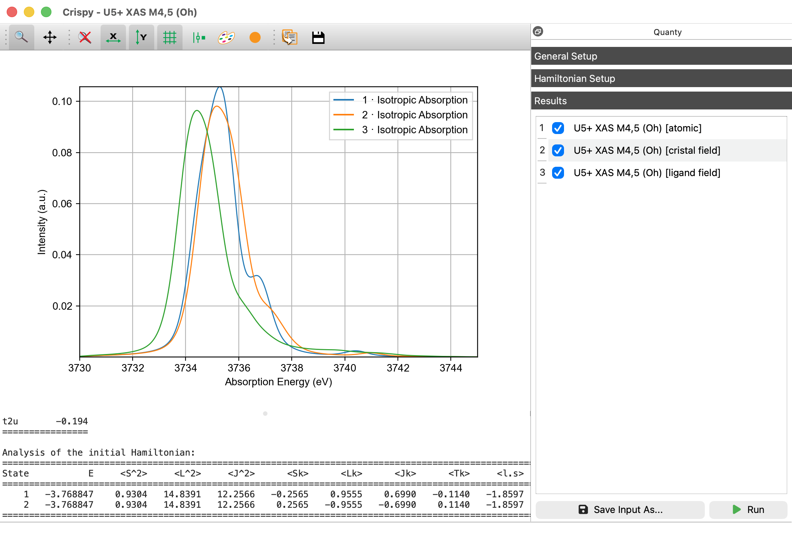
Hamiltonians
Ligand Field
Crystal Field
Ligand Field
Atomic
Atomic
Crystal Field
 | Atomic | Crystal Field | Ligand Field
Time (s) | 0.5 | 0.5 | 126
S. M. Butorin et al., Chemistry - A European Journal, 2016, 22 (28), 9693–9698

Slide 8
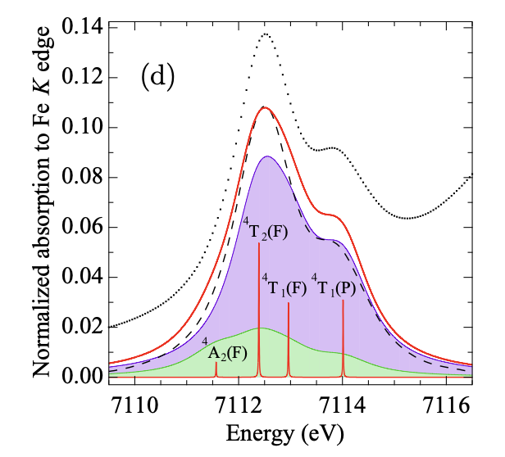
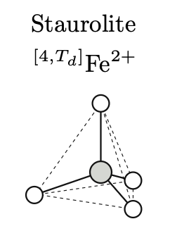
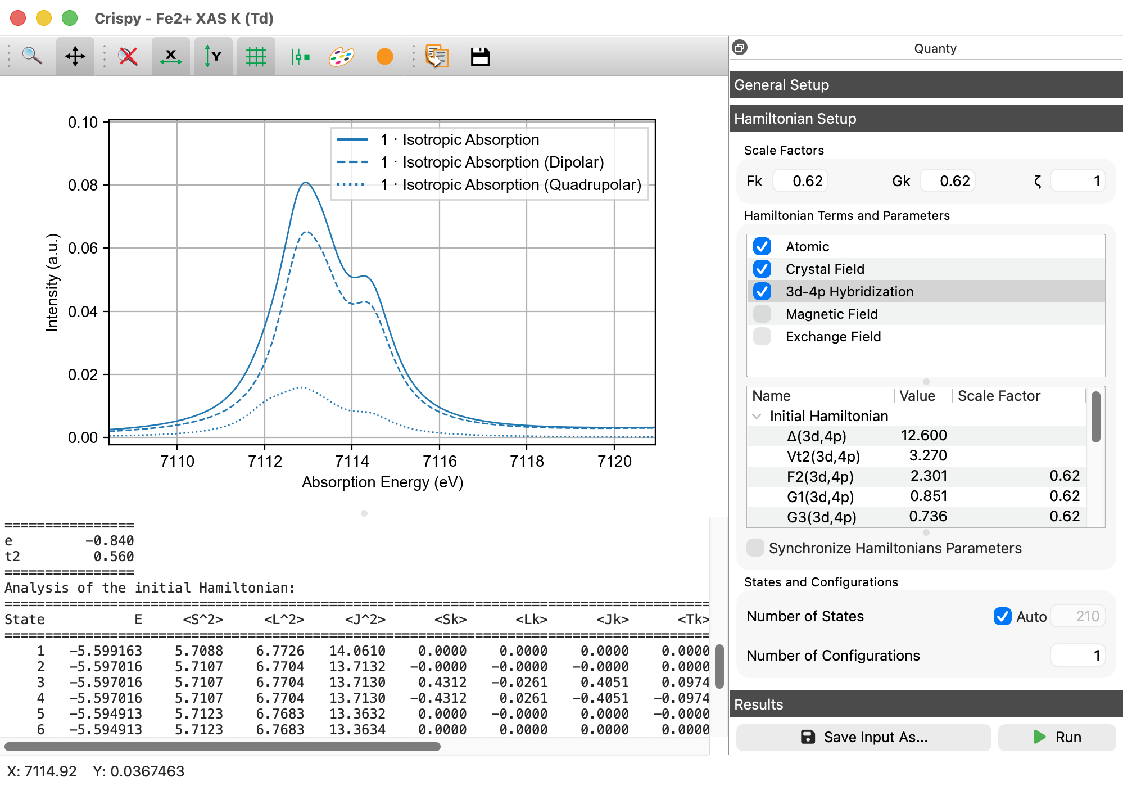
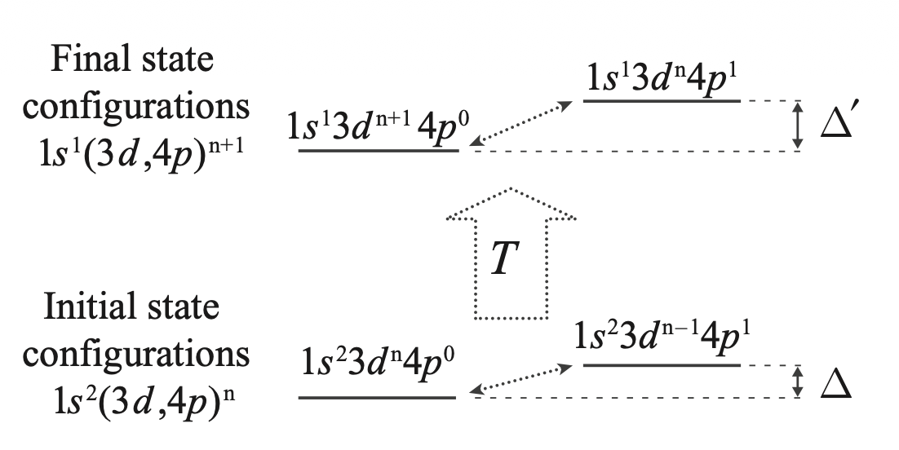
Special Hamiltonian Terms
V. Vercamer et al., Phys. Rev. B, 2016, 94, 245115

Slide 9
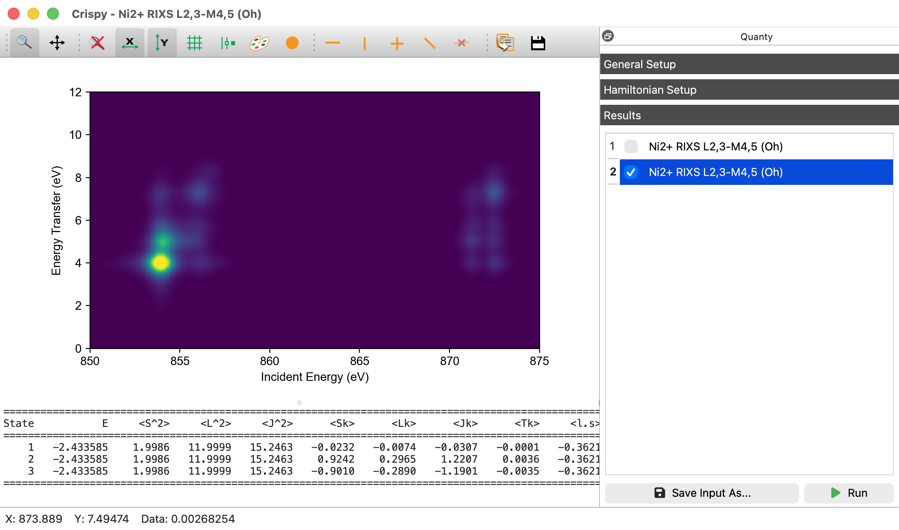
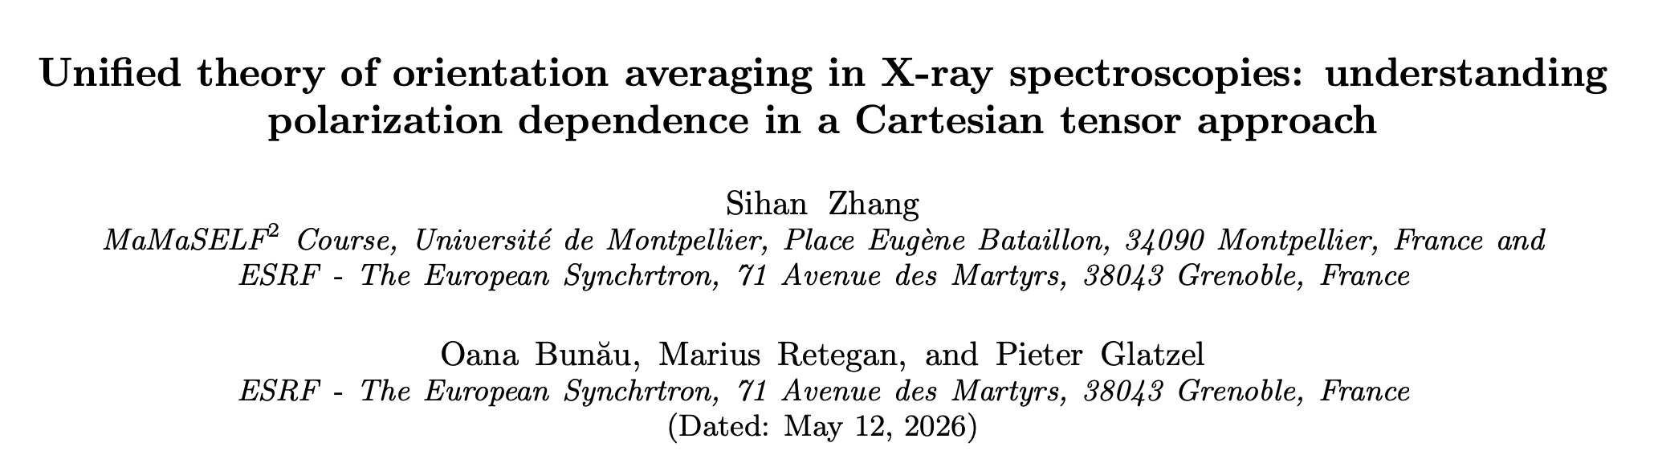
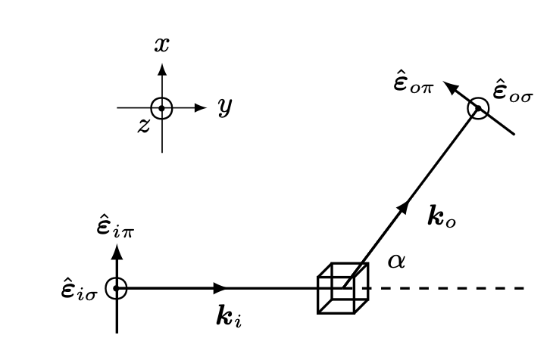
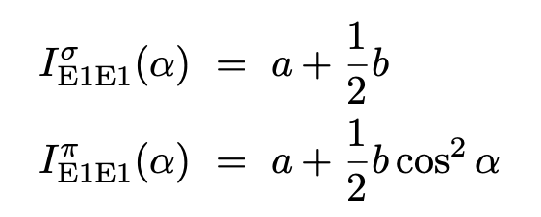
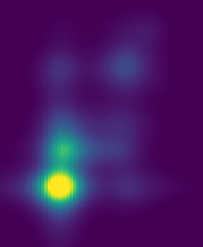
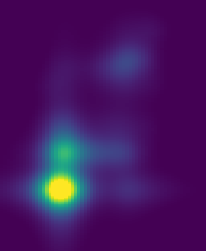
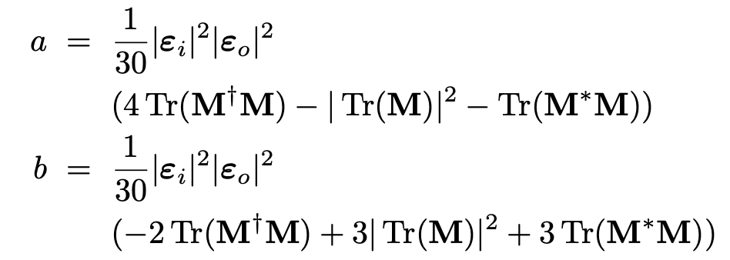
Orientation-Averaged RIXS
S. Zhang, O. Bunău et al., accepted to Phys. Rev. B
current
previous

Slide 10
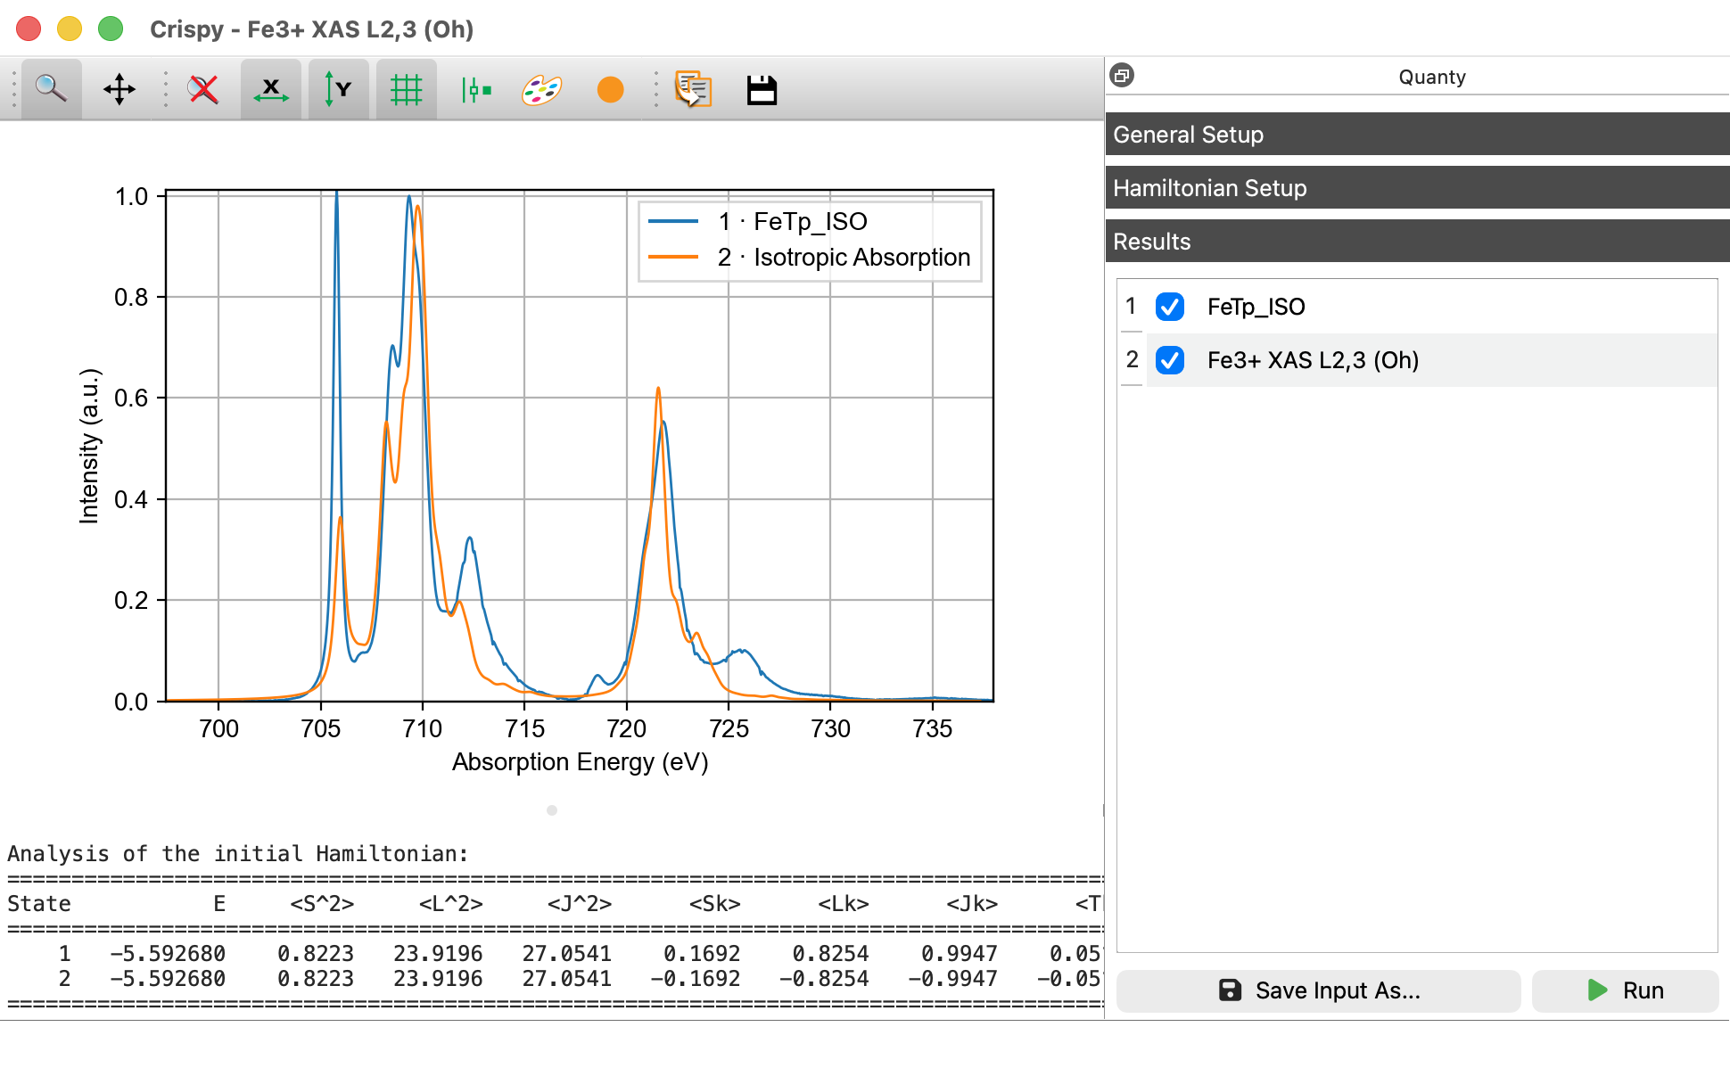
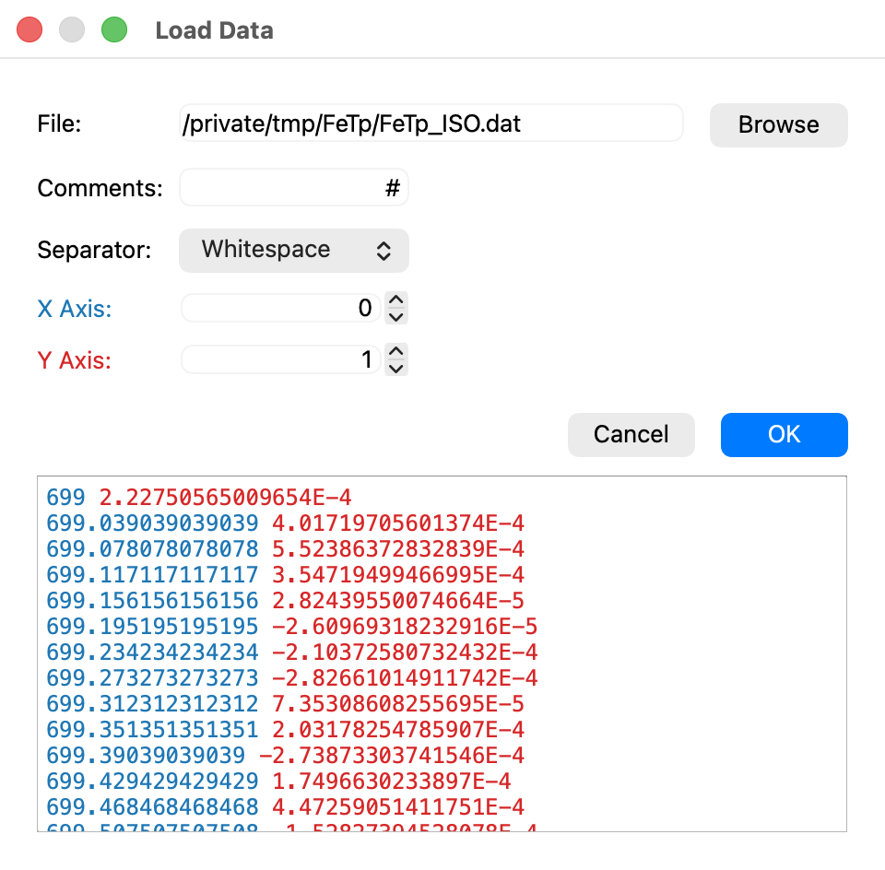
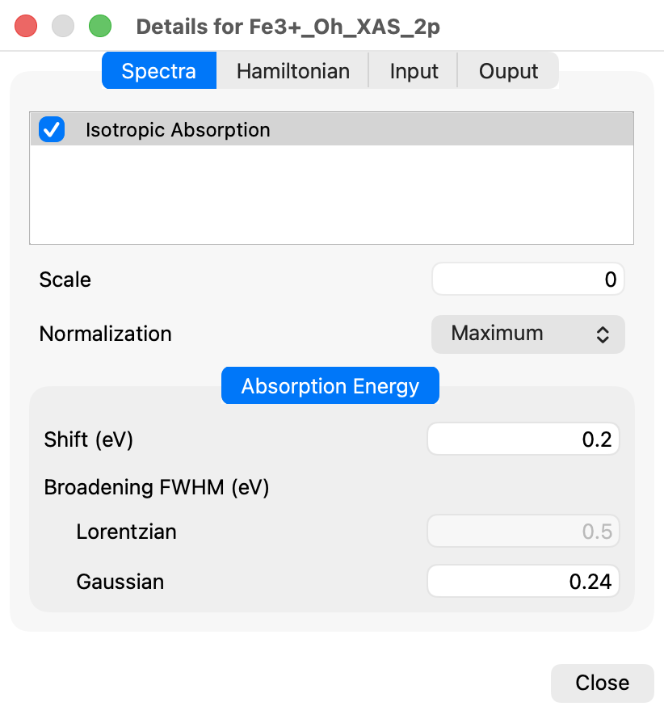
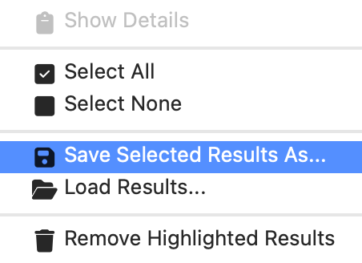
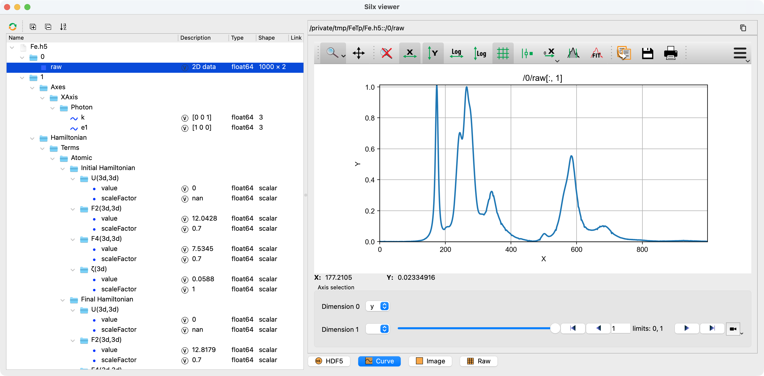
Loading and Saving Data
A dedicated widget allows to open ASCII data files.
The results can be serialized and deserialized to a HDF5 file format, that can be be visualized with utils like silx view.

Slide 11
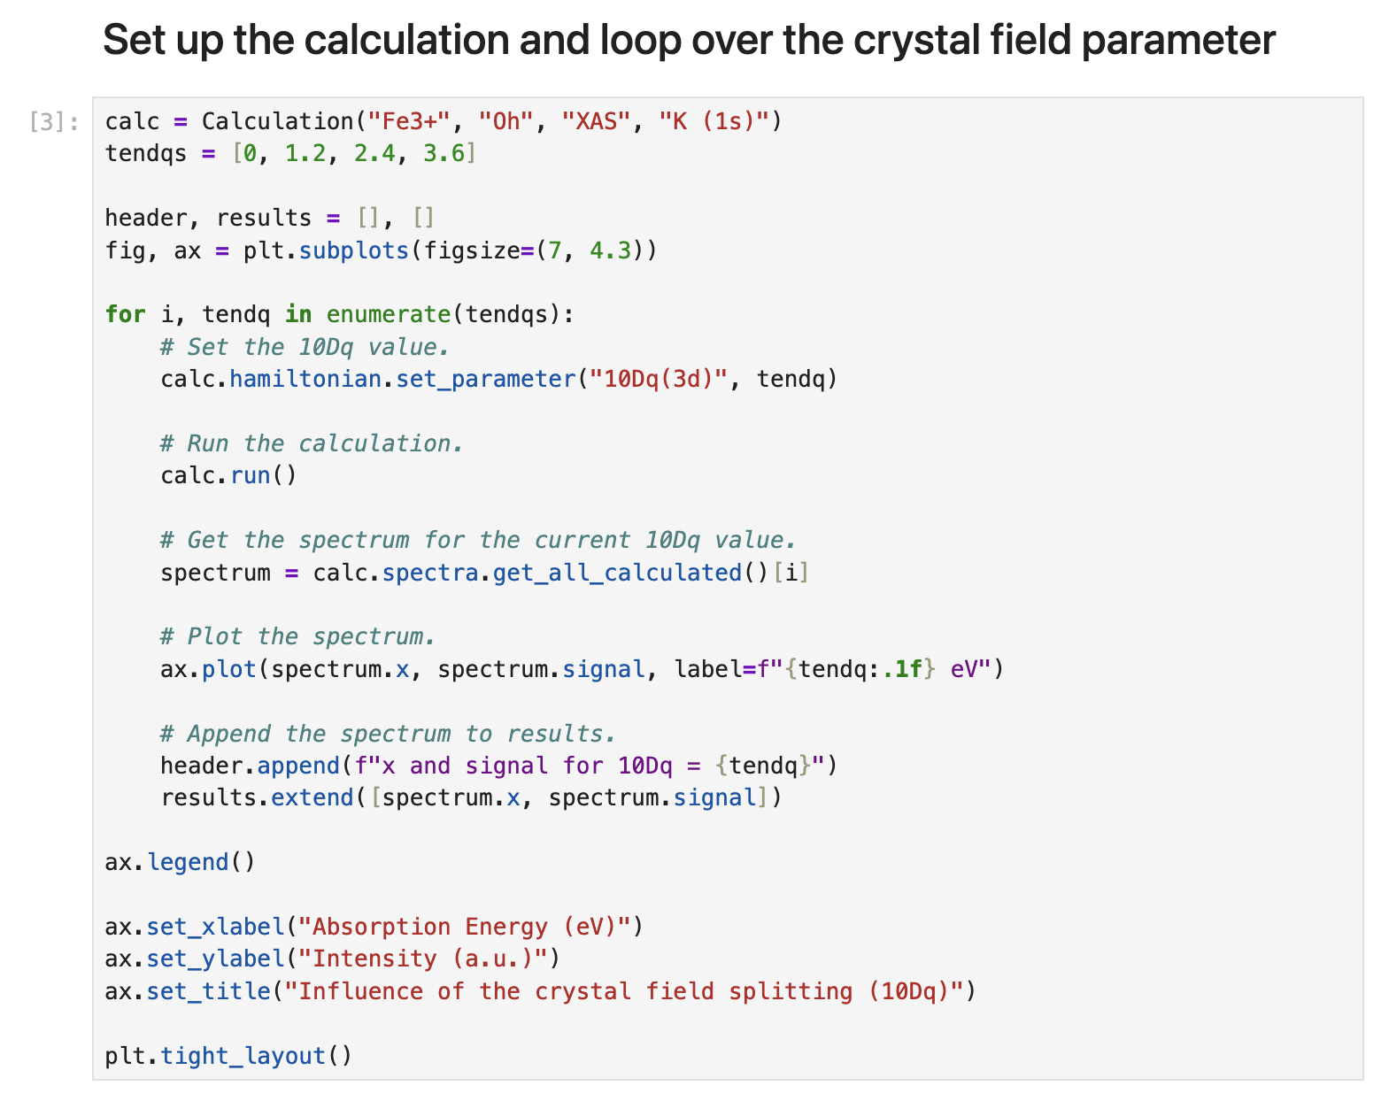
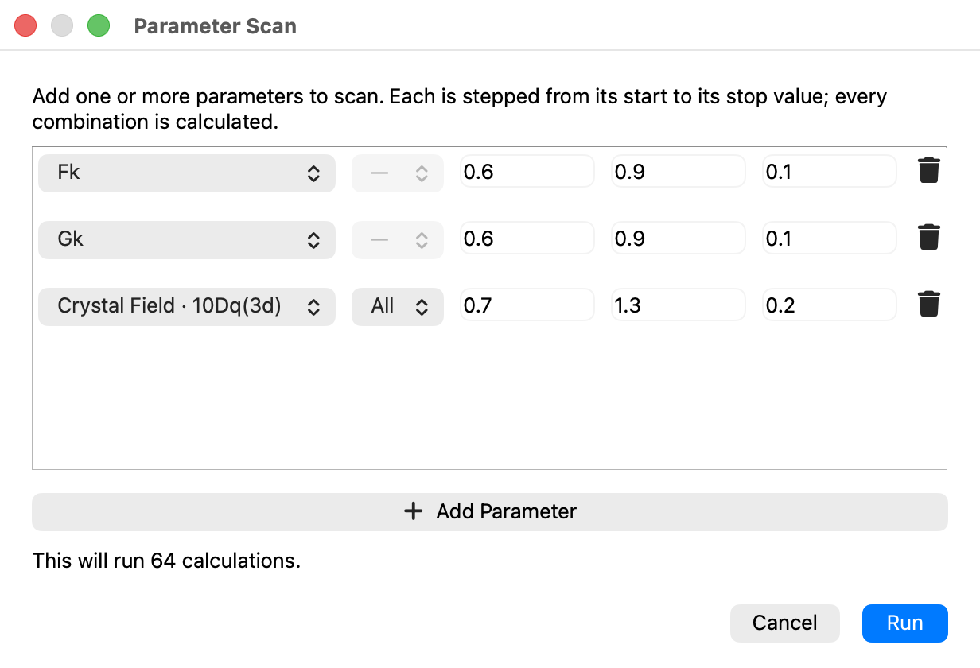
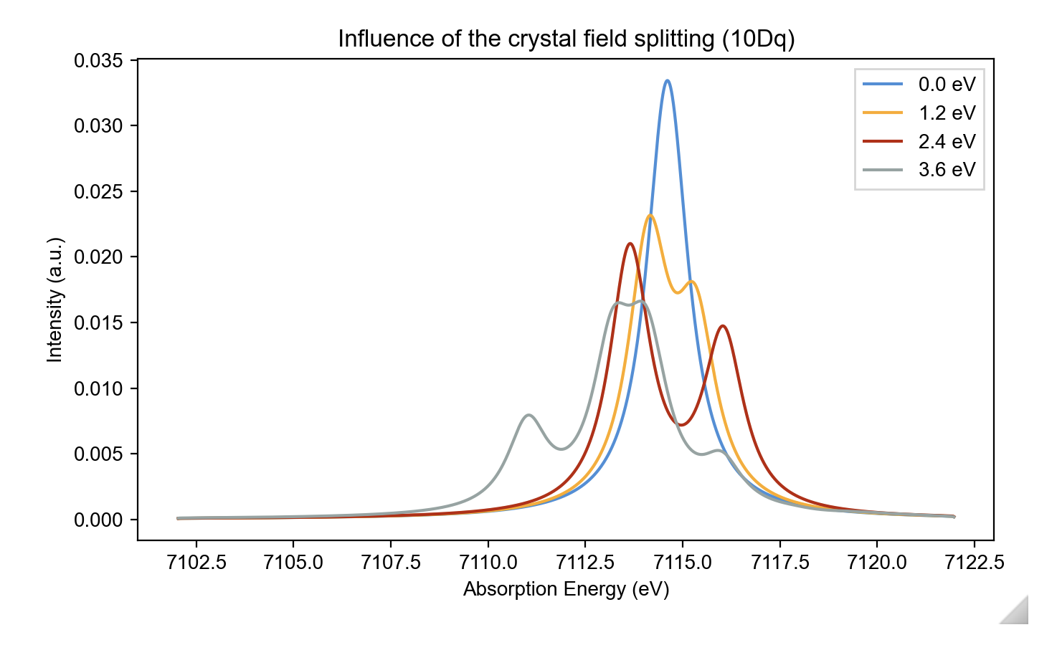
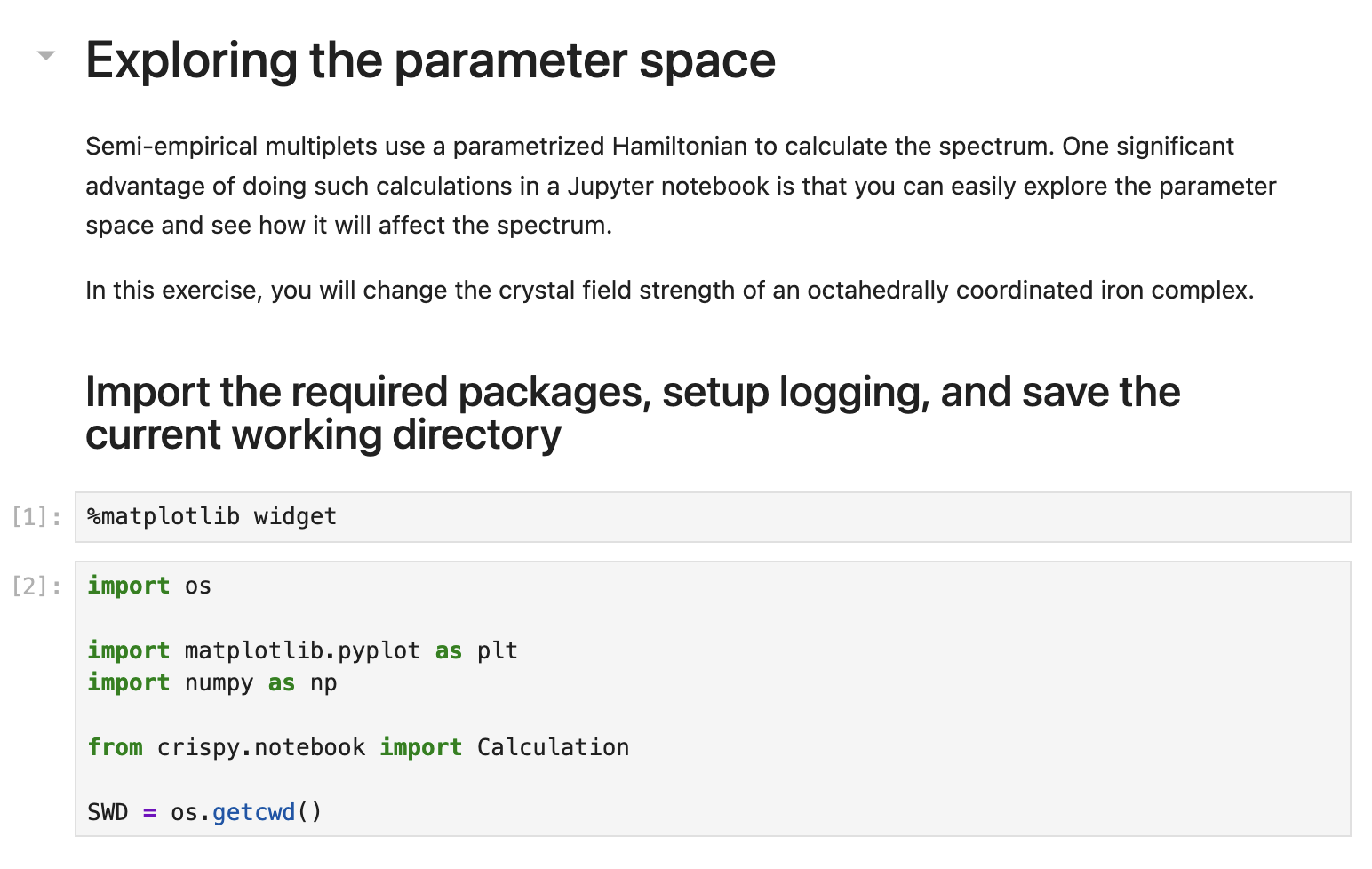
Parameter Scan: Integrated Widget and Jupyter Notebooks
Widget
Jupyter Notebook

Slide 12
Application of the XMCD sum-rules

Slide 13
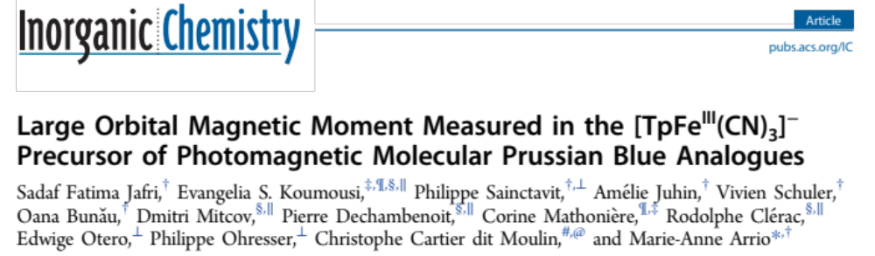
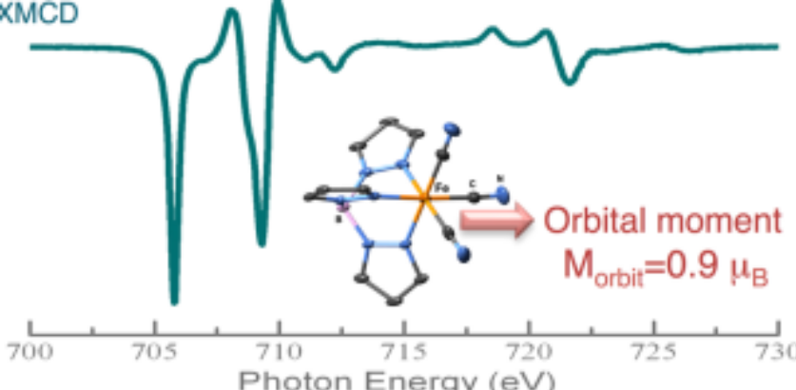
XMCD Sum rules for L_{2,3} edges
Jafri et al., Inorg. Chem., 2016

Slide 14


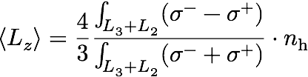
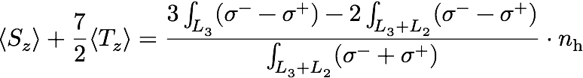
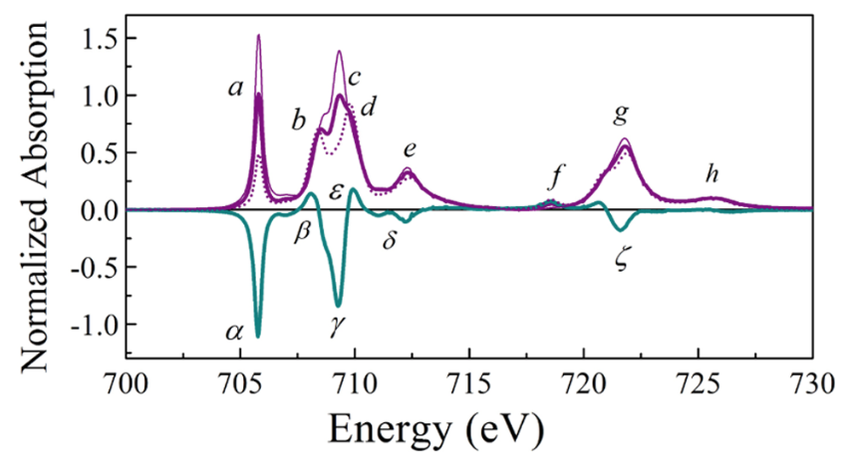
The magneto-optical sum rules

Slide 15
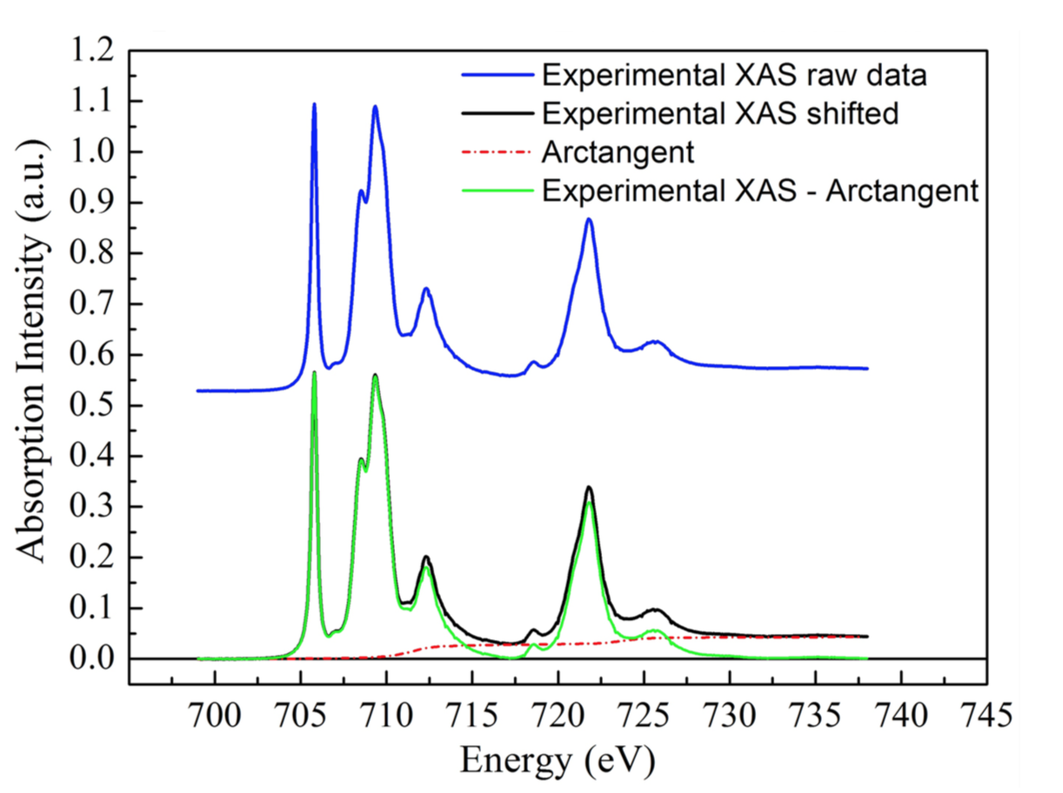
Sum rules in practice
The sum rules can provide very useful information on the magnetic electronic
structure by separating the orbit and spin parts of the magnetization.
Origin of problems in the application of the sum rules:
  Removal of the transitions towards continuum states is done by subtracting parameterized arctangent functions.
  The cutoff energy between L₃ and L₂ edges in the XMCD spectrum.
  Intermixing of L₃ and L₂.

Slide 16
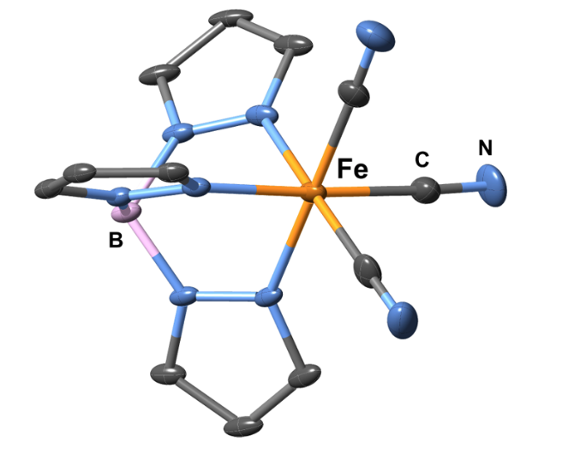
Experimental data
Experimental details:
  the metal atom in FeTp is Fe³⁺
  temperature (T = 2 K)
  magnetic field (B = 6.5 T)
Measured spectra: http://bit.ly/multiplets

Slide 17
Calculations using octahedral (Oh) symmetry
Calculate the spectrum using the following parameters:
    Lorentzian FWHM: 0.5
    Gaussian FWHM: 0.24
    scale factors: Fk = Gk = 0.7, zeta = 1.0
After the first calculation, open the “Details” dialog and normalize the spectrum to the maximum.
Increase the 10Dq value in steps of 0.5. Note the effect on the calculated spectrum. Are any features that start appearing in the spectrum for larger 10Dq? Follow the changes in the expectation value of the ⟨S_{z}⟩ operator.
Note the expectation values of the spin (S), orbital (L), and magnetic dipole (T) operators for 10Dq = 2.8 eV. How do they compare with the calculations from the original publication?
 | ⟨S_{z}⟩ | ⟨L_{z}⟩ | ⟨T_{z}⟩
Jafri et al. | −0.1786 | −0.8521 | −0.0523

Slide 18

Ligand field calculation in octahedral symmetry
Add the metal-ligand hybridization charge transfer (MLCT) term with the following parameters:
Δ_{i} = 3.0, Δ_{f} = 3.4, V(e_{g}) = −0.8, V(t_{2g}) = 1.8.
Hocking et al., J. Am. Chem. Soc., 2006
Note the additional features appearing in the spectrum and the changes in the expectation values; compare them with the ones from the original publication.
 | ⟨S_{z}⟩ | ⟨L_{z}⟩ | ⟨T_{z}⟩
Jafri et al. | −0.1704 | −0.7754 | −0.0594

Slide 19


In search of the missing peak
Change the symmetry to C_{3v} and rerun the calculation using the following parameters for the crystal field:
  Dq = 0.28 eV (≡ 10Dq = 2.8 eV)
  Dσ = 0.07 eV
  Dτ = 0.12 eV
Did you manage to reproduce the feature f?
e
e_{g}
a₁
t_{2g}
e

Slide 20

Utility of multiplets calculations
What is the value of ⟨T_{z}⟩?
Test the validity of the sum rules and determine the origin of their potential failures.

Slide 21
Crystal field and covalency effects in uranates

Slide 22

Crystal field and covalency effects in uranates

Slide 23

Crystal field and covalency effects in uranates
1) Calculate the atomic M₄ spectrum for U⁵⁺ using the following parameters:
  scale factors: Fk = Gk = 0.7
  Lorentzian FWHM: 0.35 eV
  Gaussian FWHM: 0.8 eV
2) Add a crystal field contribution with Wybourne’s parameters:
  B40 = 2.03 eV
  B60 = 0.17 eV
3) Finally, add the hybridization term with the ligands (LMCT):
  Δ = 4.0 eV,
  U(5f,5f) = 3.5 eV
  U(3d,5f) = 6.0 eV
  V_{i} = 1.2 eV, and V_{f} = 0.9 eV

Slide 24
Calculating the L_{2,3}–edge XAS spectrum of titanium(IV)

Slide 25


Theory and calculations
de Groot et al., J. Chem. Minerals, 1992

Slide 26
Atomic multiplets
Calculate the XAS spectrum at the L_{2,3} edges of Ti⁴⁺ in spherical symmetry. Set the Lorentzian broadening to 0.1 and the Gaussian broadening to 0.0. Leave all the other parameters to their default values. How many transitions are visible in the spectrum?
Run a calculation with the scaling of the 2p spin-orbit coupling constant, ζ(2p), set to 0.5. After the calculation finishes, set this value back to 1.0 and run a second calculation with the 3d spin-orbit coupling ζ(3d) set to 0.5. Which interaction affects the most the energy separation between the L₂ and L₃ edges? Check that the energy separation between the two edges is close to 3/2·ζ(2p).
Perform three calculations using 0.8, 0.4, and 0.0 for scaling the Slater integrals, F_{k} and G_{k}. What is the influence of electronic repulsions on the spectrum?

Slide 27
Crystal-field multiplets
Set the scaling factors for the Slater integrals back to 0.8. Re-enable the crystal field and change the 10Dq value to 2.0 eV.
Change the Lorentzian broadening to 0.2, 0.4, 460. This will apply a 0.2 eV broadening at the L₃ edge and a 0.4 eV at the L₂ edge and will change between the two broadenings at 460 eV.
Run a set of calculations with 10Dq ranging from 0 to 2.0 eV in steps of 0.5 eV. Plot the resulting spectra. What is the influence of the crystal field splitting?
Set the 10Dq value to 2.0 eV and switch off the Slater integrals and the 3d spin-orbit coupling. How many transitions does the calculated spectrum have?

Slide 28
Following spin transitions in iron compounds

Slide 29



Using K pre-edge XAS to identify spin states
Westre et al., J. Am. Chem. Soc., 1997
Write down the electronic configuration of Fe³⁺. Show that there are two ways to fill the 3d orbitals, leading to a high spin (S = 5/2) and a low spin ground state (S = 1/2).
Run two K pre-edge calculations for Fe³⁺ in an octahedral crystal field, one with 10Dq set to 2.0 eV and 3.3 eV.
Change the 10Dq value from 2.6 to 3.6 eV in steps of 0.2 eV. At what value do you observe the spin transition?

